Slide 1
State Transportation Plan & State Freight Plan
2022 Updates
Commission Workshop
September 14, 2021

Slide 2
Discussion topics
Needs analyses updates
Next steps

Slide 3
Critical analyses timeline
Infrastructure condition analysis (ICE) – complete
Operations analysis (ICE-OPS) – complete
Bottlenecks analysis (INRIX) – complete
Freight network updates – complete
Resiliency analysis – complete
Mobility/accessibility analysis – complete
Capacity analysis (iTRAM) – in review
Safety analysis – ongoing
Modal systems analysis – ongoing

Slide 4
Resiliency analysis
Objective: Screen the Primary Highway System to identify locations vulnerable to a 100-year flood event
Methodology developed based on research of similar efforts nationally
The internal Resiliency Working Group served as a technical steering committee

Slide 5
Evaluation methodology
Vulnerability
100 Year Flood Exposure and Bridge Scour (45)
Evaluation of Past ER Events (15)
Robustness (70)
Roadway Resistance (10)
Redundancy (20)
Flood Resiliency Metric
System Availability (20)
Federal Functional Classification (4)
Criticality (10)
Truck AADT (4)
Social Vulnerability Index (2)

Slide 6
Initial Composite Scoring Results: Natural Breaks (10 classes)

Slide 7
Mobility/accessibility analysis
Objective: Screen the state of Iowa to identify areas at greatest risk of mobility/ accessibility challenges
Populations considered:
Under 18
65 and over
Minority
Foreign-born
Limited English proficiency
With a disability
Income below poverty level
No vehicle available
College-enrolled
Single parent households

Slide 8
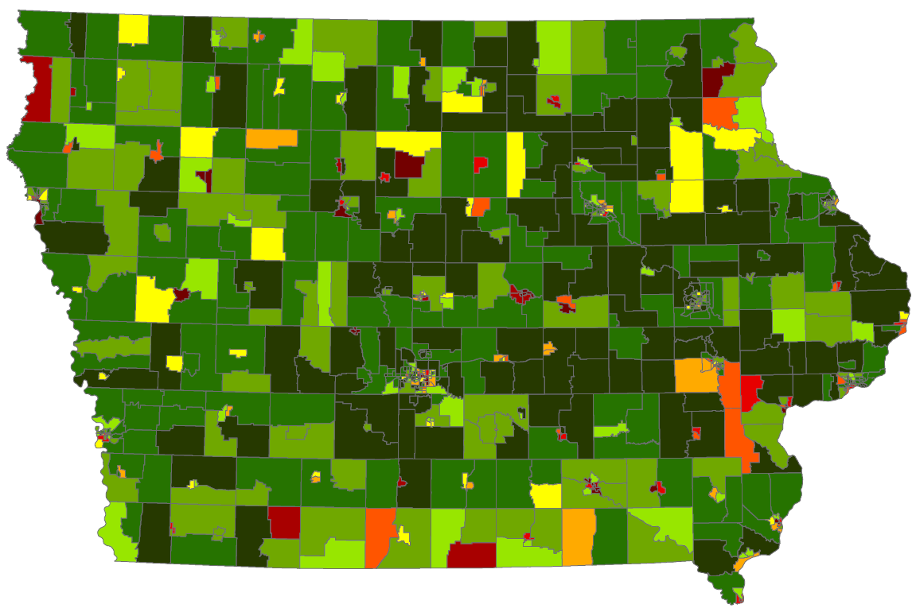

Slide 9
Capacity analysis
Objective: Screen the Primary Highway System to identify locations most likely to be approaching, at, or over capacity by 2050
Refined methodology:
Start with locations of need from 2017 plan update
Review against latest tools and analysis (statewide and metropolitan travel demand models, project forecasts)
Identify locations to add/remove
Review with stakeholders

Slide 10
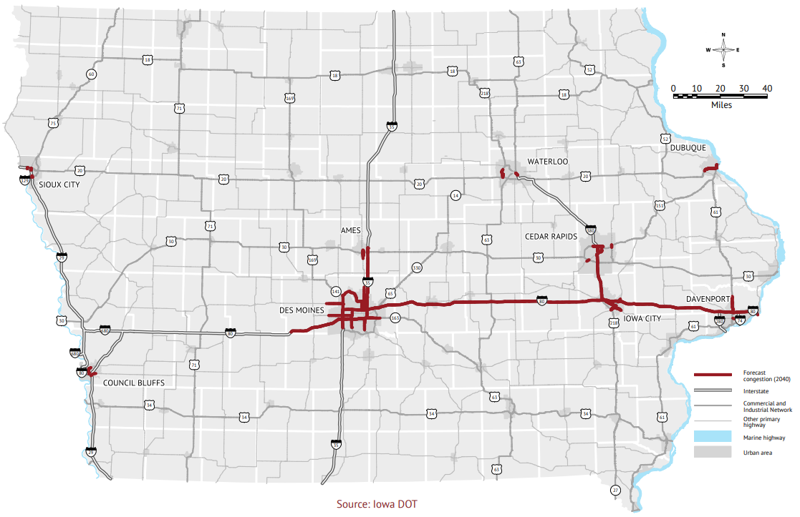
PLACEHOLDER
Insert 2017 statewide capacity needs map
Verbalize that locations are under review; significant changes unlikely
Current State Transportation Plan (2017)

Slide 11
Wrap Up
Critical next steps:
Complete needs analyses
Begin developing strategies and actions
Next workshop discussion:
Transition into strategies and actions

Slide 12
QUESTIONS?
Garrett.Pedersen@iowadot.us

