Slide 1
October Commission Tour Benchmark Assessment and Preview
Transportation Commission Workshop
September 14, 2021

Slide 2
October Tour/Meeting – Waterloo Benchmark Analysis
Are there any Governor proclamations in place restricting/discouraging indoor public gatherings?
Restrictions: None
Recommendations: None
Are there any CDC and/or Iowa Department of Public Health guidance restricting/discouraging indoor public gatherings?
Restrictions: None
Recommendations:
Recommend masks (CDC)
Recommend six-feet spacing (CDC)
Are there any local jurisdiction restrictions on indoor public gatherings? No
Is the COVID-19 seven-day positivity rate >= 15 percent the host county for the Commission meetings? No – Nine percent as of September 7, 2021

Slide 3
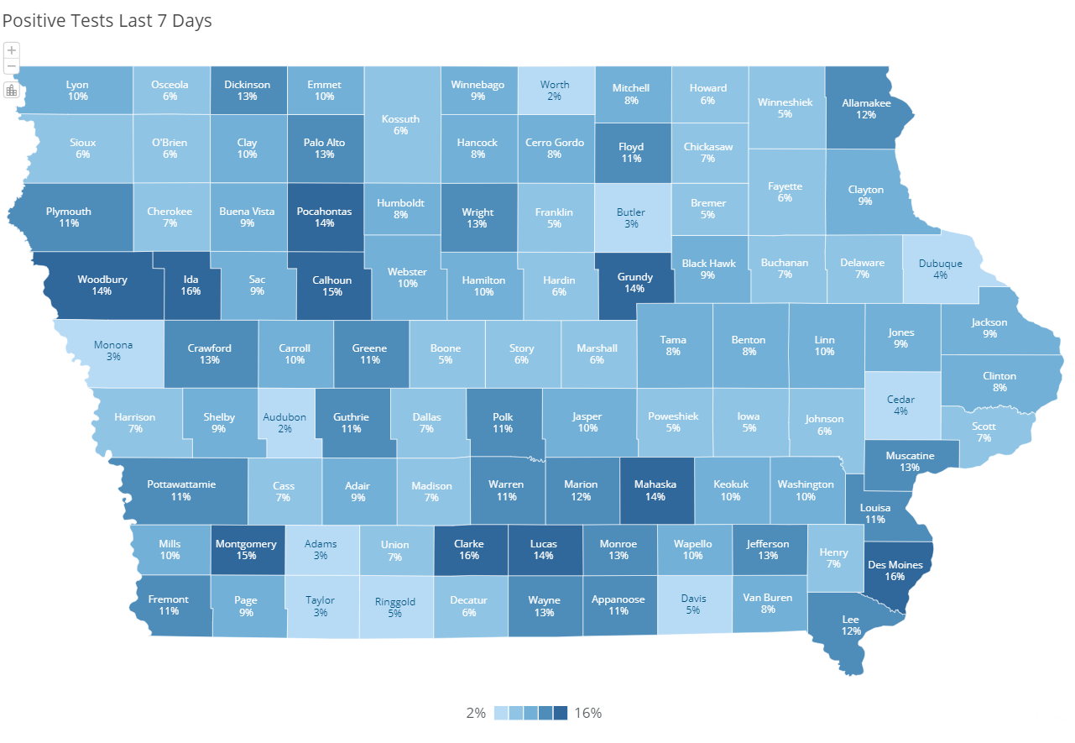
Positivity Map (as of September 7, 2021)
https://coronavirus.iowa.gov/pages/case-counts

Slide 4
Recommended Tour Plan
In-person October Tour
Masks optional on the bus
Masks optional during the meeting
Permit both in-person and virtual participation for delegations and public.
Encourage virtual participation
Continue to spread out public seating
Masks optional

Slide 6
Questions?

