Slide 1
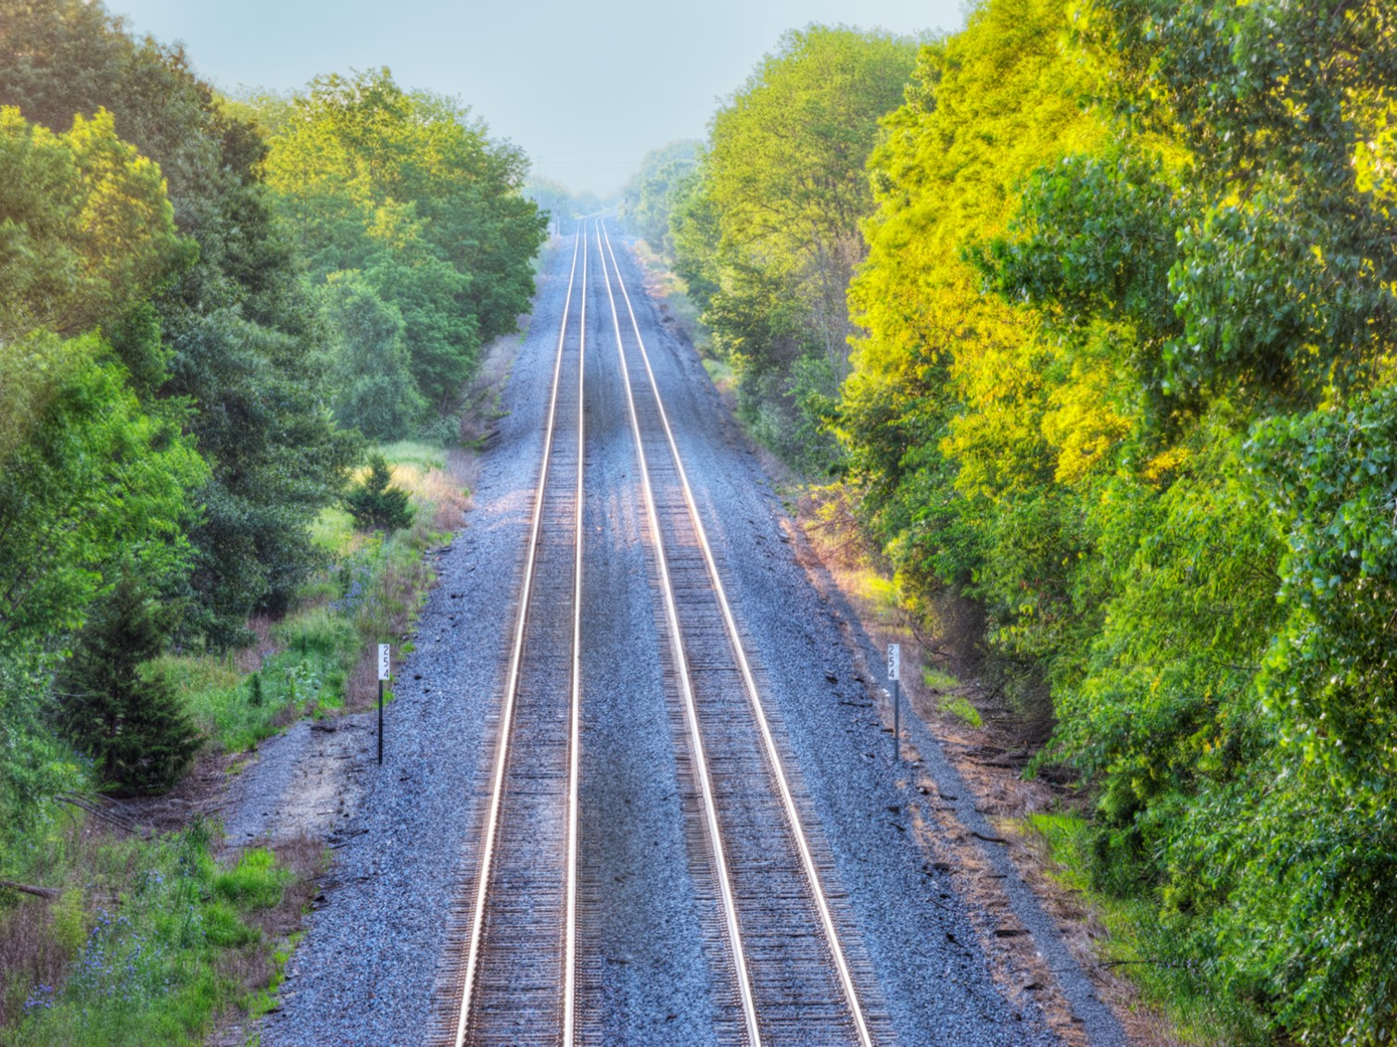

Railroad Revolving Loan and Grant Program
FY 2022 Funding Cycle

Slide 2

Railroad Revolving Loan and Grant Program
Created by legislation in 2005
Purpose: To provide loans and grants for railroad related improvement projects to benefit Iowa.
Funded by loan repayments and appropriations by the Iowa Legislature. Funding is available to cities, counties, economic development organizations and other non-profit organizations through an application program.

Slide 3
Available Funding and Application Summary
Available Funding:
  FY 2022 Legislative appropriation (RIIF): $1,000,000
  Loan repayment: $1,423,746.14
  Rescinded funds $3,715,000
  Total: $6.1 million
Application Summary:
  Total number of projects: 8
  Total rail project costs: $35,203,444
  Total amount requested: $10,730,712

Slide 4
Project Evaluation Criteria
Targeted Job Creation Projects:
  Hourly wage rates must meet 100% of the average county wage criteria:
    Job leverage: 40 pts
    Wage quality: 20 pts
    Capital investment: 20 pts
    Loan leverage: 20 pts
Rail Network Improvement Projects:
    Project readiness
    Rail network impact
    Economic impact
    Financial readiness
Rail Port Planning and Development Studies:
    Existing/potential site information
    Goals of the study
    Organizational structure and capacity to complete the study

Slide 5
Applications Received & Recommended Awards
TOTAL RAIL PROJECT COST
REQUESTED AMOUNT
(% of Total Project Cost)
RECOMMENDED AMOUNT
(% of Total Project Cost)
PROJECT NAME
SPONSOR
SCORE
Project MG Connecting Track | MG | 20.96 (Grant Only) | $13,719,632 | Grant: $600,000 (4%) | Grant: $550,000 (4%)
Charles City Terminal | Charles City Rail Terminal, LLC | 24.55 (Grant and Loan) | $5,276,000 | Loan: $1,100,000 (21%) Grant: $240,000 (4.5%) | Loan: $900,000 (17.1%) Grant: $240,000 (4.5%)
Project Peony | City of Sioux City | 36.15 (Grant Only) | $5,197,674 | Grant: $2,160,000 (41.6%) | Grant: $2,000,000 (38.5%)
CP Unit Train Expansion | Pattison Sand Company | 47.99 (Grant and Loan) | $3,140,000 | Loan: $2,224,000 (70.8%) Grant: $180,000 (5.7%) | Loan: $200,000 (6.4 %) Grant: $180,000 (5.7%)
Jump to applications not recommended for funding

Slide 6
Applications Received & Recommended Awards Contd.
TOTAL PROJECT COST
REQUESTED AMOUNT
(% of Total Project Cost)
RECOMMENDED AMOUNT
(% of Total Project Cost)
PROJECT NAME
SPONSOR
SCORE
Ten D/Merchants Railport Expansion and Upgrades | Ten D/Merchants Distribution Service | N/A (Rail Network Improvement) | $6,915,822 | Loan: $3,500,000 (50.6%) | Loan: $1,500,000 (21.7%)
Boone & Scenic Valley Railroad Expansion and Upgrade | Boone & Scenic Valley Railroad | N/A (Rail Network Improvement) | $734,816 | Loan: $551,112 (75%) | Loan: $551,112 (75%)
Oskaloosa Industrial Park Transload Facility | Mahaska Chamber and Development Group | N/A (Planning Study) | $94,500 | Grant: $75,600 (80%) | Grant: $75,600 (80%)
East Polk County Industrial Park | Ten D/Merchants Distribution Service | N/A (Planning Study) | $125,000 | Grant: $100,000 (80%) | Grant: Not Funded
Jump to applications not recommended for funding

Slide 7
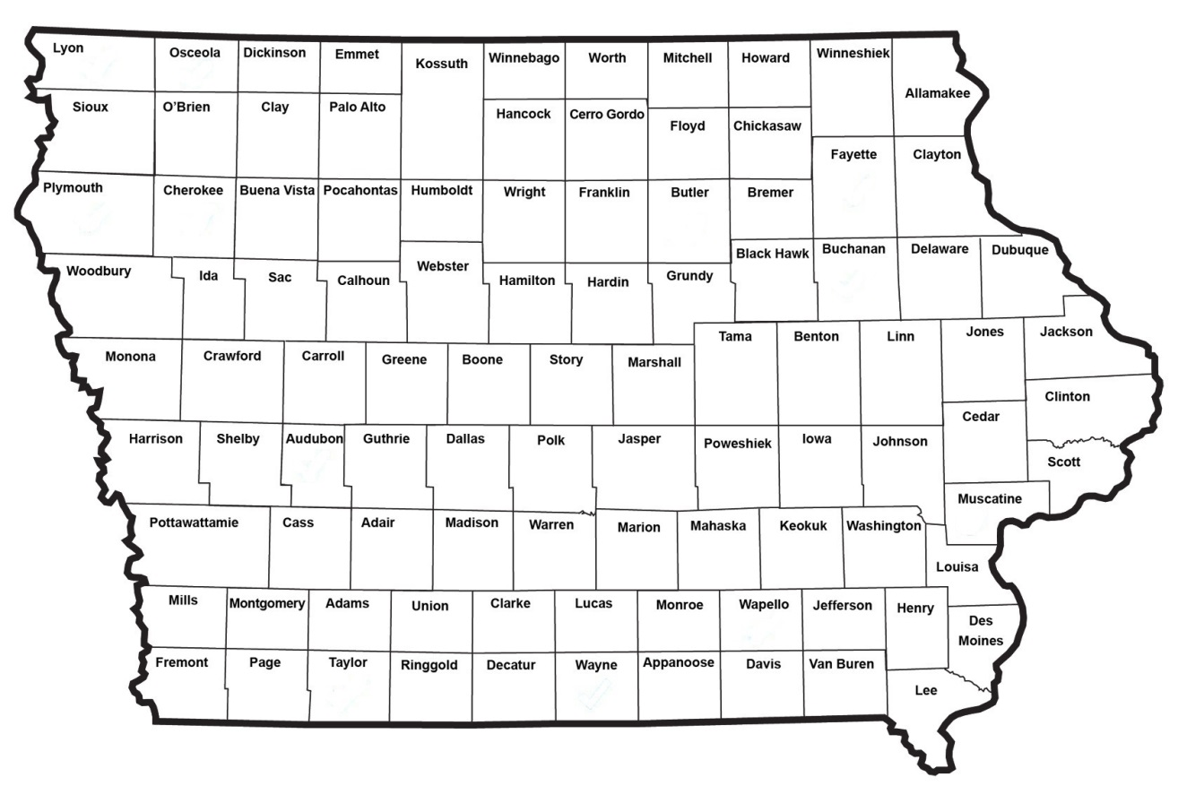
Map of Applications Received

Slide 8

QUESTIONS?
Ed Engle, Rail Transportation Bureau
Edward.Engle@iowadot.us
515-239-1058

Slide 9
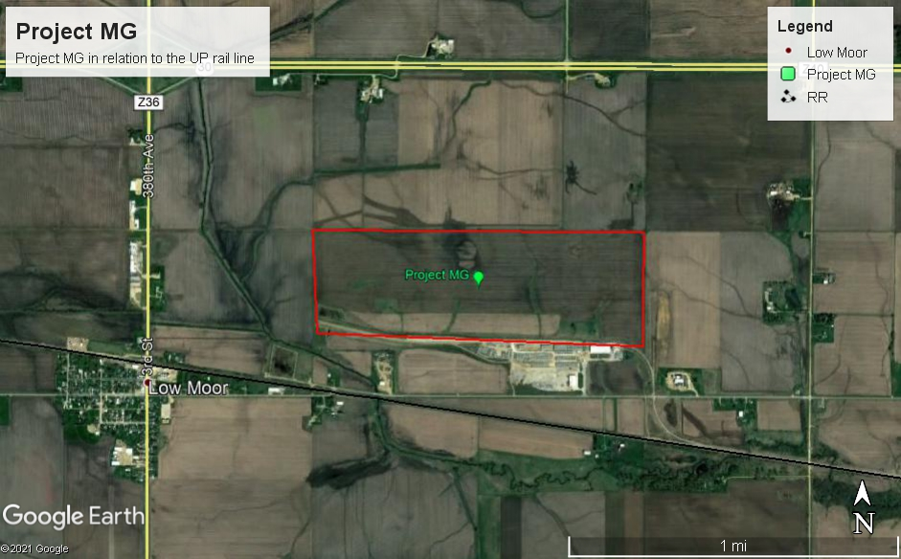
Project MG -- Clinton
Company is building a plant to convert locally produced agricultural feedstock into renewable fuels. The rail facilities improvement will connect the plant to UP railroad. Project is expected to create 50 new jobs.
Total Cost: $13,719,632
Requested: $600,000 (4.4%) Recommended: $550,000 (4%)
Return to Recommendation Summary

Slide 10
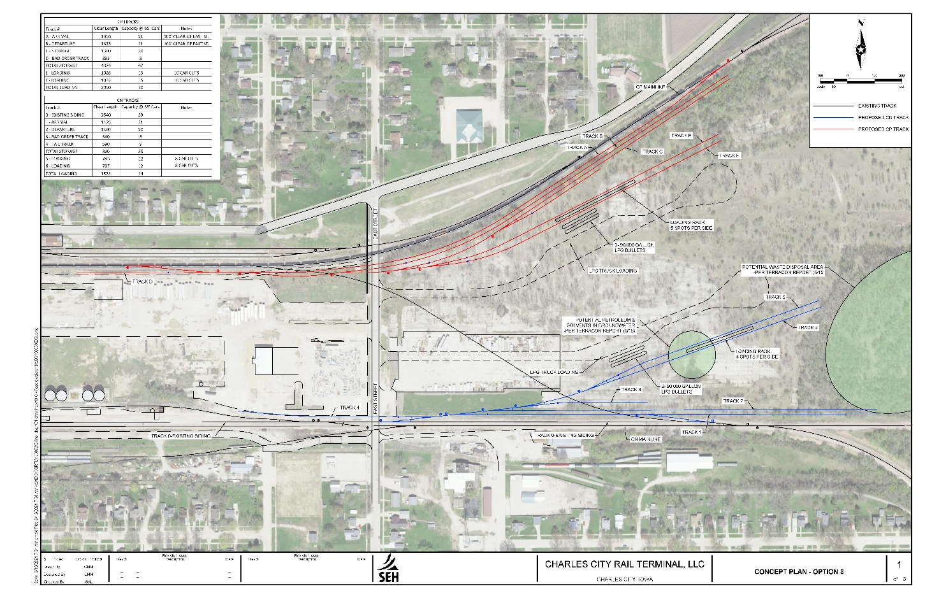
Charles City Terminal
The proposed project will re-purpose the former Oliver/White Tractor Manufacturing plant site as a railcar-truck transload center for transshipment of propane, bio-renewables, and specialized fuels through connections with both CP and CN railroads. Project is expected to create 20-25 new jobs.
Total Cost: $5,276,000
Requested: $1,340,000 (25%) Recommended: $1,140,000 (21.6%)
Return to Recommendation Summary

Slide 11
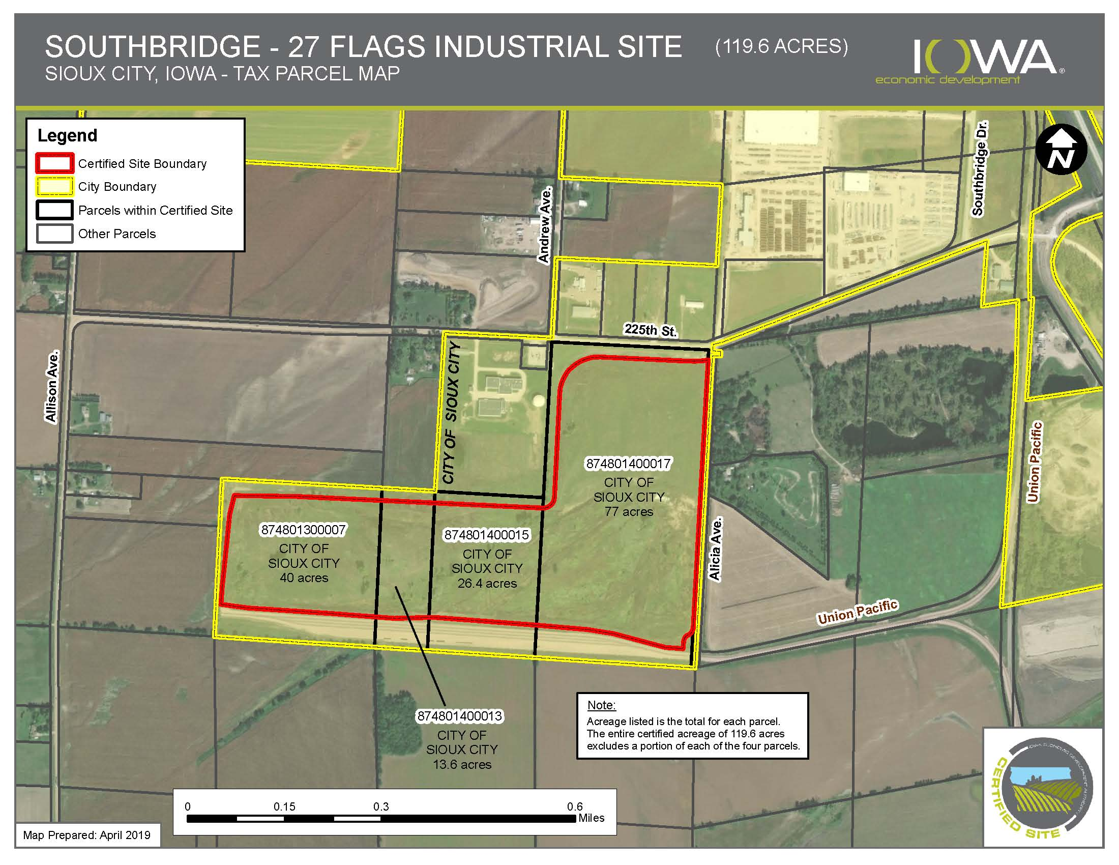
Project Peony
Project is adding a switch and 15,750-foot rail spur to the planned industrial facility connecting it to the railroad network. Project is expected to create 180 new jobs.
Total Cost: $5,197,674
Requested: $2,160,000 (41.6%) Recommended: $2,000,000 (38.5%)
Return to Recommendation Summary

Slide 12
CP Unit Train Expansion (Pattison Sand IV)
The project will construct rail to add an additional 30 railcar spots in their yard as part of their long-term expansion plans. 15 jobs will be retained and 35 jobs will be created.
Total Cost: $3,140,000
Requested: $2,404,000 (76.6%) Recommended: $180,000 (0.6%)
Return to Recommendation Summary

Slide 13
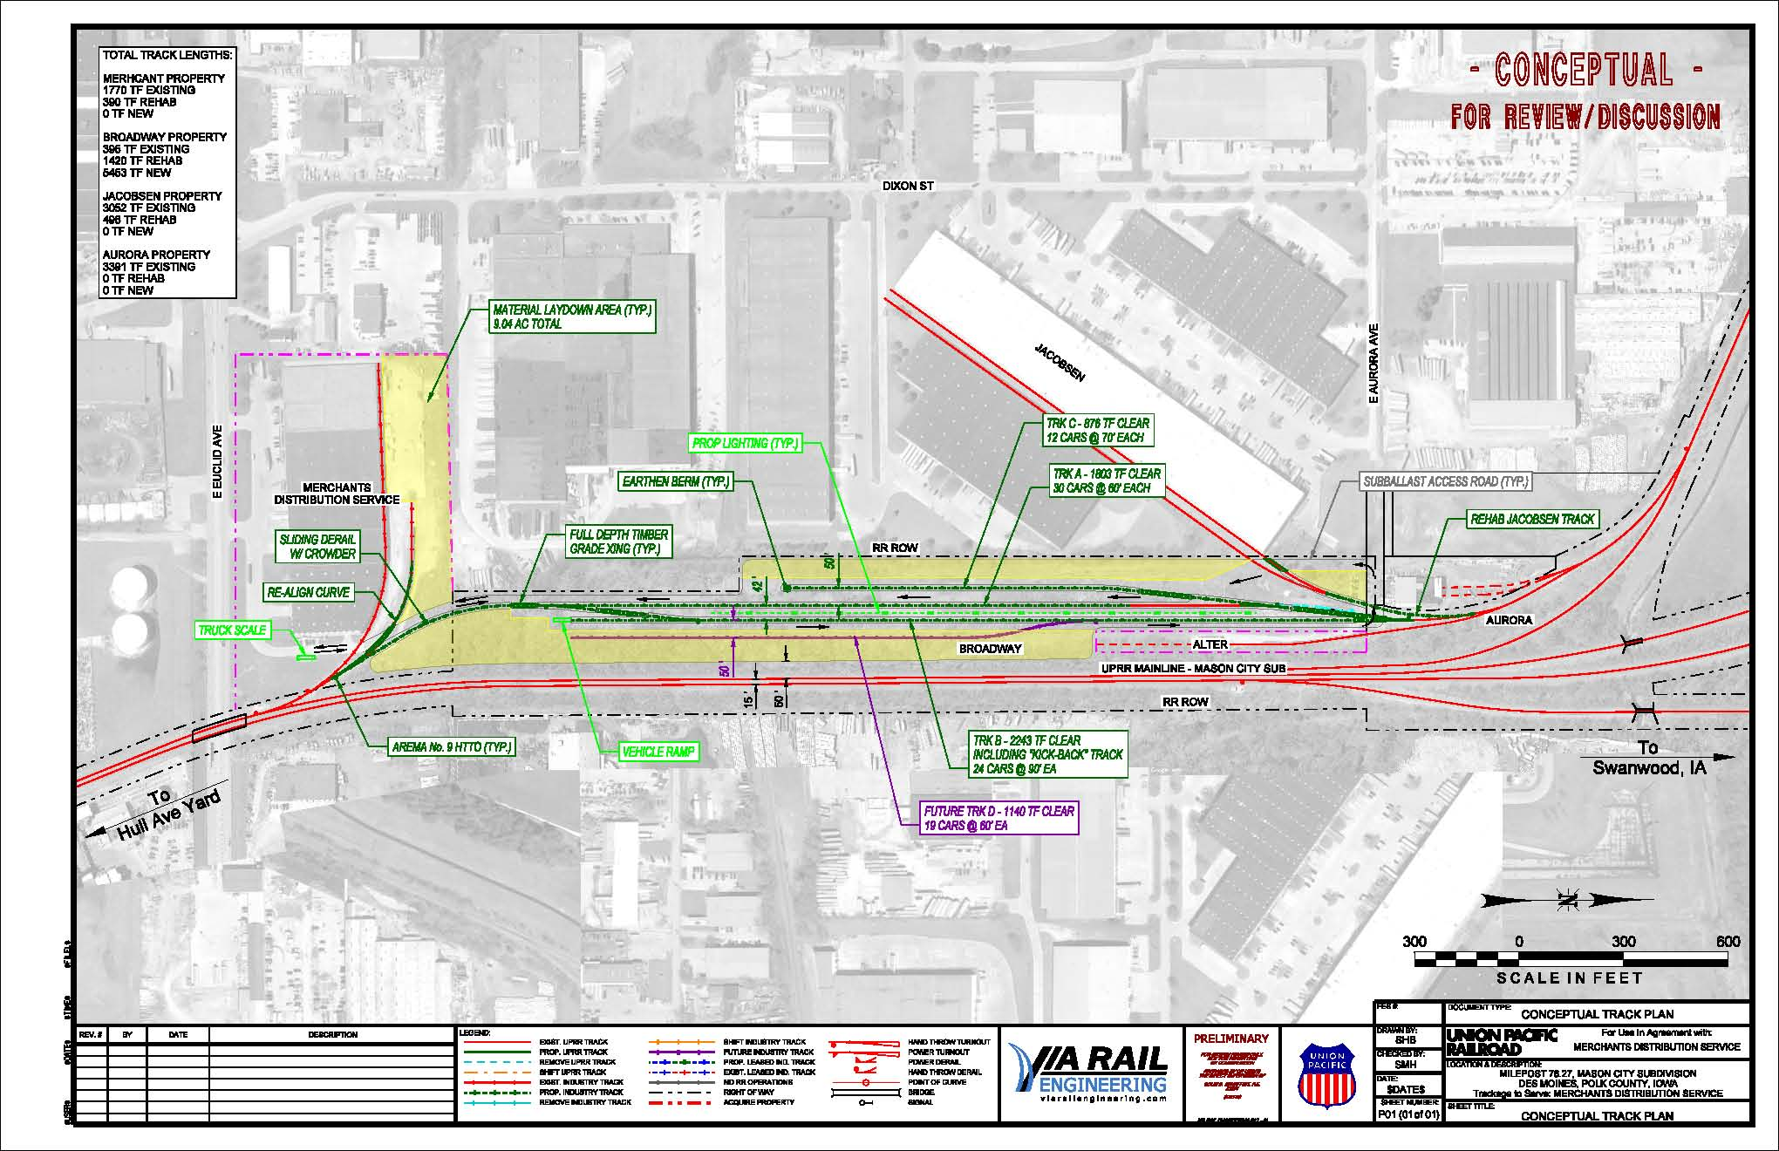
Ten D/Merchants Railport Expansion and Upgrades
Project will add 1 mile+ new rail and replace/upgrade/make accessible 1.5 mile+ of existing rail. Also will add additional transloading service capacities and capabilities.
Total Cost: $6,915,822
Requested: $3,500,000 (50.6%) Recommended: $1,500,000 (21.7%)
Return to Recommendation Summary

Slide 14
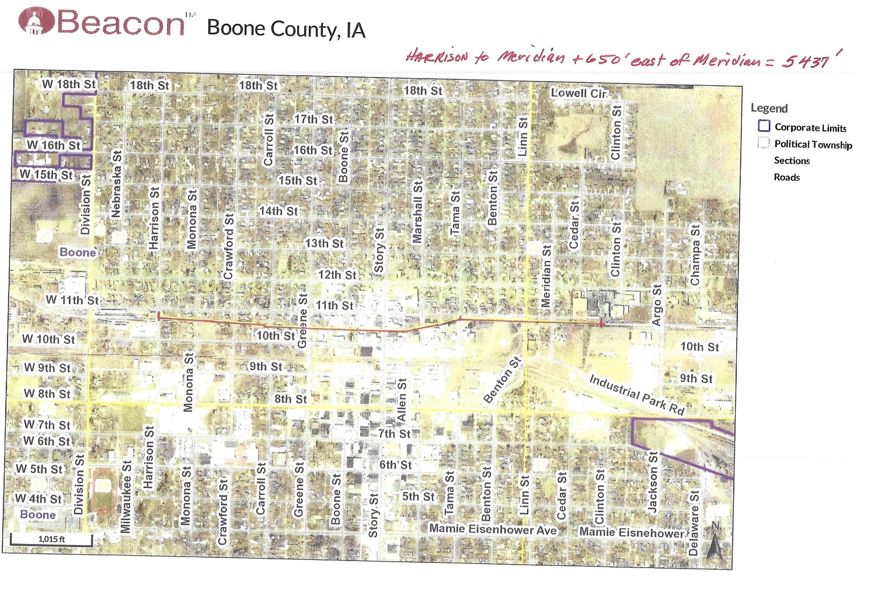
Boone and Scenic Valley Railroad Expansion and Upgrade
Project is replacing old, failing ties and constructing a new siding for additional storage and switching capabilities.
Total Cost: $734,816
Requested: $551,112 (75%) Recommended: $551,112 (75%)
Return to Recommendation Summary

Slide 15
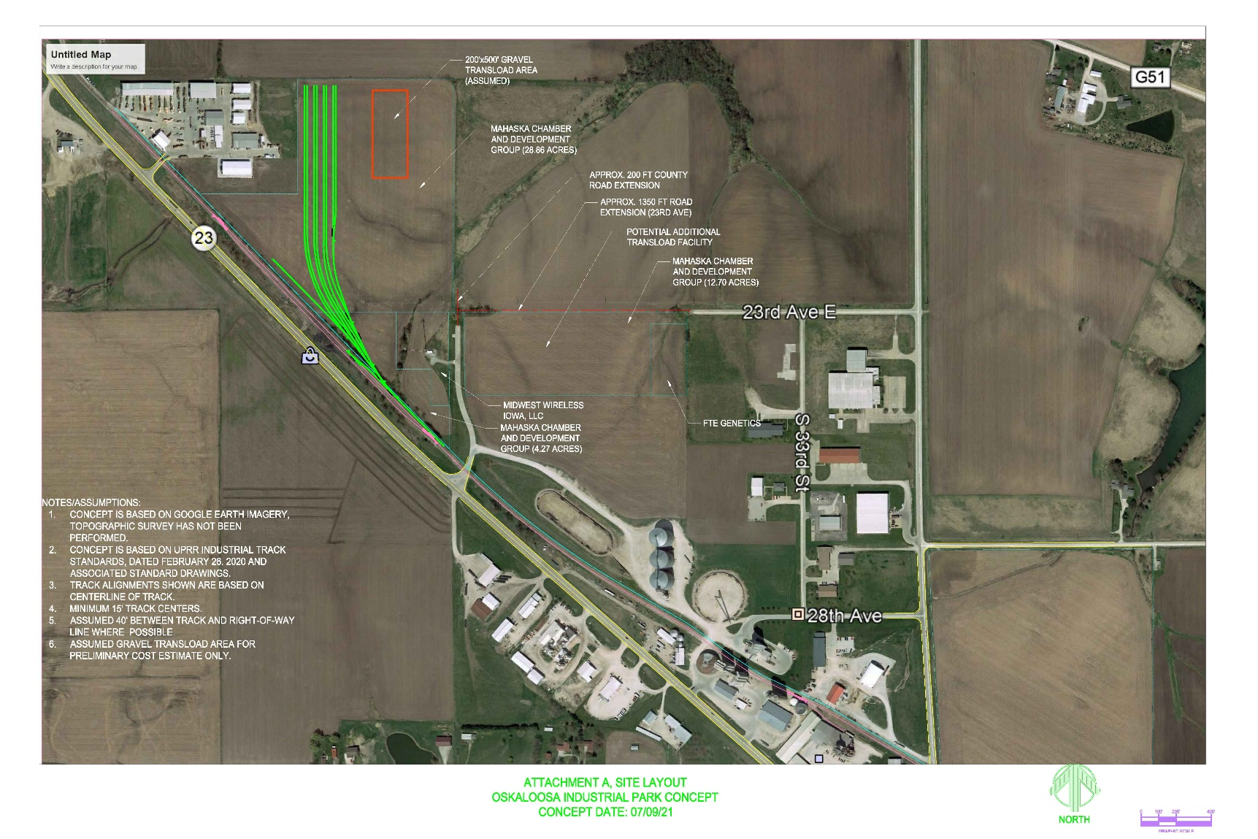
Oskaloosa Industrial Park Transload Facility
This planning study is looking at developing 29 acres of land near Oskaloosa into a railport/transload facility. The concept includes almost three miles of track and the potential of a diverse array of storage and transloading capabilities.
Total Cost: $94,500
Requested: $75,600 (80%) Recommended: $75,600 (80%)
Return to Recommendation Summary

Slide 16
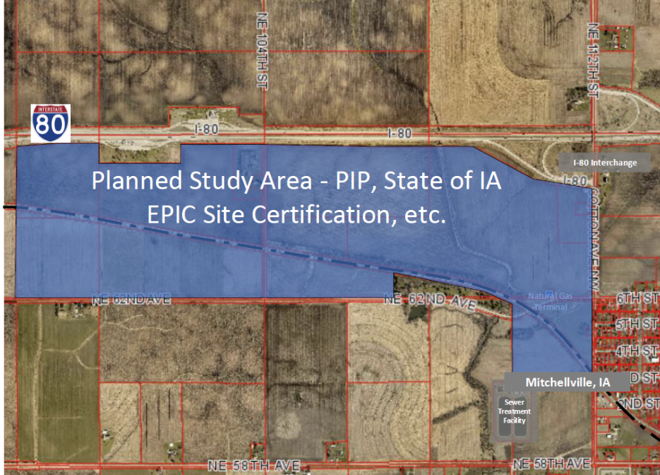
East Polk County Industrial Park
Purpose of study is to plan for future rail service on the East Polk County Industrial Park site (plus, potentially on adjacent properties) as a railport, wind energy equipment distribution center, and a potential inland port.
Total Cost: $125,000
Requested: $100,000 (80%) Recommended: Not funded
Return to Recommendation Summary

