Slide 1
State Recreational Trails Program
Funding Recommendation

Slide 2
State Recreational Trail Program
Created in 1988
Available to cities, counties, state agencies, local governments, or non-profit organizations through an application program
Purpose is to establish recreational trails in Iowa for the use, enjoyment and participation of the public.

Slide 3
Project Evaluation Criteria
Need in terms of population to be served and existing trails in the area (25 points)
Compatibility with local, areawide, regional or statewide plans (15 points)
Benefits of multiple uses and recreational opportunities (20 points)
Quality of the site (25 points)
Economic benefits to the local area (10 points)
Special facilities for disabled users (5 points)
Project is "shovel ready“ and will be completed by 6-30-2025 (25 points)
Projects with cash match (5 points)

Slide 4
Available Funding and Application Summary
Available Funding:
FY 2023 Legislative appropriation from the Rebuild Iowa Infrastructure Fund: $2,500,000
Underruns from closed projects: $ 248,949
Total available funding: $2,748,949
Application Summary:
Total number of projects: 29
Total project costs: $34,201,624
Total amount requested: $13,889,139

Slide 5
List of Applications Recommended
PROJECT NAME | SPONSOR | SCORE | TOTAL PROJECT COST | REQUESTED AMOUNT (% of Total Project Cost) | RECOMMENDED AMOUNT (% of Total Project Cost)
Raccoon River Valley Trail to High Trestle Trail Phase V | Dallas County Conservation Board | 116 | $1,897,000 | $400,000 (21%) | $400,000 (21%)
Heart of Iowa Nature Trail: 610th Avenue to 620th Avenue | Story County Conservation Board | 110 | $514,000 | $225,000 (44%) | $225,000 (44%)
West Union to Echo Valley State Park | West Union | 108 | $1,073,874 | $581,350 (54%) | $581,350 (54%)
Gear Avenue Trail Extension Phase II | West Burlington | 107 | $1,141,920 | $345,357 (30%) | $345,357 (30%)
Jump to applications not recommended for funding

Slide 6
List of Applications Recommended
PROJECT NAME | SPONSOR | SCORE | TOTAL PROJECT COST | REQUESTED AMOUNT (% of Total Project Cost) | RECOMMENDED AMOUNT (% of Total Project Cost)
Eldora Trail Expansion | Eldora | 106 | $530,303 | $397,000 (75%) | $397,000 (75%)
Glenwood Trail | Glenwood | 104 | $398,318 | $200,000 (50%) | $200,000 (50%)
Carlisle Connection Trail | Des Moines | 103 | $4,636,142 | $400,000 (9%) | $400,000 (9%)
Great Western Connector Trail | Manning | 102 | $359,978 | $250,000 (69%) | $200,242 (56%)
Jump to applications not recommended for funding

Slide 7
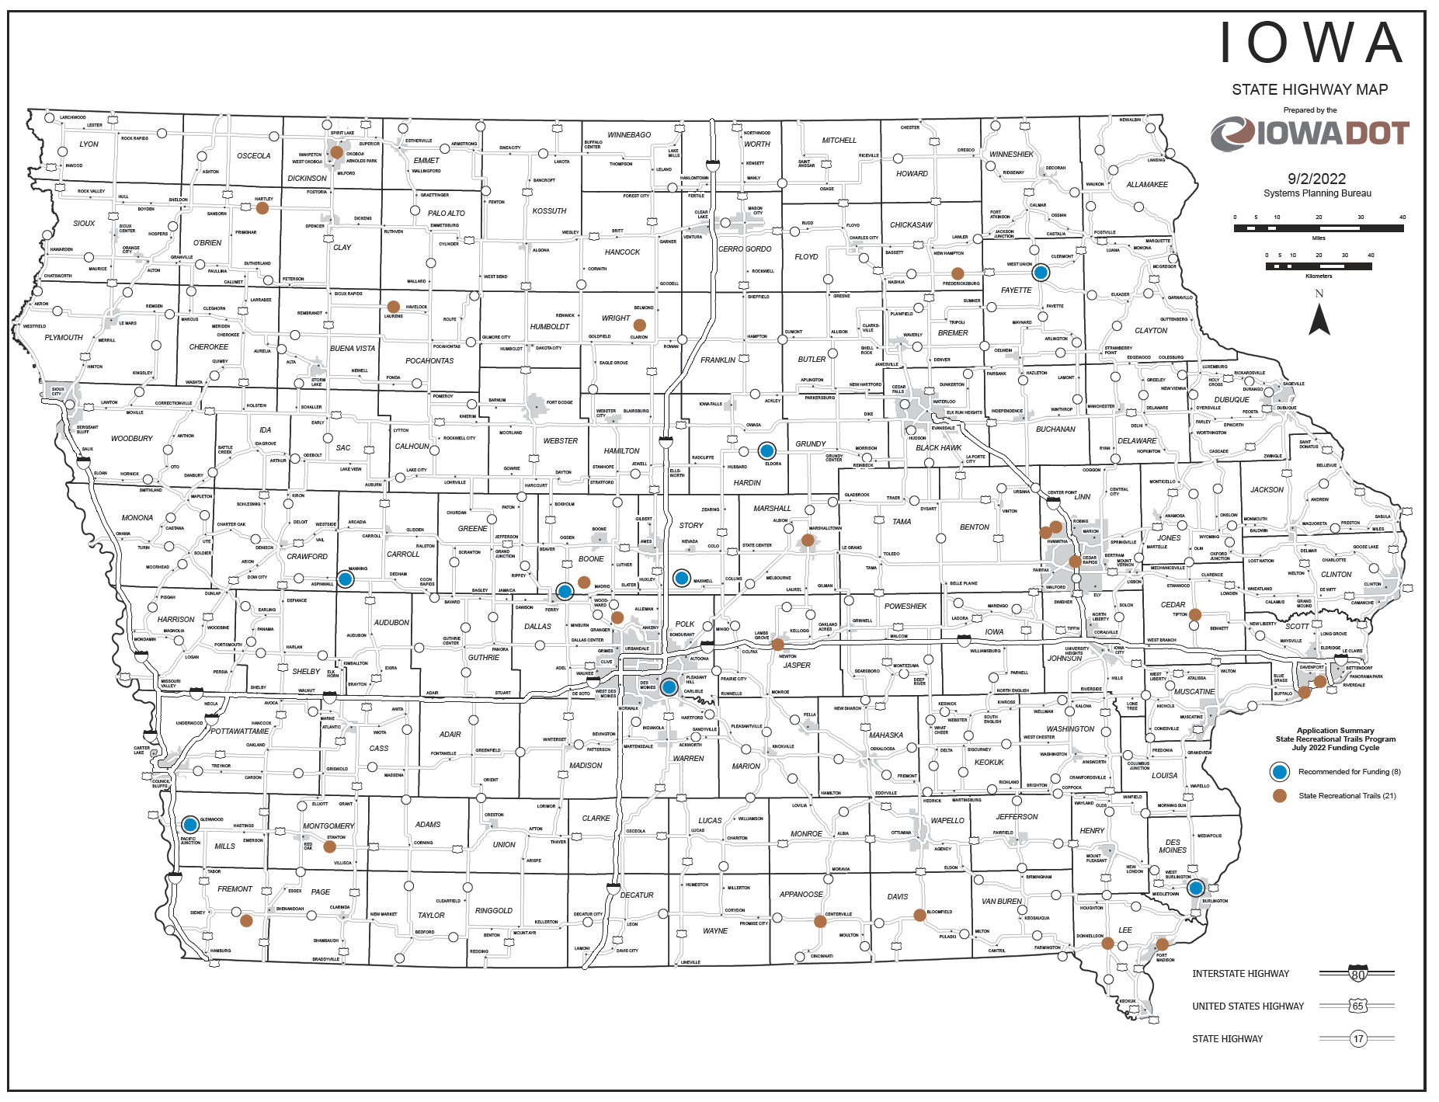
Map of Applications Received

Slide 8
QUESTIONS?
Craig Markley, Systems Planning Bureau
craig.markley@iowadot.us
515-239-1027

Slide 9
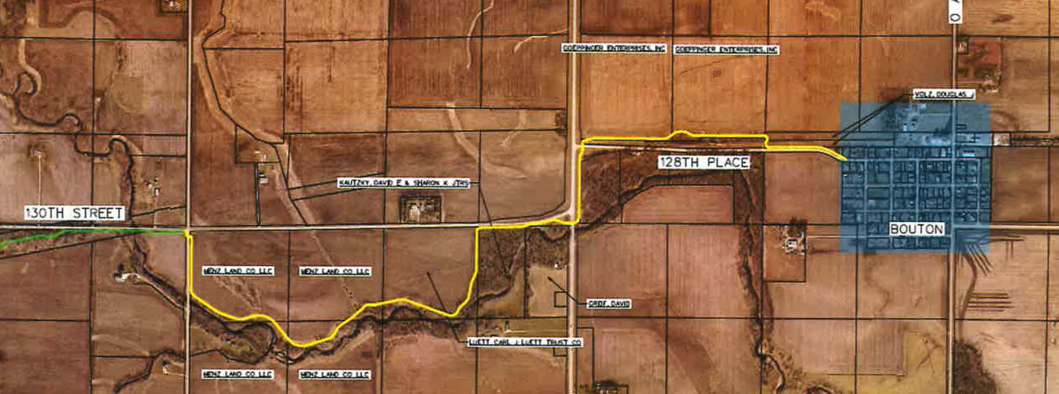
Raccoon River Valley Trail to High Trestle Trail Phase V (Dallas County Conservation Board)
Construction of 2.4 miles of paved trail from M Avenue and 130th Street to Bouton. This section completes the trail from Perry to Bouton.
Total Cost: $1,897,000
Requested: $400,000 (21%)
Return to List of Applications Recommended

Slide 10
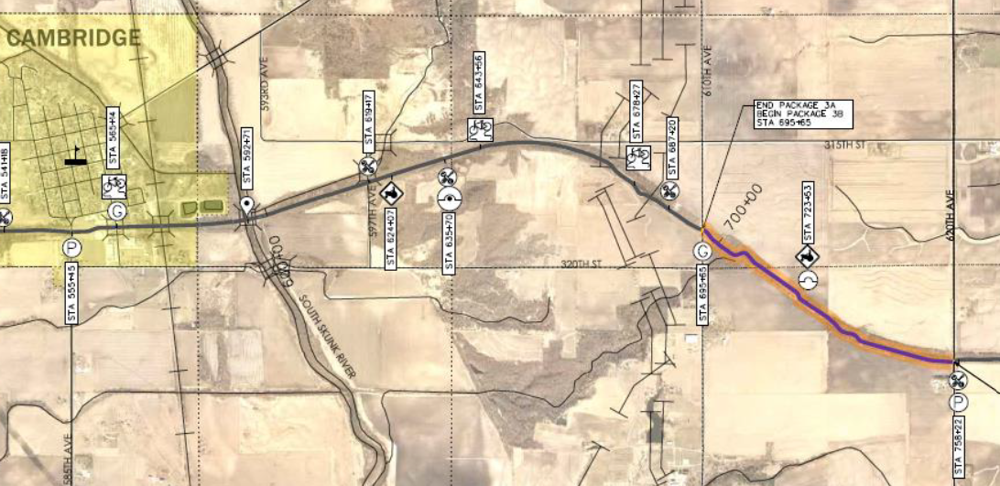
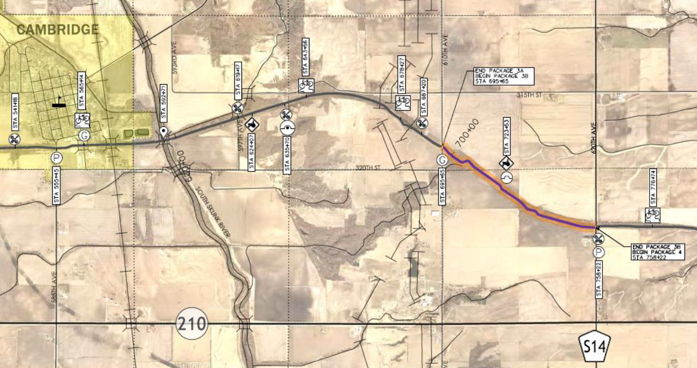
Heart of Iowa Nature Trail from 610th Avenue to 620th Avenue (Story County Conservation Board)
Paving of existing 1.2-mile limestone trail from 610th Avenue to 620th Avenue.
Total Cost: $514,000
Requested: $225,000 (44%)
Return to List of Applications Recommended

Slide 11
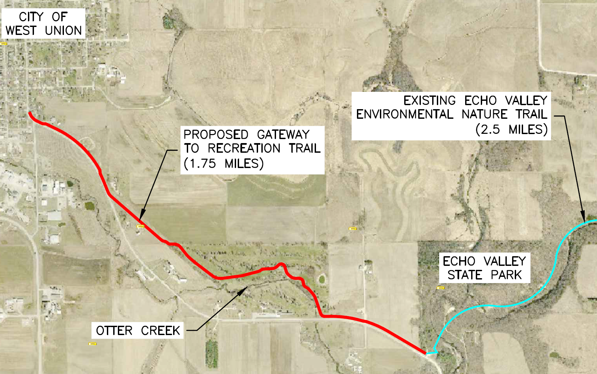
West Union to Echo Valley State Park (West Union)
Construction of a 1.75-mile paved trail from Pine Street and Echo Valley Road in West Union to the existing trail in Echo Valley State Park.
Total Cost: $1,073,874
Requested: $581,350 (54%)
Return to List of Applications Recommended

Slide 12
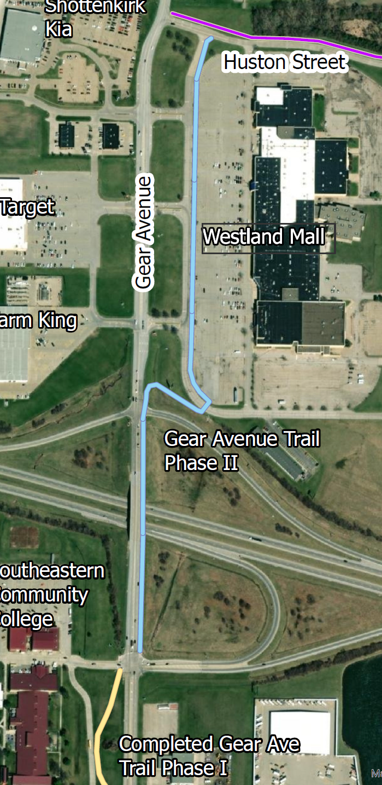
Gear Avenue Trail Extension Phase II
(West Burlington)
Construction of 0.5-mile of paved trail on east side of Gear Avenue tying into phase one near the Southeastern Community College entrance and ending at Huston Street.
Total Cost: $1,141,920
Requested: $345,357 (30%)
Return to List of Applications Recommended

Slide 13
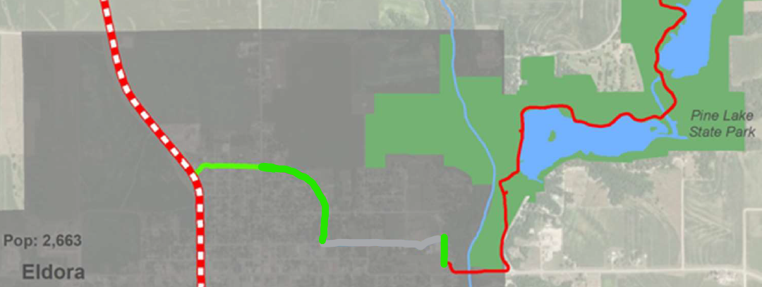
Eldora Trail Expansion (Eldora)
Pave an existing 0.48-mile segment of Eldora Trail from Washington Street to 11th Avenue. Also construct two new paved trail segments from Washington Street to the Iowa River’s Edge Trail and along Park Street from 11th Avenue to Pine Lake State Park Recreational Trail at Memorial Park totaling 0.38-mile of new trail.
Total Cost: $530,303
Requested: $397,000 (75%)
Return to List of Applications Recommended

Slide 14
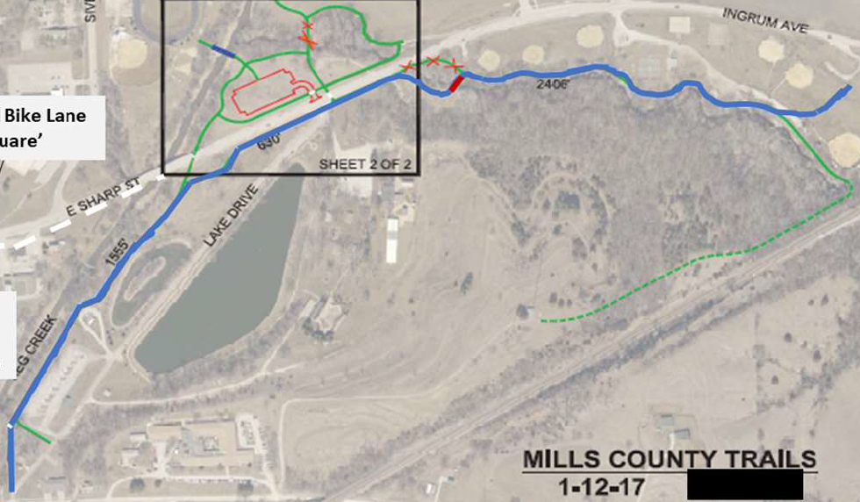
Glenwood Trail (Glenwood)
Construction of a 1.5-mile paved trail at Glenwood Lake Park from Green Street and South Linn Street along Keg Creek, crossing Rogers Creek, and continuing to the recreational complex near Ingrum Avenue.
Total Cost: $398,318
Requested: $200,000 (50%)
Return to List of Applications Recommended

Slide 15
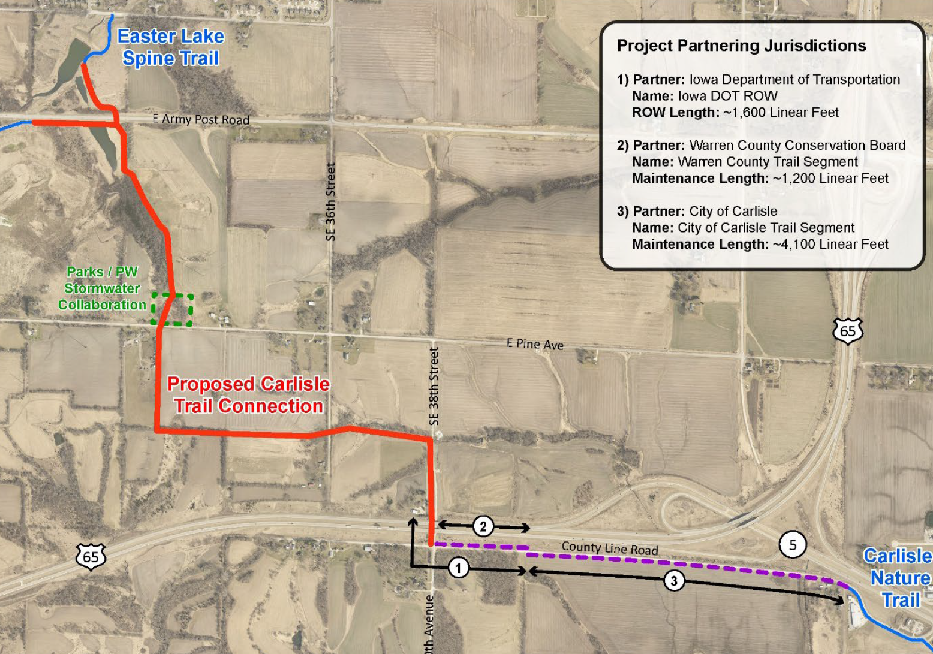
Carlisle Connection Trail (Des Moines)
Construction of a 3.1-mile paved trail from East Army Post Road at Easter Lake Park to 150th Avenue in Carlisle. This trail will eventually connect to the Summerset Trail through Carlisle and Indianola.
Total Cost: $4,636,142
Requested: $400,000 (9%)
Return to List of Applications Recommended

Slide 16
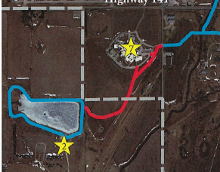
Great Western Connector Trail (Manning)
Project constructs 2,150 feet of concrete trail starting at West Street and Manning Regional Healthcare Center and connecting to the Carroll County Great Western Park.
Total Cost: $359,978
Requested: $250,000 (69%)
Recommended: $200,242 (56%)
Return to List of Applications Recommended

Slide 17
List of Applications Not Recommended for Award
PROJECT NAME | SPONSOR | SCORE | TOTAL PROJECT COST | REQUESTED AMOUNT (% of Total Project Cost) | RECOMMENDED AMOUNT (% of Total Project Cost)
High Trestle Trail to Swede Point Park Phase 1B | Boone County Conservation Board | 104 | $794,000 | $355,000 (45%) | $0
Prairie Restoration Trail | Laurens | 99 | $380,000 | $237,367 (62%) | $0
Davis County Trail Project Phase 4A | Bloomfield | 98 | $675,000 | $475,000 (70%) | $0
Iowa's River Edge Trail Radio Tower Road to Bridge #5 | Marshalltown | 96 | $1,400,000 | $500,000 (36%) | $0
Prairie Lands Trail 12-mile Connector | Wright County Conservation Board | 95 | $3,008,900 | $2,256,675 (75%) | $0
Return to List of Applications Recommended

Slide 18
List of Applications Not Recommended for Award
PROJECT NAME | SPONSOR | SCORE | TOTAL PROJECT COST | REQUESTED AMOUNT (% of Total Project Cost) | RECOMMENDED AMOUNT (% of Total Project Cost)
Clay County Connection Phase I | Dickinson County Trails Board | 94 | $1,396,753 | $450,000 (32%) | $0
Red Rock Prairie Trail Prairie City to Mitchellville | Jasper County Conservation Board | 94 | $2,166,000 | $376,000 (17%) | $0
Admiral Trail - Phase 2 Bridge | Farragut | 94 | $564,999 | $452,000 (80%) | $0
Hoover Trail Bridge #2 | Cedar County Conservation Board | 94 | $319,385 | $224,385 (70%) | $0
Connecting Fort Madison! Phase 4 48th Street Trail Connector | Fort Madison | 91 | $625,477 | $202,477 (32%) | $0
Nahant Marsh Trail Expansion Phase II | Nahant Marsh Education Center | 88 | $314,673 | $222,273 (71%) | $0
Return to List of Applications Recommended

Slide 19
List of Applications Not Recommended for Award
PROJECT NAME | SPONSOR | SCORE | TOTAL PROJECT COST | REQUESTED AMOUNT (% of Total Project Cost) | RECOMMENDED AMOUNT (% of Total Project Cost)
Cedar Valley Nature Trail- 52nd Street to Bear Creek Bridge | Linn County Conservation Board | 88 | $1,369,684 | $650,000 (47%) | $0
Copper Creek Mountain Bike Park | Polk County Conservation Board | 86 | $1,6000,000 | $400,000 (25%) | $0
Westview Park Trail and Trailhead Phase 1 | Donnellson | 81 | $187,000 | $92,000 (49%) | $0
Stanton Greenbelt Trail Phase 1 | Stanton | 79 | $528,455 | $328,455 (62%) | $0
Palo Connector Trail | Palo | 79 | $2,464,000 | $1,971,200 (80%) | $0
Plum Creek Nature Trail | Fredericksburg | 72 | $159,150 | $75,000 (47%) | $0
First Bridge Replica Pedestrian/Bicycle Trail Bridge | River Action, Inc. | 68 | $4,386,613 | $1,000,000 (23%) | $0
Return to List of Applications Recommended

Slide 20
List of Applications Not Recommended for Award
PROJECT NAME | SPONSOR | SCORE | TOTAL PROJECT COST | REQUESTED AMOUNT (% of Total Project Cost) | RECOMMENDED AMOUNT (% of Total Project Cost)
Centerville Sidewalk Extension | Centerville | 65 | $635,000 | $465,000 (73%) | $0
Cottage Grove Avenue Trail | Cedar Rapids | 63 | $446,000 | $266,400 (60%) | $0
Hartley Recreation Trail | Hartley | 53 | $229,000 | $91,200 (40%) | $0
Return to List of Applications Recommended

Slide 21
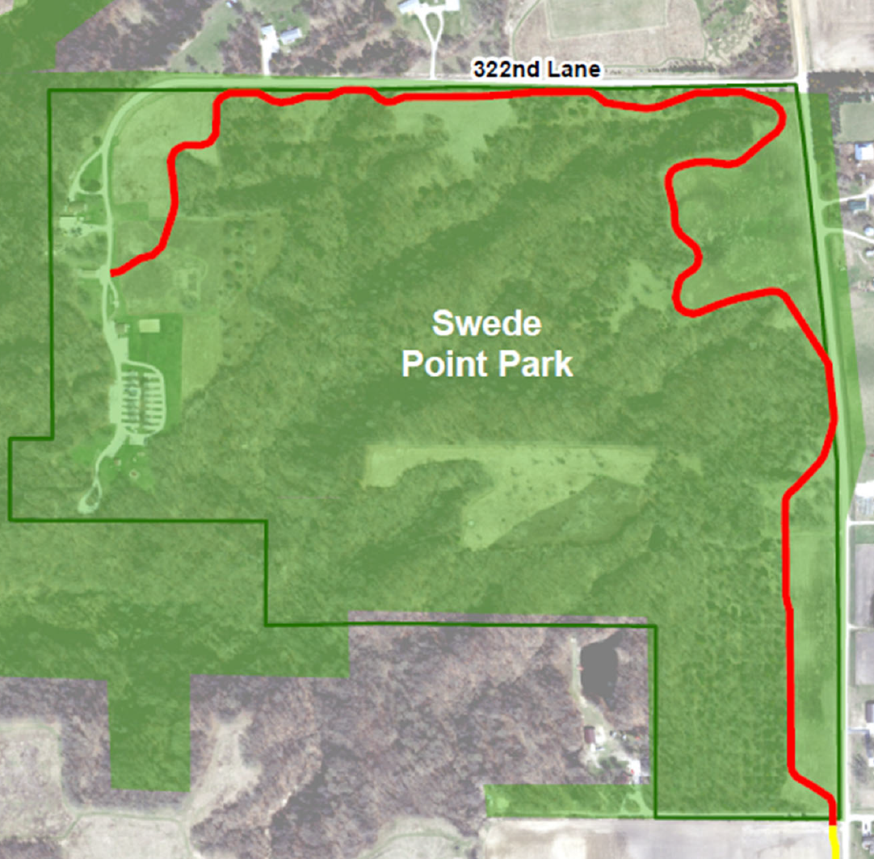
High Trestle Trail to Swede Point Park Phase 1B (Boone County Conservation Board)
This phase includes the construction of 1.23 miles of concrete trail, starting at QM Avenue at the southern entrance into Swede Point Park and completes the connection between the High Trestle Trail and the park's campground.
Total Cost: $794,000
Requested: $355,000 (45%)
Recommended: $0
Return to List of Applications NotRecommended

