Slide 1


Railroad Revolving Loan and Grant Program FY 2023 Funding Cycle
September 13, 2022
Commission Workshop

Slide 2

Railroad Revolving Loan and Grant Program
Created by legislation in 2005
Purpose: To provide loans and grants for railroad related improvement projects to benefit Iowa.
Funded by loan repayments and appropriations by the Iowa Legislature. Funding is available to cities, counties, economic development organizations, businesses, rail companies and alliances of such organizations.

Slide 3
Available Funding and Application Summary
Available Funding:
FY 2023 Legislative appropriation (RIIF): $2,000,000
Loan repayments and rescinded funds: $4,300,000
Total Available: $6.3 million
Application Summary:
Total number of projects: 7
Total rail project costs: $27,015,941
Total amount requested: $13,250,230

Slide 4
Project Evaluation Criteria
Targeted Job Creation Projects:
Hourly wage rates must meet 100% of the average county wage criteria:
Job leverage: 40 pts
Wage quality: 20 pts
Capital investment: 20 pts
Loan leverage: 20 pts
Rail Network Improvement Projects:
Project readiness
Rail network impact
Economic impact
Financial readiness
Rail Port Planning and Development Studies:
Existing/potential site information
Goals of the study
Organizational structure and capacity to complete the study
Notes:
An application is required in order to submit for RRLG funding. Once applications are received, an evaluation team is identified an we review and evaluate each application based on the project type.
Targeted Job Creation
Rail Network Improvements
Planning study
TJ: Require projects to either create or retain jobs for the state of Iowa. TJ Program offers both grants and loans or combo of the two
Grants maxed at 12,000 per job (50/50), loans (80/20).
RNI: Projects that do not have jobs attached to them. Loans only at 0% interest for 10 years.
PS: Grants of up to $100,000 are available for planning studies that enable a community, county, or region to make fact-based decisions concerning the location, design or funding requirements for a rail port facility.

Slide 5
Applications Received & Recommended Awards
TOTAL RAIL PROJECT COST
REQUESTED AMOUNT
(% of Total Project Cost)
RECOMMENDED AMOUNT
(% of Total Project Cost)
PROJECT NAME
SPONSOR
SCORE
Alta, Iowa Soybean Crush Plant (Buena Vista) | Platinum Crush, LLC | 32.8 (Targeted Jobs) | $14,070,389 | Loan: $2,000,000 (14.2%) Grant: $612,000 (4.3%) | Loan: $2,000,000 (14.2%) Grant: $612,000 (4.3%)
Floyd Valley Transload (Woodbury) | Floyd Valley Transload, LLC | 28.2 (Targeted Jobs) | $981,000 | Loan: $664,800 (67.8%) Grant: $120,000 (12.2%) | Loan: $664,800 (67.8%) Grant: $120,000 (12.2%)
IceCap Cold Storage (Pottawattamie) | US Property, Inc. | 25.5 (Targeted Jobs) | $1,349,144 | Loan: $503,315 (37.3%) Grant: $576,000 (42.7%) | Loan: $503,315 (37.3%) Grant: $576,000 (42.7%)
Notes:
We are recommending funding for 6 projects.
3 projects include loans plus grants for job creation.
**Platinum Crush is building a new soybean crush plant that will procure soybeans and process them into livestock feed and vegetable oil. The $37M plan includes a private loop track that can accommodate 5 unit trains.
Job creation: 51 jobs at an average $22.32/hour.
Total project cost is $14,070,389
We recommend a loan award of $X and grant of $X.
**Floyd Valley transload is building a transload for shipping to and from the Sioux City, IA area. The proposed project will add the needed railroad infrastructure (switch and track) to create the transload and connect to the BNSF railroad.
Job creation: 20 jobs at an average $25/hour.
Total project cost is $981,000
We recommend a loan award of $X and grant of $X.
**Ice Cap Cold Storage: Phase 2 of the Cold Storage project includes 1,458 feet of rail track and spur that will provide access to the IceCap Cold Storage facility and future expansion.
Job creation: 48 jobs at an average $22.94/hour.
Total project cost is $1,349,144
We recommend a loan award of $X and grant of $X.

Slide 6
Applications Received & Recommended Awards Contd.
TOTAL RAIL PROJECT COST
REQUESTED AMOUNT
(% of Total Project Cost)
RECOMMENDED AMOUNT
(% of Total Project Cost)
PROJECT NAME
SPONSOR
SCORE
CP Unit Train Expansion Phase 5 (Clayton) | Pattison Sand Company | N/A (Rail Network Improvement) | $2,700,000 | Loan: $2,000,000 (74.1%) | Loan: $1,650,000 (61.1%)
Booneville North Transload Facility (Dallas) | Legacy Materials | N/A (Planning Study) | $125,000 | Grant: $100,000 (80%) | Grant: $100,000 (80%)
Pacific Junction South Industrial Park Transload Facility (Mills) | Mills County Economic Development Foundation | N/A (Planning Study) | $103,050 | Grant: $82,440 (80%) | Grant: $82,440 (80%)
Notes:
One project is a Rail Network Improvement for a loan only.
**CP Unit Train Expansion (Pattison Sand V)
The project will construct rail to add an additional 400 feet of track for three spurs.
Total project cost is $2,700,000.
We recommend a loan award of $X.
Two projects are planning studies.
**Booneville North Transload Facility
The purpose of the study is to determine the feasibility of a transload facility to serve Dallas County. The study will determine the current and future needs of the area and prepare a plan for an efficient rail transportation to meet those needs.
We recommend a grant award of $X.
**Pacific Junction South Industrial Park Transload Planning Study
The Mills County Economic Development Foundation seeks to develop approximately 217 acres of land located south of Pacific Junction, Iowa into a railport/transload facility. The development study will assess the feasibility of the facility and determine the economic impacts to the city, county, and region.
We recommend a grant award of $X.

Slide 7
Applications Received & Not Recommended for Award
REQUESTED AMOUNT
(% of Total Project Cost)
RECOMMENDED AMOUNT
(% of Total Project Cost)
PROJECT NAME
SPONSOR
SCORE
TOTAL RAIL PROJECT COST
Central Iowa Railport & Logistics Park Phase 2 (Polk) | Ten D/Merchants Distribution Service | N/A (Rail Network Improvement) | $7,687,358 | Loan: $6,149,866 (80%) | Loan: 0 (0%)
Notes:
Due to limited funding and the number of request for FY ‘23, we are not recommending funding for the Ten C/Merchants Phase 2 project.

Slide 8
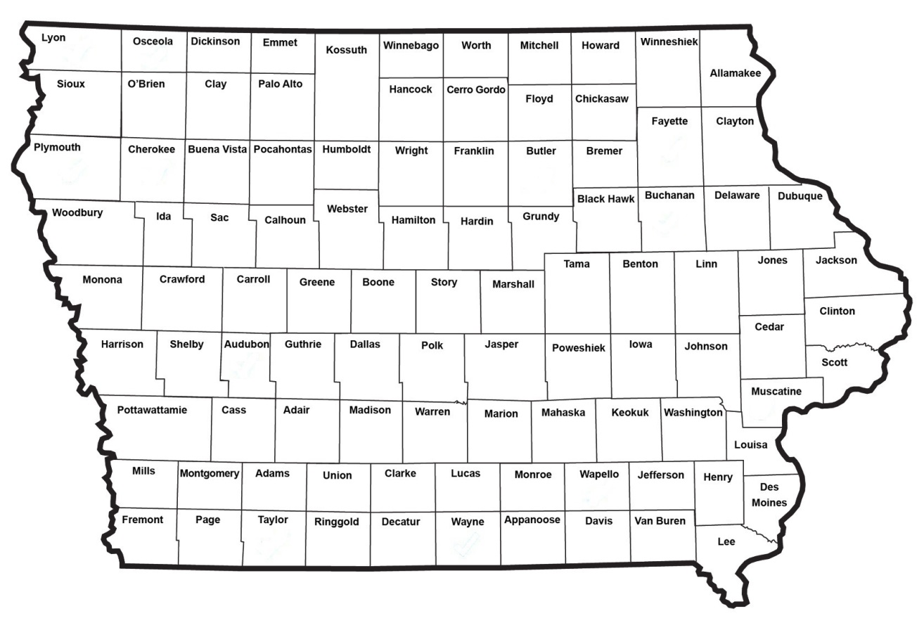
Map of Applications Received
Application received and award recommended
Application received and not recommended for funding

Slide 9

QUESTIONS?
Ed Engle, Modal Transportation Bureau, Rail Team
Edward.Engle@iowadot.us
515-239-1058

Slide 10
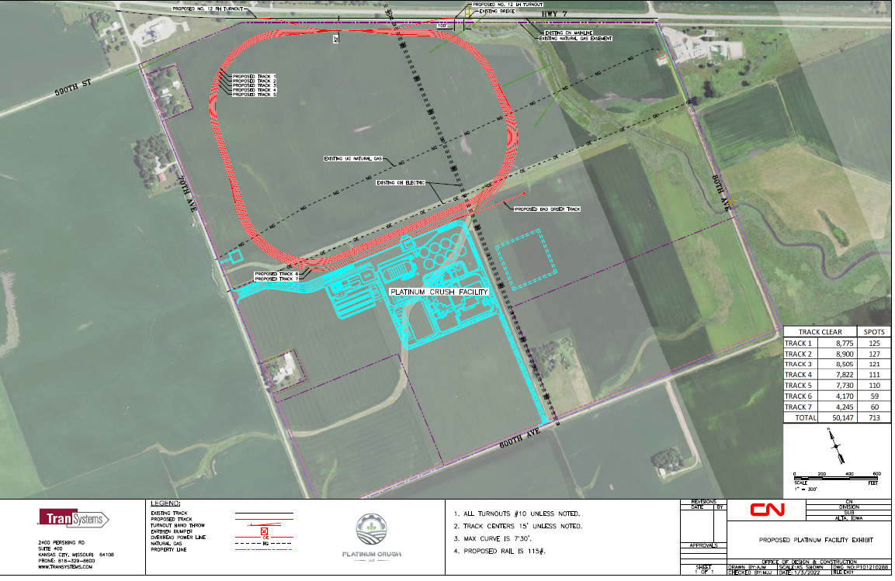
Soybean Crush Plant – Alta
Company is building a plant in Alta, Iowa to process soybeans into soybean meal and soybean oil. They will be shipping the products via the Canadian National Railroad.
Total Rail Cost: $14,070,389
Requested: $2,612,000 Recommended: $2,612,000
Return to Recommendation Summary
Notes:
Platinum Crush is building a new soybean crush plant that will procure soybeans and process them into livestock feed and vegetable oil. The $37M plan includes a private loop track that can accommodate 5 unit trains.
Job creation: 51 jobs at an average $22.32/hour.

Slide 11
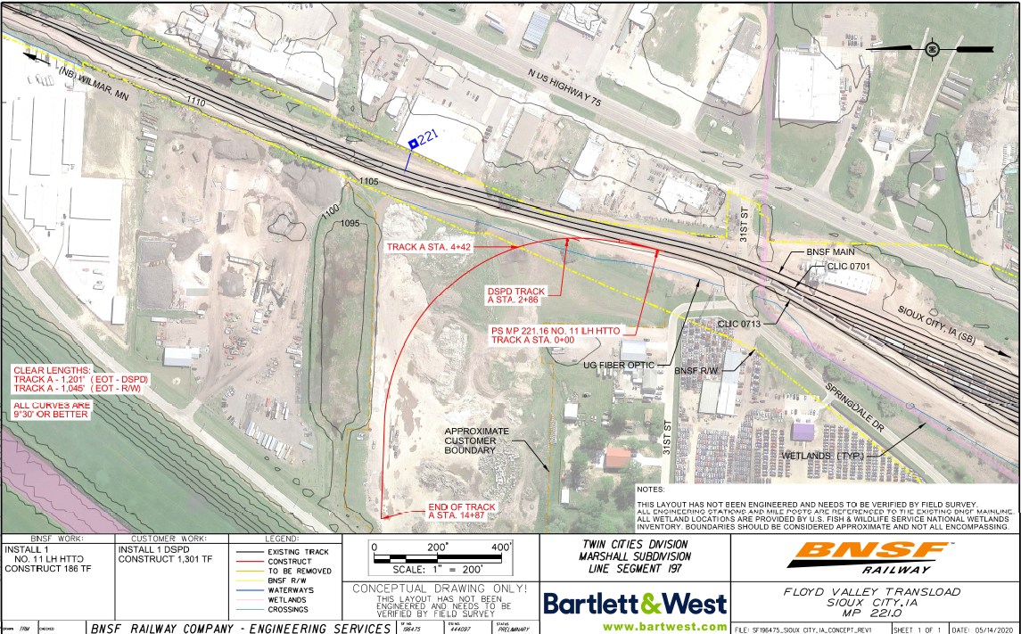
Floyd Valley Transload
The company is building a transload for shipping to and from the Sioux City, IA area. The proposed project will add the needed railroad infrastructure (switch and track) to create the transload and connect to the BNSF railroad.
Total Cost: $981,000
Requested: $784,800 Recommended: $784,800
Return to Recommendation Summary

Slide 12
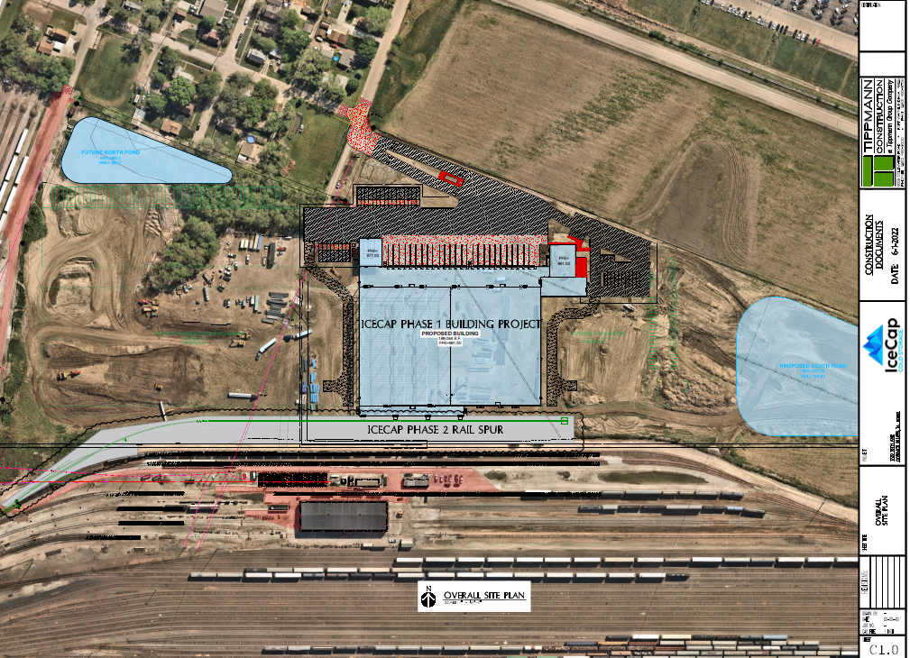
IceCap Cold Storage
Project will provide cold storage and transload of perishable products, with significant cold-storage capacity and connection to the UP railroad.
Total Cost: $2,412,166
Requested: $1,521,124 Recommended: $1,079,315
Return to Recommendation Summary
Notes:
Phase 2 of the Cold Storage project includes 1,458 feet of rail track and spur that will provide access to the IceCap Cold Storage facility and future expansion.

Slide 13
CP Unit Train Expansion (Pattison Sand V)
The project will construct rail to add an additional 400 feet of track for three spurs.
Total Cost: $2,700,000
Requested: $2,000,000 Recommended: $1,650,000
Return to Recommendation Summary

Slide 14
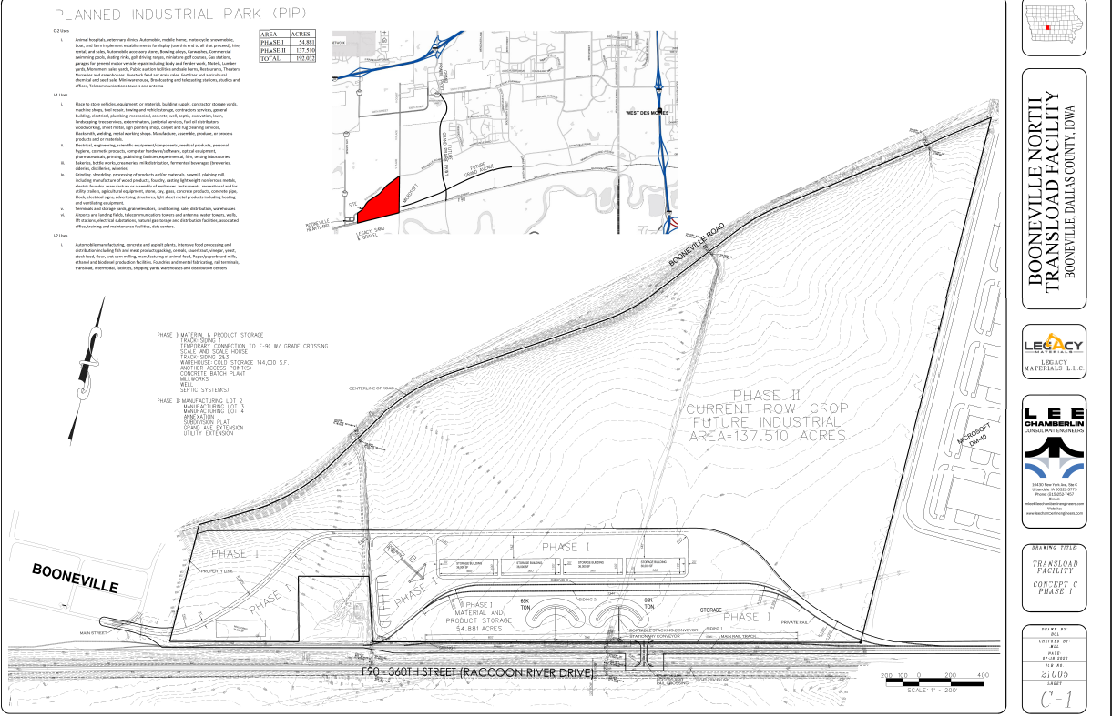
Booneville North Transload Facility
The purpose of the study is to determine the feasibility of a transload facility to serve Dallas County. The study will determine the current and future needs of the area and prepare a plan for an efficient rail transportation to meet those needs.
Total Cost: $125,000
Requested: $100,000 Recommended: $100,000
Return to Recommendation Summary
Notes:
Booneville North Transload Facility
The purpose of the study is to determine the feasibility of a transload facility to serve Dallas County. The study will determine the current and future needs of the area and prepare a plan for an efficient rail transportation to meet those needs.

Slide 15
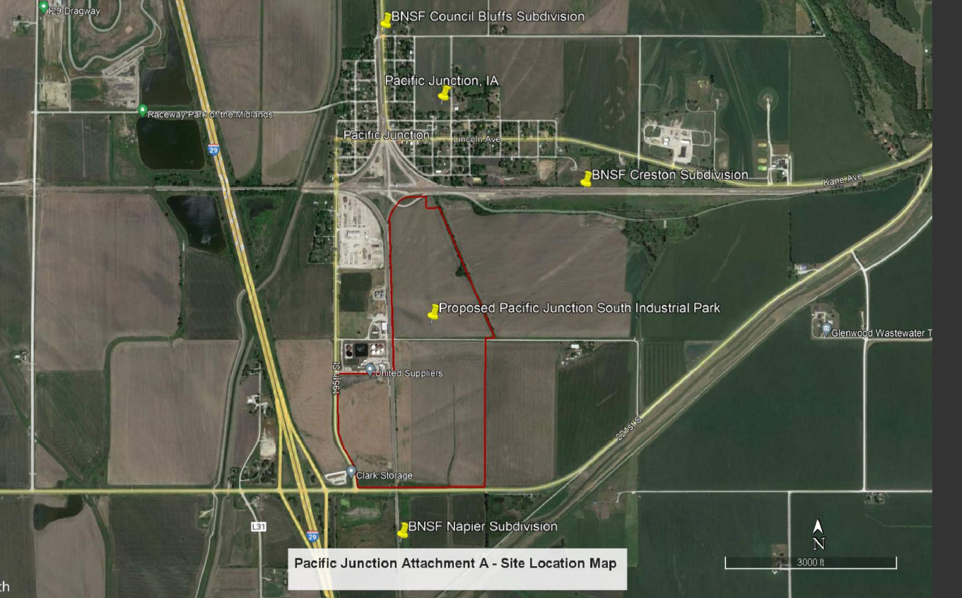
Pacific Junction South Industrial Park Transload Planning Study
The Mills County Economic Development Foundation seeks to develop approximately 217 acres of land located south of Pacific Junction, Iowa into a railport/transload facility. The development study will assess the feasibility of the facility and determine the economic impacts to the city, county, and region.
Total Cost: $103,050
Requested: $82,440 Recommended: $82,440
Return to Recommendation Summary
Notes:
Pacific Junction South Industrial Park Transload Planning Study
The Mills County Economic Development Foundation seeks to develop approximately 217 acres of land located south of Pacific Junction, Iowa into a railport/transload facility. The development study will assess the feasibility of the facility and determine the economic impacts to the city, county, and region.

Slide 16
Central Iowa Railport & Logistics Park Phase 2
Project includes adding 1 mile+ new rail and replace/upgrade/make accessible 1.5 mile+ of existing rail, adding additional transloading service capacities and capabilities.
Total Cost: $7,687,358
Requested: $6,149,866 Recommended: $0
Return to Recommendation Summary
Notes:
Due to limited funding for FY ‘22, we are not recommending funding for the Ten C/Merchants Phase 2 project.

