Slide 1
FY 2024 Highway-Railroad Crossing Safety Program
September 13, 2022

Slide 2
Program
FHWA Funding available for states to improve warning devices at railroad crossings. (23 USC Section 130)
Amount of appropriation funded by FHWA is determined by the number of public railroad crossings in the state.
Iowa currently has 4,864 public railroad crossings.

Slide 3
Project Evaluation Criteria
Benefit-Cost Ratio
Formula includes:
Number of accidents
Exposure Index, (number of trains x number of vehicles)
Train traffic
Vehicle traffic
Predicted Accidents, (train speed, roadway speed, number of traffic lanes, number of tracks)
Existing warning devices vs. possible upgrades
On-site safety diagnostic review
A project application must be filed with the department

Slide 4
Available Funding and Application Summary
Previous: 90% Federal Funds from FHWA /10% match by Highway Authority or Railroad
New: 100% FHWA funded
Number of projects: 21 (19 & 3 closure incentives)
Total project costs/ FHWA funds: $8,120,000
Annual Apportionment: $5,178,586
Additional funds (7 cancelled projects): + $2,395,000 (1-UP / 1-DME/ 6-BNSF) $7,573,586
Difference: - $546,414

Slide 5
List of Applications Recommended
PROJECT NAME | SPONSOR | SCORE | TOTAL PROJECT COST | REQUESTED AMOUNT (% of Total Project Cost) | RECOMMENDED AMOUNT (% of Total Project Cost)
Arabian Road, 307816K | CCP Railroad Linn County | 49.34 | $405,000 | $405,000 (100%) | $405,000 (100%)
150th Street, 197056P | UP Railroad Kossuth County | 22.36 | $470,000 | $470,000 (100%) | $470,000 (100%)
T-47/ Packard Ave., 607425U | IANR Railroad Butler County | 16.00 | $300,000 | $300,000 (100%) | $300,000 (100%)
210th Street, 375972F | DME Railroad Scott County | 7.52 | $460,000 | $460,000 (100%) | $460,000 (100%)
S Canfield Road, 307097B | CCP Railroad Black Hawk County | 2.93 | $400,000 | $400,000 (100%) | $400,000 (100%)
170th Street 082335P | BNSF Railroad Lyon County | 2.84 | $395,000 | $395,000 (100%) | $395,000 (100%)

Slide 6
List of Applications Recommended
PROJECT NAME | SPONSOR | SCORE | TOTAL PROJECT COST | REQUESTED AMOUNT (% of Total Project Cost) | RECOMMENDED AMOUNT (% of Total Project Cost)
73rd Street, 377213D | IAIS Railroad City of Windsor Heights | 2.40 | $400,000 | $400,000 (100%) | $400,000 (100%)
Camp Cardinal Blvd., 606887G | IAIS Railroad City of Coralville | 2.13 | $400,000 | $400,000 (100%) | $400,000 (100%)
12th Avenue, 840173H | CRANDIC Railroad City of Coralville | 2.13 | $275,000 | $275,000 (100%) | $275,000 (100%)
S Central Avenue, 385747R | DME Railroad City of Hartley | 1.90 | $495,000 | $495,000 (100%) | $495,000 (100%)
Grand Avenue, 385428X | DME Railroad City of Charles City | 1.78 | $500,000 | $500,000 (100%) | $500,000 (100%)

Slide 7
List of Applications Recommended
PROJECT NAME | SPONSOR | SCORE | TOTAL PROJECT COST | REQUESTED AMOUNT (% of Total Project Cost) | RECOMMENDED AMOUNT (% of Total Project Cost)
9th Street NW, 607880M | IAIS Railroad City of Altoona | 1.71 | $350,000 | $350,000 (100%) | $350,000 (100%)
IA 70, 606850S | IAIS Railroad Iowa DOT | 1.61 | $325,000 | $325,000 (100%) | $325,000 (100%)
245th Avenue, 078040R | BNSF Railroad Lee County | 1.50 | $425,000 | $425,000 (100%) | $425,000 (100%)
490th Avenue, 385645X | DME Railroad Palo Alto County | 1.43 | $350,000 | $350,000 (100%) | $350,000 (100%)
Wapello Avenue, 607146Y | DME Railroad City of Davenport | 1.08 | $475,000 | $475,000 (100%) | $475,000 (100%)

Slide 8
List of Applications Recommended
PROJECT NAME | SPONSOR | SCORE | TOTAL PROJECT COST | REQUESTED AMOUNT (% of Total Project Cost) | RECOMMENDED AMOUNT (% of Total Project Cost)
US 18, 599322V | IANR Railroad Iowa DOT | 0.27 | $450,000 | $450,000 (100%) | $450,000 (100%)
137th Trail, 979303R | BNSF Railroad Lucas County | 0 * | $445,000 | $445,000 (100%) | $445,000 (100%)
Jefferson Street, 063019R | BNSF Railroad City of Burlington | 0** | $500,000 | $500,000 (100%) | $500,000 (100%)
3 projected closure incentive payments at various locations ($100,000 per location) | TBD | N/A | $300,000 | $300,000 (100%) | $300,000 (100%)
*BNSF and the county are demolishing a turn of the 20th century wagon bridge and creating a new at-grade railroad crossing. The new at-grade railroad crossing does not yet exist so a B/C score cannot be computed. The new railroad crossing will need active warning devices to protect motorists on this busy roadway.
** A city of Burlington TIGER grant roadway project necessitates the relocation of the existing railroad crossing signals.

Slide 9
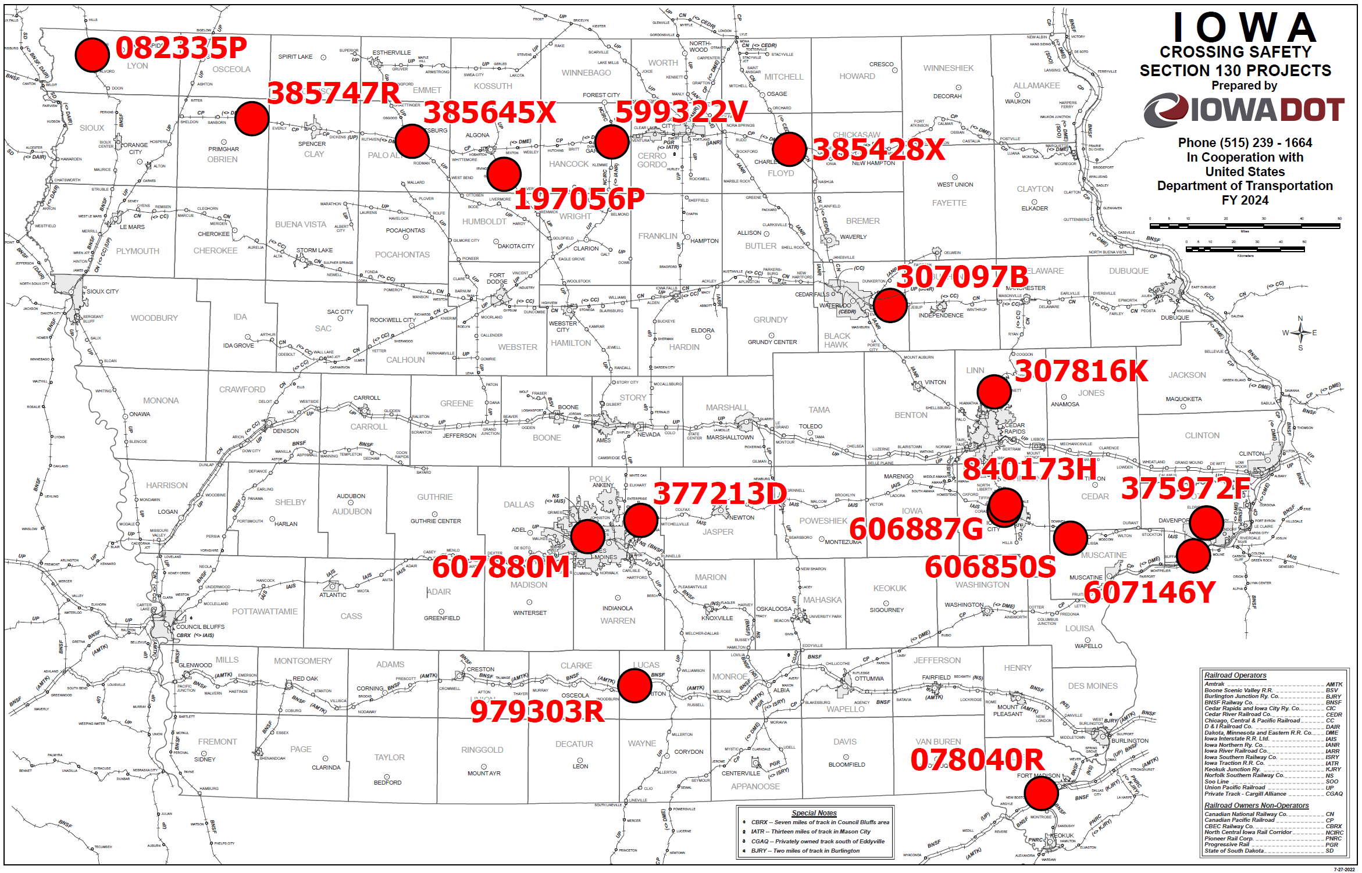
Map of Recommended Awards
607425U
063019R

Slide 10
QUESTIONS?
Kris Klop
Manager, Highway-Rail Crossing Programs
kristopher.klop@iowadot.us

