Slide 1
FY 2024 Highway-Railroad Crossing
Surface Repair Program
September 13, 2022

Slide 2
Program
Highway-Railroad crossing surface repair program incentivizes railroads and roadway authorities to participate in the cooperative repair of crossing surfaces.
Project funding breakdown:
60% State
20% Roadway authority
20% Railroad
Responsibilities:
Railroad: Replacement of rock (ballast), ties, track, underlayment, and crossing panels
Roadway Authority: Replacement of crossing approaches and existing sidewalks (ADA compliant), road closures and detours

Slide 3
Project Evaluation Criteria
Projects are funded in the order the applications are received, except that up to 50% of the program allocation can be used in a discretionary manner.
All 29 crossings currently in the program queue were scored according to the following criteria:
Type of route the crossing is on, (crude oil, ethanol, passenger)
Average daily vehicle traffic / train traffic
Exposure index, (number of trains x number of cars)
Predicted Accidents, (train speed, roadway speed, number of traffic lanes, number of tracks)
Planned concurrent roadway projects
On-site inspection
Maximum score possible: 35 points
Final Projects
The five highest scored crossings were brought forward to be funded in addition to those already scheduled to be funded for FY 2024 for a total of 11 projects.
Associated railroads and roadway authorities were contacted and confirmed they were able to participate with funding and repairs.

Slide 4
Available Funding and Application Summary
Crossing Surface Repair Program receives an annual statutory appropriation of $900,000 (off-the-top of the Road Use Tax Fund)
Program funding queue currently has 29 submitted applications.
Number of projects:
6 - in order received
5 - with scoring
11 - total
Total program funding request: $1,078,386
In order received: $571,200 / 53%
Scored: $507,186 / 47%
Annual appropriation $900,000
One cancelled project last year: + $206,400
Available funding for FY 2024: $1,106,400

Slide 5
List of Applications Recommended
PROJECT NAME | SPONSORS | SCORE | TOTAL PROJECT COST | REQUESTED AMOUNT (% of Total Project Cost) | RECOMMENDED AMOUNT (% of Total Project Cost)
29th Street NE, 307841T | CP Railroad City of Cedar Rapids | N/A Order Received | $200,000 | $120,000 (60%) | $120,000 (60%)
Wright Brothers E., 840224R | CRANDIC Railroad City of Cedar Rapids | N/A Order Received | $150,000 | $90,000 (60%) | $90,000 (60%)
60th Ave. SW, 840198D | CRANDIC Railroad City of Cedar Rapids | N/A Order Received | $110,000 | $66,000 (60%) | $66,000 (60%)
Waconia Ave. SW, 840199K | CRANDIC Railroad City of Cedar Rapids | N/A Order Received | $100,000 | $60,000 (60%) | $60,000 (60%)

Slide 6
List of Applications Recommended
PROJECT NAME | SPONSORS | SCORE | TOTAL PROJECT COST | REQUESTED AMOUNT (% of Total Project Cost) | RECOMMENDED AMOUNT (% of Total Project Cost)
Kirkwood Ave., 607307S | CRANDIC Railroad City of Iowa City | N/A Order Received | $80,000 | $48,000 (60%) | $48,000 (60%)
Grand Avenue, 377221V | IAIS Railroad City of Des Moines | N/A Order Received | $247,000 | $148,200 (60%) | $148,200 (60%)
Old Military Road, 607355V | DME Railroad Washington County | 35 | $100,000 | $60,000 (60%) | $60,000 (60%)

Slide 7
List of Applications Recommended
PROJECT NAME | SPONSORS | SCORE | TOTAL PROJECT COST | REQUESTED AMOUNT (% of Total Project Cost) | RECOMMENDED AMOUNT (% of Total Project Cost)
Camp Cardinal Blvd., 606887G | IAIS Railroad City of Coralville | 26 | $175,000 | $105,000 (60%) | $105,000 (60%)
Cedar Waspi Road, 607625D | IANR Railroad Black Hawk County | 25 | $90,000 | $54,000 (60%) | $54,000 (60%)
East St/N Finn Drive 390124S | DME Railroad City of Algona | 24 | $191,843 | $115,106 (60%) | $115,106 (60%)
Augusta Avenue, 608027T | IAIS Railroad City of Oxford | 22 | $308,416 | $185,050 (60%) | $185,050 (60%)

Slide 8
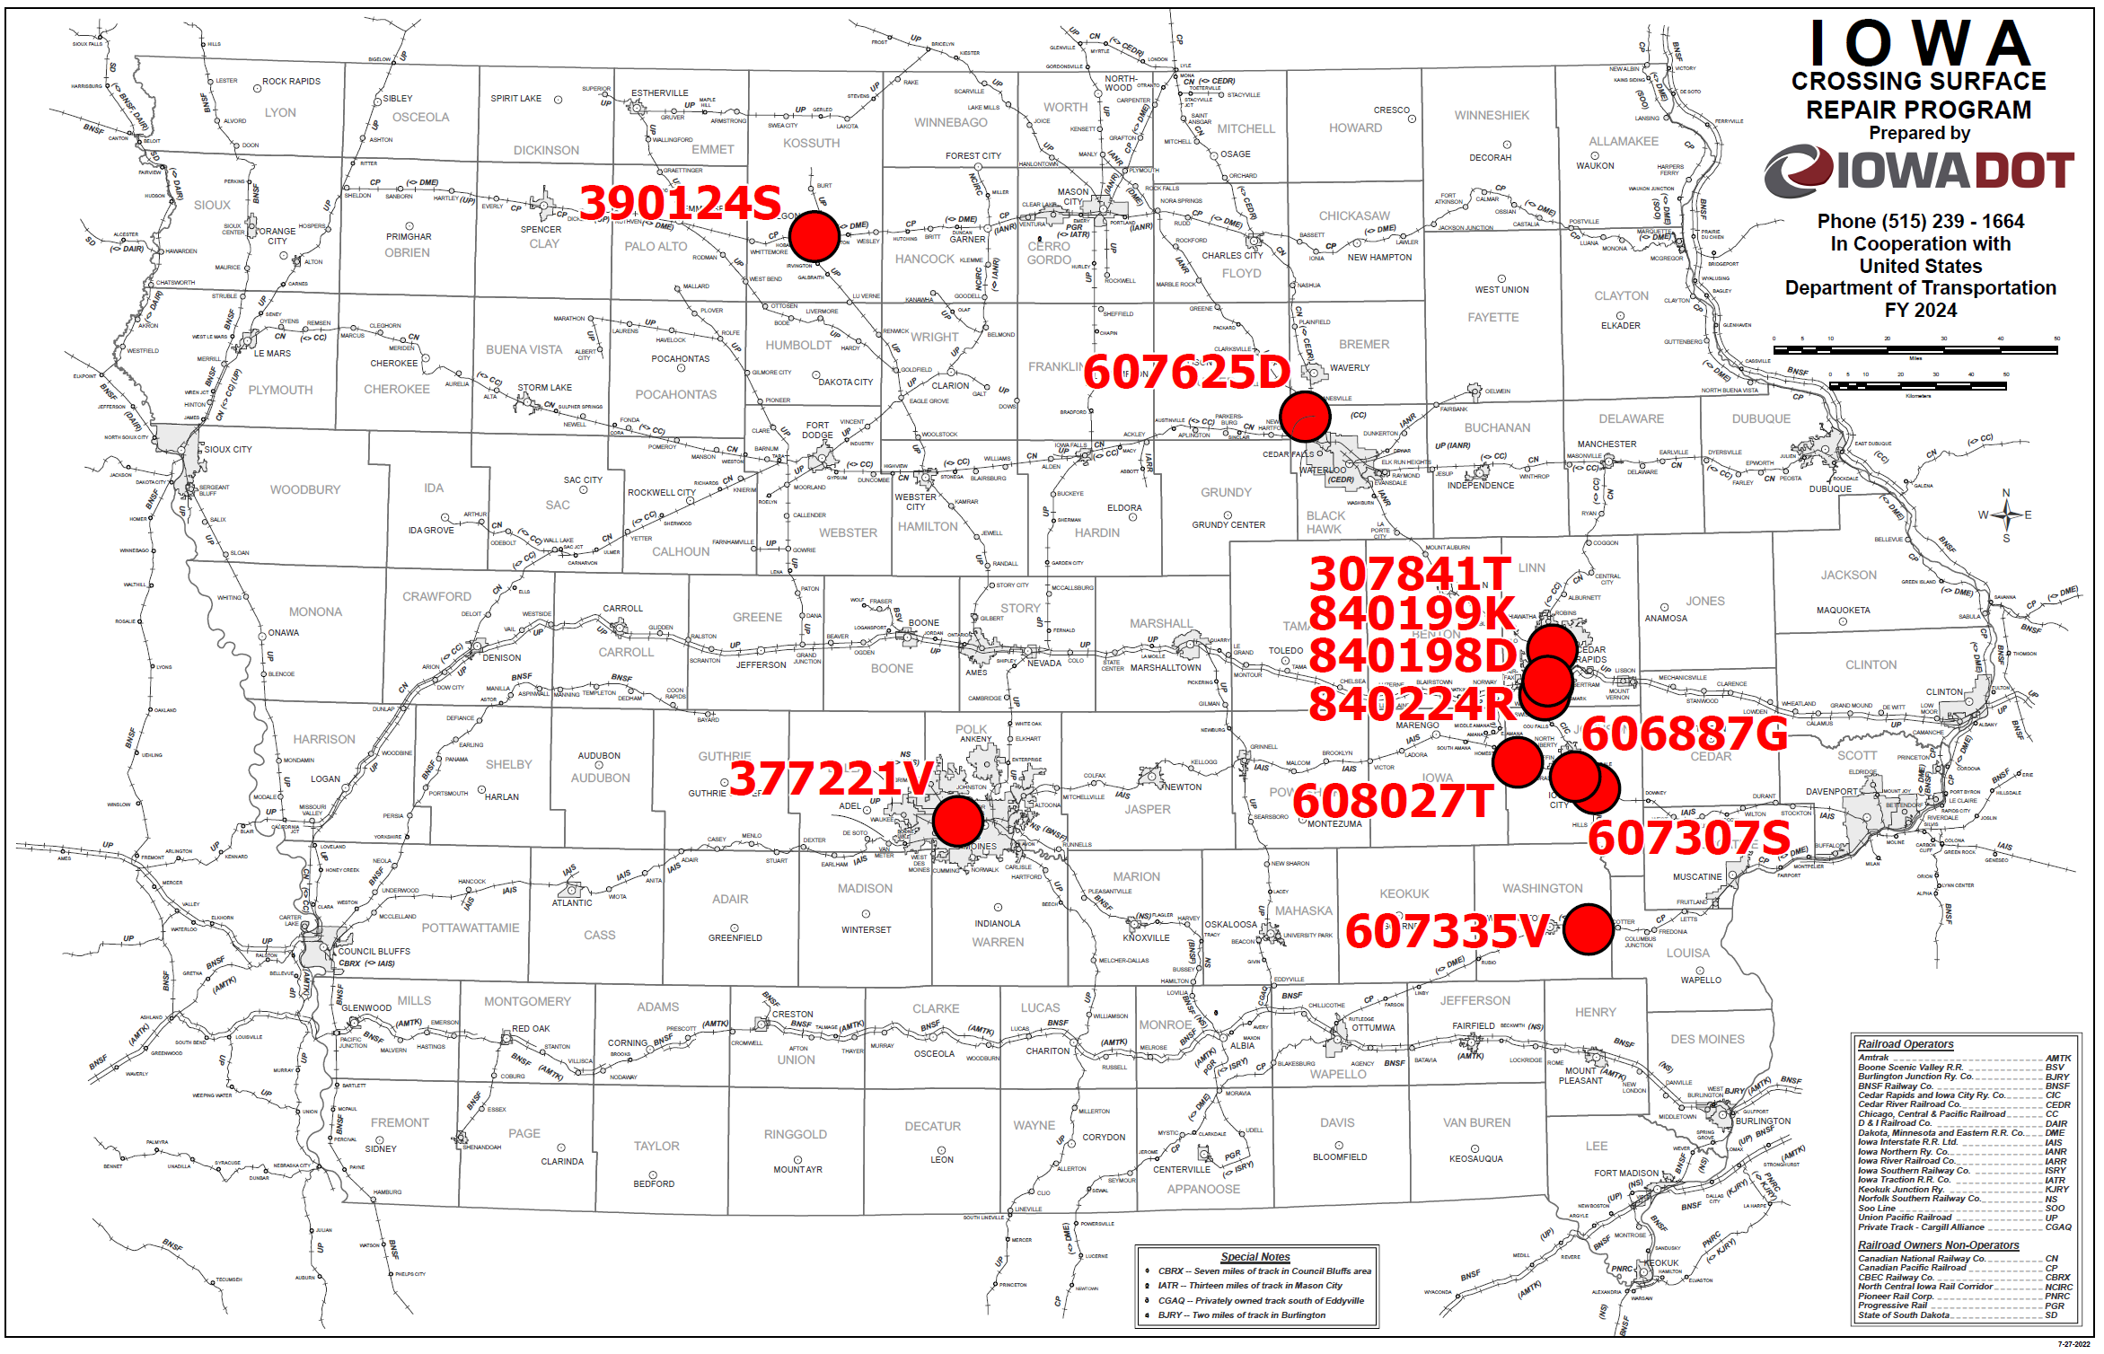
Map of Recommended Awards

Slide 9
QUESTIONS?
Kristopher Klop
Manager, Highway-Rail Crossing Programs
kristopher.klop@iowadot.us

