Slide 1
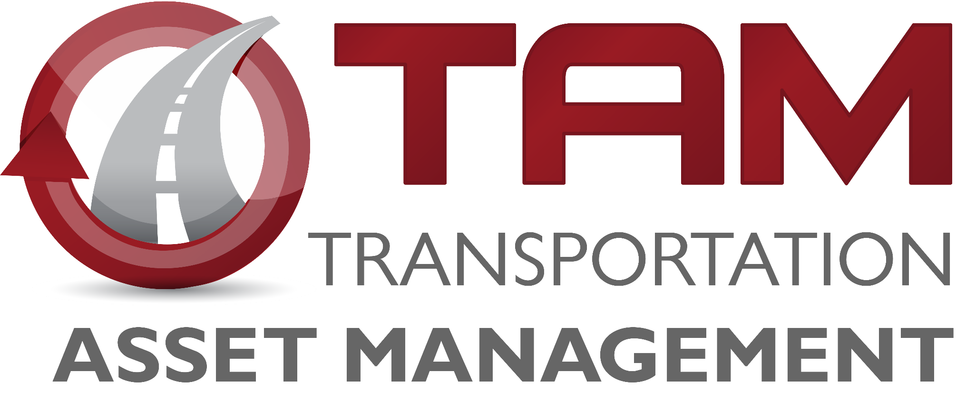

Transportation Asset Management (TAM) Overview
Charlie Purcell
Deputy Director, Transportation Development Division
Transportation Commission Workshop
September 13, 2022

Slide 2

Presentation Outline
What is TAM?
Why is TAM important?
What are we doing to implement TAM?
Preview of upcoming TAM presentations

Slide 3
What is TAM?

Slide 4

TAM is:
Making the right investments at the right time in order to maximize the benefits to the transportation system while minimizing the costs
Both an art and a science

Slide 5
Why is TAM important?

Slide 6
TAM helps us:
Build, preserve, operate, maintain, upgrade, and expand the transportation system more cost-effectively throughout its whole life.
Improve performance of the transportation system.
Deliver to Iowa DOT’s customers the best value for every dollar spent
Enhance Iowa DOT’s credibility and accountability in its stewardship of transportation assets

Slide 7
TAM saves money

Slide 8
New Investment
Along with state transportation plan directions and priorities, our asset management tools will guide recommendations for how additional infrastructure funding should be utilized.
Spending wisely on the needs of our existing system will help us maximize benefits to the entire transportation system

Slide 9
What are we doing to implement TAM?

Slide 10
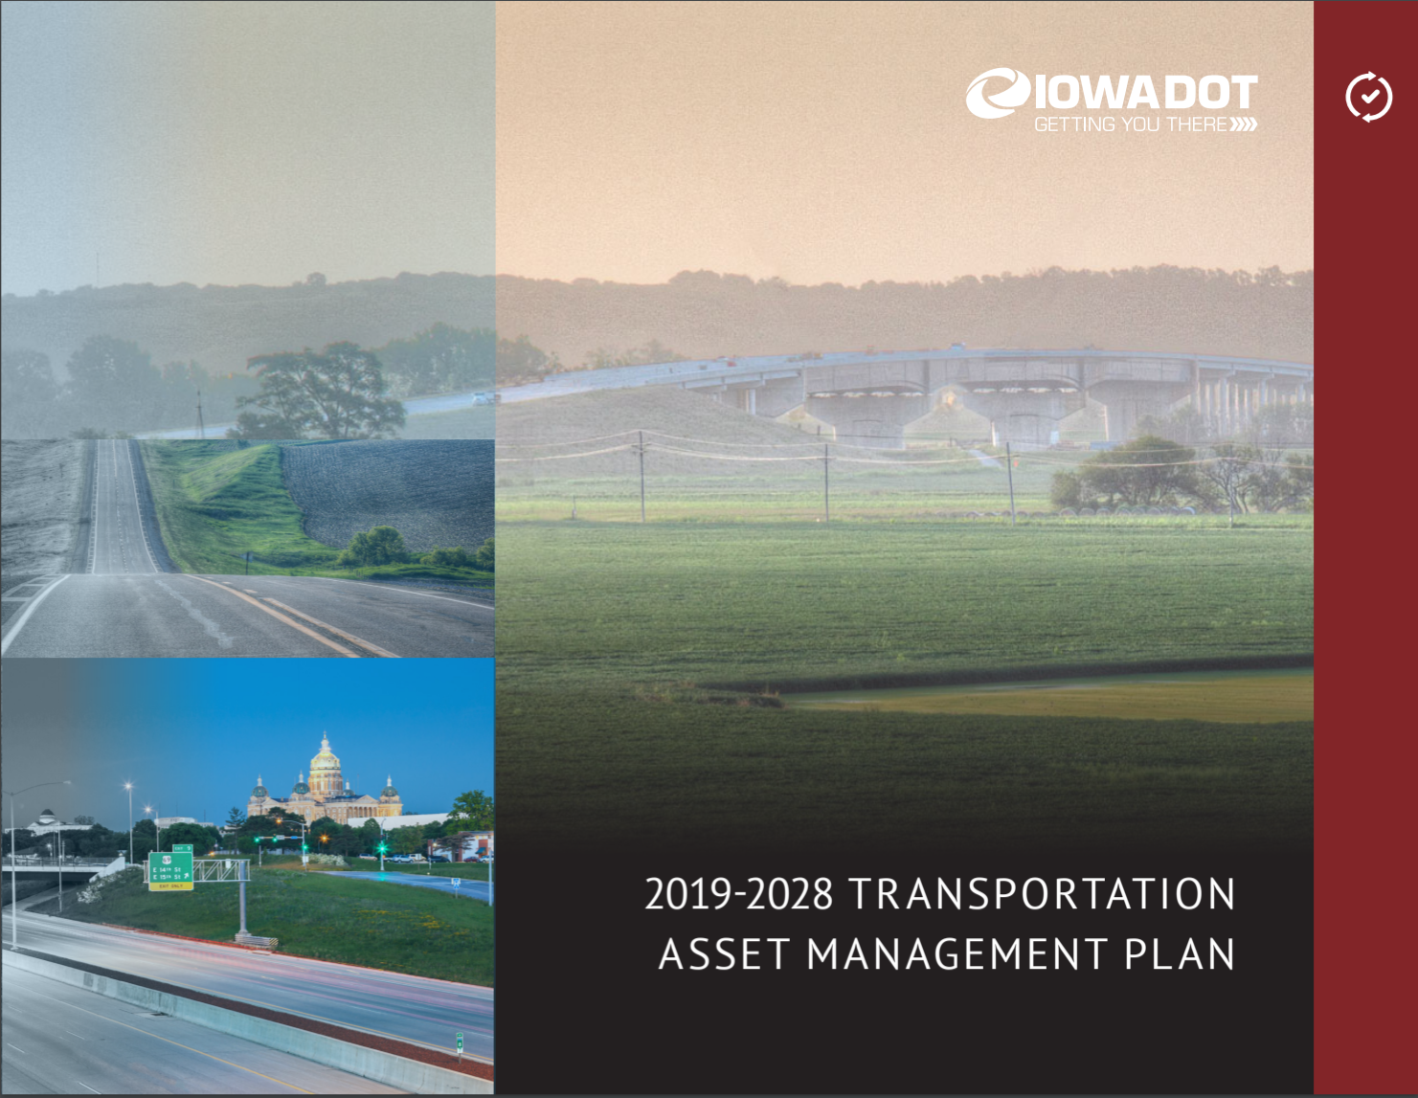
We have a plan (we call it our TAMP)
TAMP Objectives
Defines clear links among agency goals, objectives, and decisions
Defines the relationship between proposed funding levels and expected results
Develops a long-term outlook for asset performance
Documents how decisions are supported by sound information
Develops a feedback loop from observed performance to subsequent planning and programming decisions
Improves accountability for decision making
Unifies existing data, business practices, and divisions to achieve Iowa DOT’s asset management goals

Slide 11
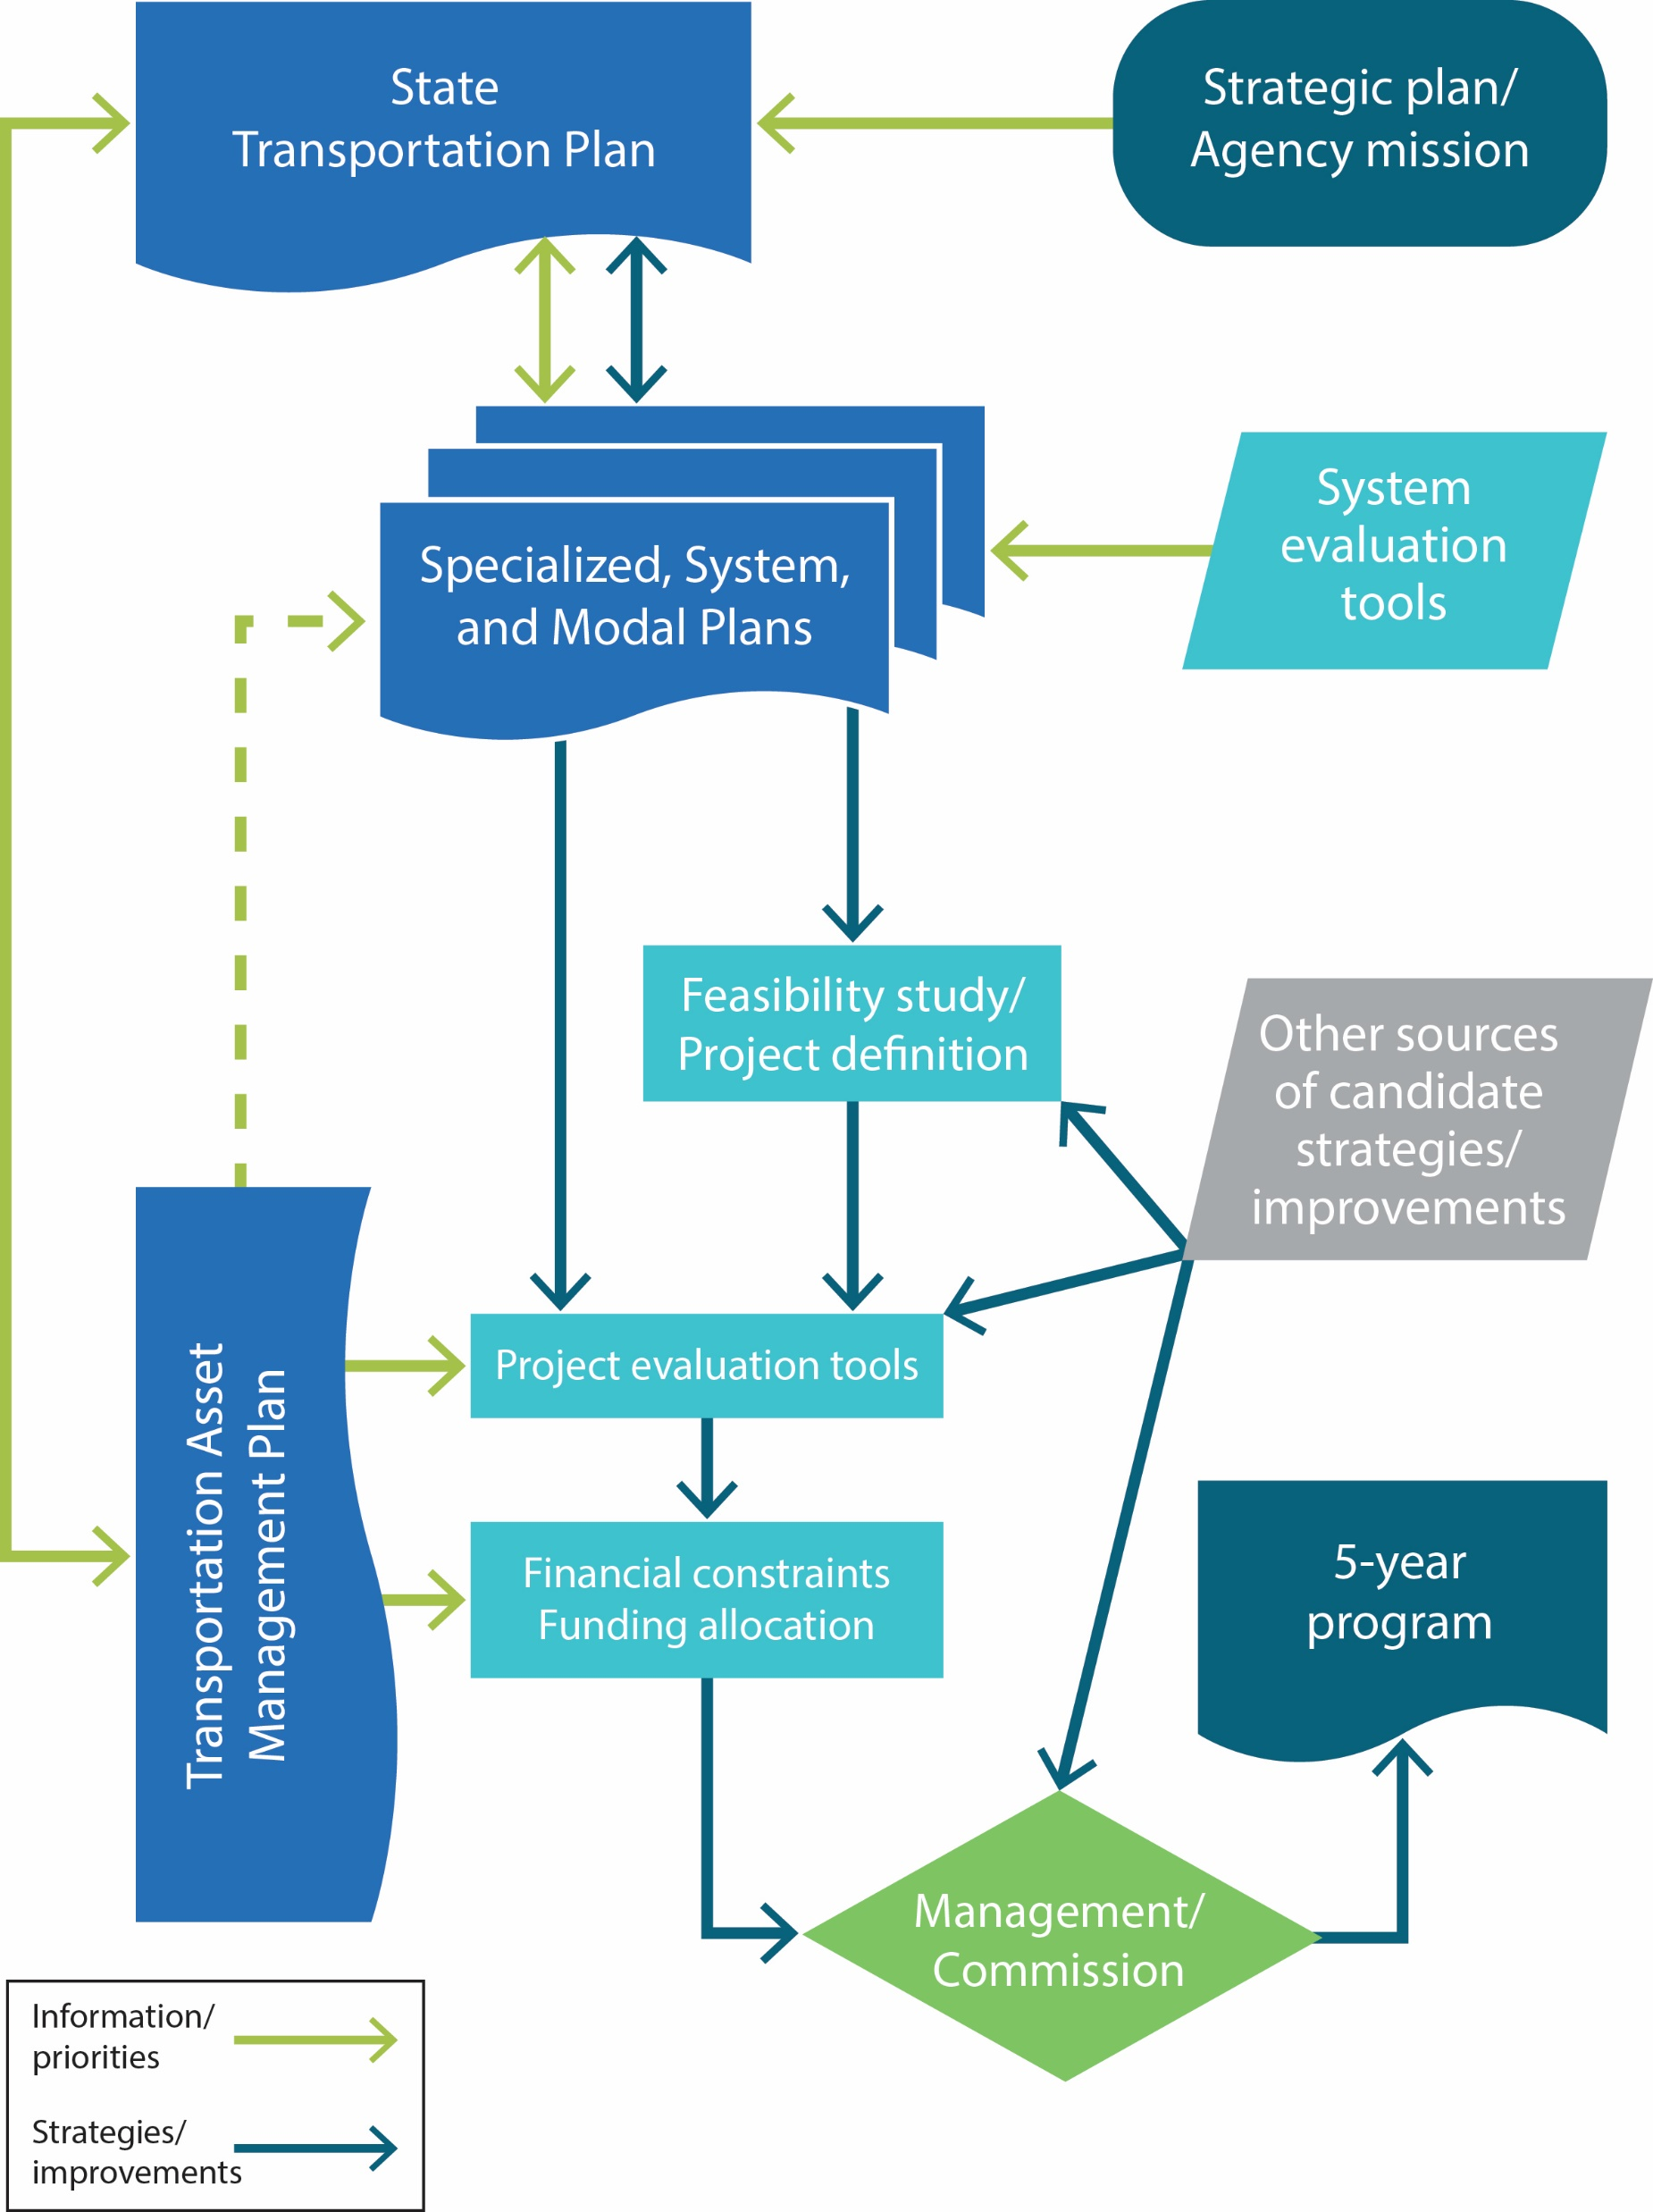
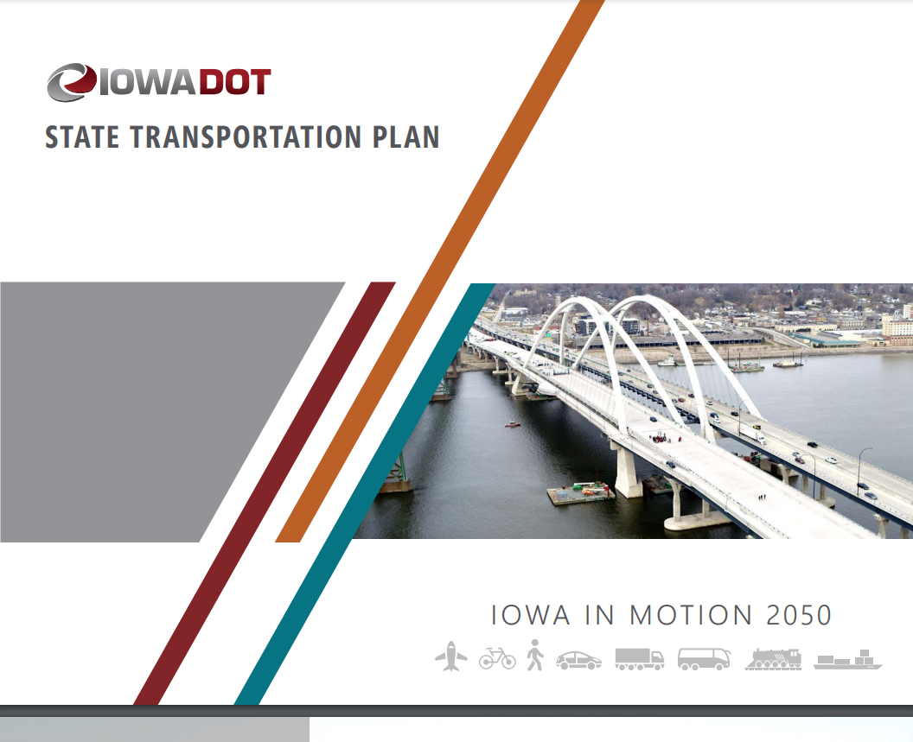
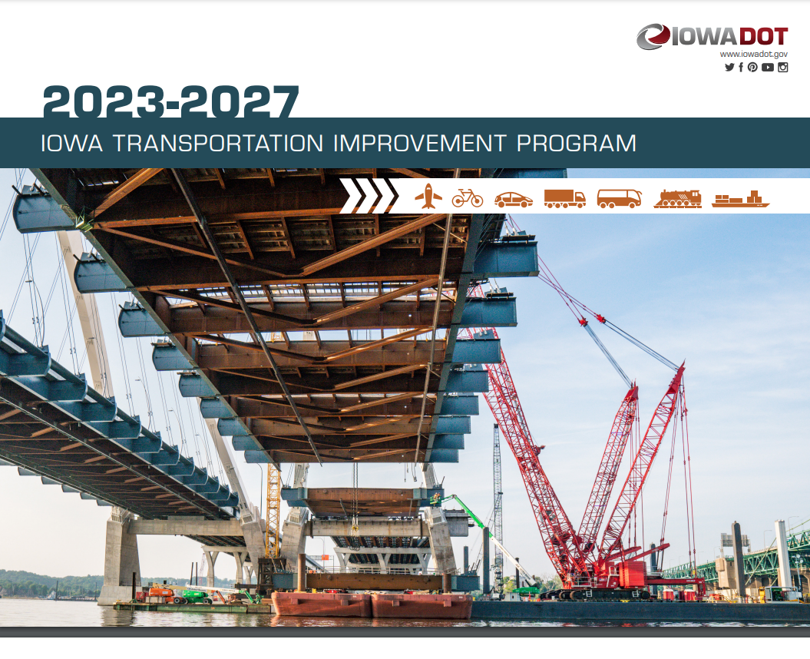
How does the TAMP fit in the planning and programming process?

Slide 12
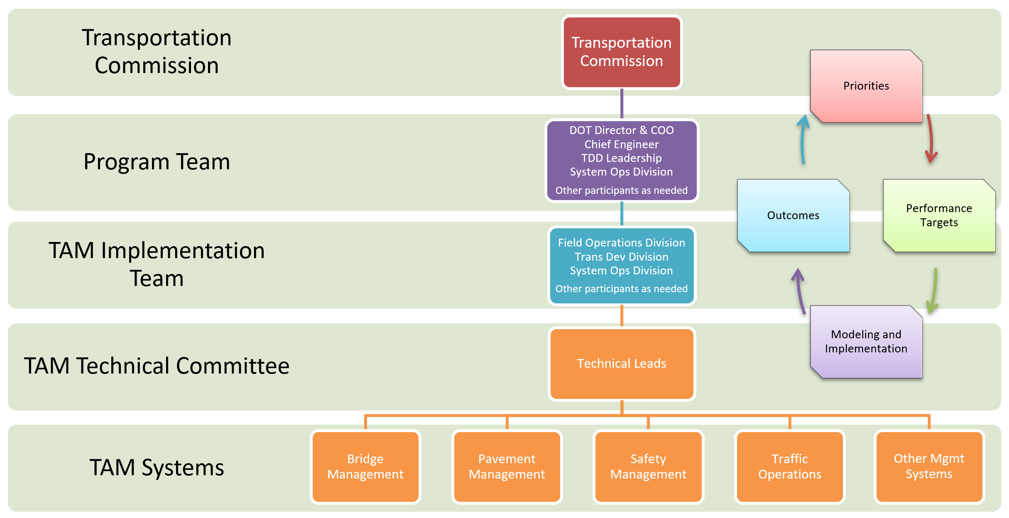
TAM Governance Structure

Slide 13
Upcoming TAM presentations

Slide 14
Upcoming TAM Presentations
Presentation | Objectives
Bridge management | Review of current bridge conditions Present different investment scenarios and resulting conditions
Pavement management | Review of current pavement conditions Present different investment scenarios and resulting conditions
Interstate Investment Plan | Present updated recommendations for timing and location of future capacity and stewardship investments Request input on proposed schedule and funding level Include a “preview” of revisions to the options list for major Interstate projects
Trade-off analysis | Present recommendations for investment levels (pavement vs. bridge, capacity vs. stewardship) Receive feedback on proposed investment levels

Slide 15
Questions?

