Slide 1
Transportation Trends Update
Transportation Commission Workshop
September 12, 2023

Slide 2
Overview
US total rail carloads
Commercial air service passenger counts
Vehicular traffic
Mississippi River

Slide 3
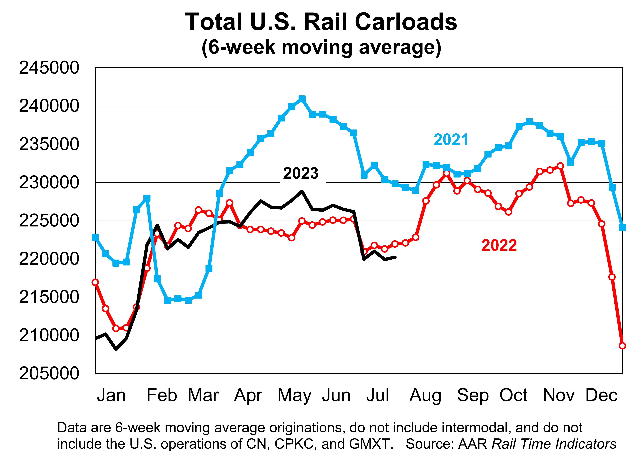

Slide 4
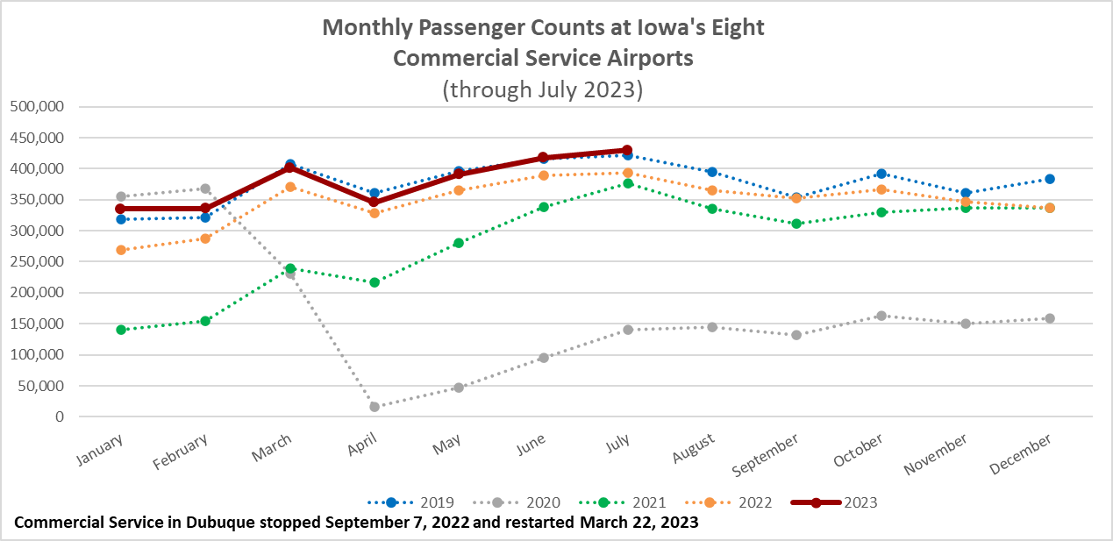

Slide 5
Monthly State Vehicle Miles of Travel
(through July 2023)

Slide 6
Mississippi River
Water levels have been falling since June and expected to continue to drop.
Result is barges are not fully loaded with grain causing reduced barge supply.
Barge transport rates are higher because of the tight supply.

Slide 7
Questions?

