Slide 1
State Recreational Trails Program
Funding Recommendation

Slide 2
State Recreational Trail Program
Created in 1988
Available to cities, counties, state agencies, local governments, or non-profit organizations through an application program
Purpose is to establish recreational trails in Iowa for the use, enjoyment and participation of the public.

Slide 3
Project Evaluation Criteria
Need in terms of population to be served and existing trails in the area (25 points)
Compatibility with local, areawide, regional or statewide plans (15 points)
Benefits of multiple uses and recreational opportunities (20 points)
Quality of the site (25 points)
Economic benefits to the local area (10 points)
Special facilities for disabled users (5 points)
Project is "shovel ready“ and will be completed by 6-30-2025 (25 points)
Projects with cash match (5 points)

Slide 4
Available Funding and Application Summary
Available Funding:
FY 2023 Legislative appropriation from the Rebuild Iowa Infrastructure Fund: $2,500,000
Underruns from closed projects: $ 253,115
Total available funding: $2,753,115
Application Summary:
Total number of projects: 44
Total project costs: $44,610,141
Total amount requested: $21,507,764

Slide 5
List of Applications Recommended
PROJECT NAME | SPONSOR | SCORE | TOTAL PROJECT COST | REQUESTED AMOUNT (% of Total Project Cost) | RECOMMENDED AMOUNT (% of Total Project Cost)
Raccoon River Valley Trail to High Trestle Trail Connector Phase VI | Dallas County Conservation Board | 116 | $2,072,127 | $675,000 (33%) | $675,000 (33%)
Red Rock Prairie Trail: Prairie City to Mitchellville | Jasper County Conservation Board | 108 | $2,439,800 | $499,800 (20%) | $499,800 (20%)
Fontana Park Learning and Discovery Trail | Buchanan County Conservation Board | 102 | $547,674 | $238,534 (44%) | $238,534 (44%)
Hoover Trail Bridge #2 | Cedar County Conservation Board | 100 | $320,000 | $130,000 (41%) | $130,000 (41%)
Jump to applications not recommended for funding

Slide 6
List of Applications Recommended
PROJECT NAME | SPONSOR | SCORE | TOTAL PROJECT COST | REQUESTED AMOUNT (% of Total Project Cost) | RECOMMENDED AMOUNT (% of Total Project Cost)
Copper Creek Mountain Bike Park | Polk County Conservation Board | 100 | $1,450,000 | $400,000 (28%) | $400,000 (28%)
Little River Scenic Pathway Phase 2 | Decatur County Conservation Board | 97 | $480,000 | $346,913 (72%) | $346,913 (72%)
Ballpark to Ballpark Shelby County Trail Phase 2 | Shelby County | 96 | $898,975 | $672,980 (75%) | $462,868 (51%)
Jump to applications not recommended for funding

Slide 7
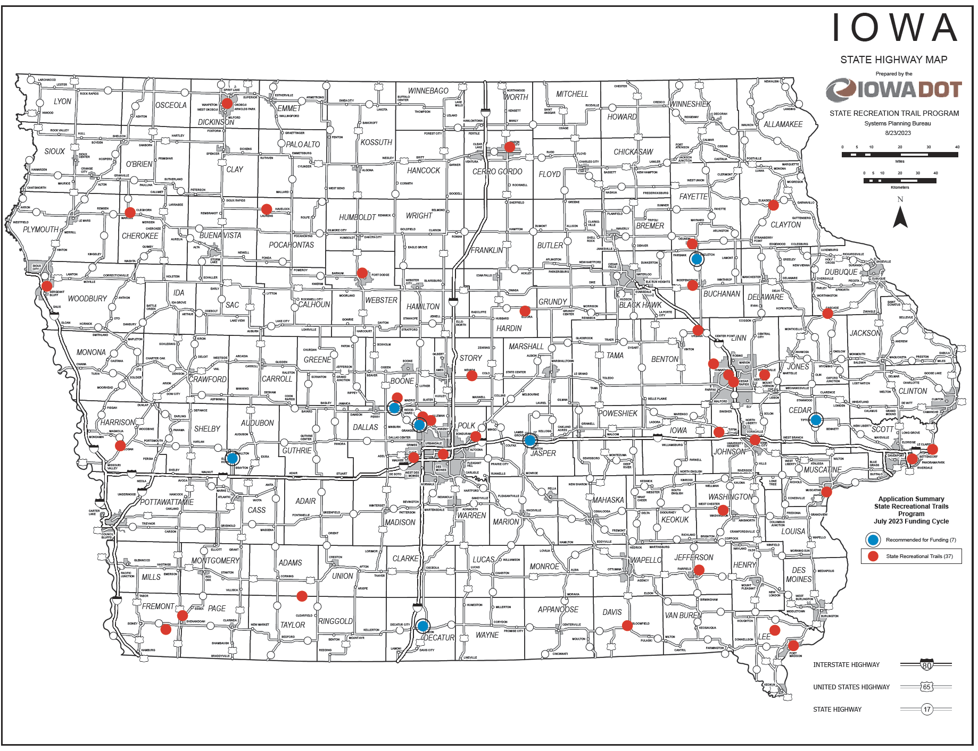
Map of Applications Received

Slide 8
QUESTIONS?
Scott Flagg, Systems Planning Bureau
Scott.Flagg@iowadot.us
515-239-1252

Slide 9
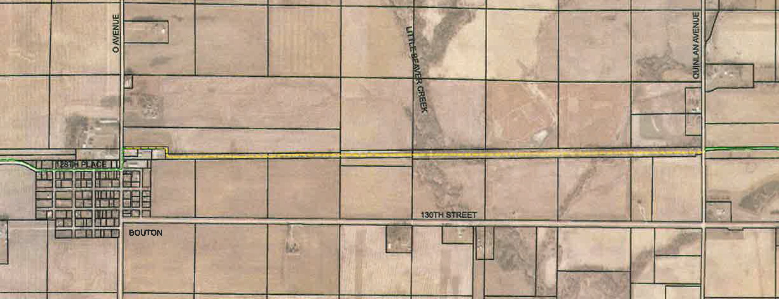
Raccoon River Valley Trail to High Trestle Trail Connector Phase VI (Dallas County Conservation Board)
This project will construct 2.0 miles of paved trail from O Avenue in Bouton to Quinlan Avenue where it will connect to the existing 25-mile High Trestle Trail. This is the final phase of the 9- mile connector trail between the High Trestle Trail and the 89-mile Raccoon River Valley Trail.
Total Cost: $2,072,127
Requested: $ 675,000 (33%)
Return to List of Applications Recommended

Slide 10
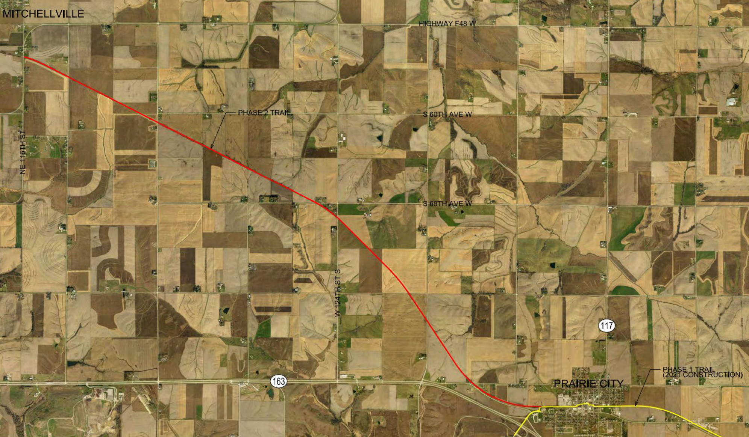
Red Rock Prairie Trail: Prairie City to Mitchellville (Jasper County Conservation Board)
Construction of this 7-mile trail will extend Red Rock Prairie Trail from Prairie City near Commerce Drive to Mitchellville at NE 116th Street. The Red Rock Prairie Trail currently extends 9 miles from Monroe to Prairie City.
Total Cost: $2,439,800
Requested: $ 499,800 (20%)
Return to List of Applications Recommended

Slide 11
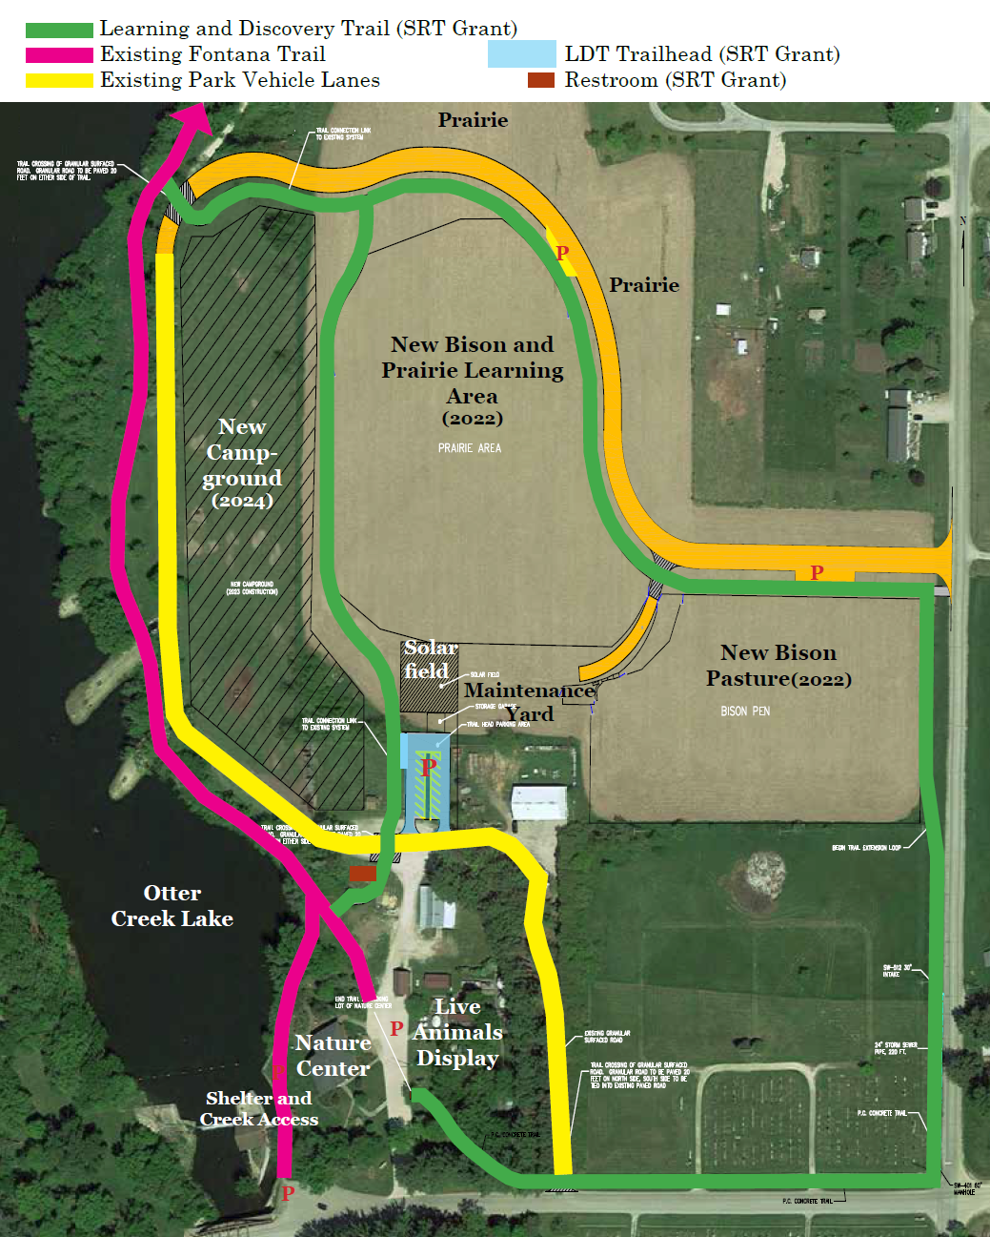
Fontana Park Learning and Discovery Trail (Buchanan County Conservation Board)
This project constructs a 0.9-mile ADA accessible trail loop through the existing Bison and Prairie Learning Area in Fontana Park connecting to the existing 2.2-mile Fontana Trail and includes a concrete-paved trailhead with ADA-accessible parking and vault restroom.
Total Cost: $547,674
Requested: $238,534 (44%)
Return to List of Applications Recommended

Slide 12
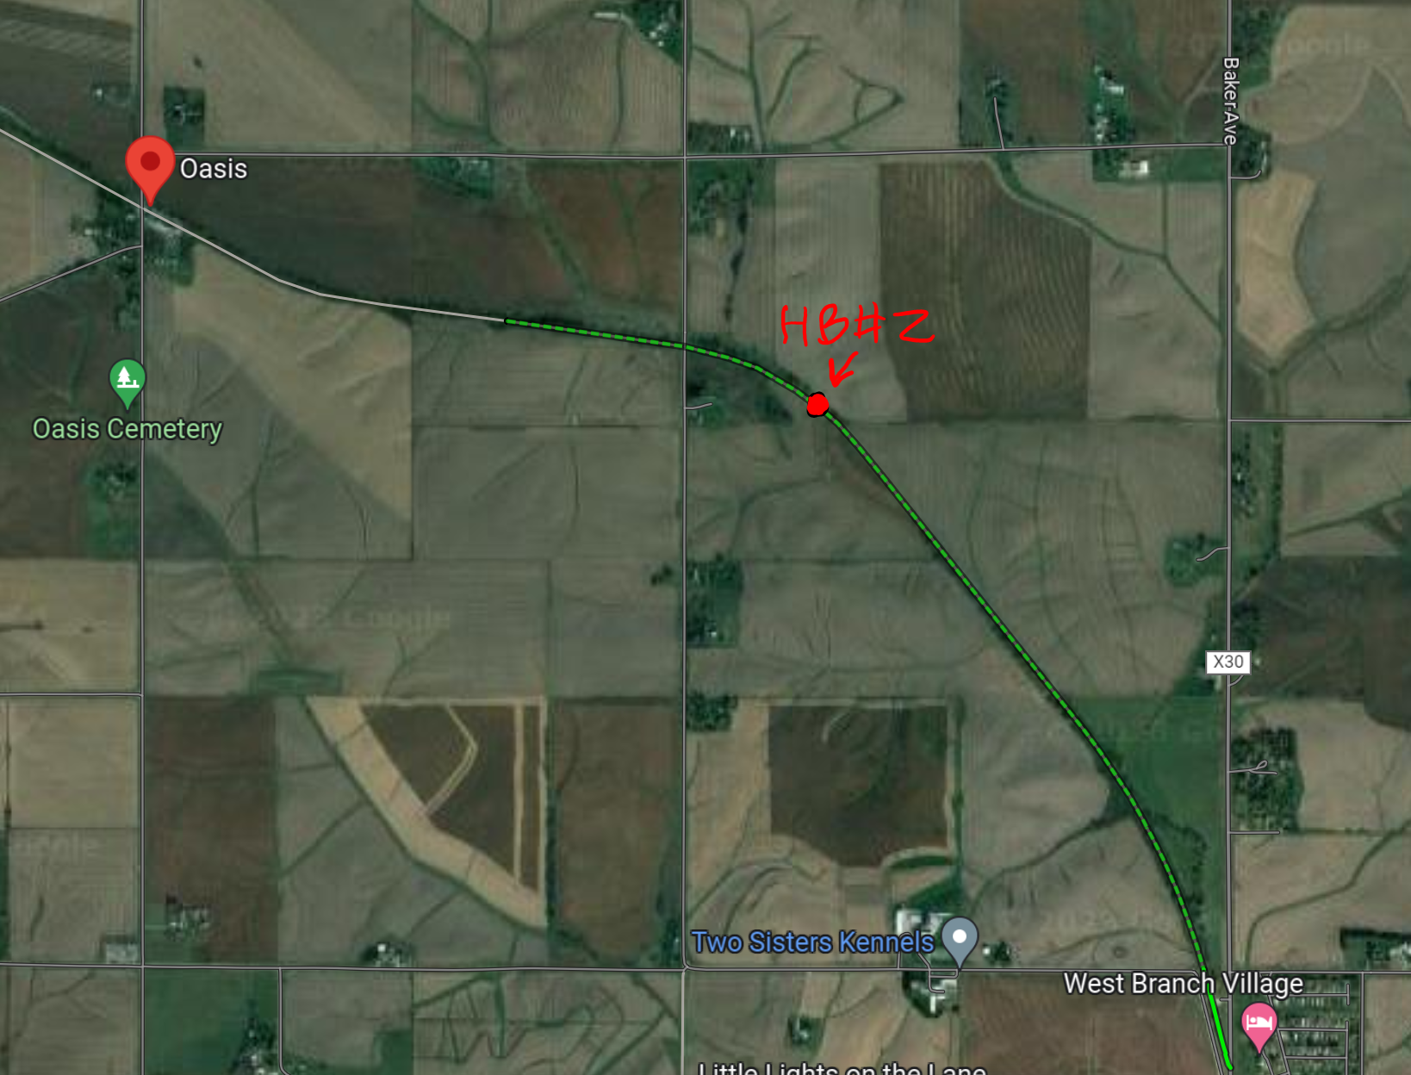
Hoover Trail Bridge #2 (Cedar County Conservation Board)
This project will replace an unsafe timber bridge with a prefabricated steel truss bridge along the Hoover Nature Trail. Designated as part of the national American Discovery Trail, this 3.7-mile segment was opened in 1990 and was one of the first rail-to-trail conversion projects completed in Iowa.
Total Cost: $320,000
Requested: $130,000 (41%)
Return to List of Applications Recommended

Slide 13
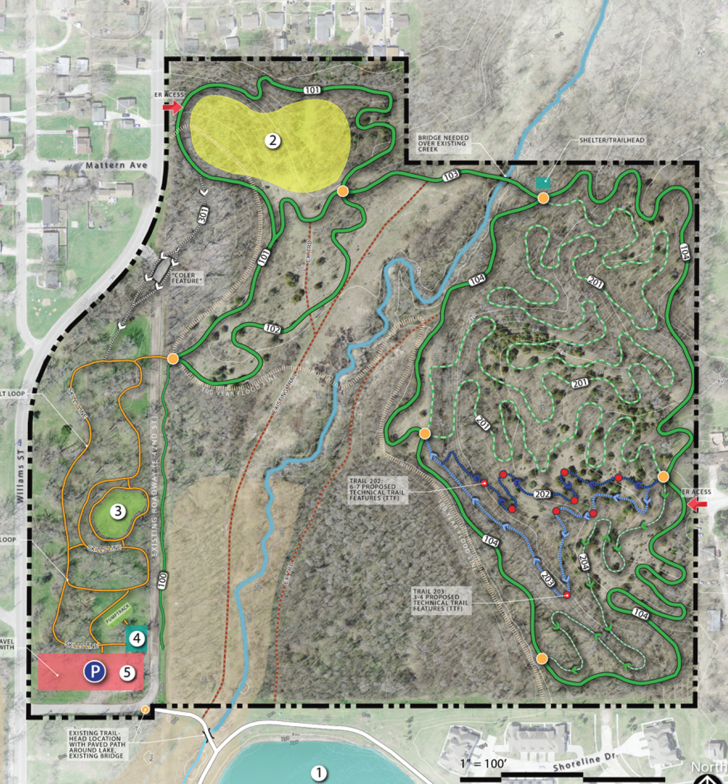
Copper Creek Mountain Bike Park (Polk County Conservation Board)
This project will construct a 4.4-mile soft surface multi-use trail system within the Fourmile Creek Greenway in east Des Moines. This trail system will offer mountain bikers banked turns, quick elevation changes and jumps as well as hiking and non-mountain biking pursuits.
Total Cost: $1,450,000
Requested: $ 400,000 (28%)
Return to List of Applications Recommended

Slide 14
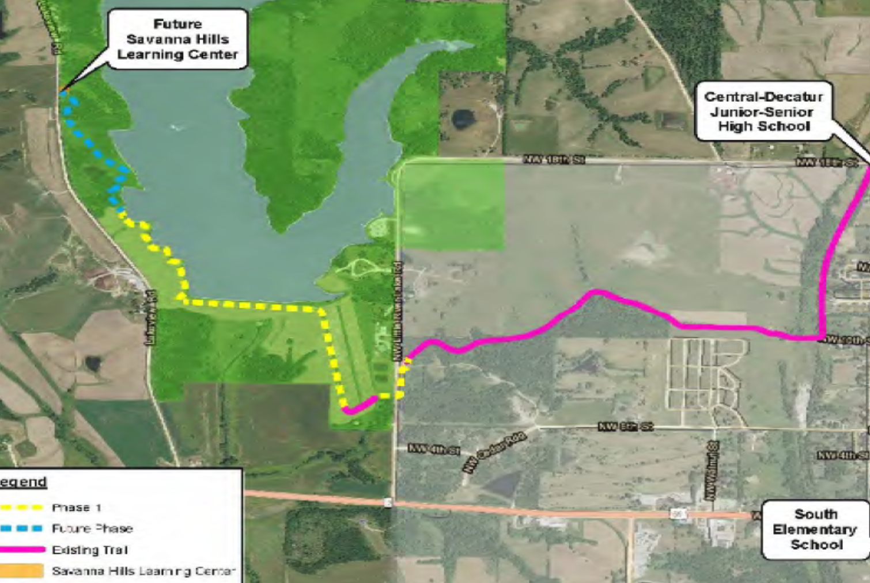
Little River Scenic Pathway Phase 2 (Decatur County Conservation Board)
This project extends the Little River Scenic Pathway 0.4 miles from the end of phase 1 near the west side of the Little River Dam to the planned Savanna Hills Learning Center.
Total Cost: $480,000
Requested: $346,913 (72%)
Return to List of Applications Recommended

Slide 15
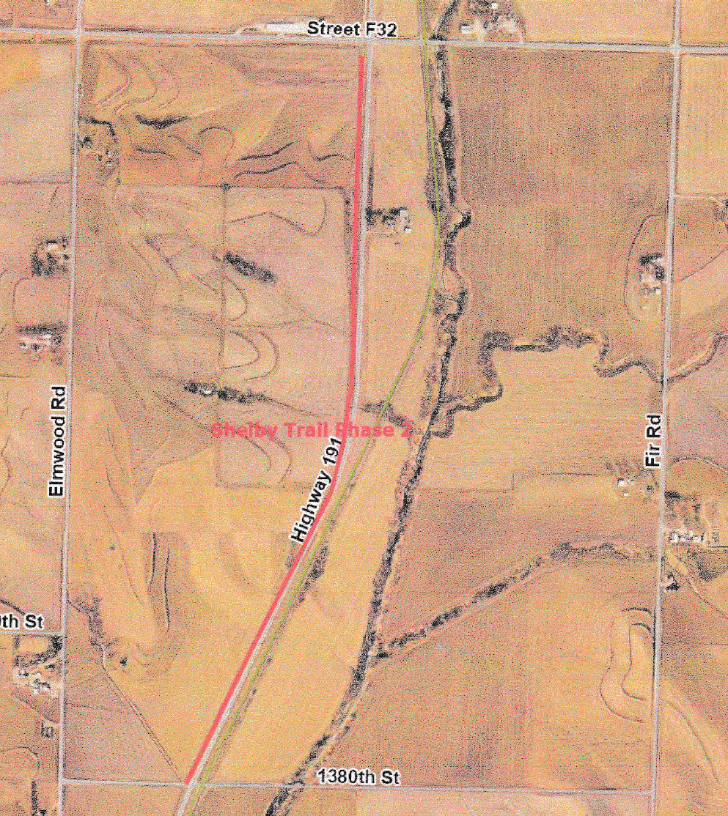
Ballpark to Ballpark Shelby County Trail Phase 2 (Shelby County)
This project will construct a 1.5-mile multi-use trail along Iowa 191 from Street F32 to 1380th Street. This is phase 2 of an eventual 7-mile trail connecting Panama to Portsmouth.
Total Cost: $898,975
Requested: $672,980 (75%)
Recommended: $462,868 (51%)
Return to List of Applications Recommended

Slide 16
List of Applications Not Recommended for Award
PROJECT NAME | SPONSOR | SCORE | TOTAL PROJECT COST | REQUESTED AMOUNT (% of Total Project Cost) | RECOMMENDED AMOUNT (% of Total Project Cost)
Clive Greenbelt to Raccoon River Valley Trail Connection | Clive | 95 | $1,400,000 | $470,000 (34%) | $0
Bondurant Recreational Sports Complex to Lake Petocka Trail | Bondurant | 95 | $485,360 | $100,000 (21%) | $0
Wabash Trace Nature Trail & Rapp Park Connection | Southwest Iowa Nature Trails Project, Inc. | 95 | $2,146,604 | $600,000 (28%) | $0
Admiral Trail Bridge Phase 2 | Farragut | 95 | $695,918 | $521,938 (75%) | $0
Iowa River's Edge Trail Paving Project | Hardin County | 94 | $1,000,000 | $300,000 (30%) | $0
Connecting Fort Madison! Phase IV - 48th Street Trail Connector | Fort Madison | 93 | $631,388 | $175,000 (28%) | $0
Return to List of Applications Recommended

Slide 17
List of Applications Not Recommended for Award
PROJECT NAME | SPONSOR | SCORE | TOTAL PROJECT COST | REQUESTED AMOUNT (% of Total Project Cost) | RECOMMENDED AMOUNT (% of Total Project Cost)
Kewash Nature Trail Phase 3 | Washington County Conservation Board | 93 | $880,000 | $630,000 (72%) | $0
Marcus Trail Phase 1 | Marcus | 93 | $749,910 | $92,089 (12%) | $0
Murphy Park Bridge and Trail | Mason City | 92 | $2,138,150 | $500,000 (23%) | $0
Grant Wood Trail: Paralta Road to Springville Road | Linn County Conservation Board | 92 | $960,000 | $650,000 (68%) | $0
Neal Smith Trail to High Trestle Trail Connection | Polk City | 91 | $565,000 | $440,000 (78%) | $0
Clay County Connection Phase II | Dickinson County | 91 | $1,407,545 | $490,000 (35%) | $0
Central Place Levee Trail Phase 1 | Des Moines | 89 | $1,500,000 | $500,000 (33%) | $0
Return to List of Applications Recommended

Slide 18
List of Applications Not Recommended for Award
PROJECT NAME | SPONSOR | SCORE | TOTAL PROJECT COST | REQUESTED AMOUNT (% of Total Project Cost) | RECOMMENDED AMOUNT (% of Total Project Cost)
19th Street Multi-Use Trail | Nevada | 88 | $1,093,846 | $546,923 (50%) | $0
Prairie Restoration Trail | Laurens | 88 | $598,500 | $401,167 (67%) | $0
Clear Creek Trail Extension: U.S. 6 Underpass | Johnson County Conservation Board | 88 | $1,800,000 | $1,300,000 (72%) | $0
Cedar View Trail Paving Project | Jefferson County Conservation Board | 88 | $836,000 | $374,000 (45%) | $0
Fort Dodge Nature Trail | Fort Dodge | 87 | $1,164,000 | $873,000 (75%) | $0
Cone and Sertoma Mountain Bike Park Signage | Sioux City | 86 | $140,000 | $105,000 (75%) | $0
Cedar Rapids Flood Control System Trail | Cedar Rapids | 85 | $1,720,000 | $500,000 (29%) | $0
Return to List of Applications Recommended

Slide 19
List of Applications Not Recommended for Award
PROJECT NAME | SPONSOR | SCORE | TOTAL PROJECT COST | REQUESTED AMOUNT (% of Total Project Cost) | RECOMMENDED AMOUNT (% of Total Project Cost)
Huckleberry Park Connector Trail | LeClaire | 84 | $357,527 | $199,211 (75%) | $0
8th Street-South Park Connector Trail | West Point | 84 | $80,000 | $45,000 (56%) | $0
Middle Road Trail Extension | Bettendorf | 82 | $883,000 | $500,000 (57%) | $0
Davis County Trail Project: Phase 4A | Bloomfield | 81 | $804,000 | $483,954 (60%) | $0
55th Street Trail from Meadow View Drive to Richland Avenue | Urbana | 80 | $1,623,000 | $1,080,000 (67%) | $0
Lenox Recreational Trail Extension Phase 3 | Lenox | 80 | $371,210 | $237,075 (64%) | $0
Emmons Street Bridge and Trail Extension | Hiawatha | 79 | $1,024,000 | $768,000 (75%) | $0
Return to List of Applications Recommended

Slide 20
List of Applications Not Recommended for Award
PROJECT NAME | SPONSOR | SCORE | TOTAL PROJECT COST | REQUESTED AMOUNT (% of Total Project Cost) | RECOMMENDED AMOUNT (% of Total Project Cost)
Taylor Park to Kent-Stein Park Trail | Muscatine | 78 | $259,000 | $195,000 (75%) | $0
Oelwein Municipal Urban Trail Segment 2 | Oelwein | 78 | $676,929 | $440,004 (65%) | $0
High Trestle Trail to Swede Point Park, Phase 1b | Boone County Conservation Board | 78 | $1,034,000 | $600,000 (58%) | $0
Pony Hollow Trail Extension | Clayton County Conservation Board | 76 | $1,787,140 | $500,000 (28%) | $0
lowa River Corridor Trail Gateway Segment | Iowa City | 74 | $686,843 | $515,132 (75%) | $0
Logan Recreational Trail Phase 1 | Logan | 72 | $548,062 | $275,000 (50%) | $0
Enterprise Drive Trail Extension Phase 2 | Independence | 72 | $631,692 | $401,544 (64%) | $0
Return to List of Applications Recommended

Slide 21
List of Applications Not Recommended for Award
PROJECT NAME | SPONSOR | SCORE | TOTAL PROJECT COST | REQUESTED AMOUNT (% of Total Project Cost) | RECOMMENDED AMOUNT (% of Total Project Cost)
Palo Connector Trail | Palo | 63 | $2,650,000 | $1,987,500 (75%) | $0
Woodhaven Trail Connection | Polk City Friends of the Parks | 61 | $64,000 | $48,000 (75%) | $0
Cascade Trail | Cascade | 54 | $1,009,441 | $700,000 (69%) | $0
Return to List of Applications Recommended

