Slide 1
Railroad Revolving Loan and Grant Program FY 2024 Funding Cycle
September 12, 2023
Commission Workshop

Slide 2
Railroad Revolving Loan and Grant Program
Created by legislation in 2005
Purpose: To provide loans and grants for railroad related improvement projects to benefit Iowa.
Funded by loan repayments and appropriations by the Iowa Legislature. Funding is available to cities, counties, economic development organizations, businesses, rail companies and alliances of such organizations.

Slide 3
Available Funding and Application Summary
Available Funding:
FY 2024 Legislative appropriation (RIIF): $500,000
Loan repayments: $1,398,286
Rescinded or unused funds: $789,696
Total Available: $2,687,982
Application Summary:
Total number of projects: 3
Total rail project costs: $15,641,253
Total amount requested: $6,722,000

Slide 4
Project Evaluation Criteria
Targeted Job Creation Projects:
Hourly wage rates must meet 100% of the average county wage criteria:
Job leverage: 40 pts
Wage quality: 20 pts
Capital investment: 20 pts
Loan leverage: 20 pts
Rail Network Improvement Projects:
Project readiness
Rail network impact
Economic impact
Financial readiness
Rail Port Planning and Development Studies:
Existing/potential site information
Goals of the study
Organizational structure and capacity to complete the study
Notes:
An application is required in order to submit for RRLG funding. Once applications are received, an evaluation team is identified an we review and evaluate each application based on the project type.
Targeted Job Creation
Rail Network Improvements
Planning study
TJ: Require projects to either create or retain jobs for the state of Iowa. TJ Program offers both grants and loans or combo of the two
Grants maxed at 12,000 per job (50/50), loans (80/20).
RNI: Projects that do not have jobs attached to them. Loans only at 0% interest for 10 years.
PS: Grants of up to $100,000 are available for planning studies that enable a community, county, or region to make fact-based decisions concerning the location, design or funding requirements for a rail port facility.

Slide 5
Applications Received & Recommended Awards
TOTAL RAIL PROJECT COST
REQUESTED AMOUNT
(% of Total Project Cost)
RECOMMENDED AMOUNT
(% of Total Project Cost)
PROJECT NAME
SPONSOR
SCORE
New Horizons Switching Track and Additions (Clinton) | Atlas Roofing Corporation | 34.93 (Targeted Jobs) | $7,200,000 | Loan: $1,000,000 (13.9%) Grant: $1,404,000 (19.5%) | Loan: $715,000 (9.9%) Grant: $1,404,000 (19.5%)
Shenandoah Clean Sugar Plant Rail Spur (Fremont) | Green Plains Shenandoah LLC | 28.74 (Targeted Jobs) | $941,253 | Loan: $424,000 (45.0%) Grant: $144,000 (15.3%) | Loan: $424,000 (45.0%) Grant: $144,000 (15.3%)
Notes:
We are recommending funding for 2 projects.
These projects include loans plus grants for job creation.
**Atlas Roofing Corporation is building a new roofing materials plant that will produce asphalt shingles. The $218M plan includes rail infrastructure that will also benefit future rail access in the industrial park.
Job creation: 117 jobs at an average $28.61/hour.
Total project rail cost is $7,2000,000
We recommend a loan award of $715,000 and grant of $1,404,000.
**Green Plains Shenandoah LLC is building a new Clean Sugar Plant adjacent to its existing BioRefinery facility. The new plant will use the output from the BioRefinery plant to produce Clean Sugar Syrup for retail customers. The spur addition will connect the plant’s output to the BNSF railway.
Job creation: 12 jobs at an average $24.83/hour.
Total project rail cost is $941,253
We recommend a loan award of $424,000 and grant of $144,000.

Slide 6
Applications Received & Not Recommended for Award
REQUESTED AMOUNT
(% of Total Project Cost)
RECOMMENDED AMOUNT
(% of Total Project Cost)
PROJECT NAME
SPONSOR
SCORE
TOTAL RAIL PROJECT COST
Project Zetta Rail Improvement (Woodbury) | City of Sioux City |  | $7,500,000 | Grant: $3,750,000 (50%) | Grant: 0 (0%)
Notes:
The client has not committed to Sioux City as the location for this project yet, so design work has not started. They are unable to provide an itemized rail cost estimate currently. If a commitment is secured, Sioux City intends to apply for funding in the next round, FY25.
Due to the project not having commitment yet, we are not recommending funding for the Project Zetta Rail Improvement project.

Slide 7
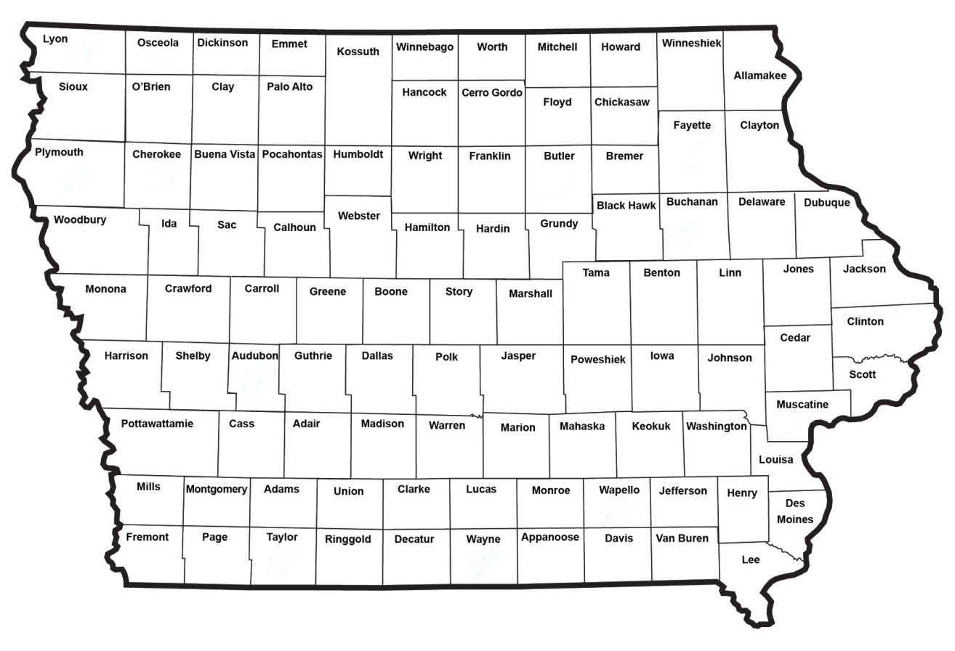
Map of Applications Received
Application received and award recommended
Application received and not recommended for funding

Slide 8
QUESTIONS?
James Glaspie, Rail Development Manager
Modal Transportation Bureau
James.glaspie@iowadot.us
515-239-1066

Slide 9
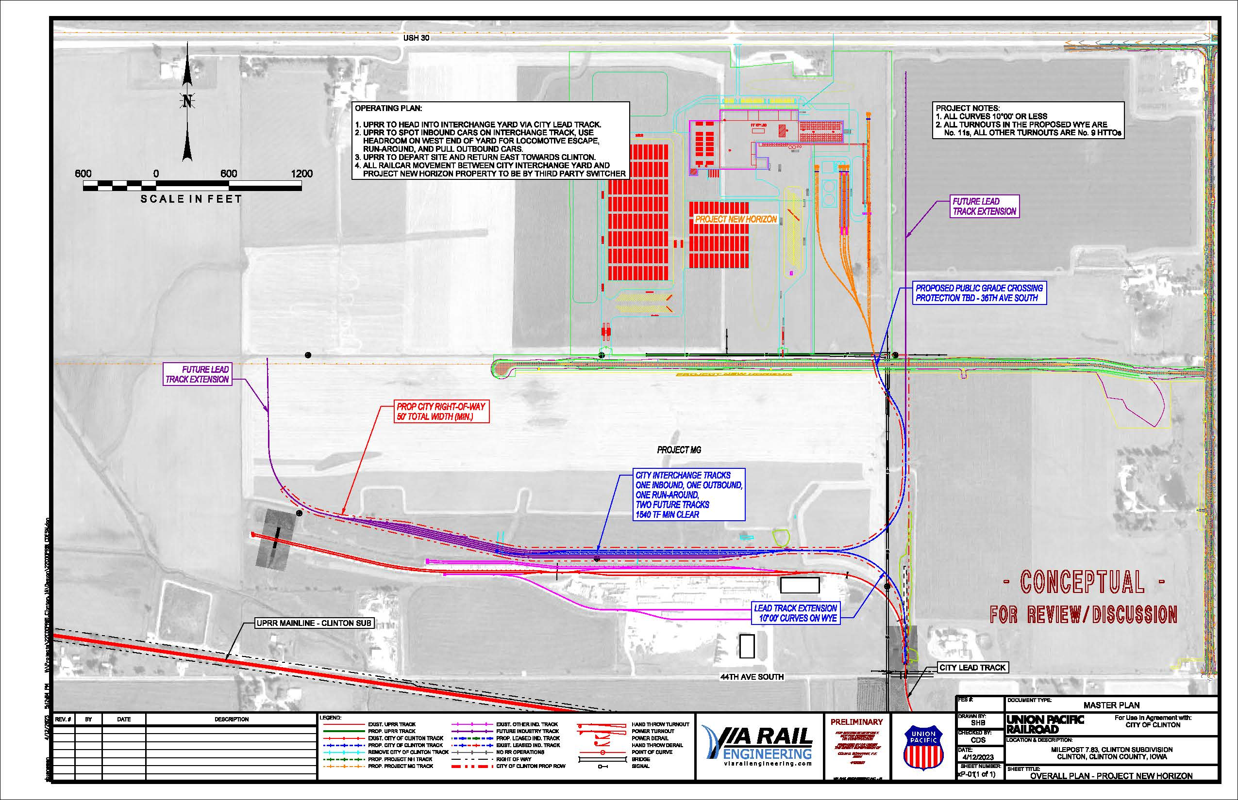
Atlas Roofing Corporation, Clinton, Co is building a new roofing materials plant that will produce asphalt shingles. The $218M plan includes rail infrastructure that will also benefit future rail access in the industrial park.
Job creation: 117 jobs at an average $28.61/hour. Total project rail cost is $7,2000,000
We recommend a loan award of $715,000 and grant of $1,404,000.
Return to Recommendation Summary
Notes:
**Atlas Roofing Corporation is building a new roofing materials plant that will produce asphalt shingles. The $218M plan includes rail infrastructure that will also benefit future rail access in the industrial park.
Job creation: 117 jobs at an average $28.61/hour.
Total project rail cost is $7,2000,000
We recommend a loan award of $715,000 and grant of $1,404,000.

Slide 10
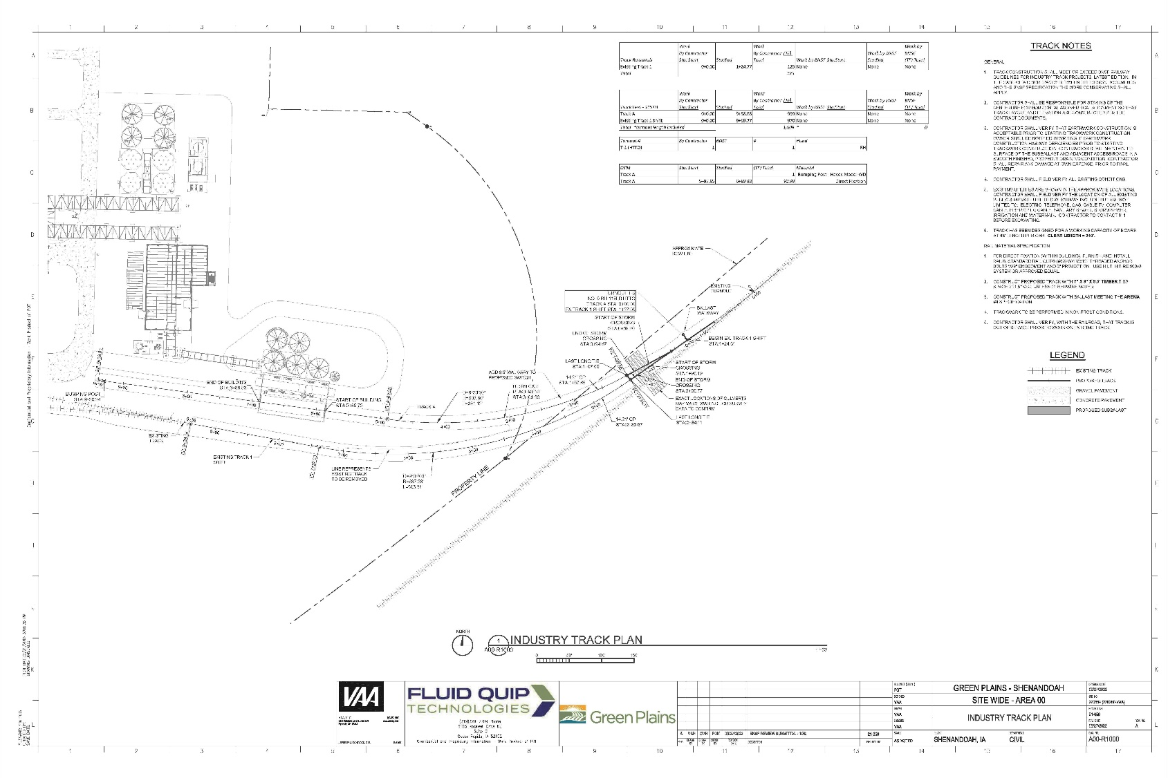
Green Plains Shenandoah LLC, Fremont Co, is building a new Clean Sugar Plant adjacent to its existing BioRefinery facility. The new plant will use the output from the BioRefinery plant to produce Clean Sugar Syrup for retail customers. The spur addition will connect the plant’s output to the BNSF railway.
Job creation: 12 jobs at an average $24.83/hour. Total project rail cost is $941,253
We recommend a loan award of $424,000 and grant of $144,000.
Return to Recommendation Summary
Notes:
**Green Plains Shenandoah LLC is building a new Clean Sugar Plant adjacent to its existing BioRefinery facility. The new plant will use the output from the BioRefinery plant to produce Clean Sugar Syrup for retail customers. The spur addition will connect the plant’s output to the BNSF railway.
Job creation: 12 jobs at an average $24.83/hour. Total project rail cost is $941,253
We recommend a loan award of $424,000 and grant of $144,000.

Slide 11
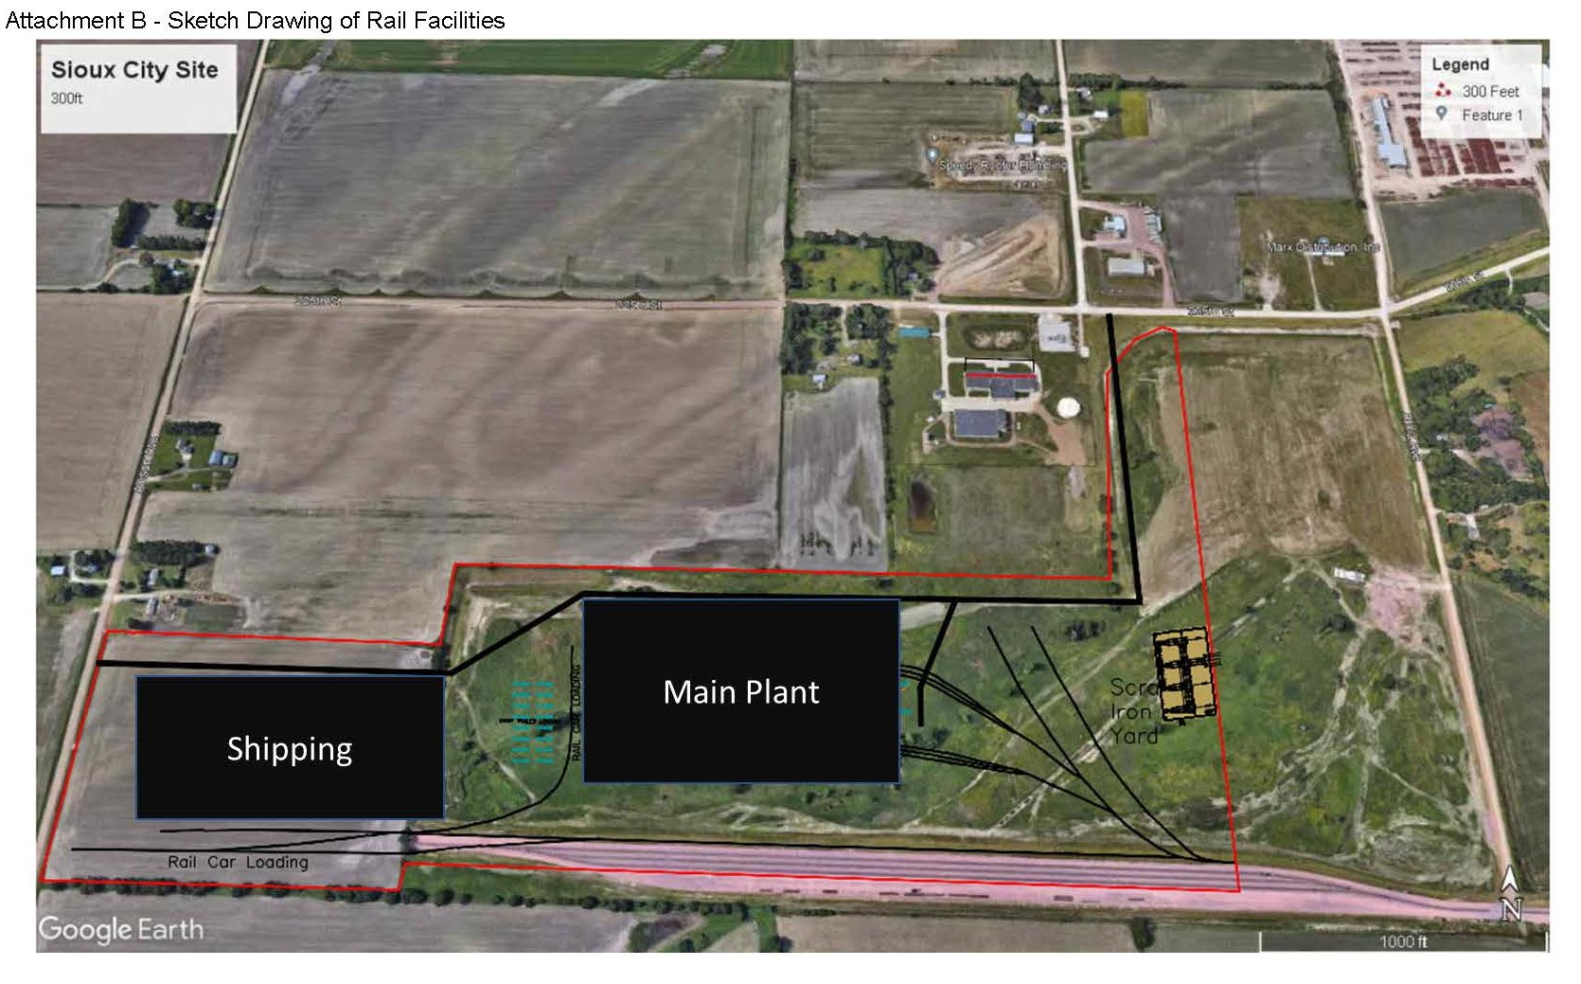
Project Zetta Rail Improvements, Woodbury Co is looking to built a state-of-the-art construction materials manufacturing facility in the Sioux City Southbridge Business Park.
Job creation: 350 at an average of $35.00/hour. Total Project Rail Cost: $7,500,000
Requested: $3,750,000 Recommended: $0
Return to Recommendation Summary
Notes:
The project adds several rail spurs to the site and will connect to the Sioux City owned tracks to the South.
The project is still under development and an estimate of construction is not available yet.
We are not recommending funding for the Project Zetta Rail Improvement project.

