Slide 1
FY 2025 Highway-Railroad Crossing Safety Program
September 12, 2023

Slide 2
Program
FHWA Funding available for states to improve warning devices at railroad crossings. (23 USC Section 130)
Amount of appropriation funded by FHWA is determined by the number of public railroad crossings in the state.
Iowa currently has 4,862 public railroad crossings, (4,089 at-grade).

Slide 3
Project Evaluation Criteria
Benefit-Cost Ratio
Formula includes:
Number of accidents
Exposure Index, (number of trains x number of vehicles)
Train traffic
Vehicle traffic
Predicted Accidents, (train speed, roadway speed, number of traffic lanes, number of tracks)
Existing warning devices vs. possible upgrades
On-site safety diagnostic review
A project application must be filed with the department

Slide 4
Available Funding and Application Summary
Federal Funds from FHWA, 100%
Number of projects: 16 (13 & 3 closure incentives)
Total project costs/ FHWA funds: $6,100,000
Annual Apportionment: $5,178,586
Additional funds (1 cancelled project): + $475,000 (1-DME) $5,653,586
Difference: - $446,414

Slide 5
List of Applications Recommended
PROJECT NAME | SPONSOR | SCORE | TOTAL PROJECT COST | REQUESTED AMOUNT (% of Total Project Cost) | RECOMMENDED AMOUNT (% of Total Project Cost)
695th Avenue, 079400P | BNSF Railroad Monroe County | 50.26 | $475,000 | $475,000 (100%) | $475,000 (100%)
160th Street, 079143U | BNSF Railroad Monroe County | 48.15 | $375,000 | $375,000 (100%) | $375,000 (100%)
2nd Street, 307227V | CCP Railroad City of Parkersburg | 31.27 | $475,000 | $475,000 (100%) | $475,000 (100%)
Oregon Street, 607211C | DME Railroad City of Muscatine | 26.31 | $500,000 | $500,000 (100%) | $500,000 (100%)
3rd Street NW, 067358J | BNSF Railroad City of Sioux Center | 22.14 | $400,000 | $400,000 (100%) | $400,000 (100%)

Slide 6
List of Applications Recommended
PROJECT NAME | SPONSOR | SCORE | TOTAL PROJECT COST | REQUESTED AMOUNT (% of Total Project Cost) | RECOMMENDED AMOUNT (% of Total Project Cost)
130th Avenue, 385195D | DME Railroad Winneshiek County | 21.47 | $400,000 | $400,000 (100%) | $400,000 (100%)
Elm Street, 063199R | BNSF Railroad City of Creston | 20.35 | $600,000 | $600,000 (100%) | $600,000 (100%)
Lee Street, 375644A | DME Railroad City of Seymour | 18.96 | $400,000 | $400,000 (100%) | $400,000 (100%)
North Elk Run Road, 200775H | IANR Railroad Black Hawk County | 7.82* | $400,000 | $400,000 (100%) | $400,000 (100%)
Zeller Avenue, 308234J | CCP Railroad Sac County | 3.05** | $475,000 | $475,000 (100%) | $475,000 (100%)
Existing signals are constantly damaged by turning trucks. Truck traffic has increased due to new businesses in the area. Roadway is being redesigned.
** Part of an overall roadway safety improvement project consisting of modifying drive lanes and establishing new curbs.

Slide 7
List of Applications Recommended
PROJECT NAME | SPONSOR | SCORE | TOTAL PROJECT COST | REQUESTED AMOUNT (% of Total Project Cost) | RECOMMENDED AMOUNT (% of Total Project Cost)
Bridge Street, 381610H | DAIR Railroad Lyon County | 0.28* | $250,000 | $250,000 (100%) | $250,000 (100%)
Dogwood Avenue, 694426L | DME Railroad Washington County | 0 ** | $550,000 | $550,000 (100%) | $550,000 (100%)
Lane Street, 385429E | DME Railroad City of Charles City | 0.27*** | $500,000 | $500,000 (100%) | $500,000 (100%)
3 projected closure incentive payments at various locations ($100,000 per location) | TBD | N/A | $300,000 | $300,000 (100%) | $300,000 (100%)
Upgrade of signal system to constant warning time (CWT) necessary due to consistent false activations of the existing signal equipment and recent accident.
** Degraded (RR over roadway) grade separation being eliminated along with one at-grade railroad crossing; being replaced by this new
crossing that requires active warning devices.
*** This railroad crossing is interconnected to another railroad crossing that was funded for signal upgrades last fiscal year. The systems
cannot communicate and upon review of the location it was discovered that this railroad crossing roadway geometry is extremely
dangerous, and the existing signals are not adequate for the roadway.

Slide 8
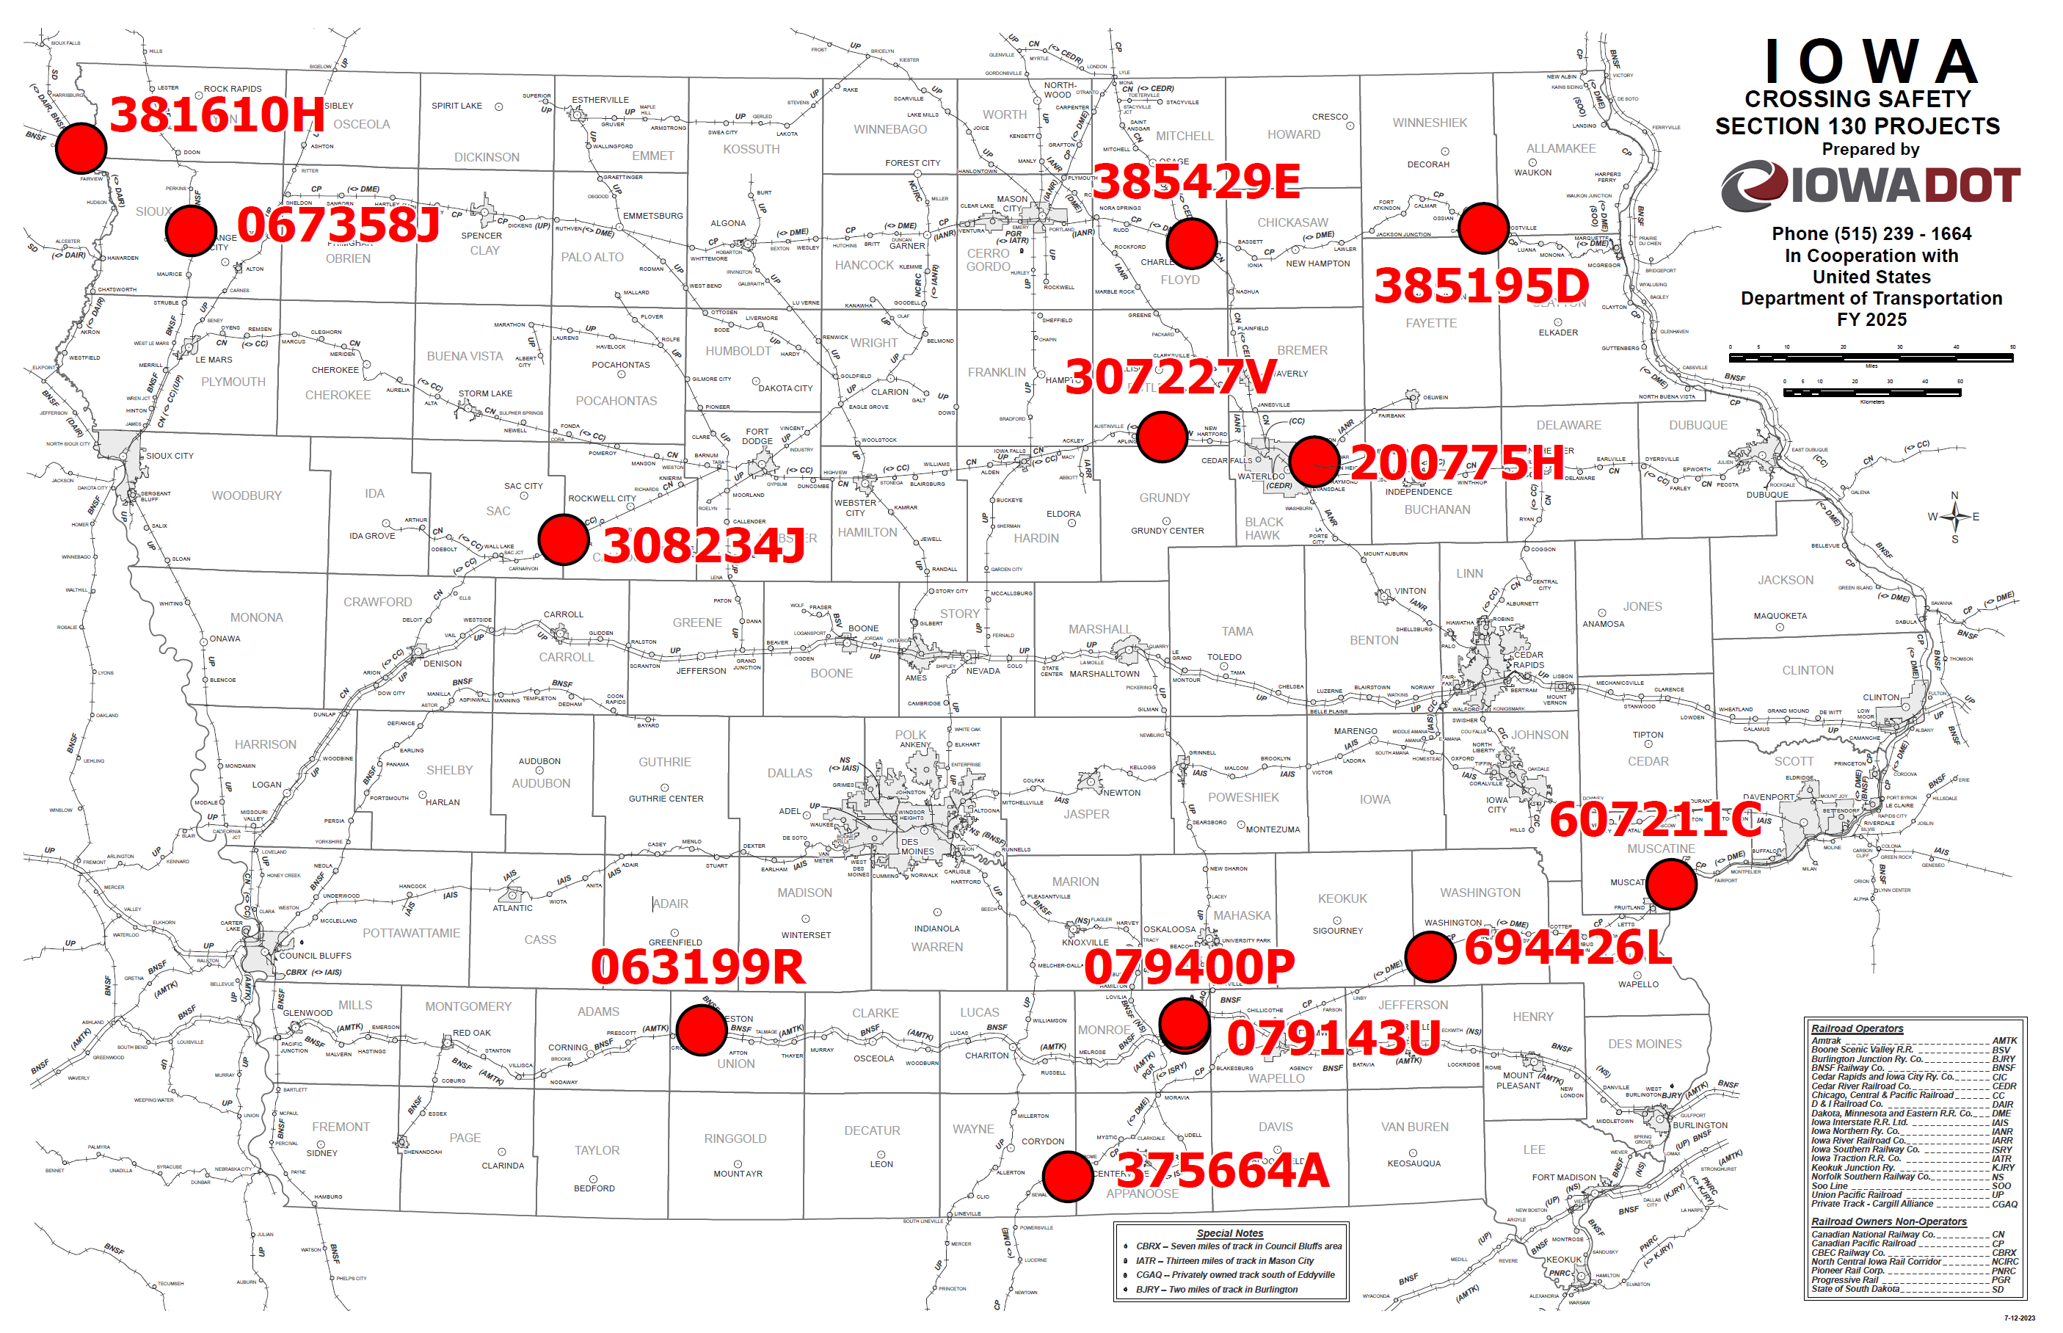
Map of Recommended Awards

Slide 9
QUESTIONS?
Kris Klop
Manager, Highway-Rail Crossing Programs
kristopher.klop@iowadot.us

