Slide 1
FY 2025 Highway-Railroad Crossing
Surface Repair Program
September 12, 2023

Slide 2
Program
Highway-Railroad crossing surface repair program incentivizes railroads and roadway authorities to participate in the cooperative repair of crossing surfaces.
Project funding breakdown:
60% State
20% Roadway authority
20% Railroad
Responsibilities:
Railroad: Replacement of rock (ballast), ties, track, underlayment, and crossing panels
Roadway Authority: Replacement of crossing approaches and existing sidewalks (ADA compliant), road closures and detours

Slide 3
Project Evaluation Criteria
Projects are funded in the order the applications are received, except that up to 50% of the program allocation can be used in a discretionary manner.
All 29 crossing applications currently in the program queue were scored according to the following criteria:
Type of route the crossing is on, (crude oil, ethanol, passenger)
Average daily vehicle traffic / train traffic
Exposure index, (number of trains x number of cars)
Predicted Accidents, (train speed, roadway speed, number of traffic lanes, number of tracks)
Planned concurrent roadway projects
On-site inspection
Maximum score possible: 35 points
Final Projects
The three highest scored crossings were brought forward to be funded in addition to those already scheduled to be funded for FY 2025 for a total of 11 projects.
Associated railroads and roadway authorities were contacted and confirmed they were able to participate with funding and repairs.

Slide 4
Available Funding and Application Summary
Crossing Surface Repair Program receives an annual statutory appropriation of $900,000 (off-the-top of the Road Use Tax Fund)
Program funding queue currently has 29 submitted applications.
Number of projects:
8 - in order received
3 - with scoring
11 - total
Total program funding request: $951,000
In order received: $711,000 / 75%
Scored: $240,000 / 25%
Annual appropriation: $900,000
Difference: ($51,000)

Slide 5
List of Applications Recommended
PROJECT NAME | SPONSORS | SCORE | TOTAL PROJECT COST | REQUESTED AMOUNT (% of Total Project Cost) | RECOMMENDED AMOUNT (% of Total Project Cost)
Wright Bros. West, 376746K | CRANDIC Railroad Linn County | N/A Order Received | $100,000 | $60,000 (60%) | $60,000 (60%)
North Park Drive, 385610W | DME Railroad City of Algona | N/A Order Received | $180,000 | $108,000 (60%) | $108,000 (60%)
Roan Street, 386607N | DME Railroad City of Algona | N/A Order Received | $175,000 | $105,000 (60%) | $105,000 (60%)
Main Street, 385606G | DME Railroad City of Algona | N/A Order Received | $295,000 | $177,000 (60%) | $177,000 (60%)

Slide 6
List of Applications Recommended
PROJECT NAME | SPONSORS | SCORE | TOTAL PROJECT COST | REQUESTED AMOUNT (% of Total Project Cost) | RECOMMENDED AMOUNT (% of Total Project Cost)
Main Street, 385606G | DME Railroad City of Algona | N/A Order Received | $295,000 | $177,000 (60%) | $177,000 (60%)
73rd Street, 377213D | IAIS Railroad City of Windsor Weights | N/A Order Received | $165,000 | $99,000 (60%) | $99,000 (60%)
T-61 / Monroe Wapello Road, 375736B | DME Railroad City of Algona | N/A Order Received | $170,000 | $102,000 (60%) | $102,000 (60%)
Big Sioux River Road, 381531W | DME Railroad City of Akron | N/A Order Received | $55,000 | $33,000 (60%) | $33,000 (60%)

Slide 7
List of Applications Recommended
PROJECT NAME | SPONSORS | SCORE | TOTAL PROJECT COST | REQUESTED AMOUNT (% of Total Project Cost) | RECOMMENDED AMOUNT (% of Total Project Cost)
11th Street, 607576J | IANR Railroad City of Waterloo | 24 | $170,000 | $102,000 (60%) | $102,000 (60%)
South Expressway, 074403T | BNSF Railroad City of Council Bluffs | 24 | $150,000 | $90,000 (60%) | $90,000 (60%)
North Elk Run Road 200775H | IANR Railroad Black Hawk County | 24 | $80,000 | $48,000 (60%) | $48,000 (60%)

Slide 8
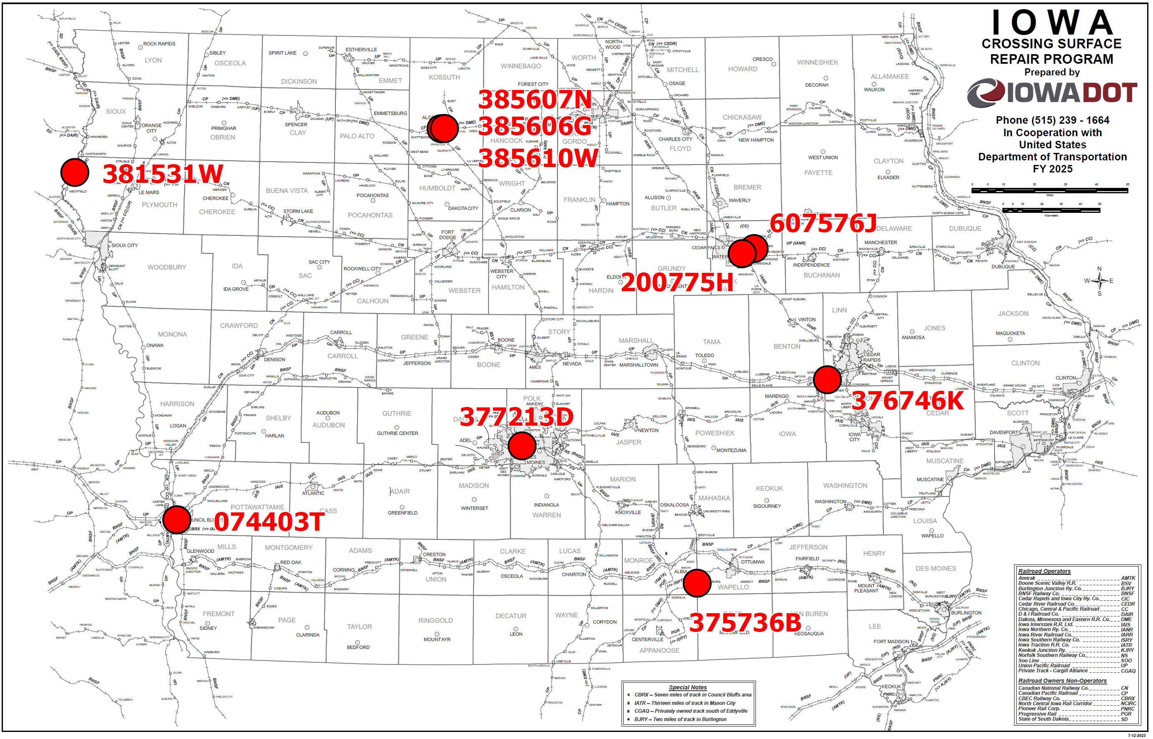
Map of Recommended Awards

Slide 9
QUESTIONS?
Kristopher Klop
Manager, Highway-Rail Crossing Programs
kristopher.klop@iowadot.us

