Slide 1
Infrastructure Investment and Jobs Act (IIJA) Implementation
National Electric Vehicle Infrastructure
Transportation Commission Workshop
September 12, 2023

Slide 2
Summary
IIJA policies previously approved July 12, 2022
Overview of National Electric Vehicle Infrastructure (NEVI) Program
Next steps

Slide 3
National Electric Vehicle Infrastructure
New US DOT program from the Infrastructure Bill
Iowa allocated $51 million over FFY 2022-2026 – approximately $10.3 million per year
Initially, for use to purchase/install electric vehicle charging infrastructure within one mile of Alternative Fuel Corridor Routes

Slide 4
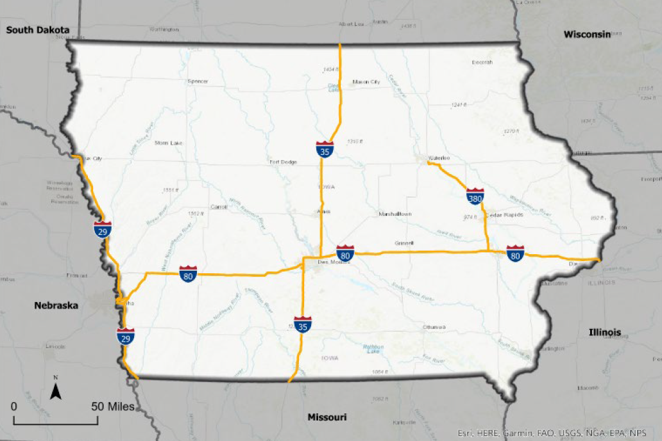
Iowa’s Alternative Fuel Corridors

Slide 5
Electric Vehicle Deployment Plan
State Deployment Plan
Approval by FHWA required to access funds
Initial plan submitted August 1, 2022
Required annual update submitted August 1, 2023
Iowa DOT and Iowa Economic Development Authority have coordinated on the development and update of plan

Slide 6
Program Requirements
Title 23 requirements apply to this program in the same manner as they apply to highway or bridge projects.
Each electric vehicle charging site will require design, specialized equipment, utility upgrades, construction/installation, workforce requirements, technical compliance, etc.
This means sites will be developed by teams of property owners, vendors, contractors, and utilities

Slide 7
Program Requirements (continued)
Governmental entities and municipal utilities are not eligible applicants.
Capital costs are eligible for reimbursement up to 80 percent.
Operating and maintenance costs across the five-year operations and maintenance period is eligible for reimbursement up to 80 percent or $200,000, whichever is less.

Slide 8
Competitive Procurement
Competitive procurement process is required
Developing a competitive Notice of Funding Opportunity (NOFO) that identifies specific criteria for proposal scoring and details of the selection process
Project teams will be identified through each proposal
Selections will be based on alignment to scoring criteria
Significant evaluation that will include agency partners and technical experts

Slide 9
Next Steps
Commission consideration/adoption of updated IIJA policies
Finalize NOFO and publish for comment
Initiate formal advertisement this fall
Review of applications through spring 2024
Update on status of program and results of evaluation in summer 2024

Slide 10
Questions?

