Slide 1
Highway System Overview
Iowa Transportation Commission Workshop
Garrett Pedersen
Systems Planning Bureau Director
9/12/2023

Slide 2
Agenda
Iowa’s Public Road System
Highway Networks
State Highway System Usage
Highway Planning and Programming
2

Slide 3
Iowa’s Public Road System

Slide 4
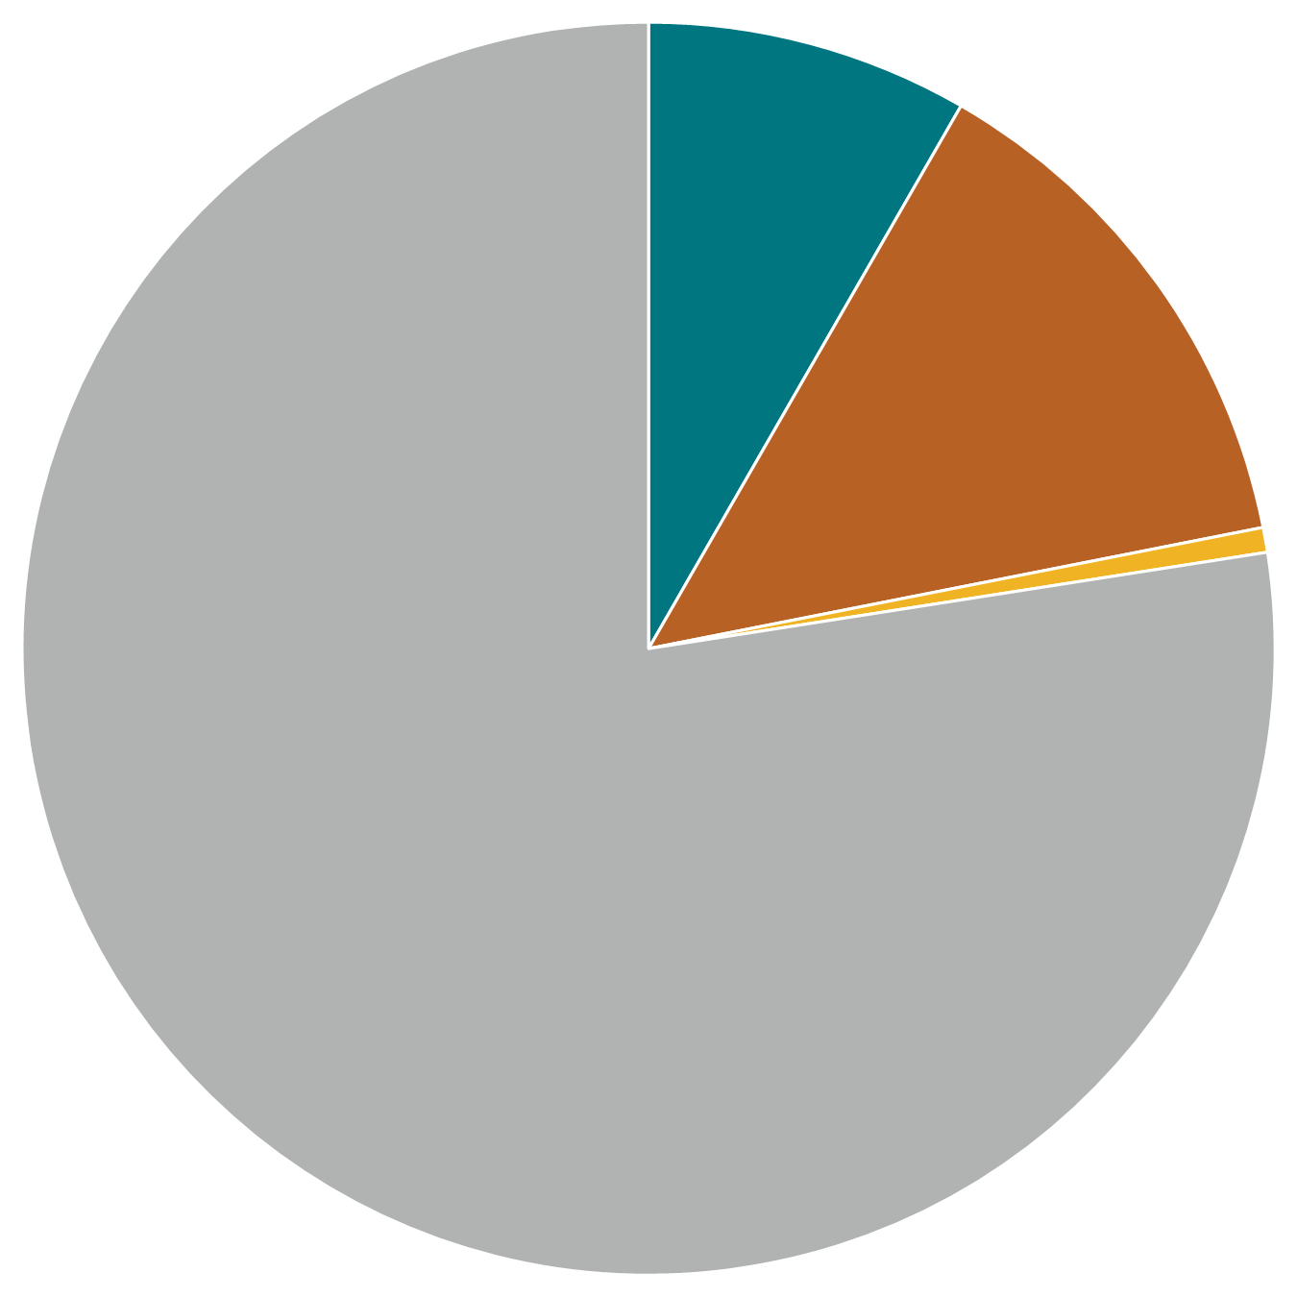
Iowa Public Road System Mileage Ownership and Surface, 2022
Primary
9,616
City
15,716
Parks & Institutional
741
Total Miles:
115,681
County
89,608
Paved
Not Paved
Notes:
These are center-line miles with ramps included.
Over, 38% of highways are paved (asphalt, concrete, or bituminous treatment) and 62% is not paved (gravel or not surfaced).
System breakout (percentages shown on next slide)
Primary: 8%
City: 14%
Parks and Institutional: 1%
County: 77%

Slide 5
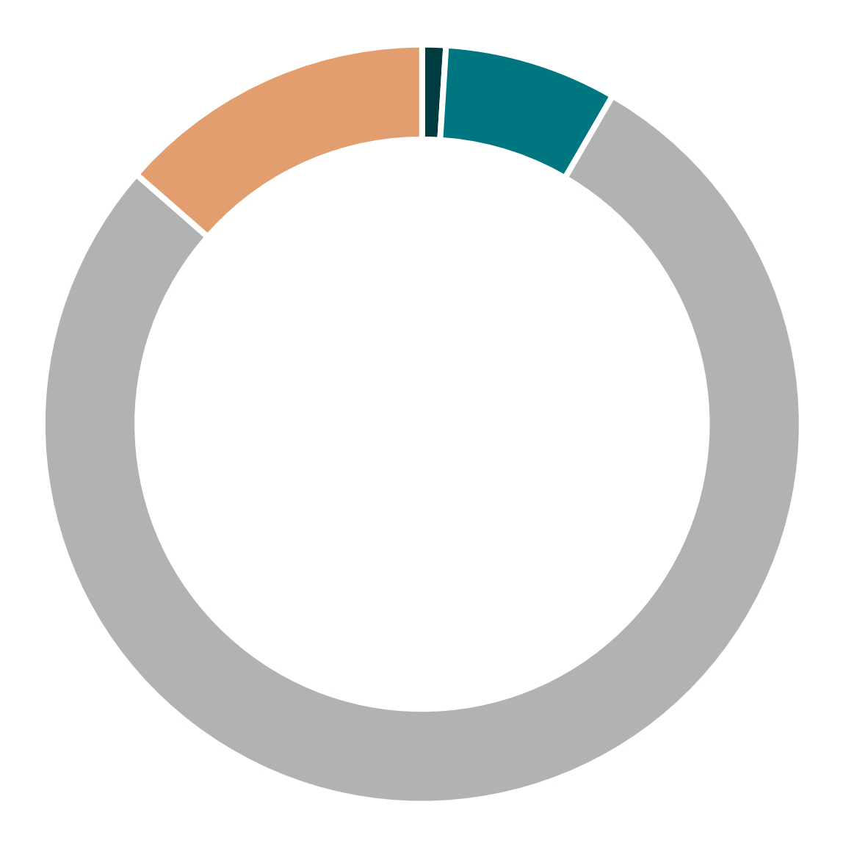
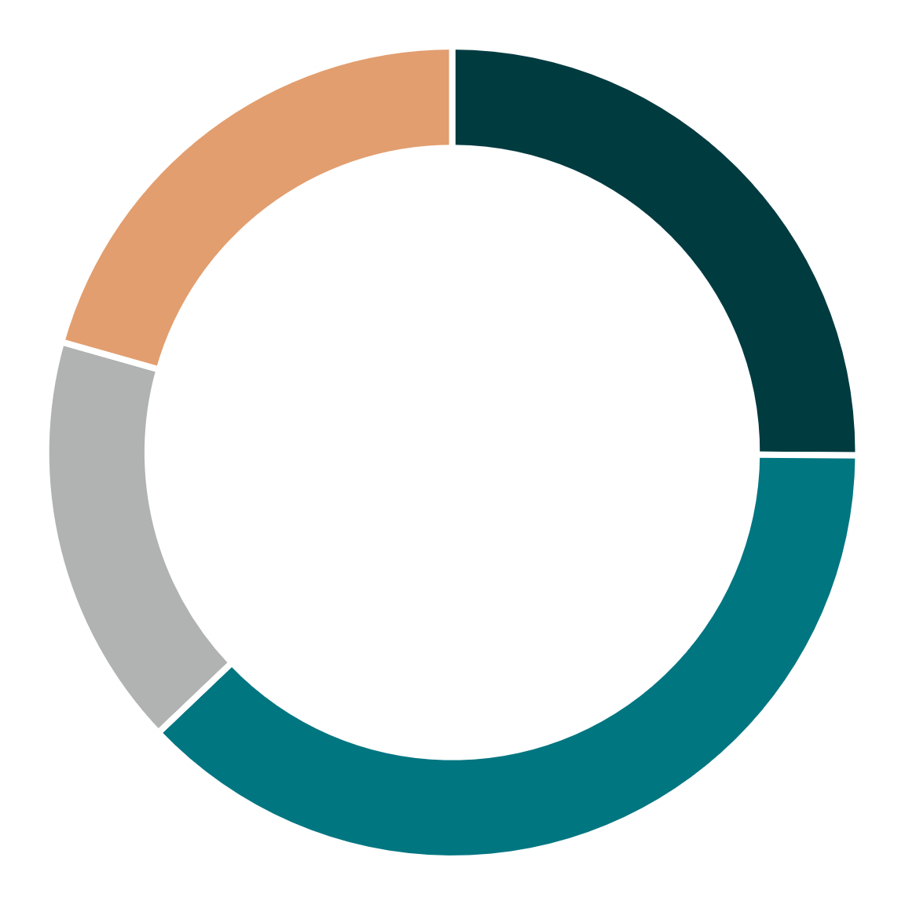
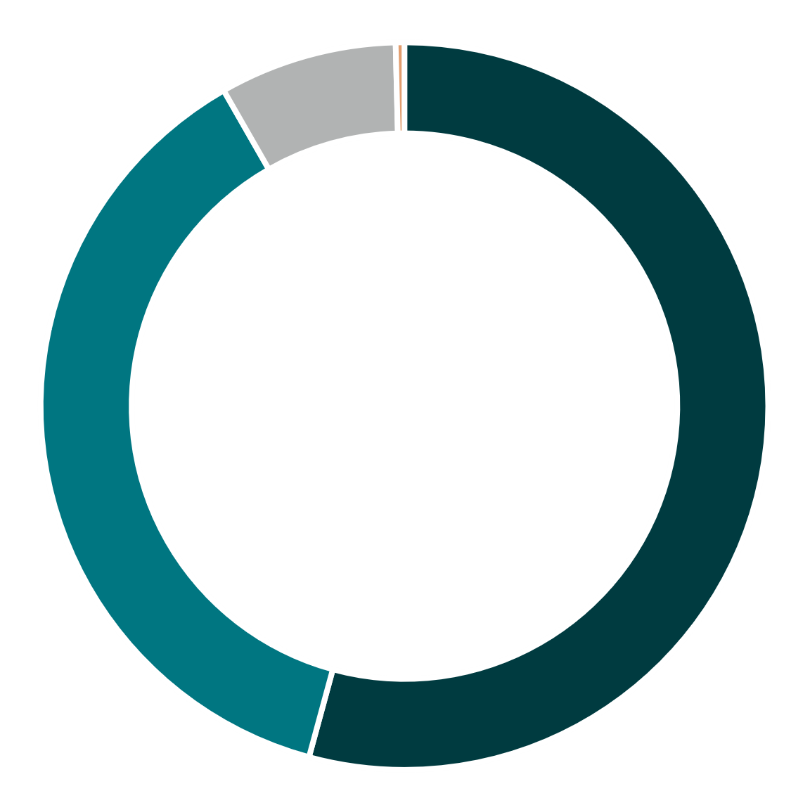
Iowa Public Road System – 2022
Interstate
County
City
City
Other Primary
City
Interstate
14%
7%
8%
Interstate
1%
21%
25%
<1%
54%
16%
37%
Miles of roads
All Traffic
Large Truck Traffic
County
Other Primary
78%
38%
County
Other Primary
Does not include Park & Institutional Roads
Notes:
Split out Interstate to show what a large percentage of traffic it carries for only being 1% of the overall public road system’s mileage.

Slide 6
Highway Networks
Notes:
Covering CIN, Access Iowa, and NHS.

Slide 7
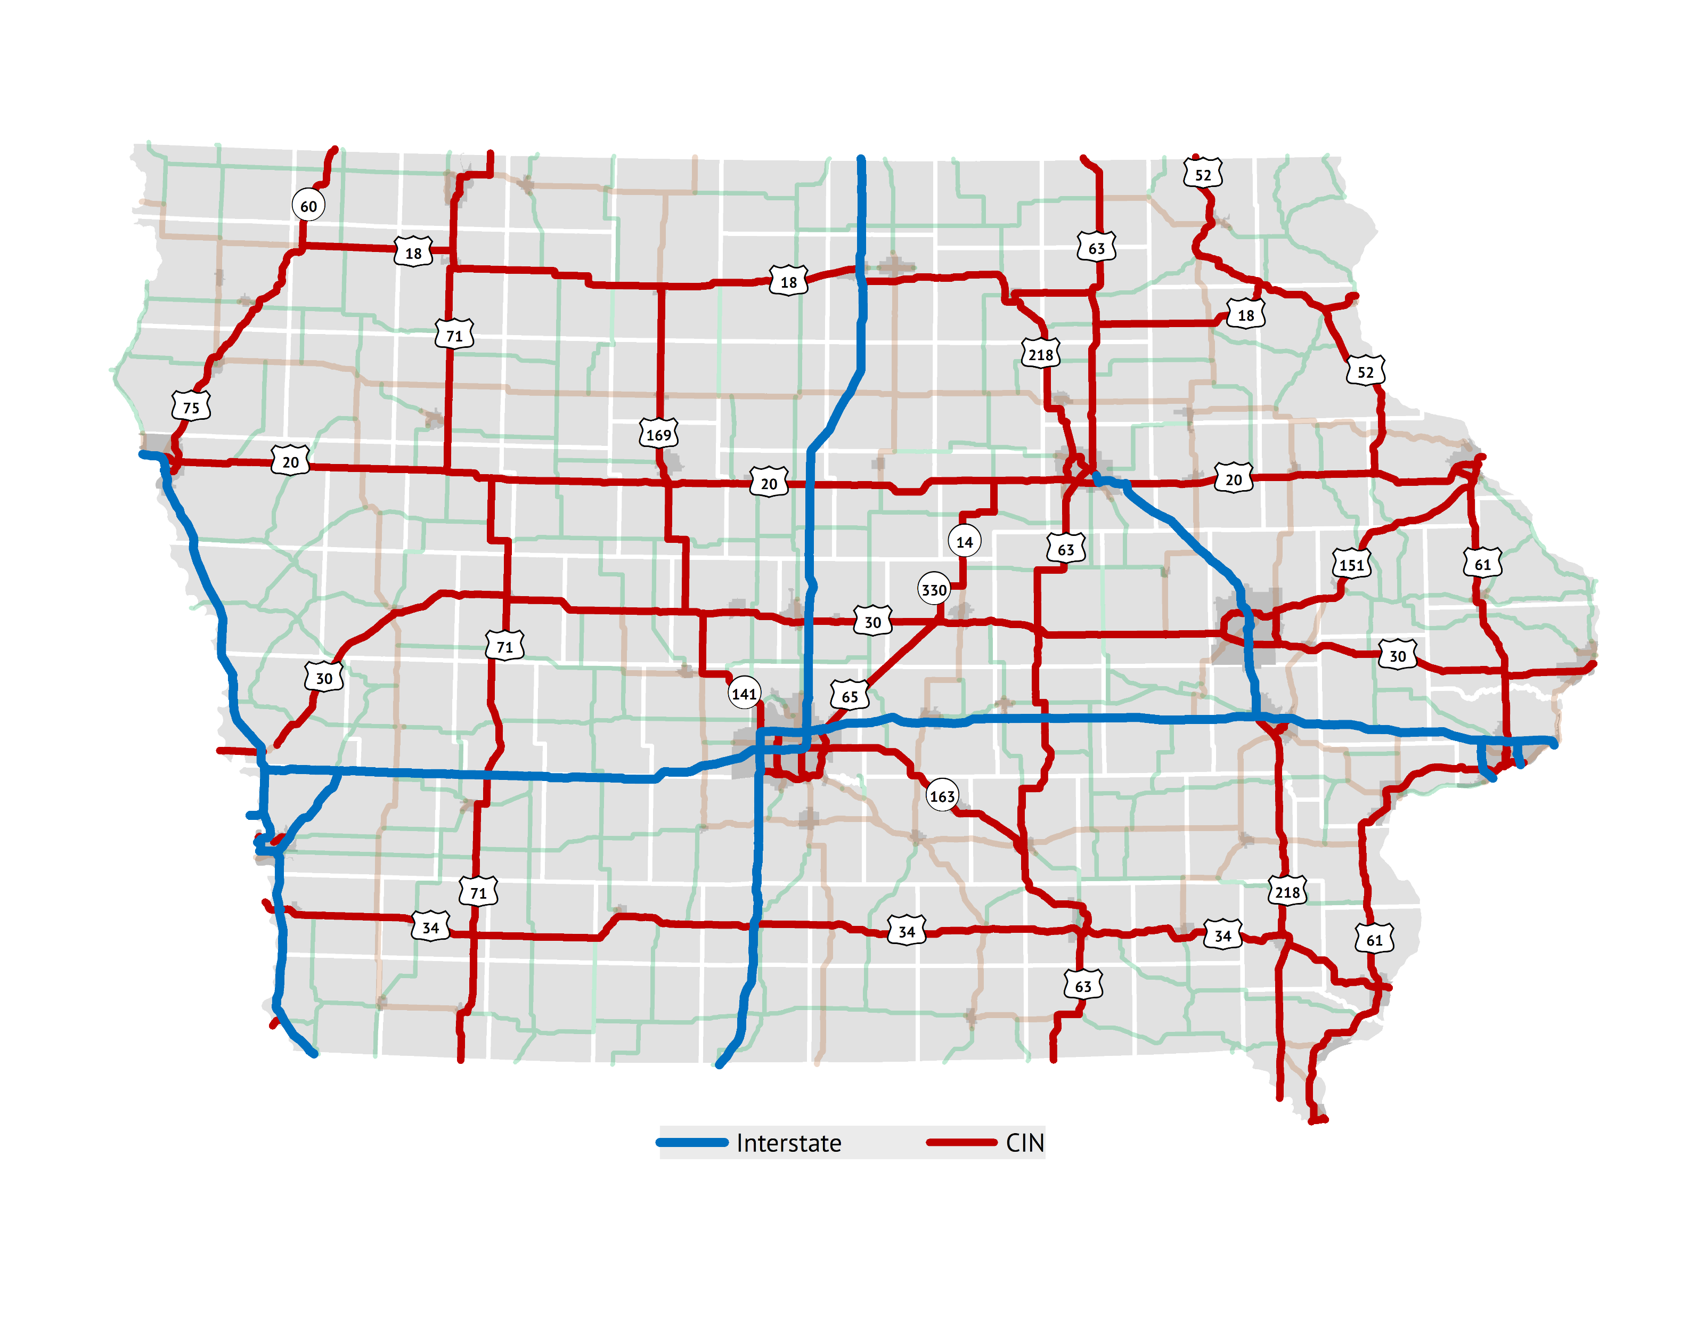
Commercial and Industrial Network
State legislature directed Commission to designate a network of commercial and industrial highways
Purpose:
Improve the flow of commerce
Make travel more convenient, safe, and efficient
Better connect Iowa with regional, national, and international markets
Enhance opportunities for the development and diversification of Iowa’s economy
Notes:
(Map option to right is the more standard alternative.)
Text from last presentation’s notes:
1988: Legislature directed the designation
Required the Commission to concentrate a major portion of its annual construction budget on this network
Aligns well with the Commission’s recent emphasis on Super-2 improvements on several of these corridors.
Per Mike, there are 2543 miles of open, public, cardinal direction mainline routes on the CIN

Slide 8
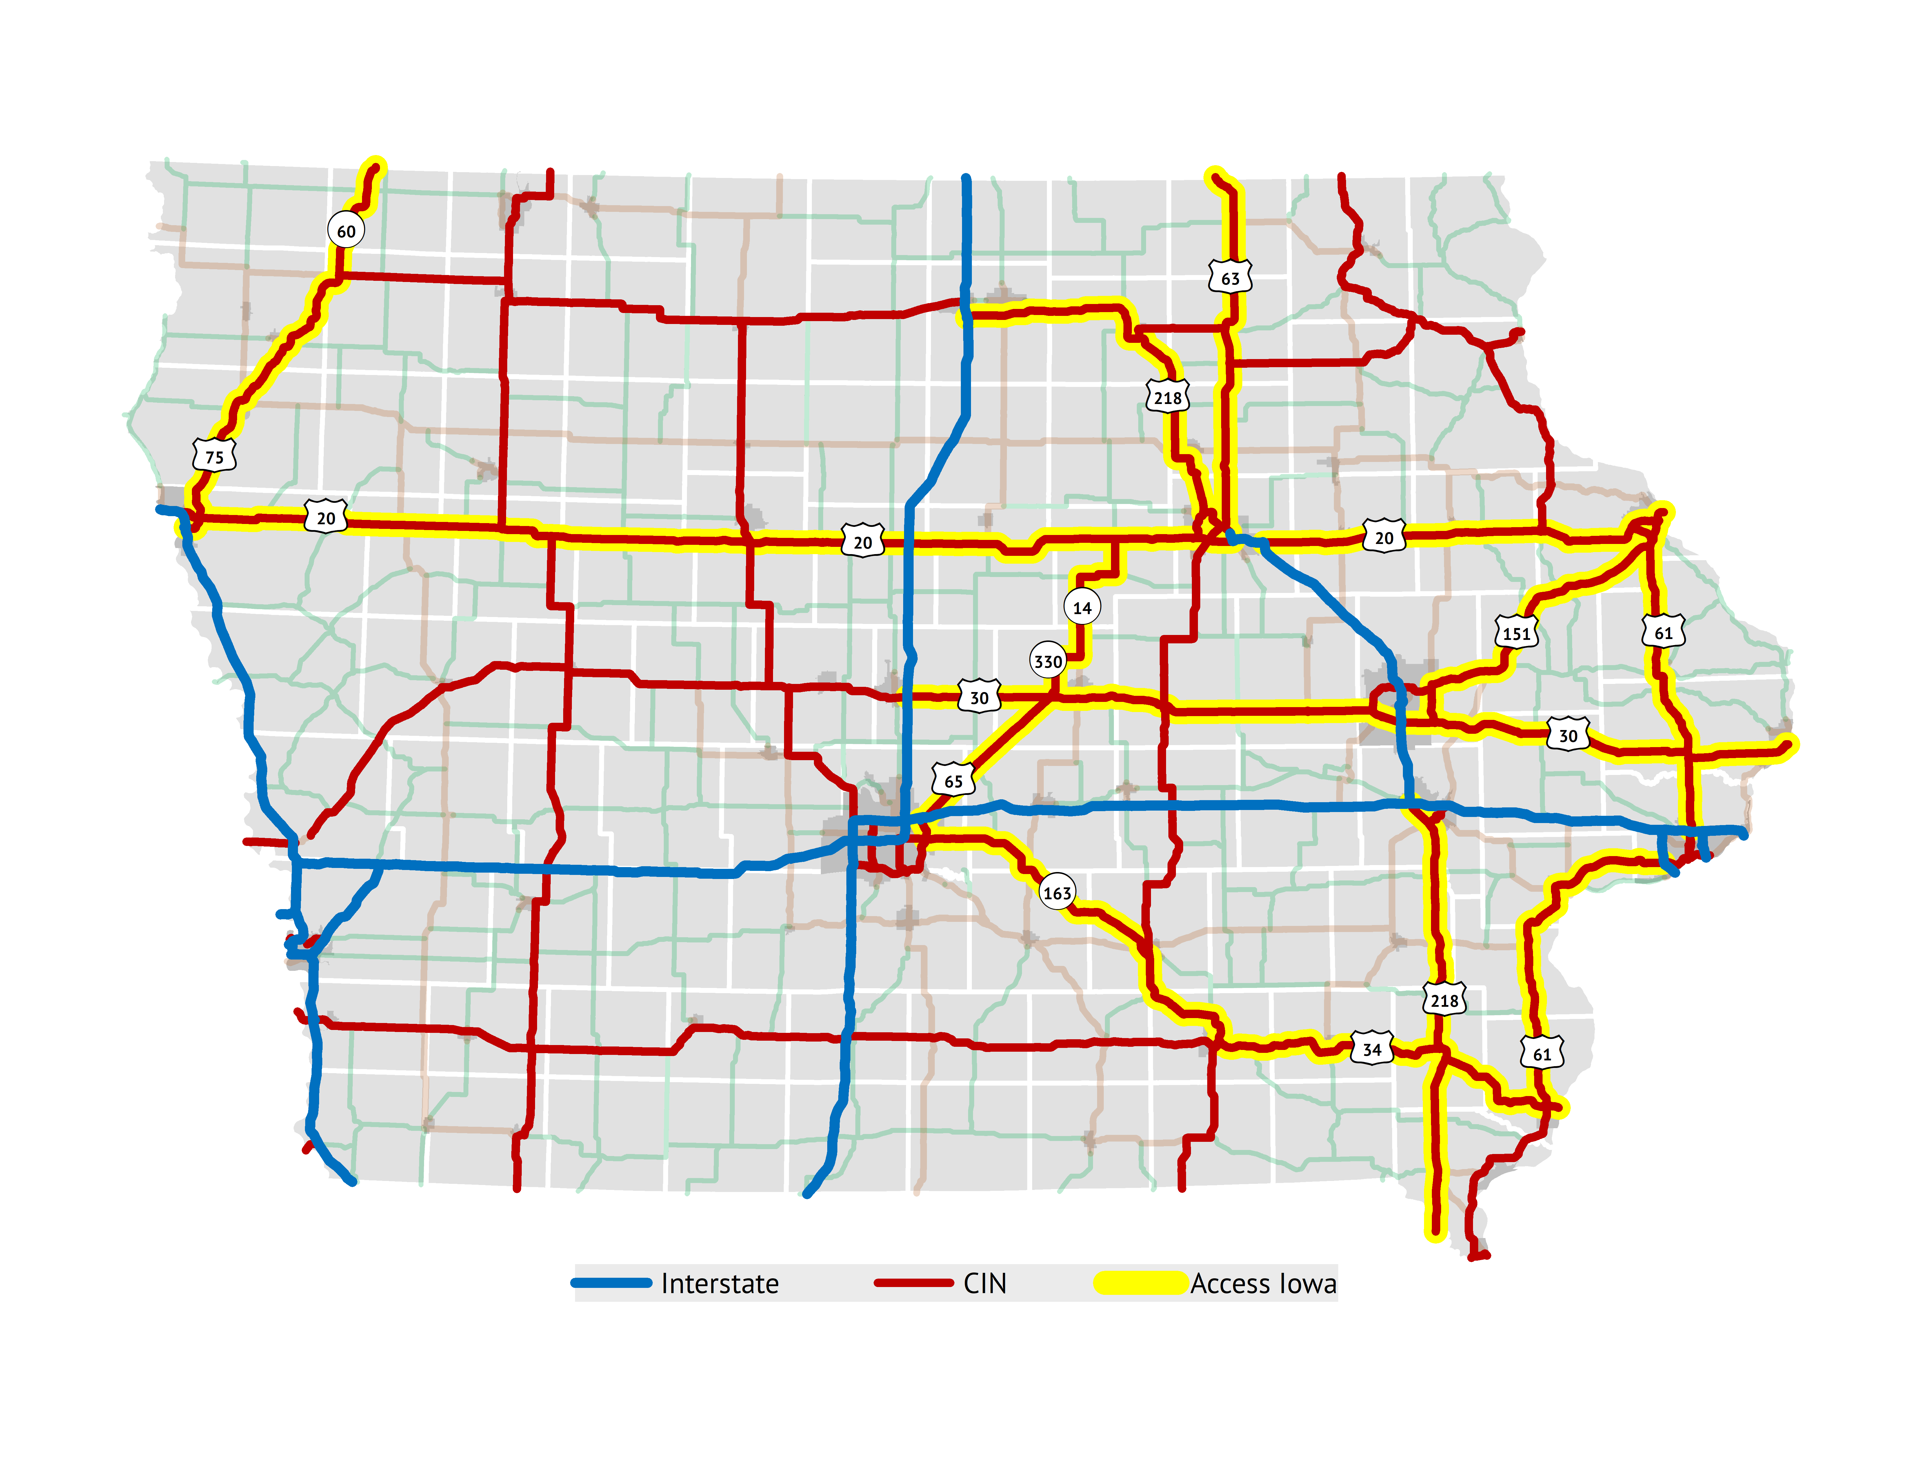
Access Iowa
State legislature directed DOT to designate sub-system of CIN to connect areas with 20,000 population or greater to “expedite and accelerate” development
Access Iowa represents approximately half of the CIN
Notes:
(Map option to right is the one from the last presentation.)
Access Iowa mileage is approximately 1,300 miles. (In old presentation it was 1,313. Current unofficial estimate is 1,277.)

Slide 9
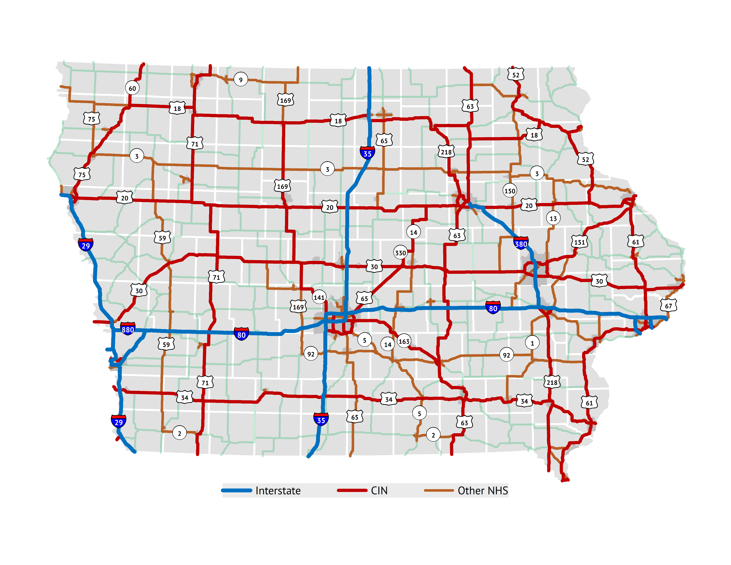
National Highway System (NHS)
Federally-designated system
Includes Interstate System and other “Principal Arterial” routes
Includes full CIN
Small portion is locally-owned
Purpose:
“National Highway System consists of roadways important to the nation's economy, defense, and mobility”
Eligible for federal National Highway Performance Program (NHPP) funding
Performance management reporting
Notes:
(Map options to right are the more standard alternative and the map from the TAMP.)

Slide 10
State Highway System Usage

Slide 11
State Highway System Mileage and Traffic
National Highway System (NHS) – 57%
Interstate
9%
Commercial and Industrial Network (CIN) - 29%
Other Primary
62%
Miles of
roads
National Highway System (NHS) – 87%
Interstate
40%
Commercial and Industrial Network (CIN) 33%
Other Primary
27%
All Traffic
National Highway System (NHS) – 92%
Interstate
59%
Commercial and Industrial Network (CIN) - 27%
Other Primary
14%
Large Truck
Traffic
Notes:
(The recent system stratification is implied in these graphics.) This slide illustrates the dominance of the Interstate and CIN for moving traffic.

Slide 12
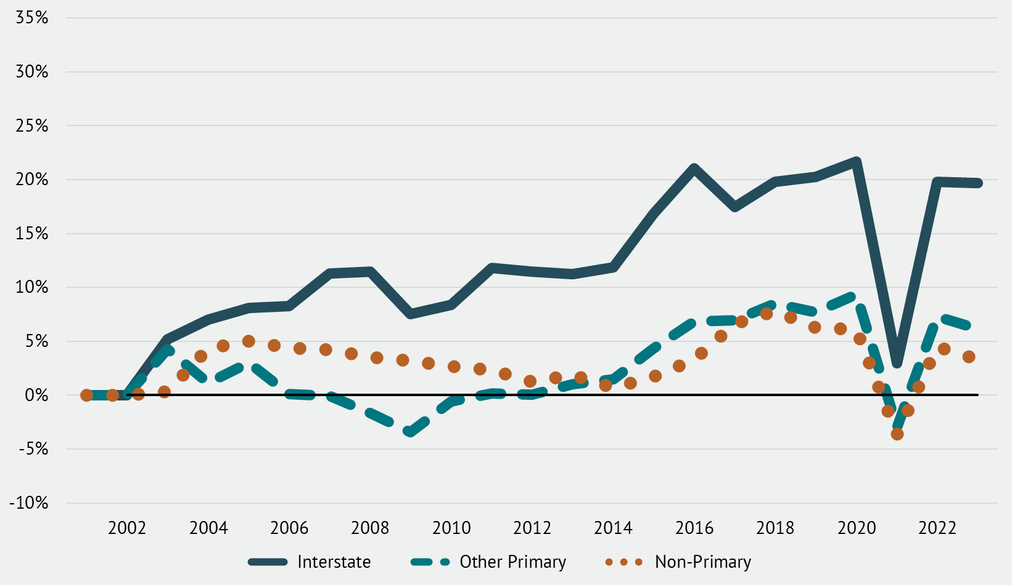
Traffic – Percent Change since 2001
Based on Vehicle Miles Traveled (VMT) in Iowa, 2001-2022
Notes:
Growth was more rapid during the 1990s. Since 2000, have seen slower growth over time. Forecasting about 0.5% growth per year over time. It’s interesting to see impacts of Great Recession and Pandemic. Additionally, Interstate traffic growth has been much higher than the rest of the system.

Slide 13
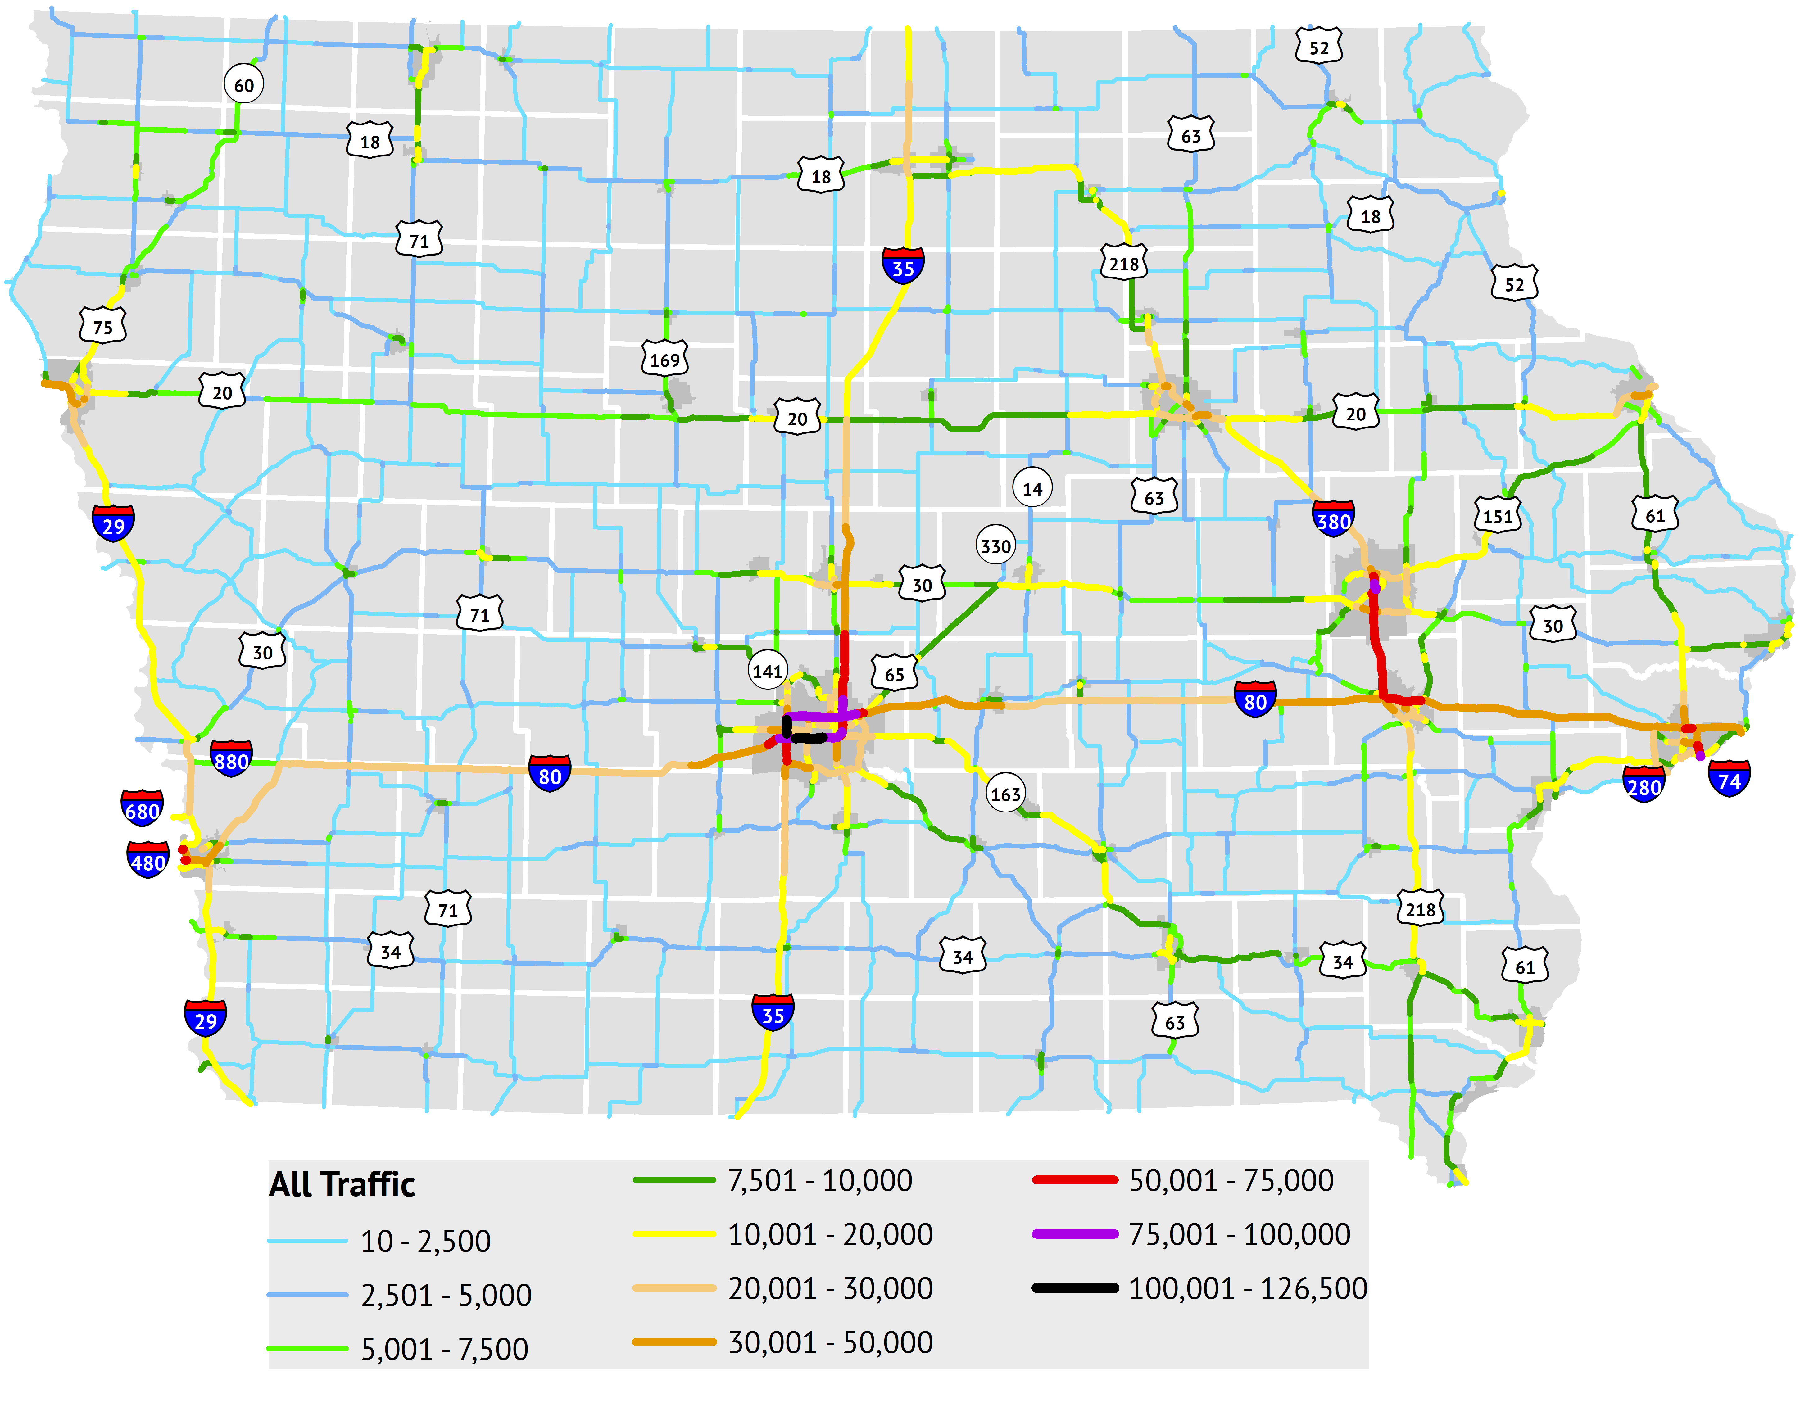
Traffic Volume
Annual Average Daily Traffic (AADT); 2022
Notes:
Shows expected pattern of concentration in metro areas and on interstates; commuter corridors on 35 and 380 stand out.
(Map off slide shows the Access Iowa routes highlighted, does a good job of capturing highest AADT routes. Which makes sense since they connect to urban areas over 20K.)

Slide 14
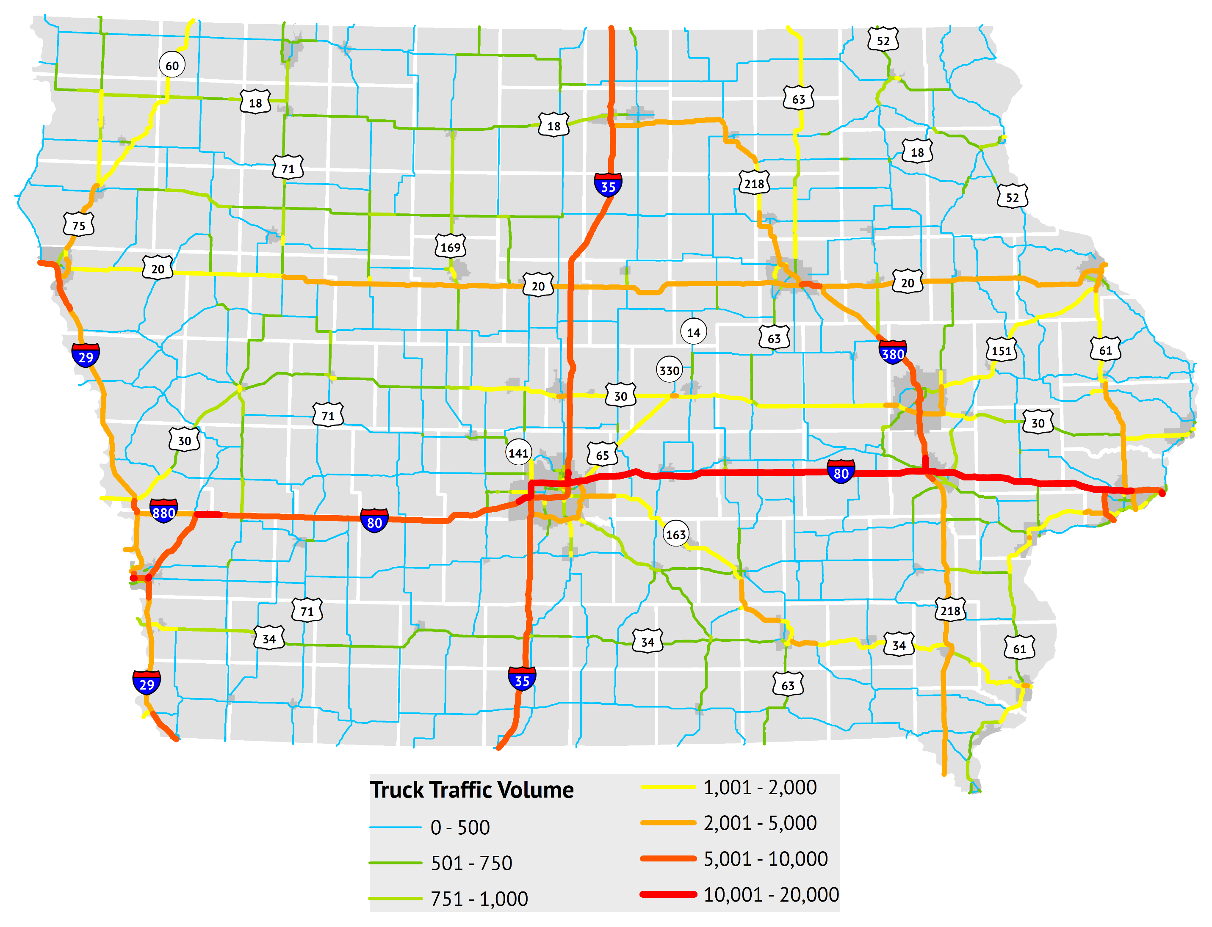
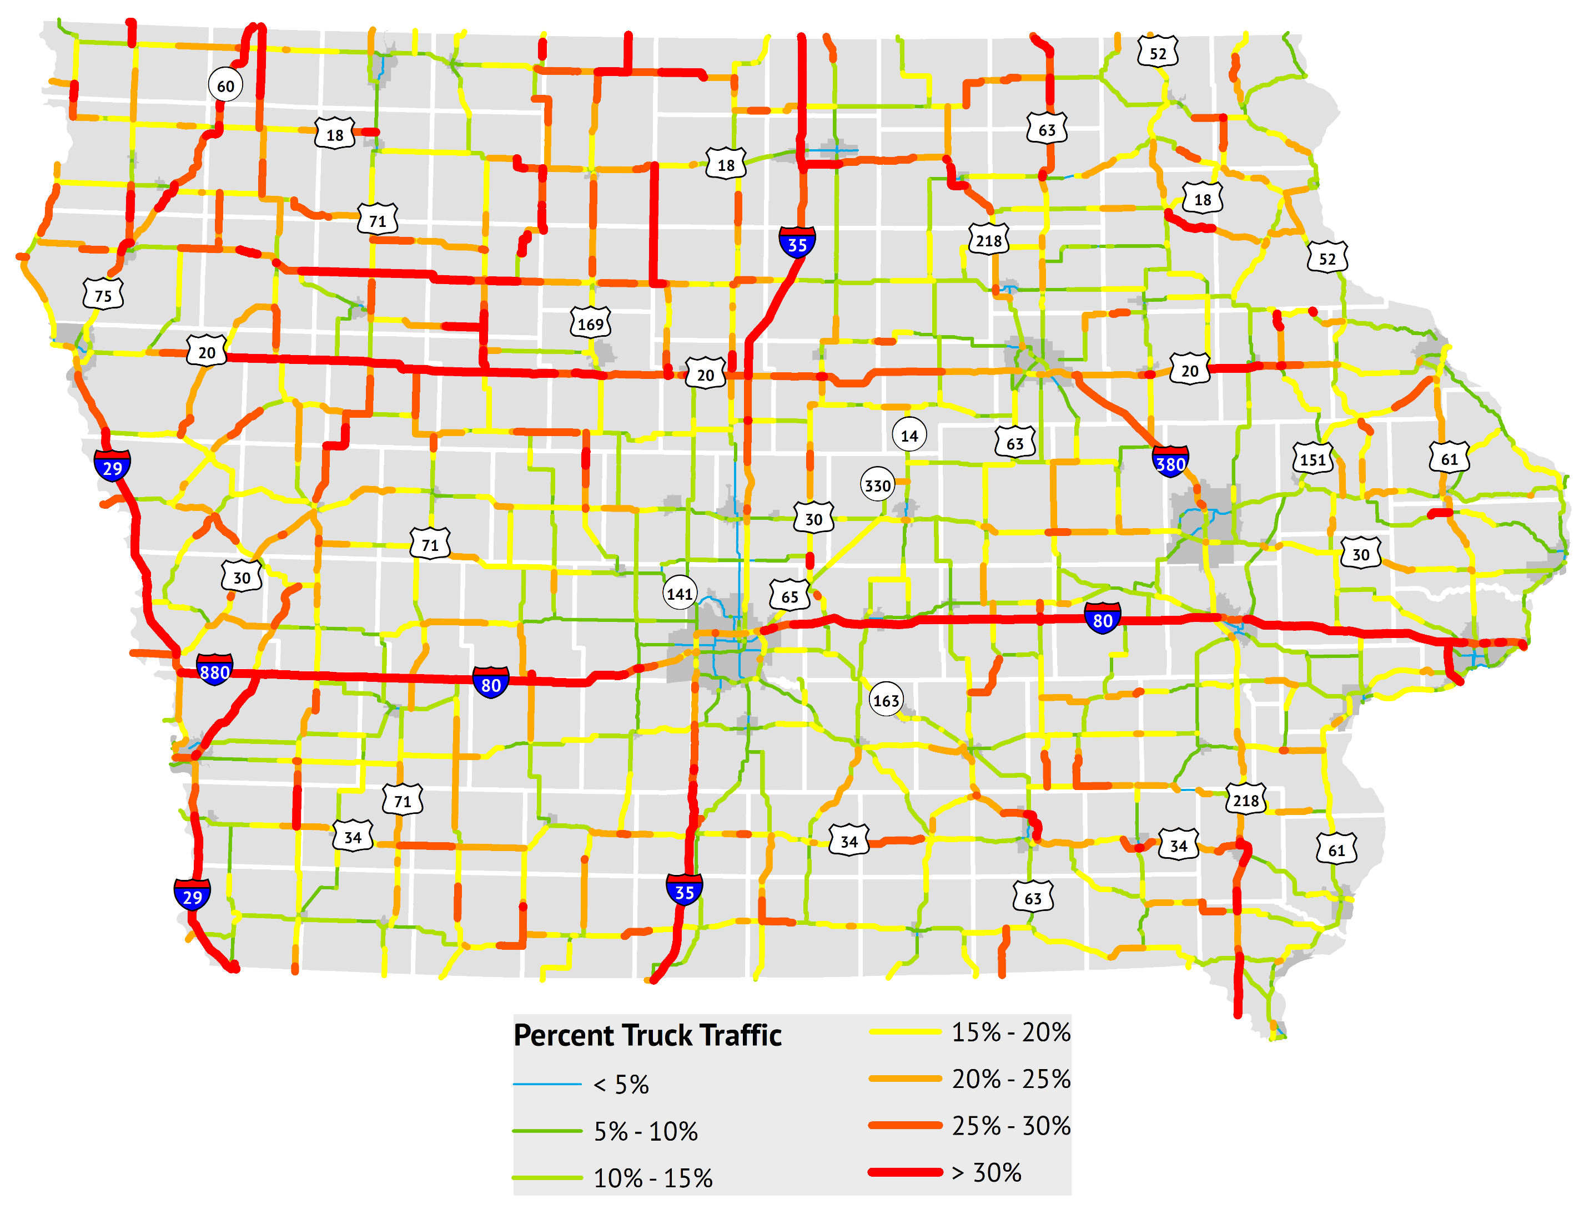
Truck Traffic Volume
Annual Average Daily Truck Traffic (AADTT); 2022
Notes:
Truck Traffic Volume – Interstates and CIN stand out significantly compared to other highways. (See map that is off slide.)
Only about 2 miles of highways that are not on the Interstate or CIN have more than 2,000 trucks per day.
Percent Truck Traffic – notice low numbers in metro areas and cities due to much heavier passenger traffic. NW Iowa doesn’t have high truck traffic overall, but has high percent trucks (most productive ag area of state in terms of crops and hogs)

Slide 15
Highway Planning and Programming

Slide 16
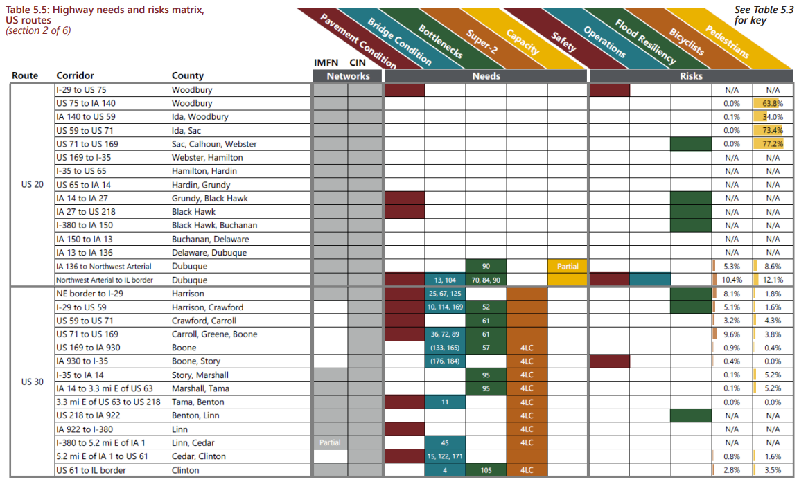
Planning and Programming Process: Key Metrics
Condition: Pavement Condition Index (PCI), International Roughness Index (IRI), Bridge Condition Index (BCI)
Safety: crashes, crash rate, Potential for Crash Reduction (PCR)
Usage: traffic volumes (historical and forecasted), Vehicle Miles of Travel (VMT)
Operational efficiency: travel time indices, bottlenecks, Level of Service
Other: flood resiliency, transportation accessibility, etc.
Notes:
Slide focus: Policy goals & system objectives set through ELT/Commission, Business plan helps describe the operationalization of this. Plans like the SLRTP, SFP, TAMP provide the highest level view of the highway system, its needs and risks, and and strategies that help narrow our focus from a policy and system perspective.

Slide 17
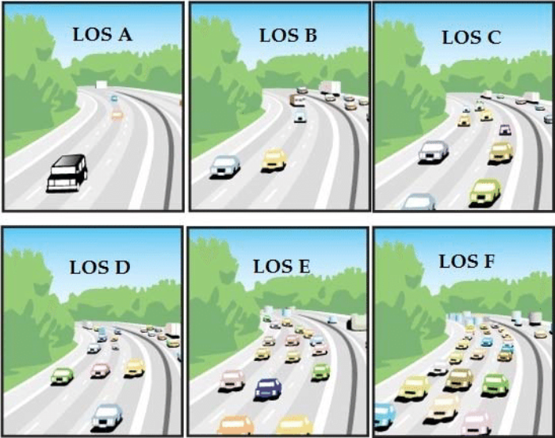
Planning and Programming Process: Level of Service
Describes quality of traffic flow
Expressed as A (best) through F (worst) rating
Generally, applies to “peak hour”
Similar metrics include volume-to-capacity (V/C) ratio
Used to estimate when additional travel lanes (i.e., capacity) may be needed
Notes:
Slide focus: Policy goals & system objectives set through ELT/Commission, Business plan helps describe the operationalization of this. Plans like the SLRTP, SFP, TAMP provide the highest level view of the highway system, its needs and risks, and and strategies that help narrow our focus from a policy and system perspective.

Slide 18
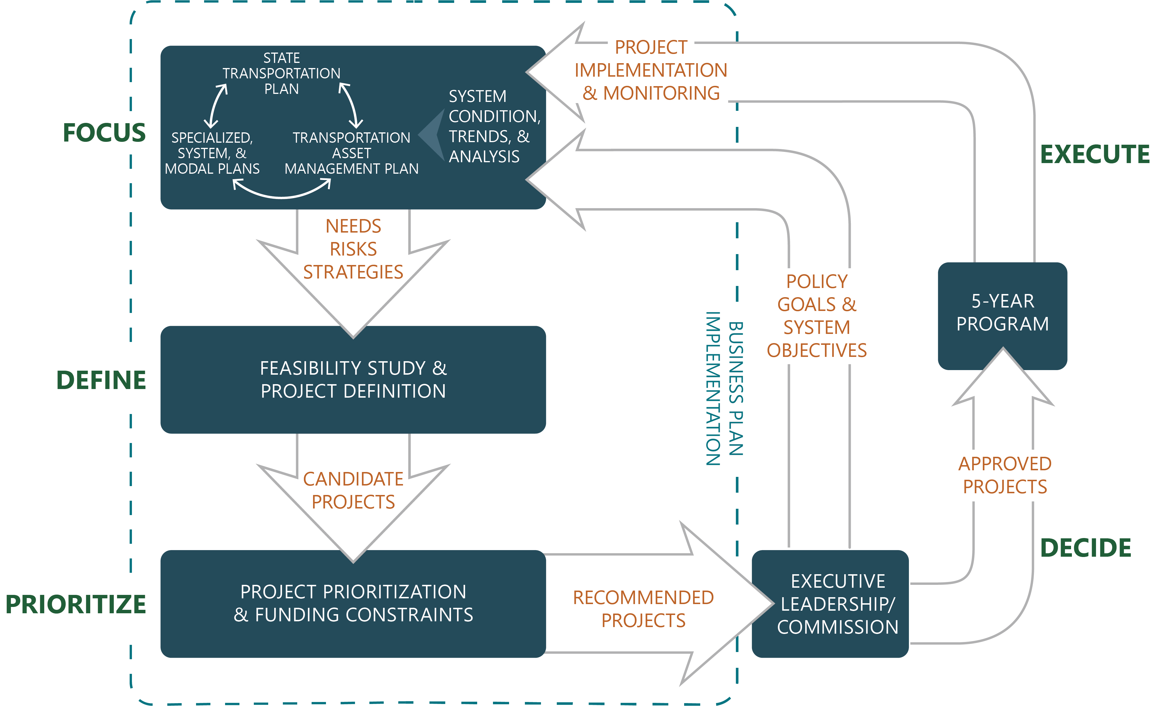
Planning and Programming Process
Notes:
The emphasis here is to provide an overview of the overall process. For each of the next four slides, a specific section of the diagram is highlighted, and the discussion will highlight the planning efforts or process steps that occur during it.

Slide 19
Planning and Programming Process: Focus
Notes:
Slide focus: Policy goals & system objectives set through ELT/Commission, Business plan helps describe the operationalization of this. Plans like the SLRTP, SFP, TAMP provide the highest level view of the highway system, its needs and risks, and and strategies that help narrow our focus from a policy and system perspective.

Slide 20
Planning and Programming Process: Define
Notes:
Slide focus: More specific plans and studies are developed based on the policies/strategies/needs identified in higher level plans. Corridor level plans provide a more detailed look at needs in a specific corridor and support project definition and the identification of candidate projects.

Slide 21
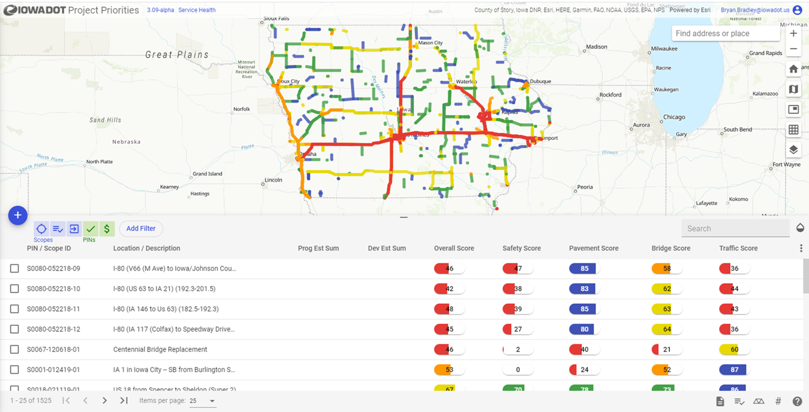
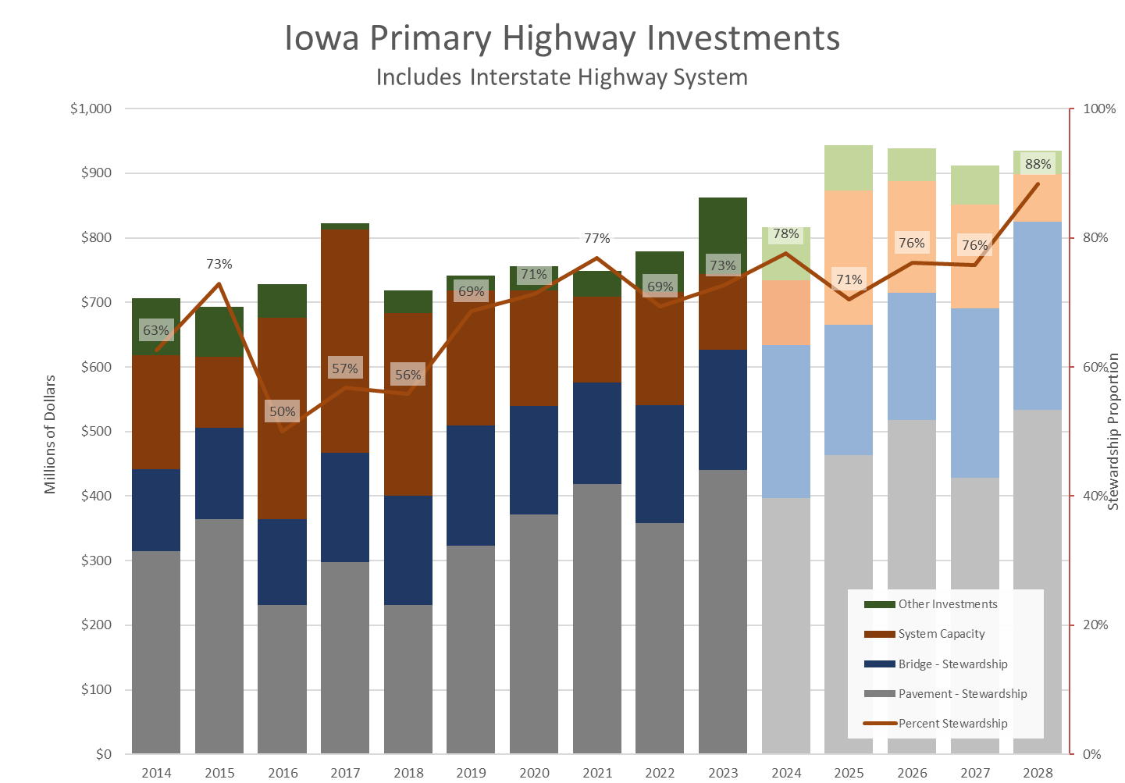
Planning and Programming Process: Prioritize
Notes:
Slide focus: Projects have to be weighed against each other and the overall funding available, including specific spending targets, to determine what to program for funding.

Slide 22
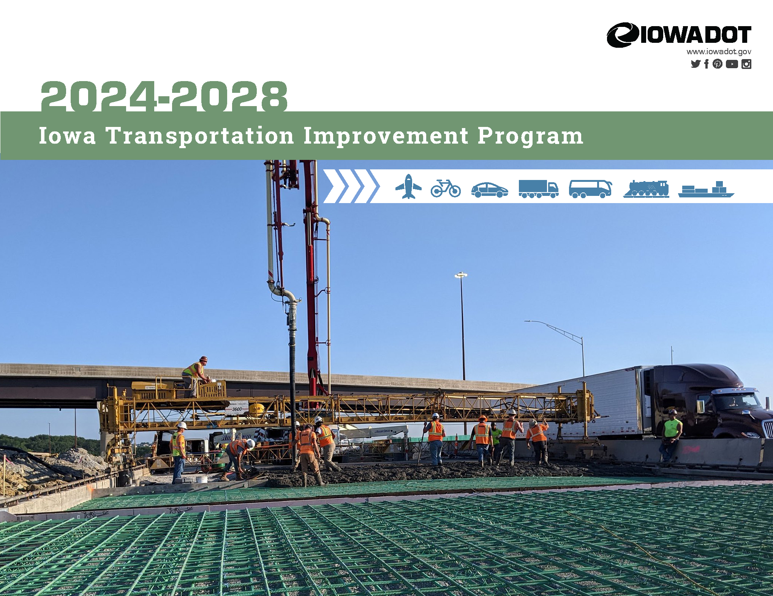
Planning and Programming Process: Decide and Execute
Notes:
Slide focus: Planning process has led to a recommended program of projects that is ultimately included in the 5YP upon Commission approval. After projects are completed, data/performance monitoring help track future condition and needs and feed back into the planning process. Highway planning and programming is an ongoing, continuous cycle of activity.

Slide 23
Questions?
Garrett.Pedersen@iowadot.us
515-239-1027

