Slide 1



Transportation Trends Update
September 10, 2024
3/2/2023

Slide 2
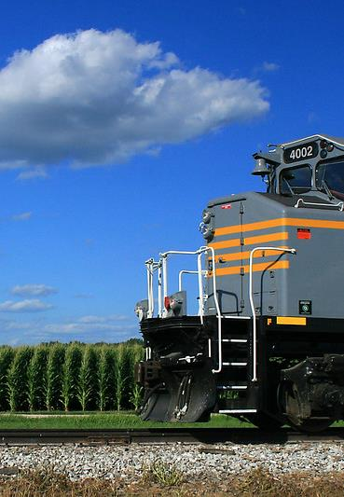

Agenda
US total rail carloads
Commercial air service passenger counts
Vehicular traffic

Slide 4
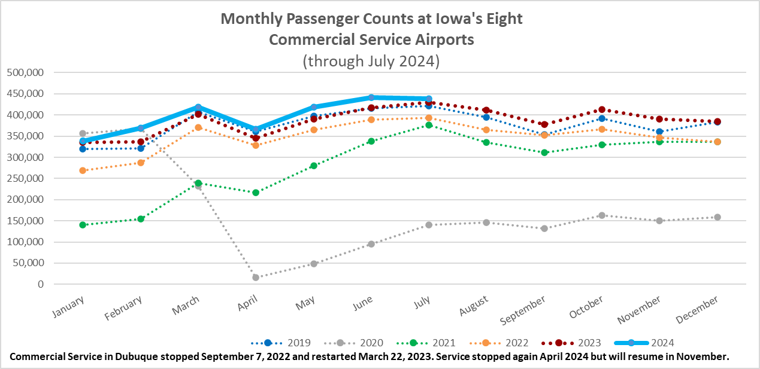

Slide 5
Monthly State Vehicle Miles of Travel
(through July 2024)

Slide 6
Water Transportation
Mississippi River
Drought in the Ohio River basin is worsening low water conditions on the lower Mississippi River.
Limits are being placed on drafts and how many barges can be towed.
Spike in barge transportation rates

Slide 7
Questions?

