Slide 1
October Commission Tour Preview
September 10, 2024
3/2/2023

Slide 2
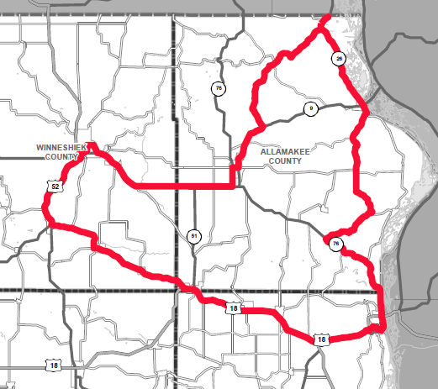
October Commission Tour Preview

Slide 3
October Commission Tour Preview
Begin tour at Hotel Winneshiek in Decorah
US 18 in Postville Pavement Rehabilitation and ADA
IA 76 Pavement Rehab and Rock Slide
Driftless Area Visitor Center-Lunch
IA 9 Bridge in Lansing
End tour at Hotel Winneshiek in Decorah

Slide 4
October Commission Tour Preview
Questions?
Shawn Majors
Shawn.majors@iowadot.gov​
iowadot.gov

