Slide 1
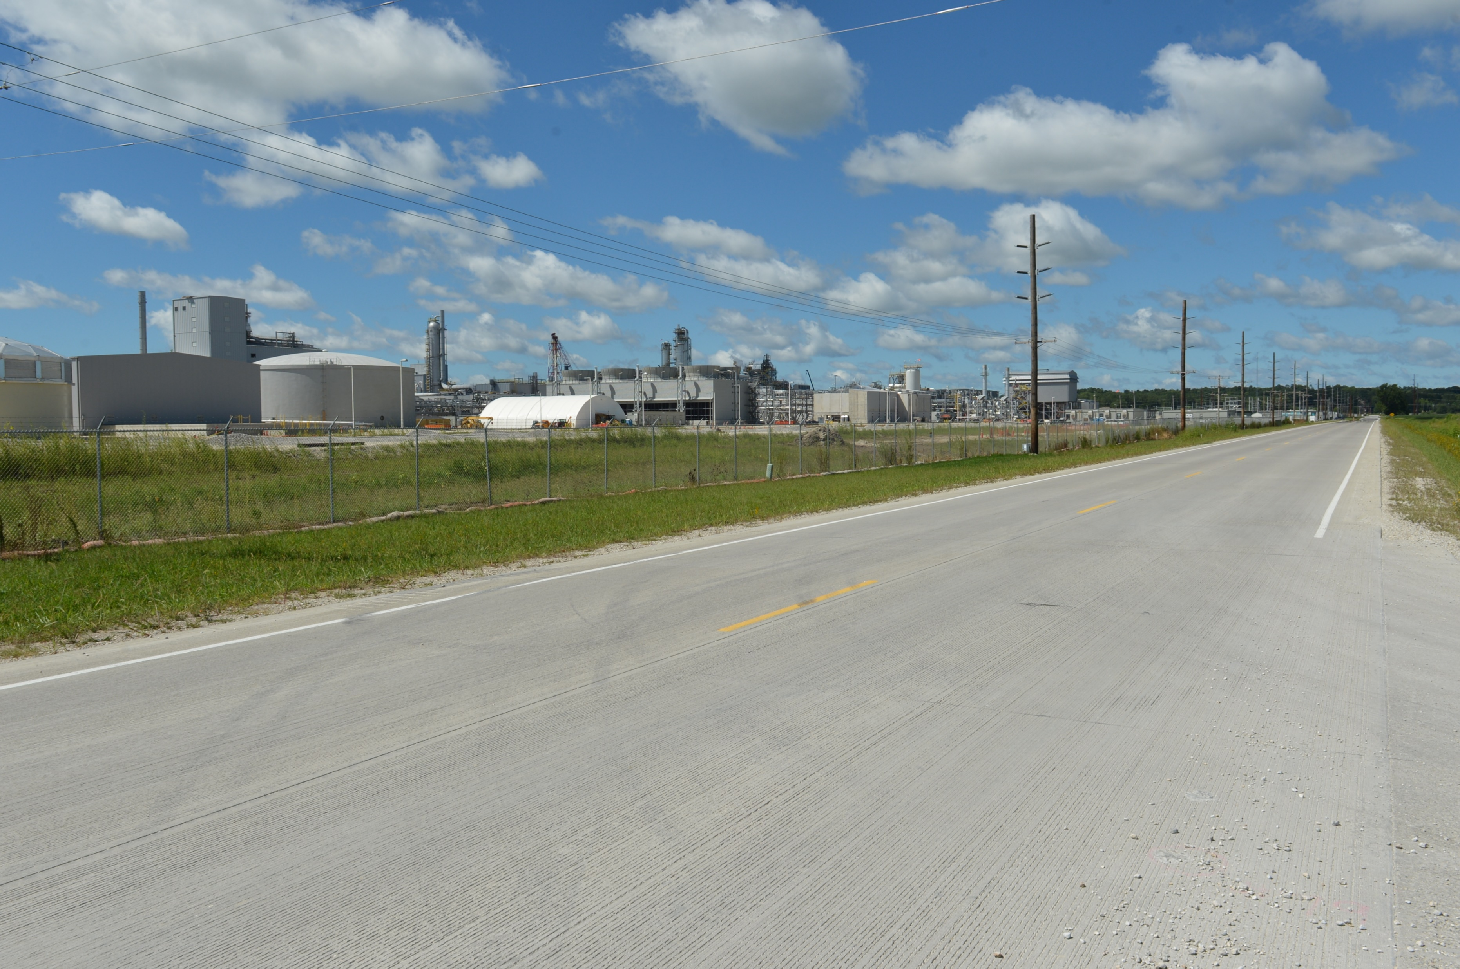
Revitalize Iowa’s Sound Economy
Business Relocation & Job Retention Local Development Program
Policy Discussion
Debra Arp
Grant Program Administration Team Lead
9/102024

Slide 2
Background
June 2024 – Devastating flooding impacted northwest Iowa
August 2024 – Introduced concept exploring how RISE could be leveraged to revitalize flooded communities and received Commission input
Today – Further discussion of potential policy revision and Commission input
2
2

Slide 3
Key Comments/Concerns from August
Is this new category consistent with the intent/purpose of the RISE program?
If implemented, would this use up all the RISE fund at the expense of “traditional” RISE projects? Should there be a cap on the fund requests?
Is 80 percent participation too high for this category?
We need to clarify the eligibility for this category – i.e. this is not about fixing damaged roads/bridges.
3
3

Slide 4
Creation of the RISE Program
Iowa’s economy in the early 1980s was in a depression
Rural farm crisis
Impact on ag-dependent manufacturing
Impact on meat packing and food processing
Iowa ranked 49th in total employment growth in the 1980s
Iowa’s economy needed “revitalization” through more diversification and more support for development in non-metropolitan areas.
1985 – Legislature created the Revitalize Iowa’s Sound Economy (RISE) Program
4
4

Slide 5
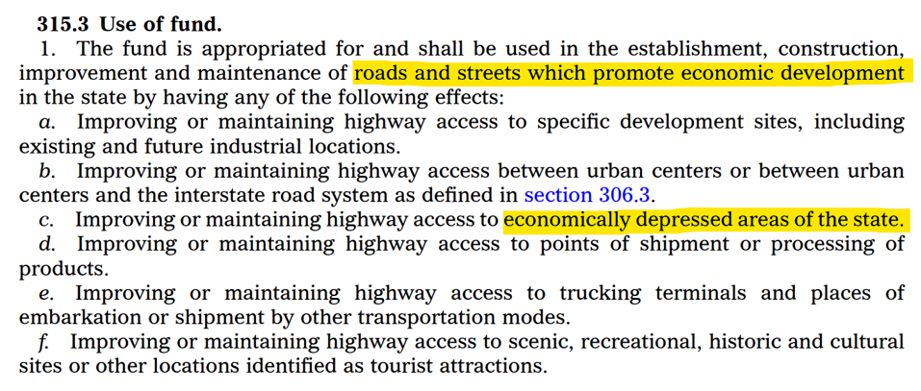
What is the intent of the
Revitalize Iowa’s Sound Economy program?
5
5

Slide 6
Should there be a cap on RISE fund requests?
Edited to highlight relevant content
6

Slide 7
Monthly Program Financial Report
Funded annually with dedicated state motor fuel and special fuel tax revenues
 | City RISE Fund | County RISE Fund
FY2025 Projected Total RISE Road Use Tax Fund (RUTF) Revenue ¹ | $11,611,933 | $5,805,967
Actual RISE Revenue Received as of 7/31/2024 ² (% of FY2025 Projected Revenue) | $934,829 (8.1%) | $467,415 (8.1%)
FY2025 RISE Funds Awarded as of 7/31/2024 (% of Projected Total RUTF committed) | $695,775 (6.0%) | $0 (0%)
Fund Balance as of 7/31/2024 | $54,629,888 | $21,398,495
Outstanding Commitments as of 7/31/2024 | ($40,162,451) | ($17,160,520)
Uncommitted Balance as of 7/31/2024³ | $14,467,437 | $467,415
¹ Calculation based on FY2024 average monthly RISE RUTF revenue of $967,661 to the city RISE fund and $483,831 to the county RISE fund. As of 7/31/2024, FY2025 is 8.3% complete.
² Actual RISE revenue includes RUTF revenue, loan repayments, and project settlements. These revenue sources are variable and are not included in projections.
³ End of FY2024 reversion to Secondary Road Fund of $3,770,560 is pending.
7
7

Slide 8
What are current RISE participation rates?
 | RISE Participation Rate
Immediate Opportunity | 80%
Local Development:
Standard | 50%
Certified Site (varies by size) - 50-499 acres certified - 500-999 acre certified - 1,000 acres or more certified | 60% 65% 70%
University Research Park | 70%
Business Relocation & Job Retention (Recommended) | 80% (original recommendation 70% (revised recommendation)
8

Slide 9
What would be an eligible community?
In a county covered by a proclamation of disaster emergency by the Governor & Presidential Disaster Declaration
Flooded businesses requesting permanent relocation outside the flood hazard area
Every community in a county that experienced flooding would not be eligible to apply
9
9

Slide 10
What would an eligible project look like?
Very similar to other standard Local Development projects
Requests to build new roadways outside the flood hazard area
An eligible project would not include repair to any existing roadways
10
10

Slide 11
Summary of Policy Proposal
Limited to communities that experienced state & federally recognized emergency events
Limited to communities where existing businesses are committing to permanent relocation out of the flood hazard area
Documentation of business interest in relocation and the economic distress of the community is required to be submitted with the application
Roadways are located outside of the flood hazard area
RISE participation held to 70% of eligible project costs
11
11

Slide 12
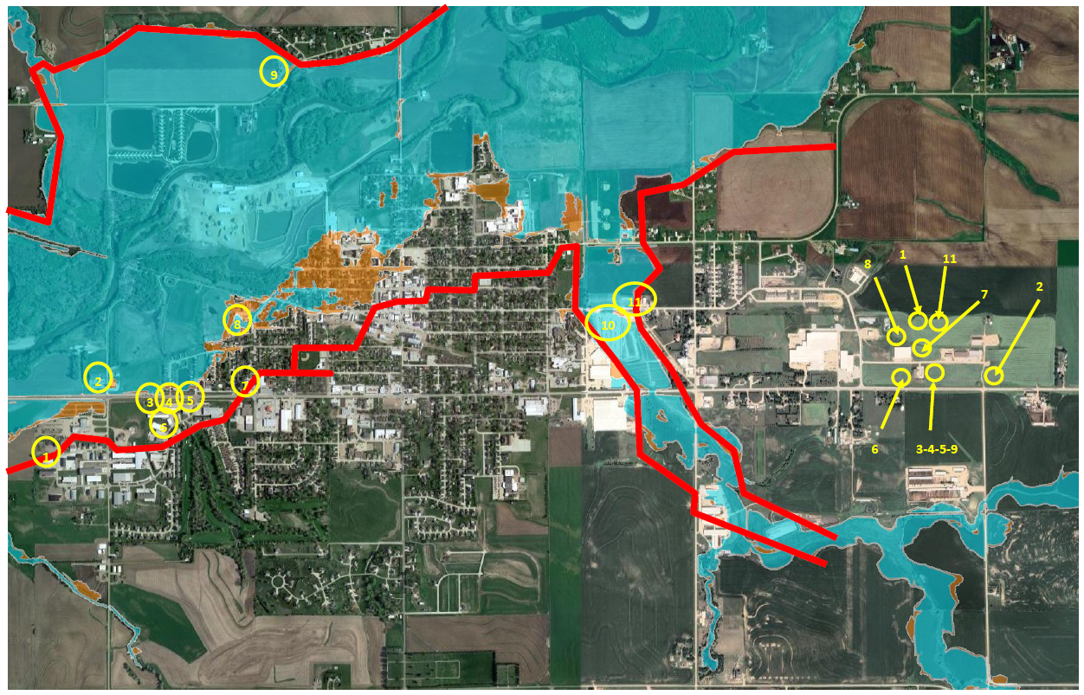
12
12

Slide 13
Rock Valley Business Relocation Interest
Rock Valley Business Park (Rock Ridge Dr) was awarded RISE in 2017 as a 29-acre 15-lot subdivision
Prior to the flood, 6 businesses were committed to the existing business park and the city was making plans for expansion to the north
Following the flood, +/-10 businesses have committed or shown interest in relocating to the new business park
Need for the expansion of the business park has been accelerated with the need to accommodate business relocation and provide developable land for continued growth
13
13

Slide 14
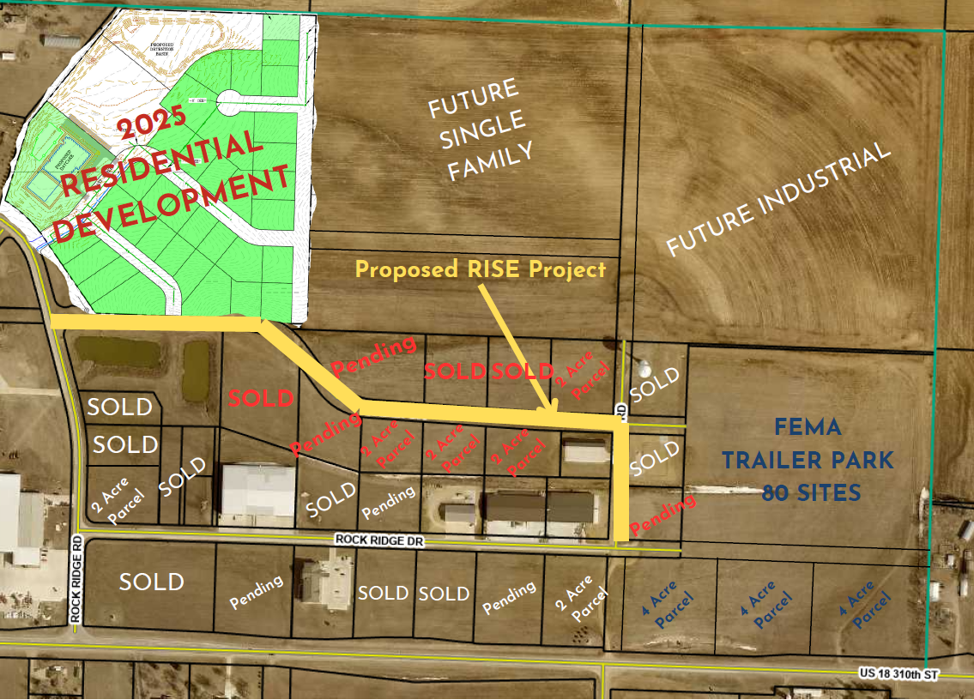
14
14

Slide 15
Rock Ridge Business Park Expansion
Provide access to 14 lots totaling approximately 25 acres
All utilities are available and sanitary sewer and water will be installed this fall
RISE improvements would include the construction of approximately 2,570 feet of Summit Drive & 541 feet of Tower Road.
Total RISE eligible projects costs = $2,133,000
Rock Valley has requested 80% in RISE funding or $1,706,400
Prepared to let in October 2024
15
15

Slide 16
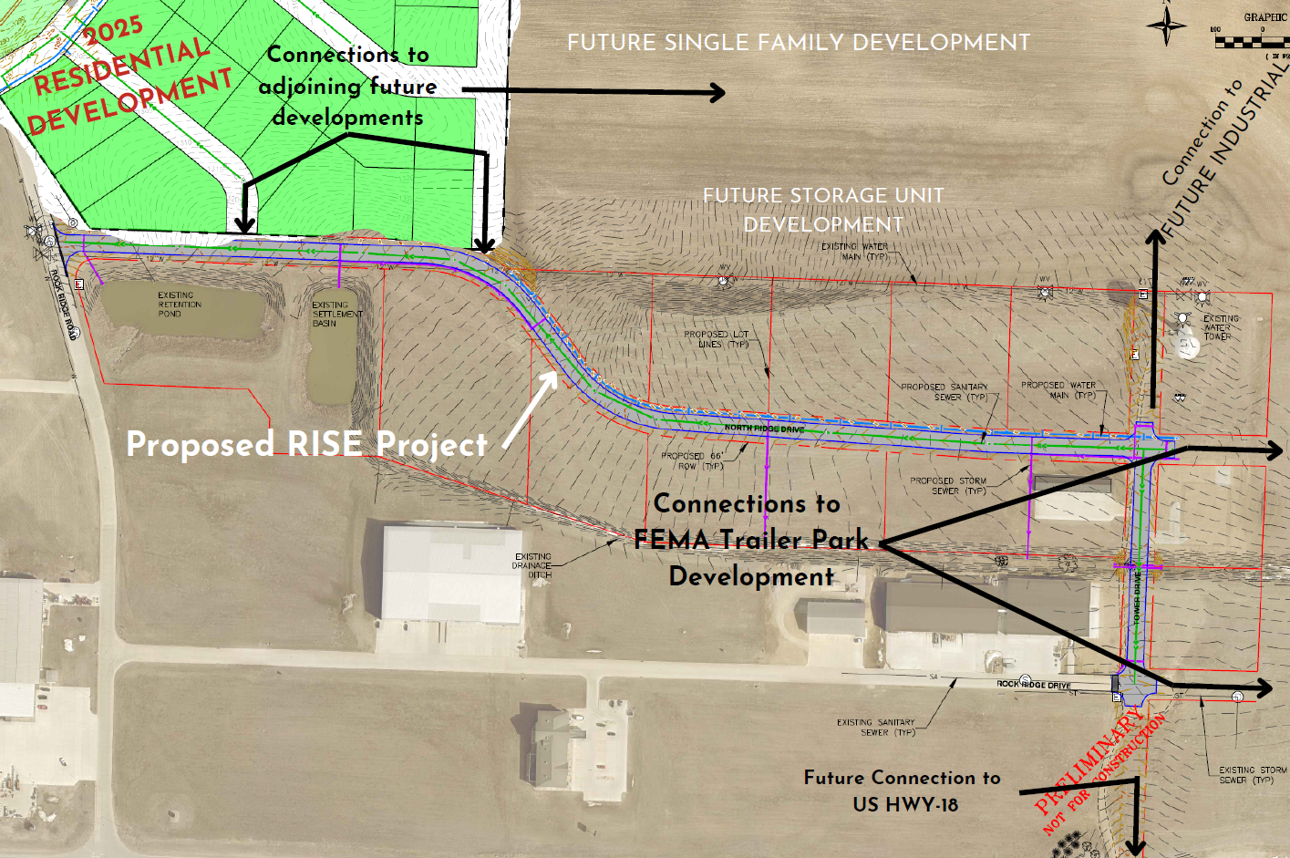
16
16

Slide 17
QUESTIONS?
17
17

