Slide 1
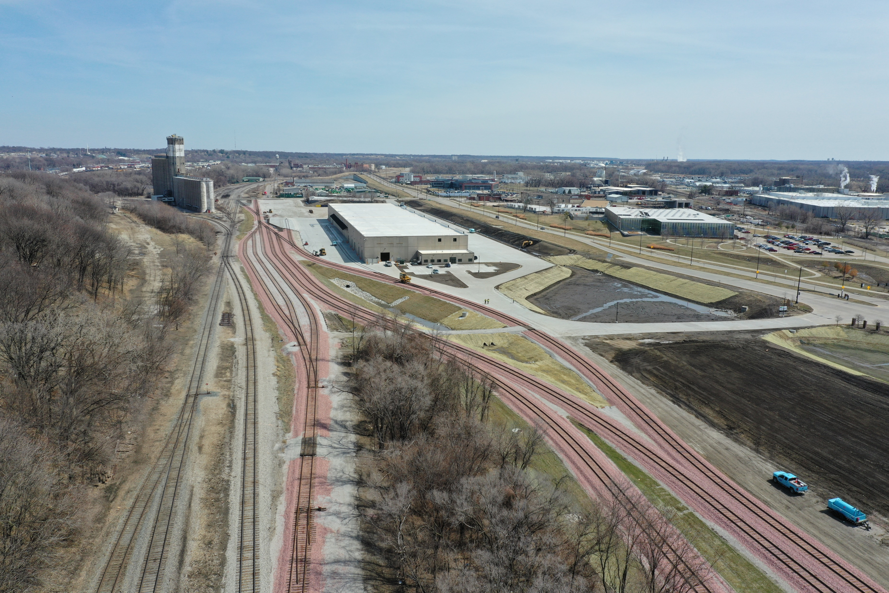
Rail Revolving Loan and Grant Program
FY2025 Funding Recommendation
Name
Title
September 10, 2024
FY 2025

Slide 2
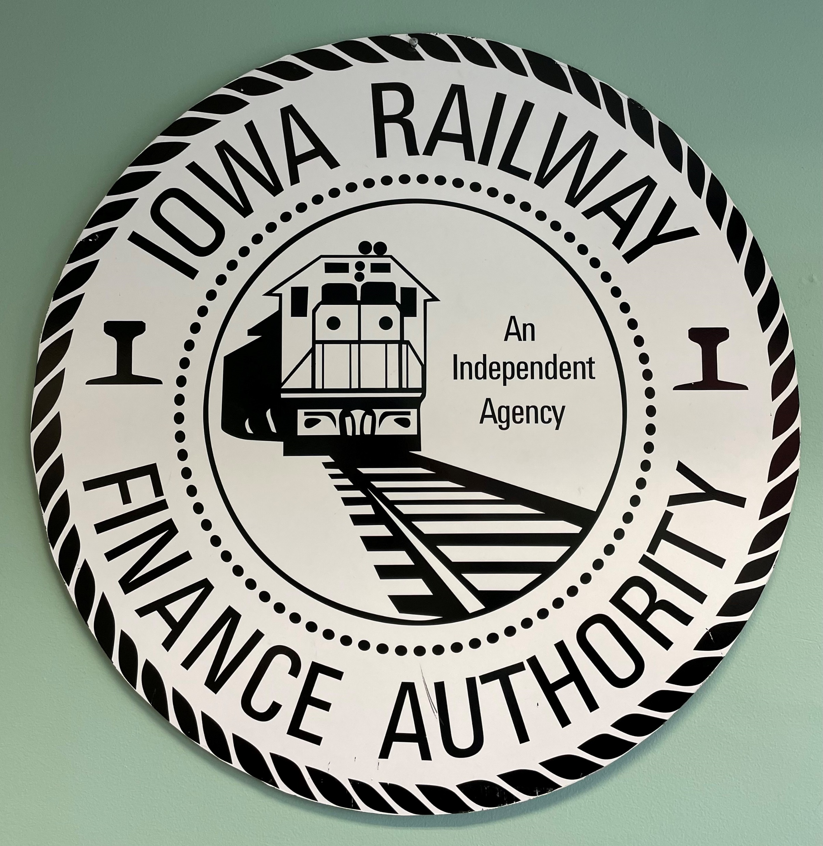
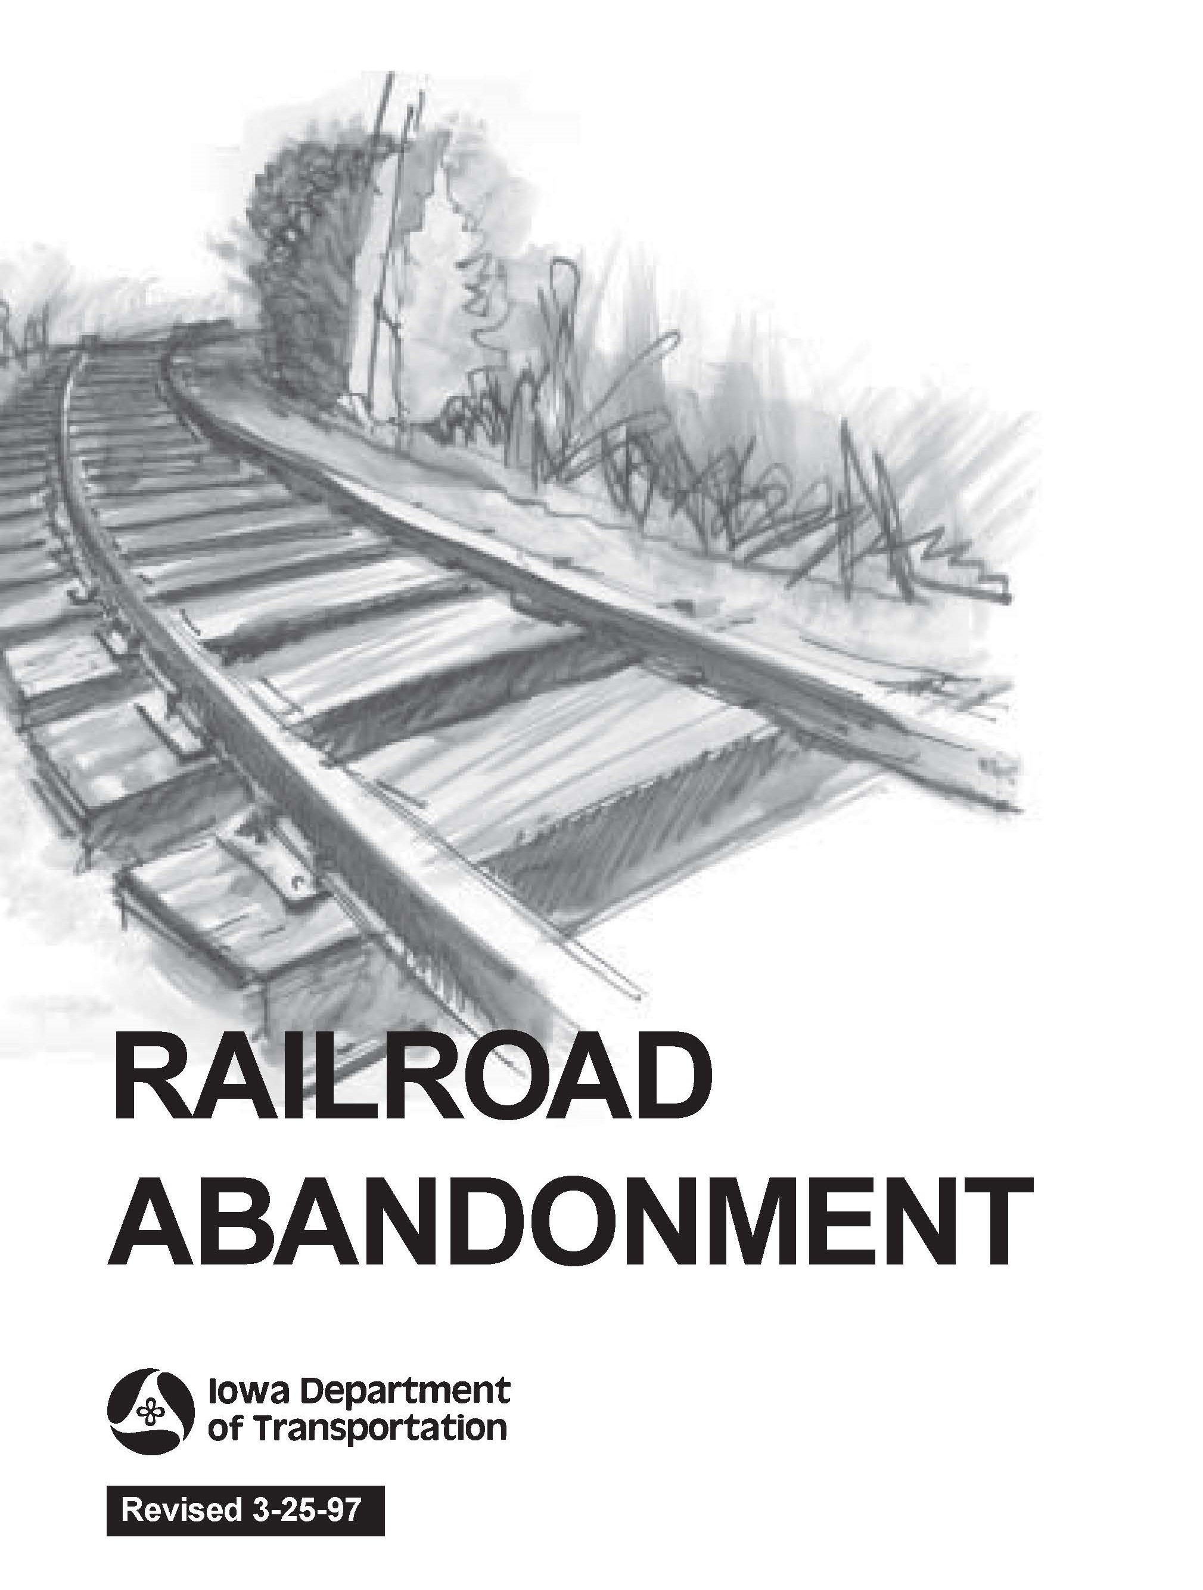
History
Created in 2005 by an amendment to Iowa Code 327H.20 and follows Administrative Rule 761, Chapter 822.
Created within what was Iowa Railway Finance Authority (IRFA).
The IRFA was created in 1980 and was active until 2009.
2
2

Slide 3
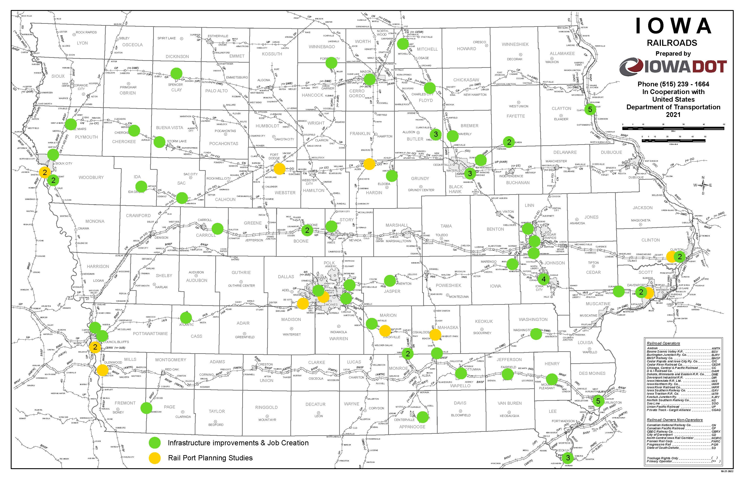
3

Slide 4
Gap between requests
and available funding
4

Slide 5
Parts of the Rail Revolving Loan and Grant Program
(1) Targeted jobs creation and retention (grant)
(2) Infrastructure creation or improvement (loan)
(3) Rail port planning study (grant)
Parts 1 and 2 can be combined.
5
5

Slide 6
Available Funding and Application Summary
Available Funding: | Column 2
Annual appropriation | $ 2,000,000
Unobligated | $ 1,791,323
Loan Repayments | $ 1,270,063
Total Available Funding | $ 5,061,386
Application Summary:
Total number of projects | 7
Total rail project costs | $ 29,950,801
Total amount requested | $ 16,787,150
6
6

Slide 7
Targeted Jobs Creation
PROJECT NAME | SPONSOR | TOTAL PROJECT COST | REQUESTED AMOUNT (% of Total Project Cost) | RECOMMENDED AMOUNT (% of Total Project Cost)
A-Line EDS Rail Spur | A-Line E.D.S. Waterloo | $4,000,000 | Grant $60,000 (1.5%) Loan $3,140,000 (78.5%) | Grant $60,000 (1.5%) Loan $1,249,000 (31.2%)
Appanoose County Rail Extension | Appanoose County Community Railroad Centerville | $6,000,000 | $1,200,000 (20%) Grant only | $600,000 (10%)
Rail realignment - flood protection gate | City of Cedar Rapids | $10,500,000 | $5,000,000 (48%) Grant only | $0
7
7
Notes:
A-Line – grant 100%, loan 40.9% of request
Appanoose County - 50%, this will meet the requirement for a 50% local match
Cedar Rapids – FY19, grant $1,028,000 for job retention related to flooding in this same area. Closed 5/26/2021 Jobs verification 7/25/2024.

Slide 8
Infrastructure Improvement Loan
PROJECT NAME | SPONSOR | TOTAL PROJECT COST | REQUESTED AMOUNT (% of Total Project Cost) | RECOMMENDED AMOUNT (% of Total Project Cost)
BJRY Rail Yard and Transload Expansion | Burlington Junction Railway Burlington (BJRY) | $343,132 | $257,349 (75%) | $257,349 (75%)
Heartland Co-op Greenfield Rail Loading Elevator | Heartland Co-op Millerton | $50,000,000 | $4,624,782 (9%) | $1,840,000 (4%)
Reid Line Dexter IA Rail Yard Improvements | Reid Line LLC Dexter | $6,507,386 | $2,405,019 (37%) | $957,000 (15%)
8
8
Notes:
BLRY - 100%. FY21 Burlington, FY17 Le Mars, FY13 planning study, FY12 Burlington, FY10, FY08 flood.
Heartland Co-op - 39.7%. RRLG-ST14(01)—9T-51 Loan for $1,450,000. Has one remaining payment July 2025.
Reid Line – 39.7%

Slide 9
Rail Port Planning and Development
PROJECT NAME | SPONSOR | TOTAL PROJECT COST | REQUESTED AMOUNT (% of Total Project Cost) | RECOMMENDED AMOUNT (% of Total Project Cost)
Webster City Rail Port Planning and Development Feasibility Study | City of Webster City | $120,000 | $100,000 (80%) | $100,000 (80%)
9
9

Slide 10
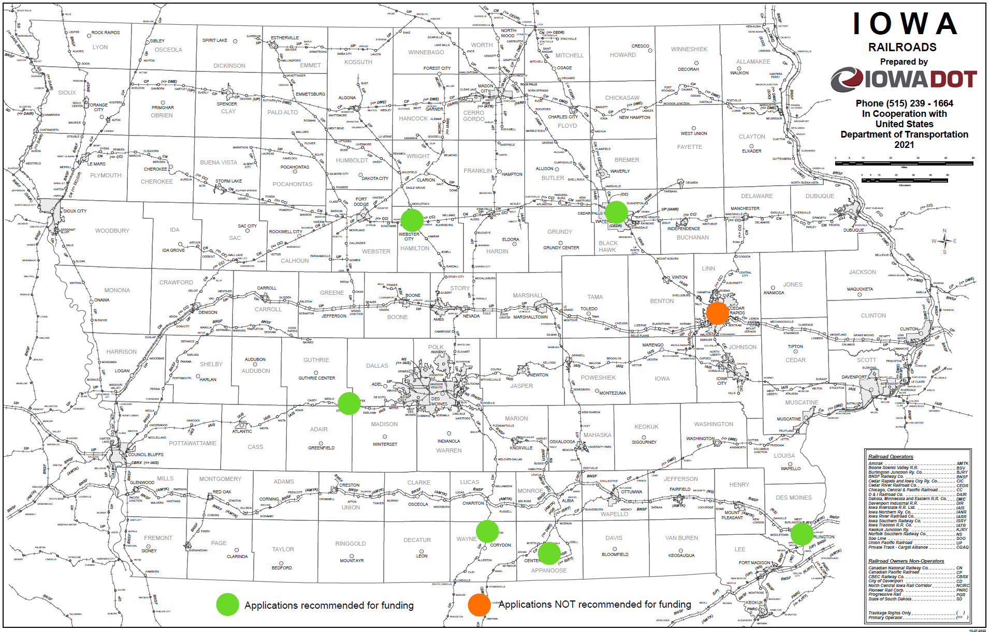
RRLG project locations & FY2025 Applications
10

Slide 11
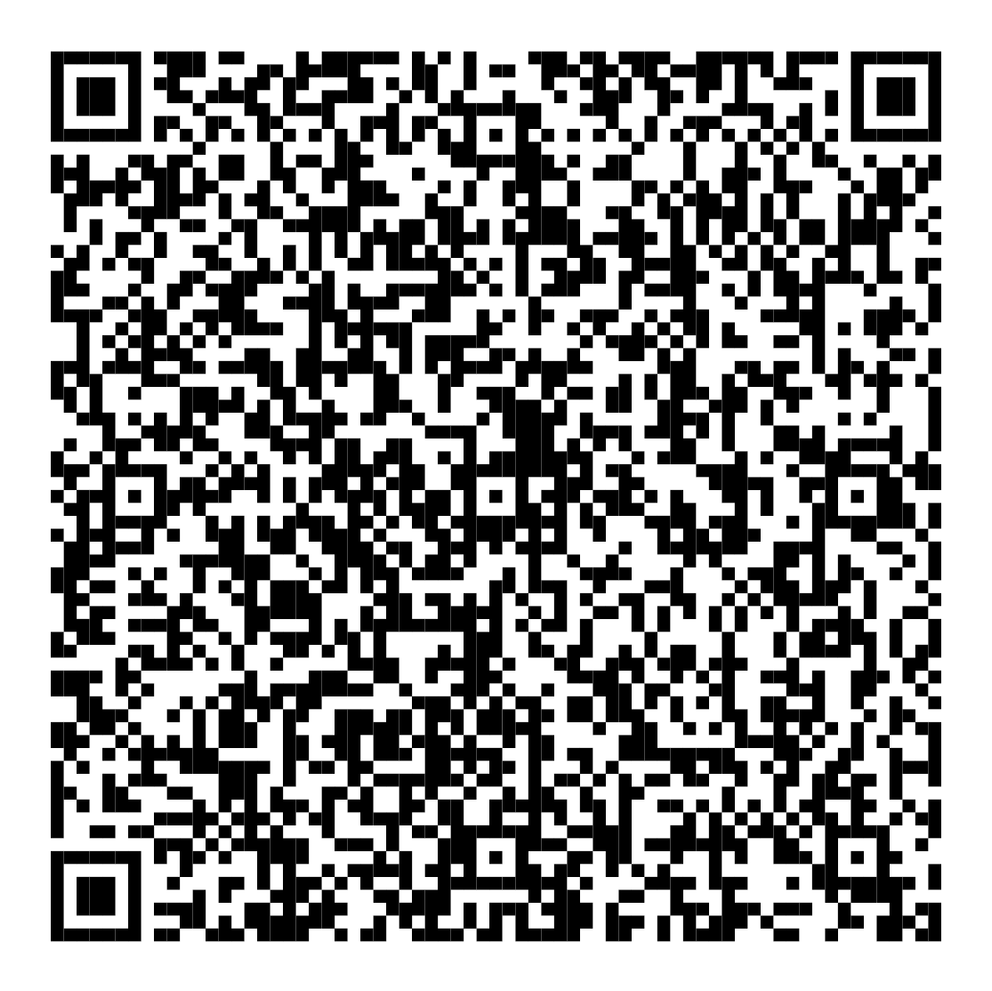
Questions?
james.glaspie@iowadot.us
515-567-0715

Slide 12
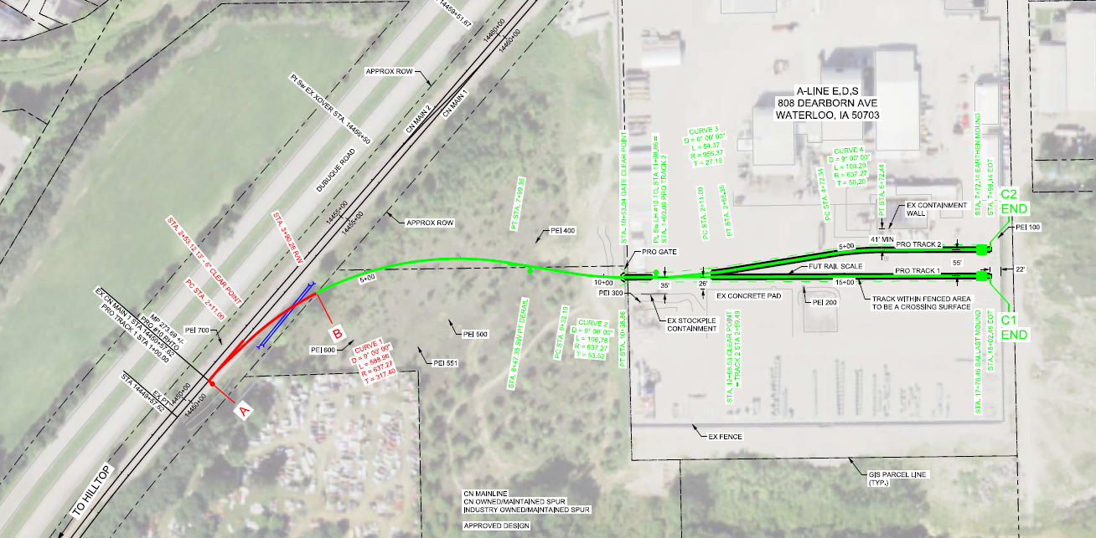
A-line E.D.S. rail spur (Waterloo)
A-line E.D.S. recycles electrical transformers from utilities companies. This new rail spur would allow mineral oil and scrap metal to be shipped out by rail using Canadian National (CN) and the potential for larger transformers to be processed at this facility.
Total Rail Cost: $ 4,000,000
Requested Loan: $ 3,140,000 (78.5%)
Requested Grant: $ 60,000 (1.5%) Jobs Creation: 10 & Retention: 5
12

Slide 13
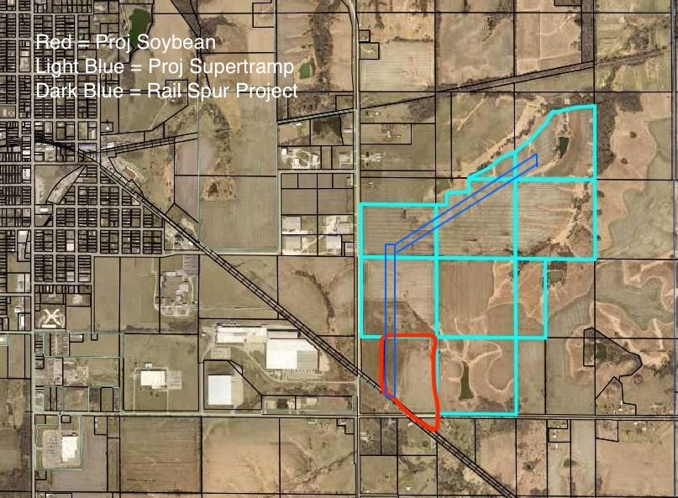
Appanoose County Community Railroad (Centerville)
This project would add a new rail spur and up to 6-miles of new track connecting Iowa Southern Railway (IASR) to proposed industrial sites East of Centerville, with connection to Canadian Pacific Kansas City (CPKC) . Two large agricultural produces are nearing the commitment stage in the development of these sites.
Total Rail Cost: $ 6,000,000
Requested Grant: $ 1,200,000 (20%)
Jobs Creation: 100
Appanoose County Community Railroad was
awarded an earmark of $6,000,000, and will be
administered through the FRA using a CRISI grant.
Part of RRLG will serve as the match required for
the CRISI grant.
Federal Railroad Administration (FRA)
Consolidated Rail Infrastructure and Safety Improvements (CRISI)
Project Soybean
Project Supertramp
Rail Spur Project
13
Notes:
This project has received a congressional earmark for 4.8 million dollars that will be administered as a Consolidated Rail Infrastructure and Safety Improvements (CRISI) grant through the FRA.

Slide 14
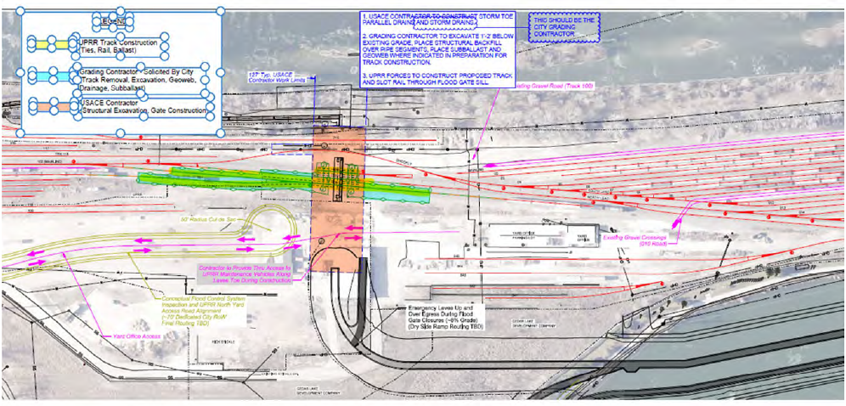
City of Cedar Rapids
This project involves constructing the line of protection through the existing Union Pacific (UPRR) Railyard, North of the PepsiCo Quaker processing plant. Costs include temporary shoofly around the gate site and the realignment of through the gate site upon completion. Rail costs do not include the flood gate.
Total Rail Cost: $ 10,500,000
Requested Grant: $ 5,000,000 (50%) Jobs Retained: 940
14
Notes:
Yard is owned by UP. UP participated in FY19 project, they are not for this application.

Slide 15
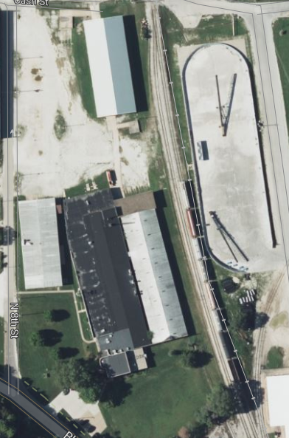
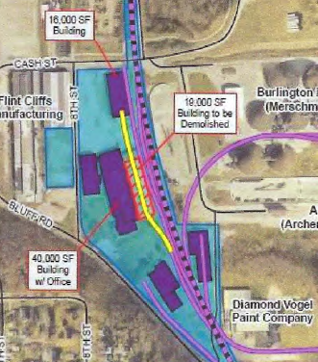
Burlington Junction Railway BJRY (Burlington)
This project will demolish a 19,000 SF building and construct a spur into a 16,000 SF building to the North for use as a transload facility.
Total Rail Cost: $ 343,132.50 Requested Loan: $ 257,349.00 (75%)
15
Notes:
BJRY has been in the RRLG program before. FY13, FY14, FY17 and FY21.

Slide 16
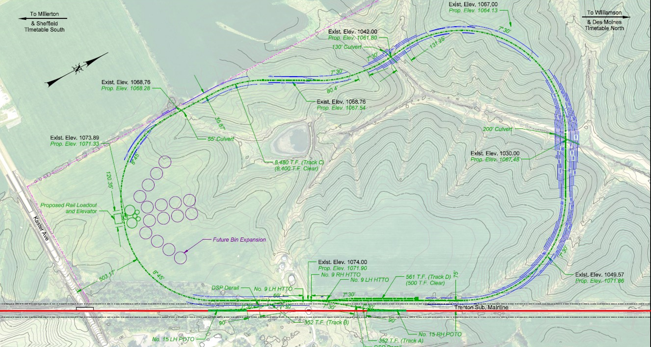
Heartland Co-op Greenfield Rail Loading Elevator (Millerton)
This project will construct a loading facility and unit train capable loop track with a connection to Union Pacific (UPRR), Northeast of Millerton.
Total Rail Cost: $ 5,780,977 Requested Loan: $ 4,624,782 (80%)
16
Notes:
Heartland Co-op Greenfield Rail Elevator at Fairfield. RRLG-ST14(01)—9T-51 Loan for $1,450,000. Has one remaining payment July 2025.

Slide 17
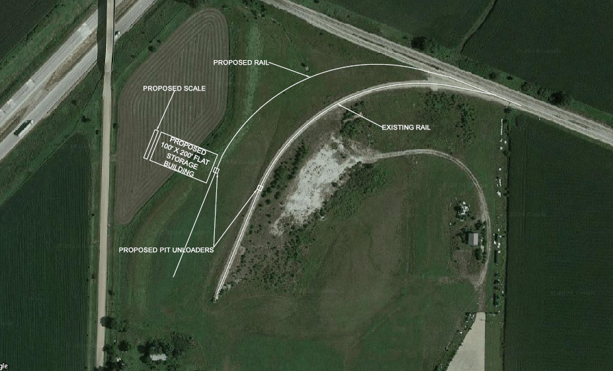
Reid Line Dexter Rail Yard Improvements (Dexter)
This project will make improvements to an existing spur and add additional rail car storage, an under track unloading pit and support a potential rail accessible warehouse. The area rail service provider is Iowa Interstate RR Ltd (IAIS).
Total Rail Cost: $ 3,206,692
Requested Loan: $ 2,405,019
(75%)
17

Slide 18
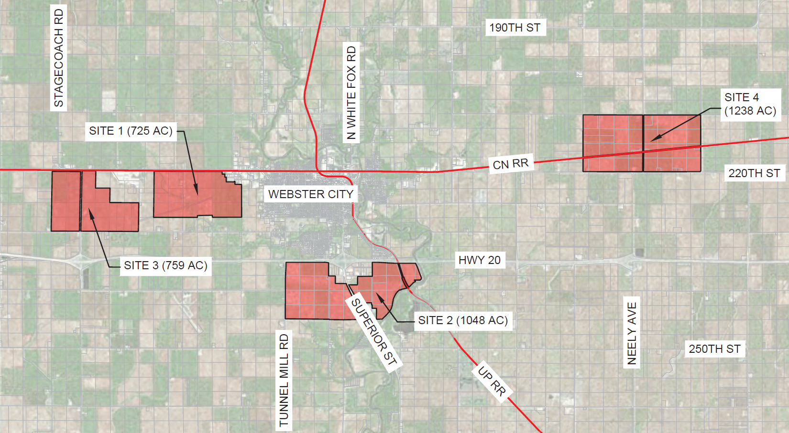
City of Webster City
The purpose of the study is to identify both local and nonlocal businesses in and around Webster City, Iowa whose operations could be improved with the addition of a rail service. Once identified, the study will investigate four site locations to determine which is the most operational cost feasible for construction of a rail port facility. The area rail service providers are Canadian National (CN) and Union Pacific (UP).
Total study Cost: $ 120,000 Requested Loan: $ 100,000 (80%)
18
Notes:
Awaiting addition information.

Slide 19
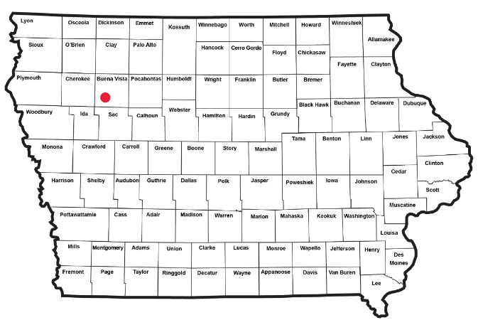
What are the results?
RRLG-ST23(01)--9T-11 Platinum Crush, LLC Alta, Buena Vista County
Project closed out 03/18/2024 RRLG funding $2,000,000 (loan) & $612,000 (grant)
The Platinum Crush facility at Alta, Iowa processes soybeans into soybean oil and soybean meal. The total onsite storage of unprocessed soybeans is 5.1 million bushels. While running at full capacity, this plant can process those 5.1 million bushels in 45 days. The oil and meal will leave the facility using rail. Built at an estimated cost of more than $14 million, the seven track, 50,147-foot loop track can accommodate 5-unit trains on site.
This facility will also create 51 jobs at an average wage of $22.32/hour.
19
19

Slide 20
(1) Targeted jobs creation and retention (grant)
Infrastructure creation or improvement that create jobs
Requires a 50% match and payroll verifications within 3 years following completion
Can provide up to $12,000 per job created or retained
3-year completion window after a funding agreement is executed
Funded once per fiscal year
20
20

Slide 21
(2) Infrastructure creation or improvement (loan)
Infrastructure creation or improvement that does not create jobs
Requires a 20% match
No maximum request amount
3-year completion window after a funding agreement is executed
Following completion, interest free loan for 10 years
Funded once per fiscal year
Grants for job creation and retention (part 1) can be combined with an infrastructure improvement loan (part 2).
21
21

Slide 22
(3) Rail port planning study (grant)
$100,000 max amount of award
Requires a 20% match
18-month completion window after a funding agreement is executed
Can be approved any time of the year based on funding availability
22
22

