Slide 1
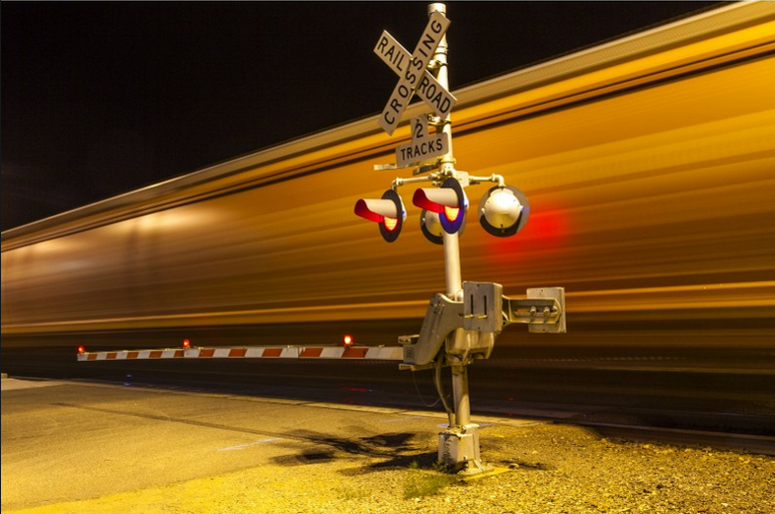
FY 2026
Highway-Railroad Crossing Safety Program
Funding Recommendation
Kristopher Klop
Railroad Crossing Safety Programs Manager
September 10, 2024

Slide 2
Program
FHWA Funding available for states to improve warning devices at railroad crossings.(23 USC Section 130) as part of the Highway Safety Improvement Program (HSIP).
Amount of appropriation funded by FHWA is determined by the number of public railroad crossings in the state.
Iowa currently has 4,855 public railroad crossings, (4,089 at-grade).
2
2

Slide 3
Available Funding and Application Summary
Available Funding from Section 130 Appropriation: | Column 2
Annual appropriation | $5,178,586
Cancelled projects (3) + | $1,170,000
Application Summary:
Total number of projects | 12 & 3 railroad crossing closures
Total project costs | $5,900,000
Total amount requested | $5,900,000
$6,348,586
During the previous two years project costs have increased 30-45% depending on the railroad involved; attributable to the following factors:
Signal component cost increases imposed by the manufacturers
Railroads utilizing consultant services in lieu of employees who have been laid off.
2023 labor union agreements attributing to an increase of up to 30% in labor fees across the board.
We are under-funding by $448,586 this fiscal year to compensate for the previous two years cost over-runs.
3
3

Slide 4
Project Requests
PROJECT NAME | SPONSOR | SCORE | TOTAL PROJECT COST | REQUESTED AMOUNT (% of Total Project Cost) | RECOMMENDED AMOUNT (% of Total Project Cost)
Prairie Street, 079126D | BNSF Railroad Webster County | 28.25 | $500,000 | $500,000 (100%) | $500,000 (100%)
Samson Avenue, 196530G | UP Railroad Webster County | 26.52 | $500,000 | $500,000 (100%) | $500,000 (100%)
W 2nd Street, 375781V | DME Railroad City of Ottumwa | 16.91 | $450,000 | $450,000 (100%) | $450,000 (100%)
North Quincy Avenue, 375779U | DME Railroad City of Ottumwa | 14.69 | $500,000 | $500,000 (100%) | $500,000 (100%)
Paragon Avenue, 200941X | UP Railroad Webster County | 11.50 | $500,000 | $500,000 (100%) | $500,000 (100%)
4
4

Slide 5
Project Requests
PROJECT NAME | SPONSOR | SCORE | TOTAL PROJECT COST | REQUESTED AMOUNT (% of Total Project Cost) | RECOMMENDED AMOUNT (% of Total Project Cost)
Mill Road, 271600Y | UP Railroad Webster County | 10.44 | $500,000 | $500,000 (100%) | $500,000 (100%)
IA 76, 376179V | DME Railroad Iowa DOT | 9.38 | $450,000 | $450,000 (100%) | $450,000 (100%)
4th Street NW, 067359R | BNSF Railroad City of Sioux Center | 2.83 * | $500,000 | $500,000 (100%) | $500,000 (100%)
80th Avenue, 307520L | CN Railroad Buena Vista County | 0.58 ** | $550,000 | $550,000 (100%) | $550,000 (100%)
IA 3, 381516U | D&I Railroad Iowa DOT | 0.34 *** | $300,000 | $300,000 (100%) | $300,000 (100%)
5
5

Slide 6
Project Requests
PROJECT NAME | SPONSOR | SCORE | TOTAL PROJECT COST | REQUESTED AMOUNT (% of Total Project Cost) | RECOMMENDED AMOUNT (% of Total Project Cost)
6th Street SW, 840201J | CIC Railroad City of Cedar Rapids | 0.66 **** | $300,000 | $300,000 (100%) | $300,000 (100%)
3rd Street, 307288C | CCP Railroad City of Parkersburg | 1.19 ***** | $550,000 | $550,000 (100%) | $550,000 (100%)
3 projected closure incentive payments at various locations ($100,000 per location) | TBD | N/A | $300,000 | $300,000 (100%) | $300,000 (100%)
6

Slide 7
Caveat project Explanation
* Signals must be constructed in conjunction with adjacent railroad crossing signals funded in FY2025
** RISE & RRLG soybean crushing facility project caused increased truck and vehicle AADT, which is not yet reflected in the benefit-cost formula
*** Signals being installed as part of a highway IA 3 roadway project
**** Roadway widening project necessitates relocating the existing signal lights and upgrading to lights / gates with constant warning time (CWT)
***** Signals must be constructed in conjunction with adjacent railroad crossing signals funded in FY2025
7
7

Slide 8
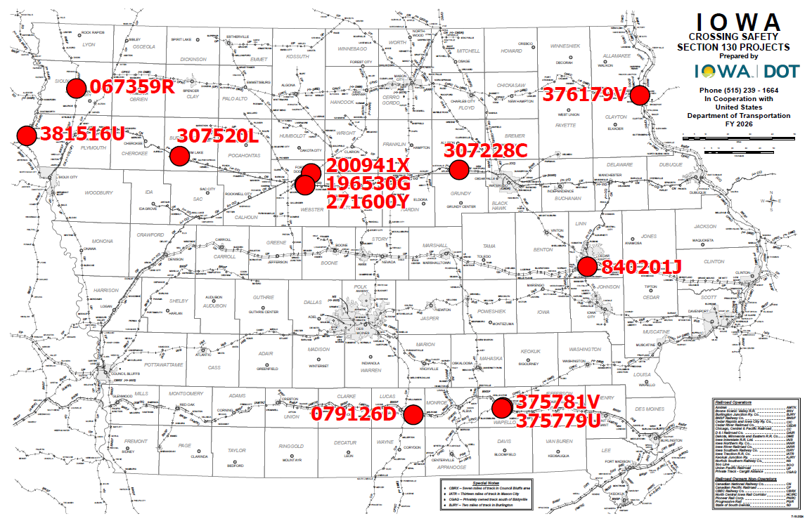
Map of Applications Received
8

Slide 9
Questions?
Kristopher.klop@iowadot.us
515-203-1646

