Slide 1
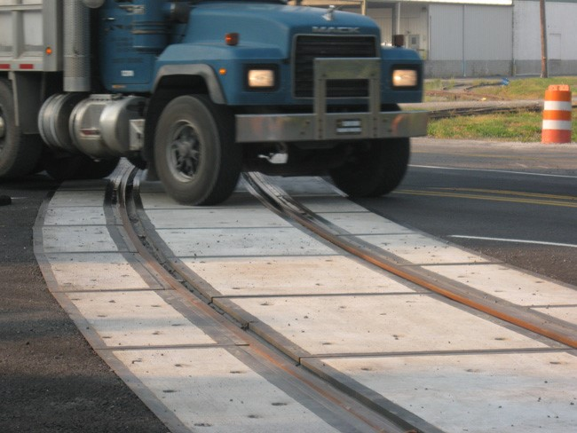

FY 2026 Highway-Railroad Crossing
Surface Repair Program
Funding Recommendation
Kristopher Klop
Railroad Crossing Safety Programs Manager
September 10, 2024

Slide 2
Program
Highway-Railroad crossing surface repair program incentivizes railroads and roadway authorities to participate in the cooperative repair of crossing surfaces.
  - Project funding breakdown:
    60% State
    20% Roadway authority
    20% Railroad
  - Responsibilities:
    Railroad: Replacement of rock (ballast), ties, track, underlayment, and crossing panels
    Roadway Authority: Replacement of crossing approaches and existing sidewalks (ADA compliant), road closures and detours
2
2

Slide 3
Project Evaluation Criteria
Projects are funded in the order the applications are received, except that up to 50% of the program allocation can be used in a discretionary manner.
All 29 crossing applications currently in the program queue were scored according to the following criteria:
  Type of route the crossing is on, (crude oil, ethanol, passenger)
  Average daily vehicle traffic / train traffic
  Exposure index, (number of trains x number of cars)
  Predicted Accidents, (train speed, roadway speed, number of traffic lanes, number of tracks)
  Planned concurrent roadway projects
  On-site inspection
  Maximum score possible: 35 points
Final Projects
  The three highest scored crossings were brought forward to be funded in addition to those already scheduled to be funded for FY 2026 for a total of 8 projects.
  Associated railroads and roadway authorities were contacted and confirmed they were able to participate with funding and repairs.
3
3

Slide 4
Available Funding and Application Summary
Available Funding: | Column 2
Annual appropriation | $900,000
Cancelled Projects (1) | $48,000
Application Summary:
Total number of projects | 5-order received $513,000 / 55% 3-scoring $427,800 / 45% 8 Total
Total project costs | $1,568,000 (100% amount)
Total amount requested | $940,800 (Program 60% amount)
4
Difference $7,200
4

Slide 5
Requested Projects
PROJECT NAME | SPONSOR | SCORE | TOTAL PROJECT COST | REQUESTED AMOUNT (% of Total Project Cost) | RECOMMENDED AMOUNT (% of Total Project Cost)
Forevergreen Road, 840258K | CRANDIC Railroad City of Coralville | N/A Order Received | $147,000 | $88,200 (60%) | $88,200 (60%)
Baxter Ave. / V-62, 200856H | IANR Railroad Buchanan County | N/A Order Received | $120,000 | $72,000 (60%) | $72,000 (60%)
Pearl Street, 382043W | BNSF Railroad City of Sioux City | N/A Order Received | $208,000 | $124,800 (60%) | $124,800 (60%)
205th Street, 079442B | BNSF Railroad Jefferson County | N/A Order Received | $240,000 | $144,000 (60%) | $144,000 (60%)
190th Street, 078279D | BNSF Railroad Lee County | N/A Order Received | $140,000 | $84,000 (60%) | $84,000 (60%)
5
5

Slide 6
Requested Projects
PROJECT NAME | SPONSOR | SCORE | TOTAL PROJECT COST | REQUESTED AMOUNT (% of Total Project Cost) | RECOMMENDED AMOUNT (% of Total Project Cost)
Douglas Avenue, 377204E | IAIS Railroad City of Urbandale | 25 | $253,000 | $151,800 (60%) | $151,800 (60%)
Meredith Drive, 377203X | IAIS Railroad City of Urbandale | 25 | $135,000 | $81,000 (60%) | $81,000 (60%)
William Street, 380054C | DME Railroad Mitchell County | 31 | $325,000 | $195,000 (60%) | $195,000 (60%)
6
6

Slide 7
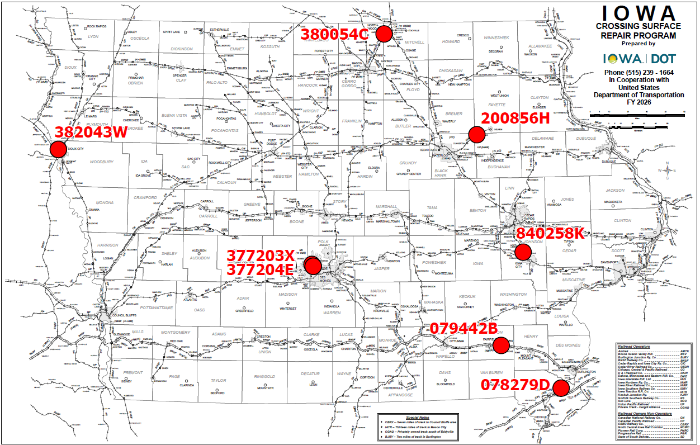
Map of Applications Recommended Awards
7

Slide 8



Questions?
Kristopher.klop@iowadot.us
515-203-1646

