Slide 1
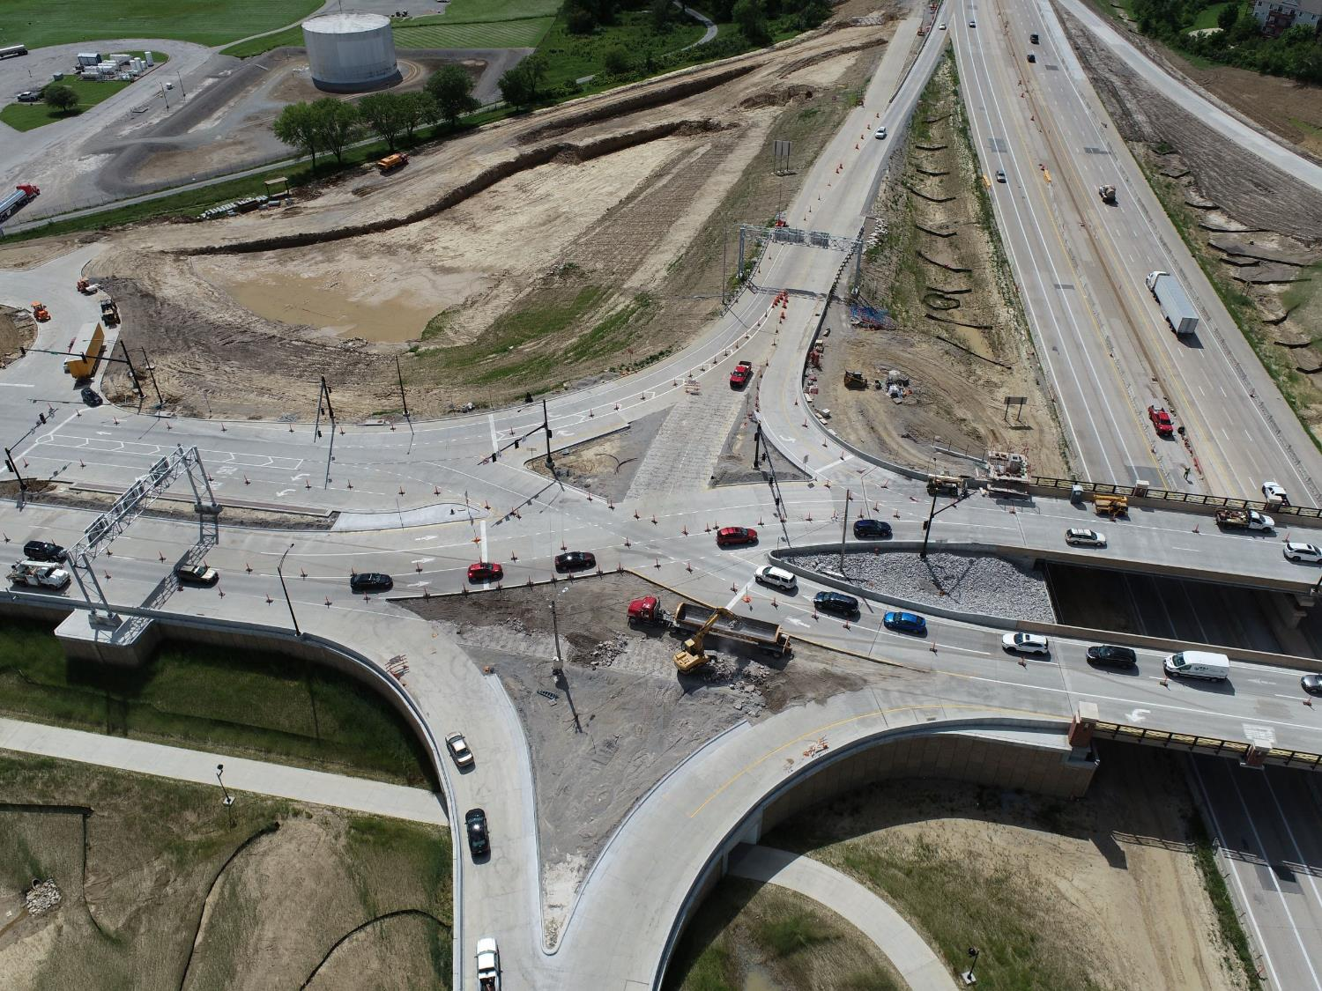
Highway System Overview
Iowa Transportation Commission Workshop
3/2/2023
Garrett Pedersen Systems Planning Bureau Director
September 10, 2024

Slide 2
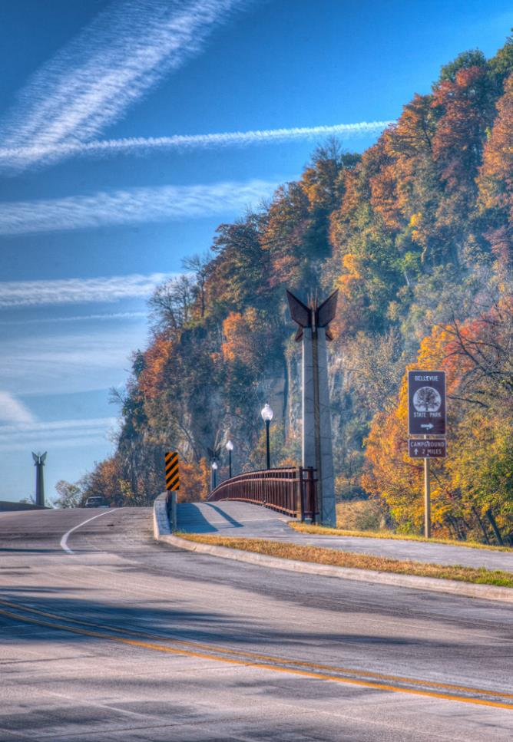
Agenda
Iowa’s Public Roadway System
Highway Networks
State Highway System Usage
Highway Planning & Programming

Slide 3
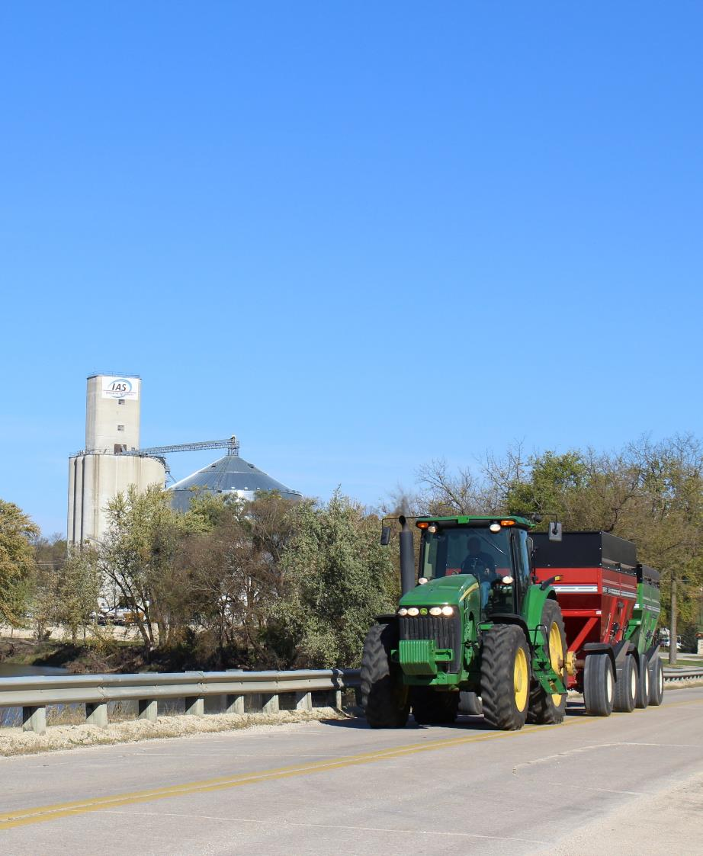
Iowa’s Public Roadway System

Slide 4
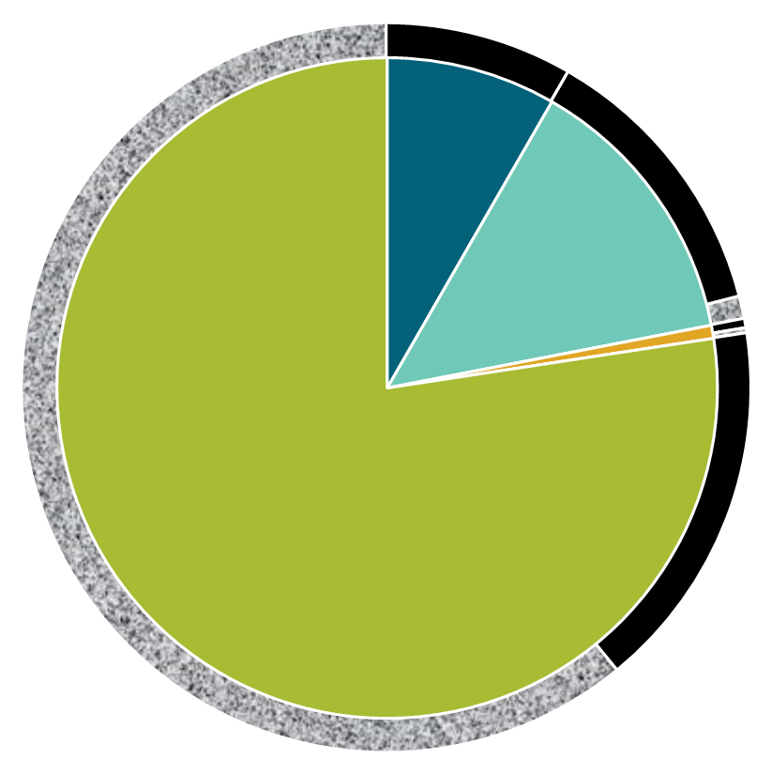
Iowa Public Road System Mileage by Ownership and Surface Type, 2023
Primary
9,624
City
15,787
Parks & Institutional
742
Total Miles:
115,739
County
89,586
Paved
Not Paved
Notes:
These are center-line miles with ramps included.
Over, 38% of highways are paved (asphalt, concrete, or bituminous treatment) and 62% is not paved (gravel or not surfaced).

Slide 5
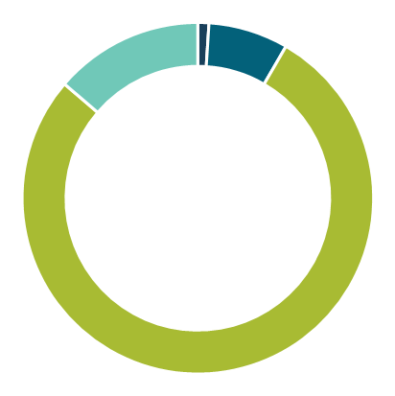
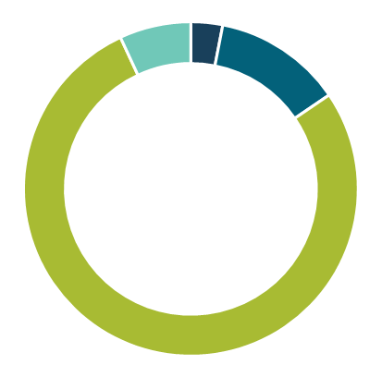
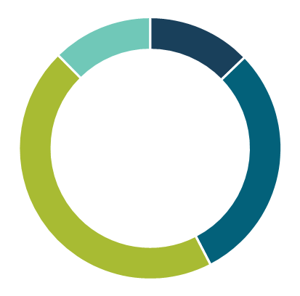
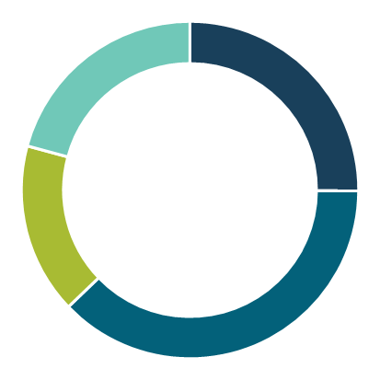
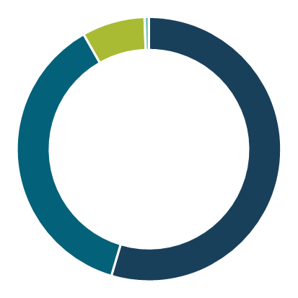
Iowa Public Road System – 2023
14%
7%
7%
12%
12%
13%
1%
3%
ft²
Miles of roads
Number of bridges
Deck area
of bridges
30%
45%
78%
78%
21%
25%
8%
Interstate
<1%
Other Primary
55%
County
16%
All traffic
37%
Large truck traffic
City
38%
Does not include Park & Institutional Roads
Notes:
Interstate is split out from the remainder of the Primary System to show what a large percentage of traffic it carries for only being 1% of the overall public road system’s mileage. Also, the Primary System only accounts for 15% of the state’s bridges by numbers, but 43% by deck area.
Note: the mileage in cities as increased by almost 2,000 miles since 2001 – reflective of overall Iowa trend of urbanization.

Slide 6
Highway
Networks

Slide 7
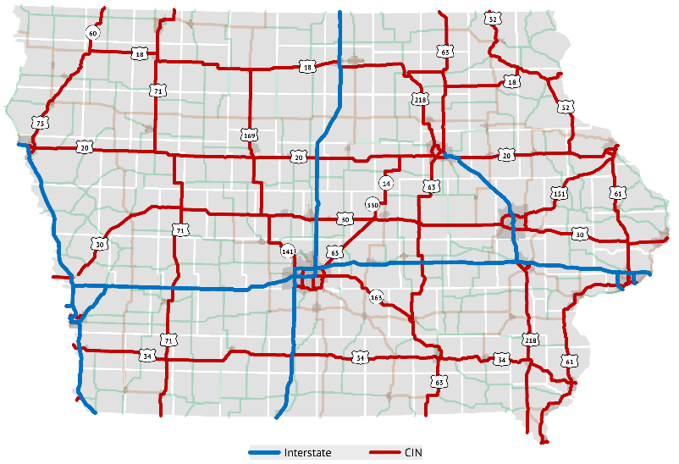
Commercial and Industrial Network
State legislature directed Commission to designate a network of commercial and industrial highways
Purpose:
Improve the flow of commerce
Make travel more convenient, safe, and efficient
Better connect Iowa with regional, national, and international markets
Enhance opportunities for the development and diversification of the state’s economy
Notes:
1988: Legislature directed the designation
Required the Commission to concentrate a major portion of its annual construction budget on this network
Aligns well with the Commission’s recent emphasis on Super-2 improvements on several of these corridors.
Per Mike, there are 2543 miles of open, public, cardinal direction mainline routes on the CIN

Slide 8
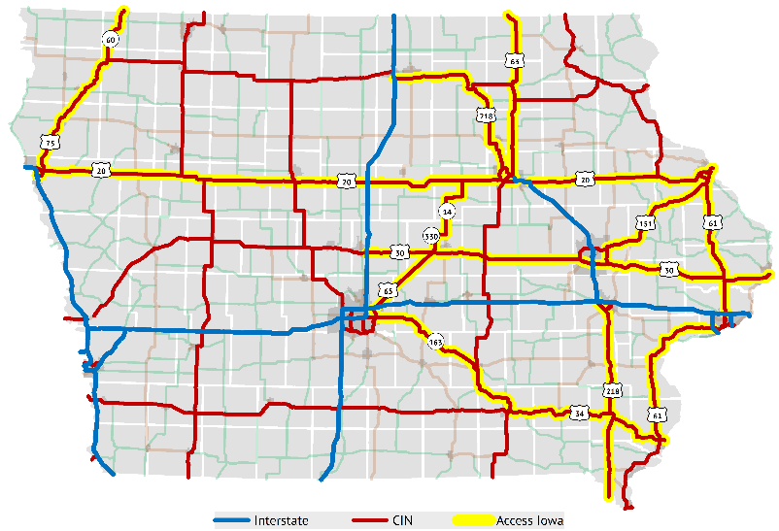
Access Iowa
State legislature directed DOT to designate sub-system of CIN to connect areas with 20,000 population or greater
Access Iowa represents approximately half of the CIN network

Slide 9
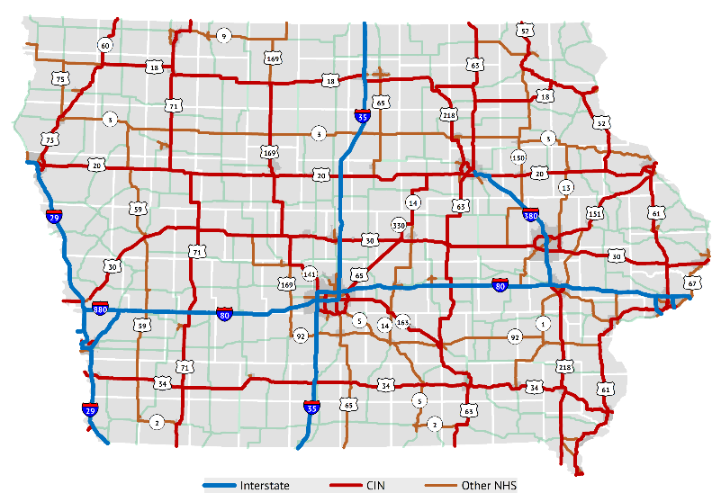
Federally-designated system
Includes Interstate System and other “Principal Arterial” routes
Includes full CIN
Small portion is locally-owned
Purpose:
“National Highway System consists of roadways important to the nation's economy, defense, and mobility”
Eligible for federal National Highway Performance Program (NHPP) funding
Performance management reporting
National Highway System (NHS)

Slide 10
State Highway
System Usage

Slide 11
State Highway System Mileage and Traffic
National Highway System (NHS) – 57%
Interstate
9%
Commercial and Industrial Network (CIN) - 29%
Other Primary
62%
Miles of
roads
National Highway System (NHS) – 87%
Interstate
40%
Commercial and Industrial Network (CIN) 33%
Other Primary
27%
All Traffic
National Highway System (NHS) – 92%
Interstate
59%
Commercial and Industrial Network (CIN) - 27%
Other Primary
14%
Large Truck
Traffic
Notes:
The recent system stratification is implied in these graphics. This slide illustrates the dominance of the Interstate and CIN for moving traffic.

Slide 12
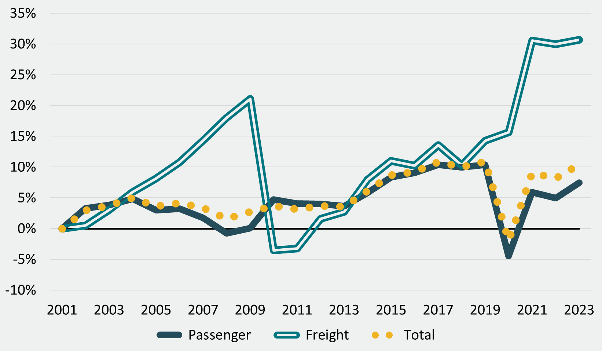
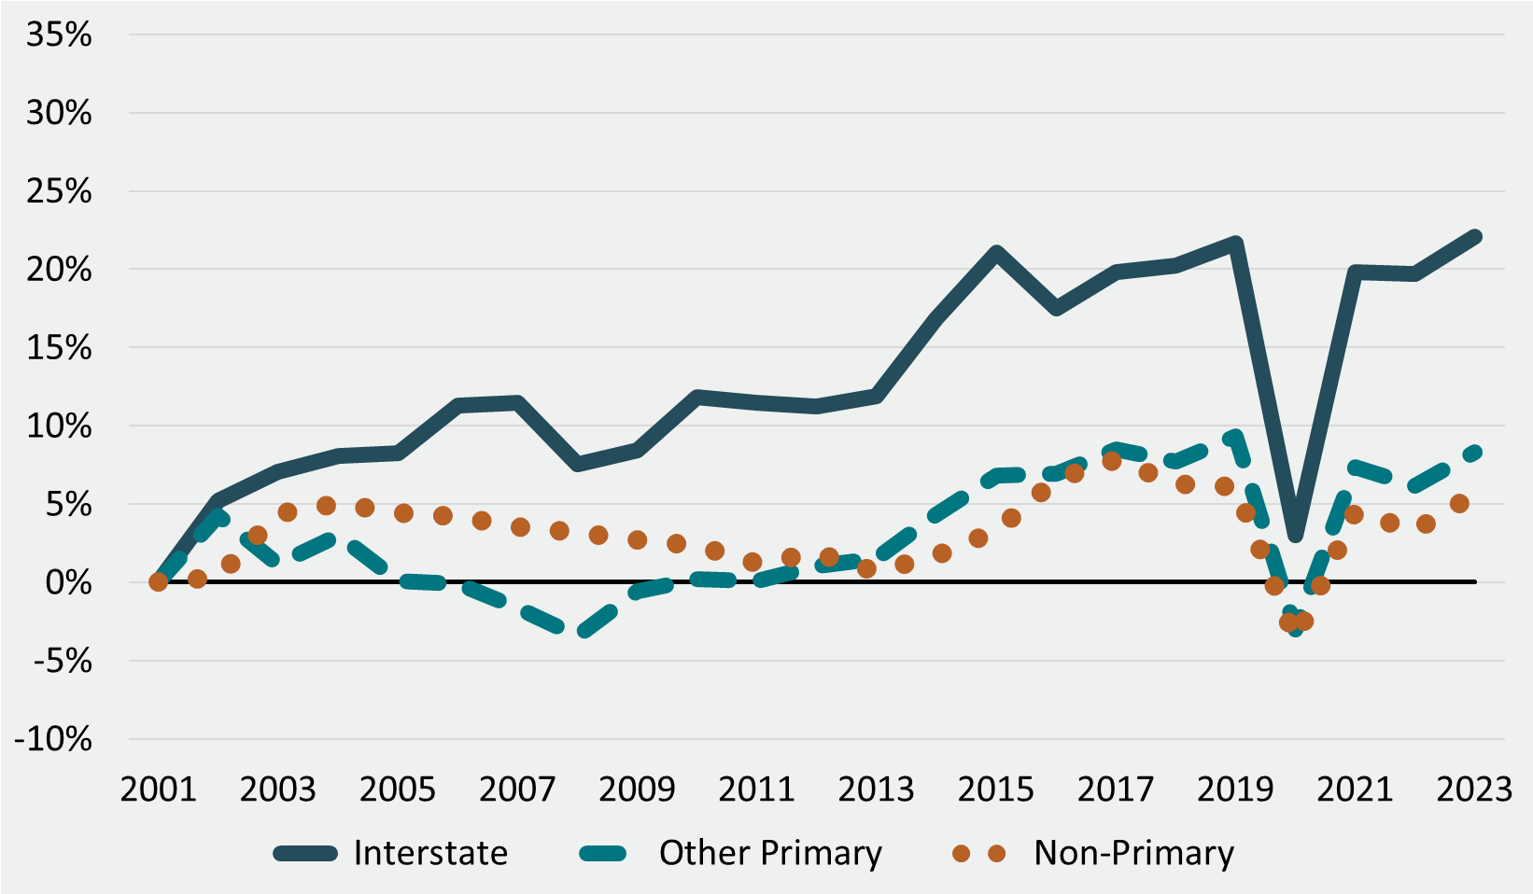
Traffic – Percent Change since 2001
Passenger and Freight
Primary and non-Primary
Notes:
VMT growth was more rapid during the 1990s. Since 2000, have seen slower growth over time. Forecasting about 0.5% growth per year over time. On the top, it’s interesting to see different impacts of Great Recession (freight drop, passenger slight increase) vs. COVID (passenger drop, freight large increase). On the bottom, Interstate traffic growth has been much higher than the rest of the system.

Slide 13
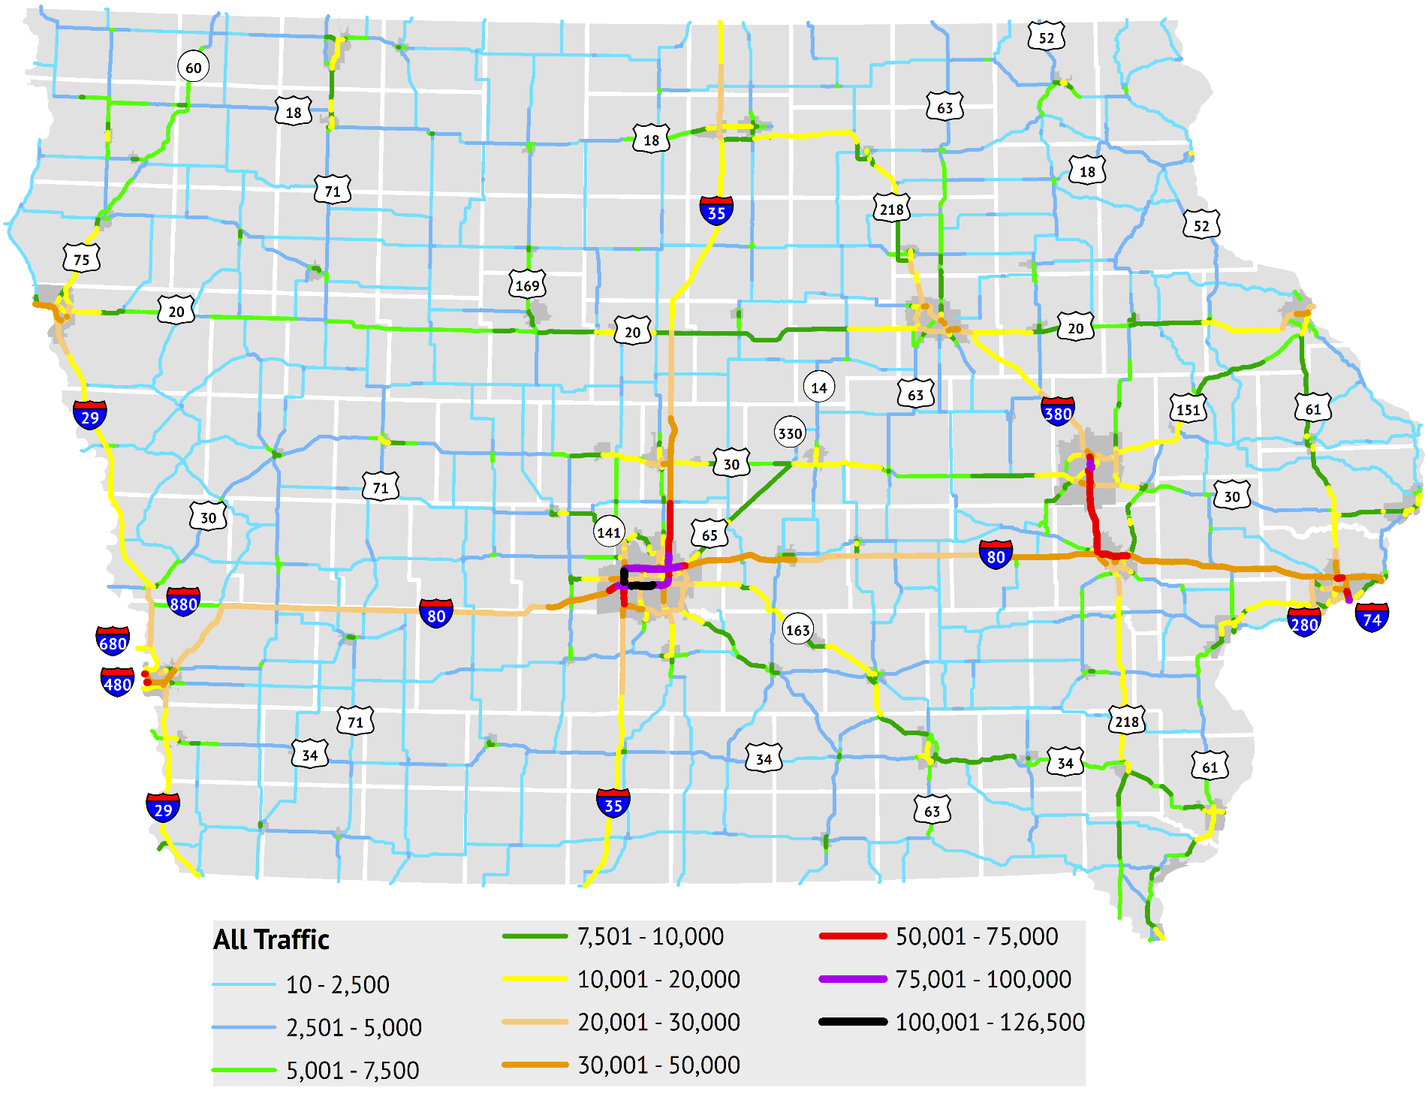
Traffic Volume
Notes:
Shows expected pattern of concentration in metro areas and on interstates; commuter corridors on 35 and 380 stand out.

Slide 14
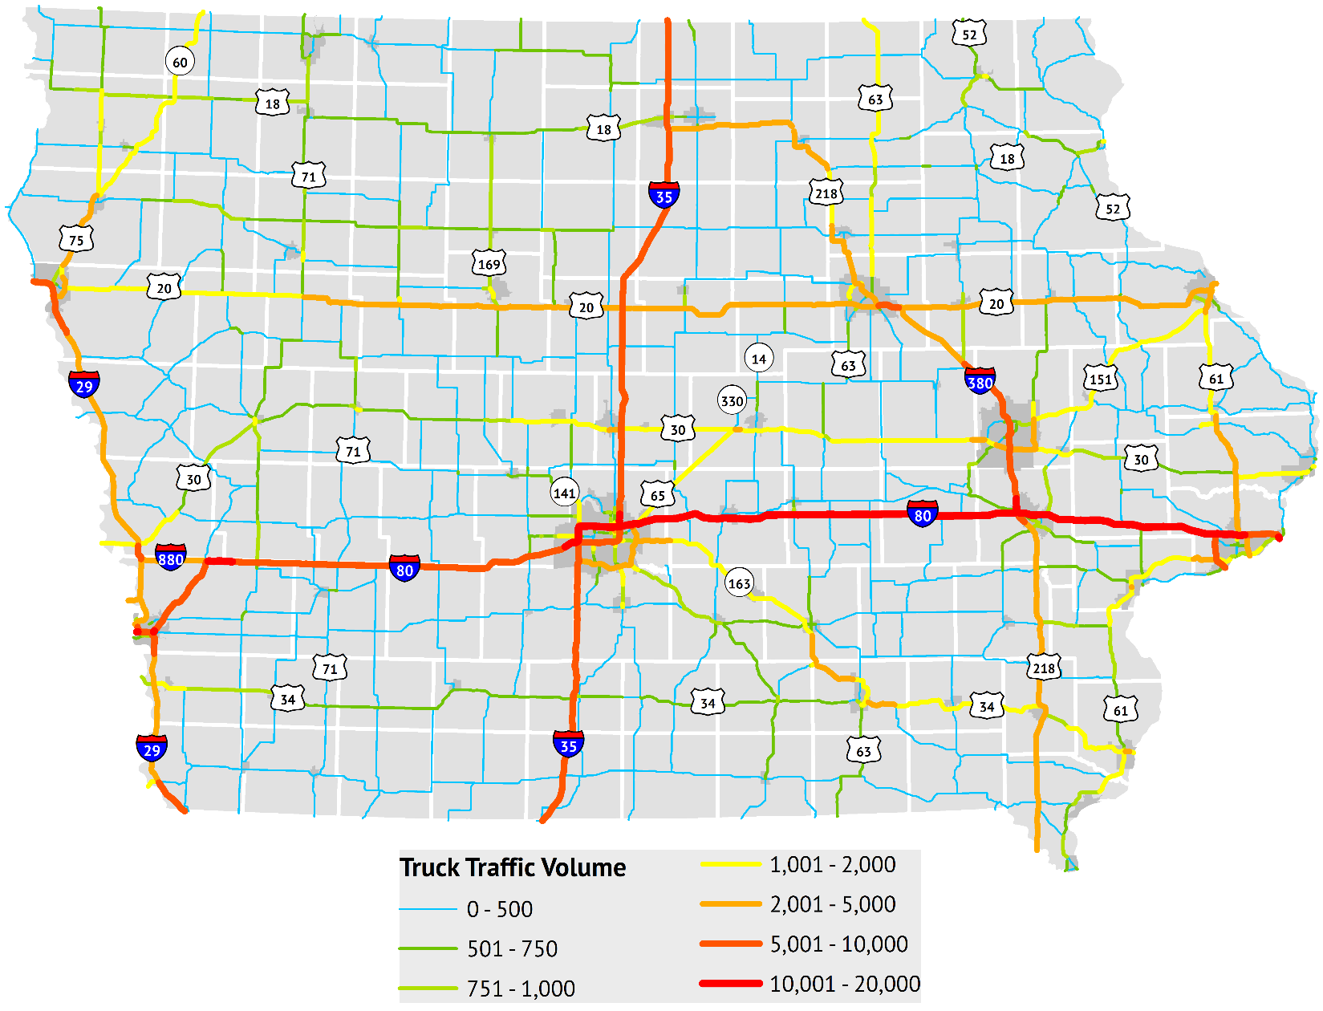
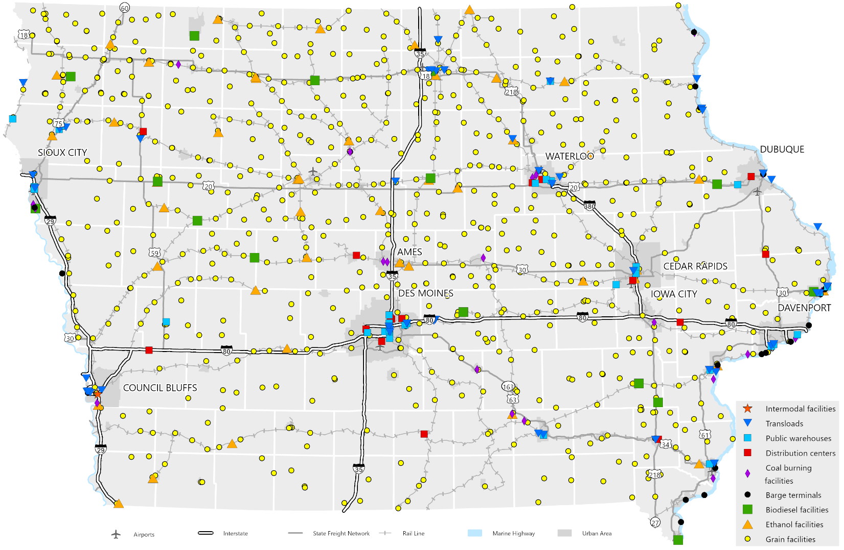
Truck Traffic Volume and Freight Generating Facilities

Slide 15
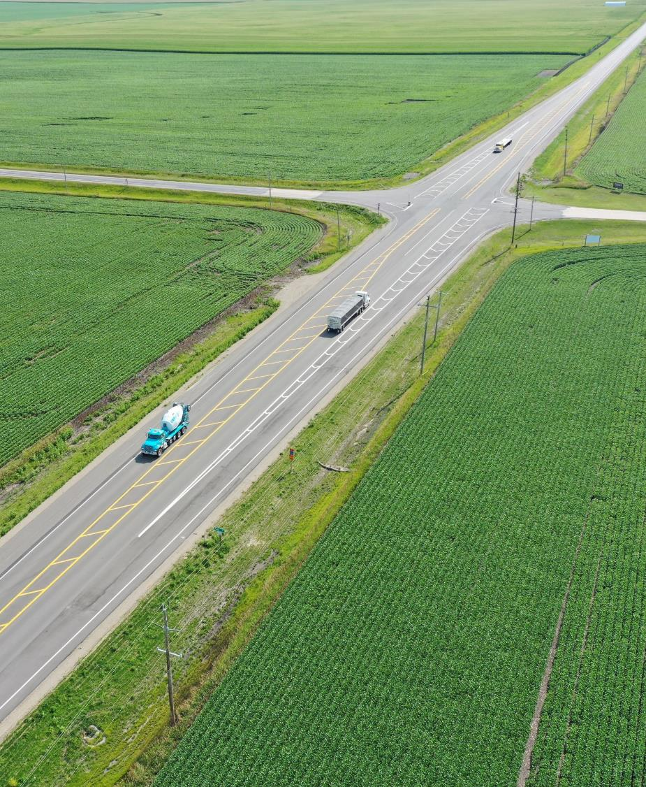
Highway Planning & Programming

Slide 16
Planning and Programming Process
Notes:
The emphasis here is to provide an overview of the overall process. For each of the next four slides, a specific section of the diagram is highlighted, and the discussion could include the planning efforts or process steps that occur during it.

Slide 17
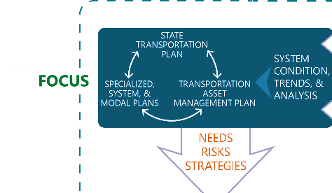
Planning and Programming Process: Focus
Notes:
Slide focus: Policy goals & system objectives set through ELT/Commission, Business plan helps describe the operationalization of this. Plans like the SLRTP, SFP, TAMP provide the highest level view of the highway system, its needs and risks, and what we need to be focusing on from a policy and system perspective.

Slide 18
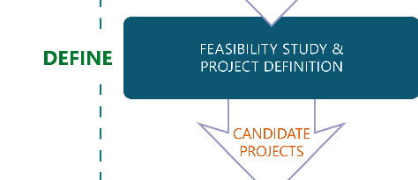
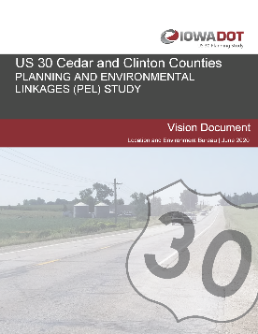
Planning and Programming Process: Define
Notes:
Slide focus: More specific plans and studies are developed based on the policies/strategies/needs identified in higher level plans. Corridor level plans provide a more detailed look at needs in a specific corridor and lead to project definition.

Slide 19
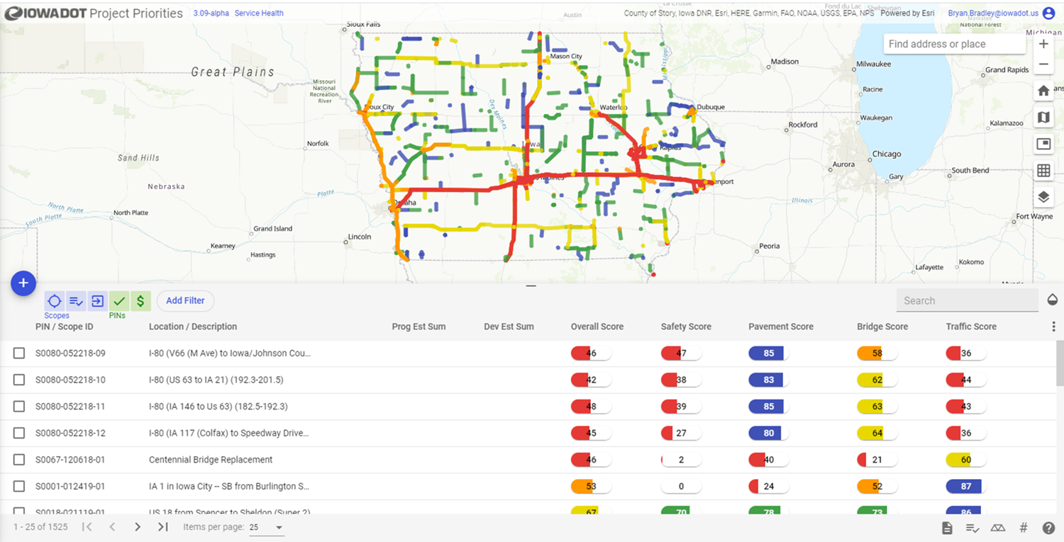
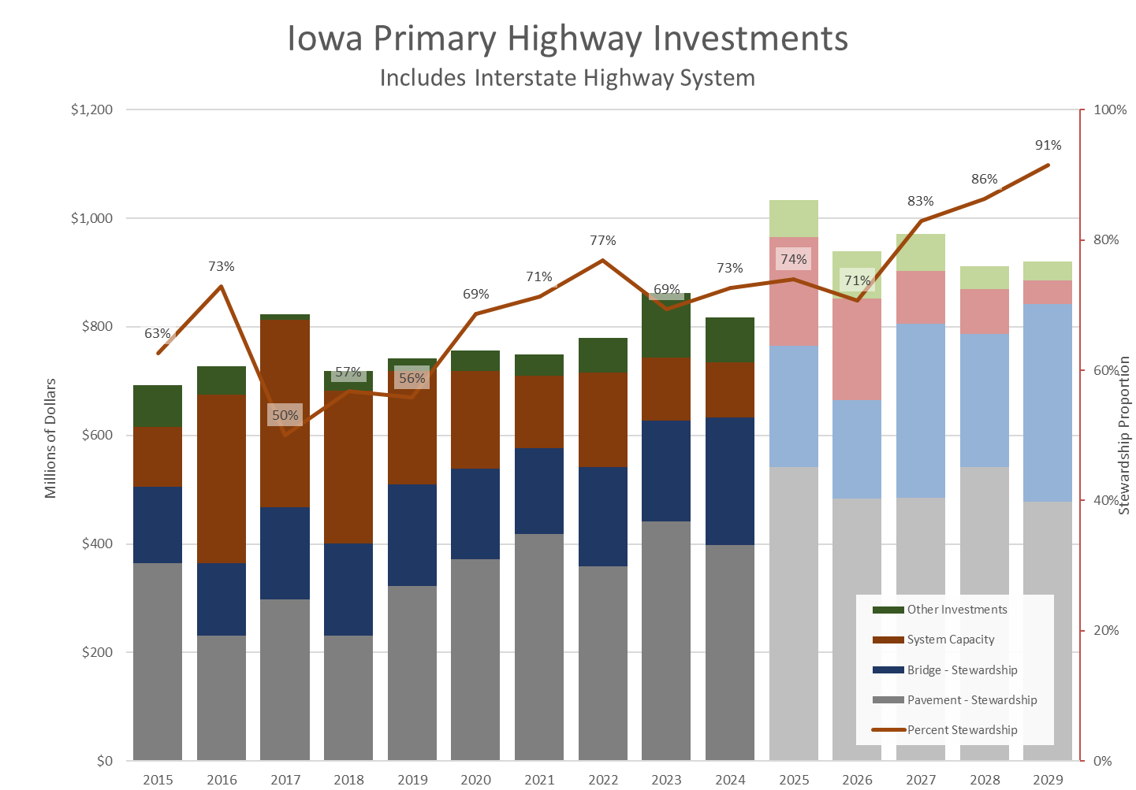
Planning and Programming Process: Prioritize
Notes:
Slide focus: Projects have to be weighed against each other and the overall funding available to determine what to program for funding.

Slide 20
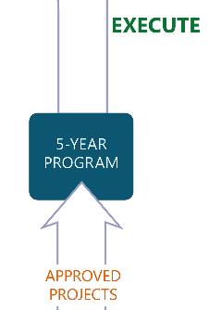
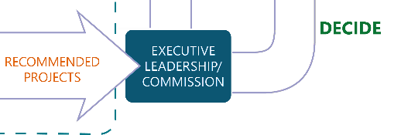
Planning and Programming Process: Decide & Execute
Notes:
Slide focus: Planning process has led to a recommended program of projects that is ultimately included in the 5YP upon Commission approval, then integrated into the STIP. After projects are completed, data/performance monitoring help track future condition and needs and feed back into the planning process.

Slide 21
Questions?
GARRETT PEDERSEN
515-239-1027
Garrett.Pedersen@iowadot.us​
iowadot.gov

