Slide 1
Transportation Asset Management Summary
March 11, 2025
Charlie Purcell
Deputy Director, Transportation Development Division
3/2/2023
Notes:
Thank chair and members of the commission
Today’s presentation will provide a summary of the key points from previous presentations and recommendations for future investment strategies

Slide 2
Asset Type | How Many? | How Much?
Roads (lane miles) | 24,636 | $31 billion
Bridges | 4,174 | $20 billion
Total |  | $51 billion
Why is asset management important?
TRANSPORTATION ASSET MANAGEMENT SUMMARY
Notes:
We’ve made a tremendous investments in our transportation system over a long period of time
Even a 1% increase in efficiency yields $510M in savings over the entire asset lifecycle
Small incremental steps when applied to our entire system of asset can have very large impacts

Slide 3
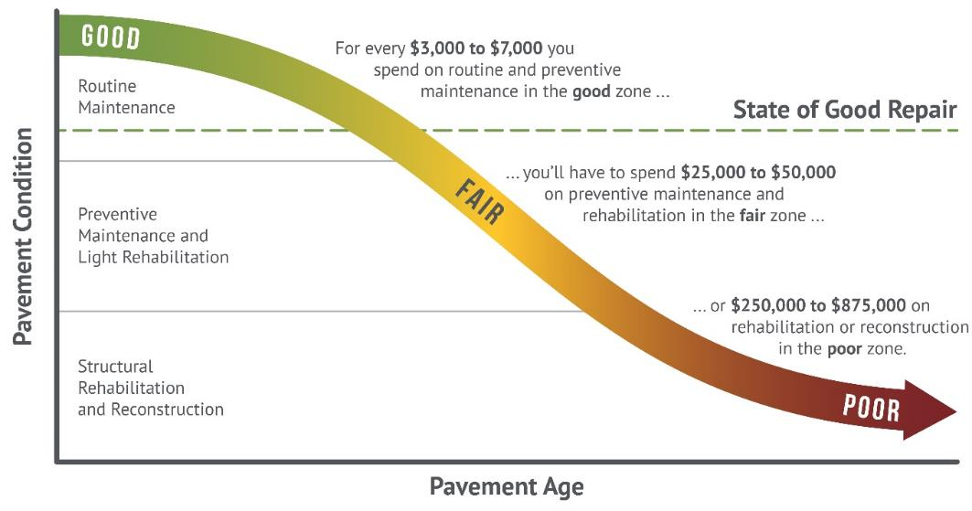
How we set targets
Targets are set to maintain a state of good repair
Maintaining assets in a state of good repair minimizes overall lifecycle costs (good roads cost less)
Notes:
Targets are set strategically

Slide 4
Cost Comparisons – what does $10 million buy?
1 mile of new 4-lane expressway, or
3 miles of 2-lane pavement reconstruction, or
16 miles of pavement resurfacing, or
3 bridge replacements
Notes:
Asset management is about trade-offs
This chart illustrates the relative amount of work that can be done for $10M for various types of assets

Slide 5
Previous presentations
Sep 2024 – Highway Planning Overview
Oct 2024 – Asset Management Overview
Nov 2024 – Project Prioritization Update
Dec 2024 – Interstate Plan Update
Jan 2025 – Pavement Management
Feb 2025 – Bridge Management
Notes:
Will

Slide 6
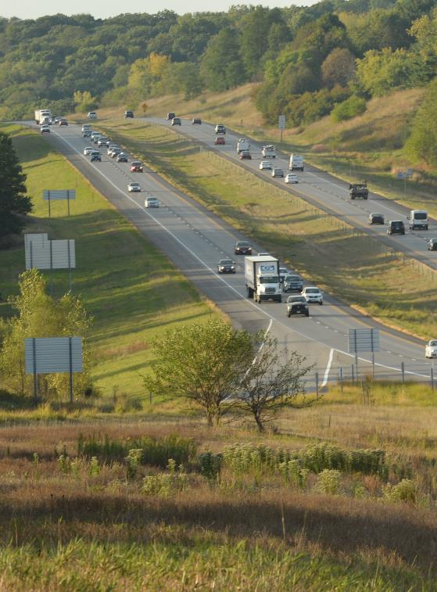
Key takeaways – Interstate Plan
Funding constraints have delayed many capacity expansion projects beyond 2050
Near term priorities for future capacity expansion remain unchanged
I-380 from Iowa City to Cedar Rapids
I-35 from Ankeny to Ames
DSM Metro
I-80 from Iowa City to Cedar River
I-80 from Altoona to Mitchellville
Notes:
DSM metro projects include:
SWMM
I-80 Dallas County (US 169 to Grand Prairie Pwky
I-80/35 and Hickman Interchange
NEMM to US 65 / Altoona

Slide 7
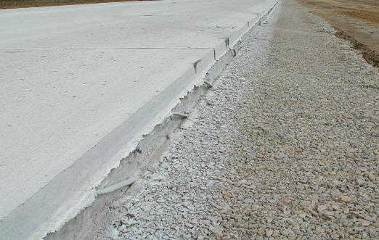
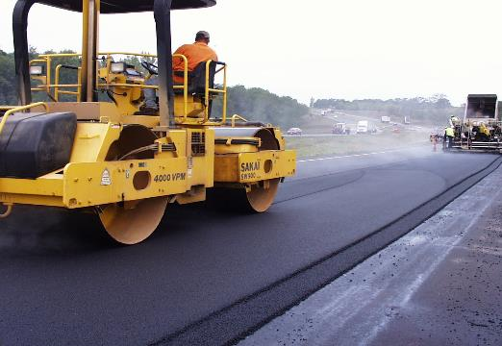
Key takeaways – Pavements
Dedicated pavement management team is helping us to:
Make better use of models and analytics
Improve project selection methods
Decreasing buying power is reducing our ability add more pavement life than is lost each year
Need to increase our investments in both pavement rehabilitation and pavement replacement to reach our pavement condition targets
$70M annually for Interstate by 2035
$325M annually for Non-Interstate by 2035

Slide 8
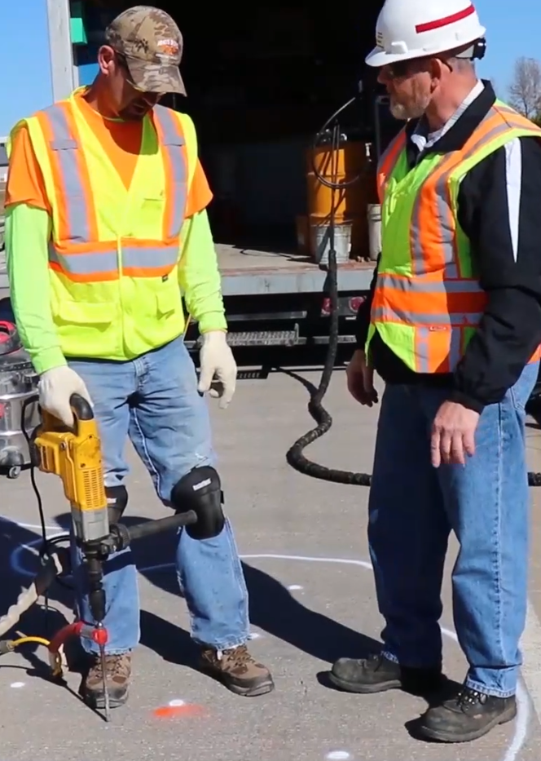
Key takeaways – Bridges
Good progress has been made reducing the number of poor bridges on the primary system
However, without continued increases to stewardship investments, this trend is likely to reverse due to the large number of aging bridges built in the 50’s, 60’s and 70’s
Preventative maintenance investments are extending the life of our structures
Large bridges represent major capital investments that need to be planned far in advance
Notes:
Only 26 poor bridges on the state system, or about 0.6% of the total
Wave of bridge is coming but strong preventative maintenance and rehabilitation strategies are increasing the life of our structures

Slide 9
Steps towards a stewardship focus
2017
Started current series of Asset Management workshop presentations connected to the 5-year program development process
2018
Began steady increases to Non-Interstate Bridge Modernization targets
Began steady increases to Non-Interstate Pavement Modernization targets
2021
Added 500k/year to Statewide Contract Maintenance line item starting in FY21 and continuing

Slide 10
Steps towards a stewardship focus
2022
Increased Non-Interstate Pavement Modernization target by $35M/year for pavement replacements starting FY27 and continuing
Increased Non-Interstate Bridge Modernization target by $20M/year starting in FY27 and continuing
Increased Safety Specific target by $5M/year starting in FY27 and continuing
2023
Increased Statewide Interstate Rest Area maintenance target by 100k/year starting in FY25 and continuing
2024
Dedicate $55M annually for pavements within the Interstate Stewardship program target
Reserve $15M of this amount in Years 2-5 to account for unforeseen needs that will arise
Notes:
Mention the proposed 2025 bump up of contract maintenance line item

Slide 11
Evidence of a stewardship focus
The percentage of the program devoted to stewardship has continued to increase
Notes:
Recognize tension between need to keep increasing stewardship vs. impracticality of 100% stewardship program

Slide 12
Summary recommendations
Maintain a focus on stewardship investments
Continuously evaluate the balance between pavement and bridge investments
Limit capacity expansions to a few prioritized interstate corridors

Slide 13
Questions?

