Slide 1
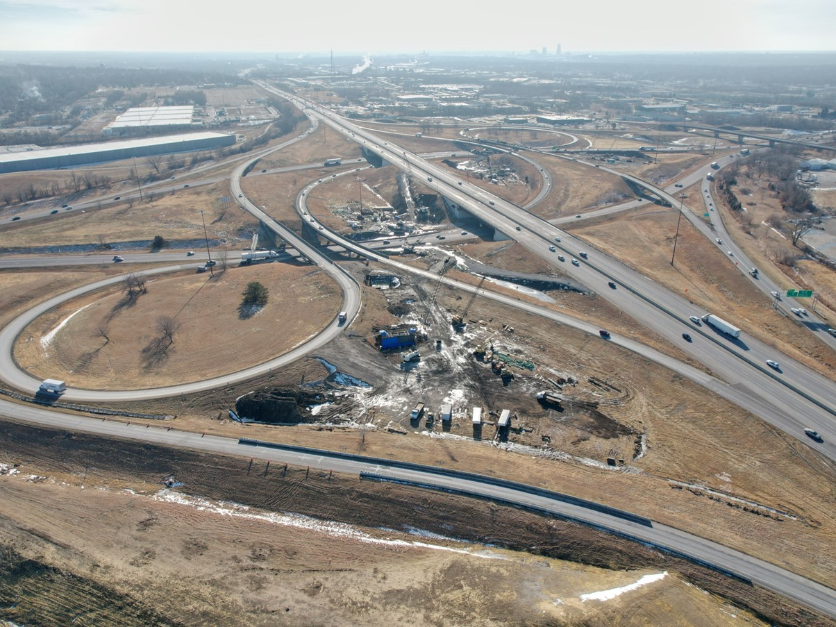


2026-2030 Highway Program Development
March 11, 2025
3/2/2023

Slide 2


Agenda
TOPIC 1
Statewide Line Items
TOPIC 2
2026-2030 Highway Program Funding
TOPIC 3
Highway Program Analysis
TOPIC 4
Program Development Considerations
TOPIC 5
Determine Highway Program Objectives
TOPIC 6
Next Steps

Slide 3
March 11, 2025
Highway Program Development Schedule (2025-2029)
March 2025
  Discuss 2026-2030 available Highway Program funding
  Discuss 2026-2030 Highway Program options
  Determine 2026-2030 Highway Program objectives
  Action Item: Line-Item Targets for Programming
April 2025
  Develop the Draft 2026-2030 Highway Program
  Action Item: 2026-2030 Highway Program objectives
May 2025
  Present the Draft 2026-2030 Iowa Transportation Improvement Program to the public (including all previous Program approvals and Draft 2026-2030 Highway Program)
June 2025
  Action Item: Approve the 2026-2030 Iowa Transportation improvement Program

Slide 4
March 11, 2025
2026-2030 Iowa Highway Program
Decision Points
Should projects in the 2026-2029 Program continue to be programmed with cost/schedule updates?
What modifications to the Program should be considered?
3. How should Program be balanced?

Slide 5
Topic 1
Statewide Line Items

Slide 6
March 11, 2025 modified from February 11, 2025
Draft 2026-2030 Iowa Highway Program Line Items
($ in thousands)
  At what levels should the line item targets be programmed?
  March Action Item:
  Line Item Targets for Programming

Slide 7
March 11, 2025
Line Item Overview
Changes to Recommended Line Items since February
  Modified line item work types to be more specific
  Reduced the recommended increase to the Statewide Consultant Services
Line Item Review for 2027-2031 Program
  Line items are evaluated during each programming cycle
  There is a need to conduct a complete overview/assessment of each line item in the context of broader road/bridge needs
  Will provide updates to the Commission throughout this process in preparation for next year’s Program

Slide 8
Topic 2
2026-2030 Highway Program Funding

Slide 9
March 11, 2025

Slide 10
March 11, 2025
2026-2030 Iowa Highway Program Funding Assumptions
RUTF/TIME-21
(For Highway Planning Purposes Only)
Overall forecast is conservative
Forecast continues to reflect expected reduction in fuel tax revenue
TIME-21 funding cap of $225 million has been met
Average combined RUTF/TIME-21 growth of 0.6% annually

Slide 11
March 11, 2025
Federal Funding Status
  FFY 2025 Appropriation: Second continuing resolution expires March 14.
  Infrastructure Bill authorizes federal funding through September 30, 2026, leaving some funding uncertainty for the last four years of this Program.
  Infrastructure Bill funding allocations based on Commission action in June 2022.
  The next Highway Trust Fund cliff is in 2028.
  Legislation to address a portion of the large August Redistribution amounts has been passed.

Slide 12
March 11, 2025
2026-2030 Forecast of Iowa Federal-Aid Formula Transportation Authorized Funds
(x $1,000)
(For Highway Planning Purposes Only)
 | 2026 | 2027 | 2028 | 2029 | 2030
National Highway Performance Program | $ 388,000 | $ 388,000 | $ 388,000 | $ 388,000 | $ 388,000
Surface Transportation Block Grant Program | $ 188,800 | $ 188,800 | $ 188,800 | $ 188,800 | $ 188,800
Highway Safety Improvement Program | $ 38,400 | $ 38,400 | $ 38,400 | $ 38,400 | $ 38,400
Rail-Highway Crossings Program | $ 5,700 | $ 5,700 | $ 5,700 | $ 5,700 | $ 5,700
Congestion Mitigation and Air Quality Program | $ 13,100 | $ 13,100 | $ 13,100 | $ 13,100 | $ 13,100
Metropolitan Planning | $ 2,800 | $ 2,800 | $ 2,800 | $ 2,800 | $ 2,800
National Highway Freight Program | $ 18,100 | $ 18,100 | $ 18,100 | $ 18,100 | $ 18,100
State Planning and Research | $ 13,200 | $ 13,200 | $ 13,200 | $ 13,200 | $ 13,200
Carbon Reduction Program | $ 17,200 | $ 17,200 | $ 17,200 | $ 17,200 | $ 17,200
PROTECT Formula Program | $ 19,500 | $ 19,500 | $ 19,500 | $ 19,500 | $ 19,500
Bridge Replacement Program | $ 93,400 | $ 93,400 | $ 93,400 | $ 93,400 | $ 93,400
Redistribution of Certain Authorized Funds | $ 4,900 | $ 4,900 | $ 4,900 | $ 4,900 | $ 4,900
 | $ 803,100 | $ 803,100 | $ 803,100 | $ 803,100 | $ 803,100
Iowa DOT Share (66.4%) | $ 533,300 | $ 533,300 | $ 533,300 | $ 533,300 | $ 533,300
Total Federal-Aid Formula Funds Forecast to DOT Programs
(x $1,000,000
2026 - ($533.3 @ 87.0% Obligation Authority = $464.0) + (August Redistribution $60.0) = $524.0
2027 - ($533.3 @ 91.0% Obligation Authority = $485.3) + (August Redistribution $30.0) = $515.3
2028 - ($533.3 @ 91.0% Obligation Authority = $485.3) + (August Redistribution $30.0) = $515.3
2029 - ($533.3 @ 91.0% Obligation Authority = $485.3) + (August Redistribution $30.0) = $515.3
2030 - ($533.3 @ 91.0% Obligation Authority = $485.3) + (August Redistribution $30.0) = $515.3

Slide 13
March 11, 2025
2026-2029 Highway Program Funding with Possible Changes That Could Impact Funds Available for ROW/Construction
($ in millions)
(For Highway Planning Purposes Only)

Slide 14
March 11, 2025
2026-2030 Highway Program Funding Available for ROW/Construction
($ in millions)
(For Highway Planning Purposes Only)

Slide 15
Topic 3
Highway Program Analysis

Slide 16
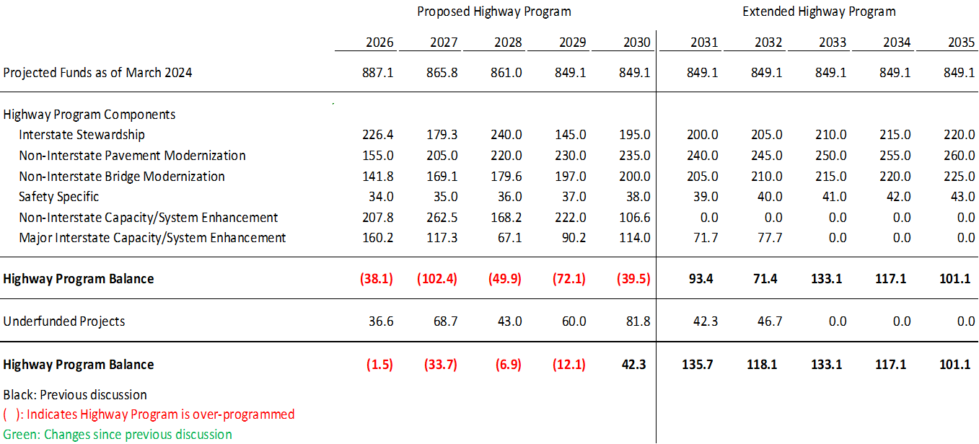
March 11, 2025 as presented February 11, 2025
2026-2035 Highway Program Analysis
($ in millions)
(For Highway Planning Purposes Only)

Slide 17
March 11, 2025
2026-2035 Highway Program Analysis
($ in millions)
(For Highway Planning Purposes Only)

Slide 18
March 11, 2025
Stewardship Targets - Possible Adjustments
Stewardship targets adjusted in extended highway program analysis to reflect flat revenue beyond the program.
Stewardship targets in 2031 and beyond would remain at 2030 levels for current program.
Without adjustment the stewardship targets would utilize all projected funds which doesn’t recognize capacity and system enhancement needs on the primary system.
Continue to evaluate funding levels and stewardship targets annually during program development.

Slide 19
March 11, 2025
2026-2035 Stewardship Targets with Possible Changes
($ in millions)
(For Highway Planning Purposes Only)

Slide 20
March 11, 2025
2026-2035 Stewardship Targets
($ in millions)
(For Highway Planning Purposes Only)

Slide 21
March 11, 2025
Underfunded Projects with Possible Changes
($ in millions)
(For Highway Planning Purposes Only)

Slide 22
March 11, 2025
Underfunded Projects
($ in millions)
(For Highway Planning Purposes Only)

Slide 23
March 11, 2025
2026-2035 Highway Program Analysis
($ in millions)
(For Highway Planning Purposes Only)

Slide 24
March 11, 2025
Notable 2026-2029 Iowa Highway Program Changes
IA 12 Gordon Drive Viaduct
  Project letting advanced to 2028
US 61 Louisa County
  Project split into two sections
  Section B stays on schedule
  Section C North of Wapello delayed two years
  Due to project development issues
US 30 610th Ave Interchange in Nevada
  Project letting delayed two years
  Due to utility coordination issues

Slide 25
March 11, 2025
2026-2035 Highway Program Analysis
($ in millions)
(For Highway Planning Purposes Only)

Slide 26
March 11, 2025
2026-2035 Highway Program Analysis
($ in millions)
(For Highway Planning Purposes Only)

Slide 27
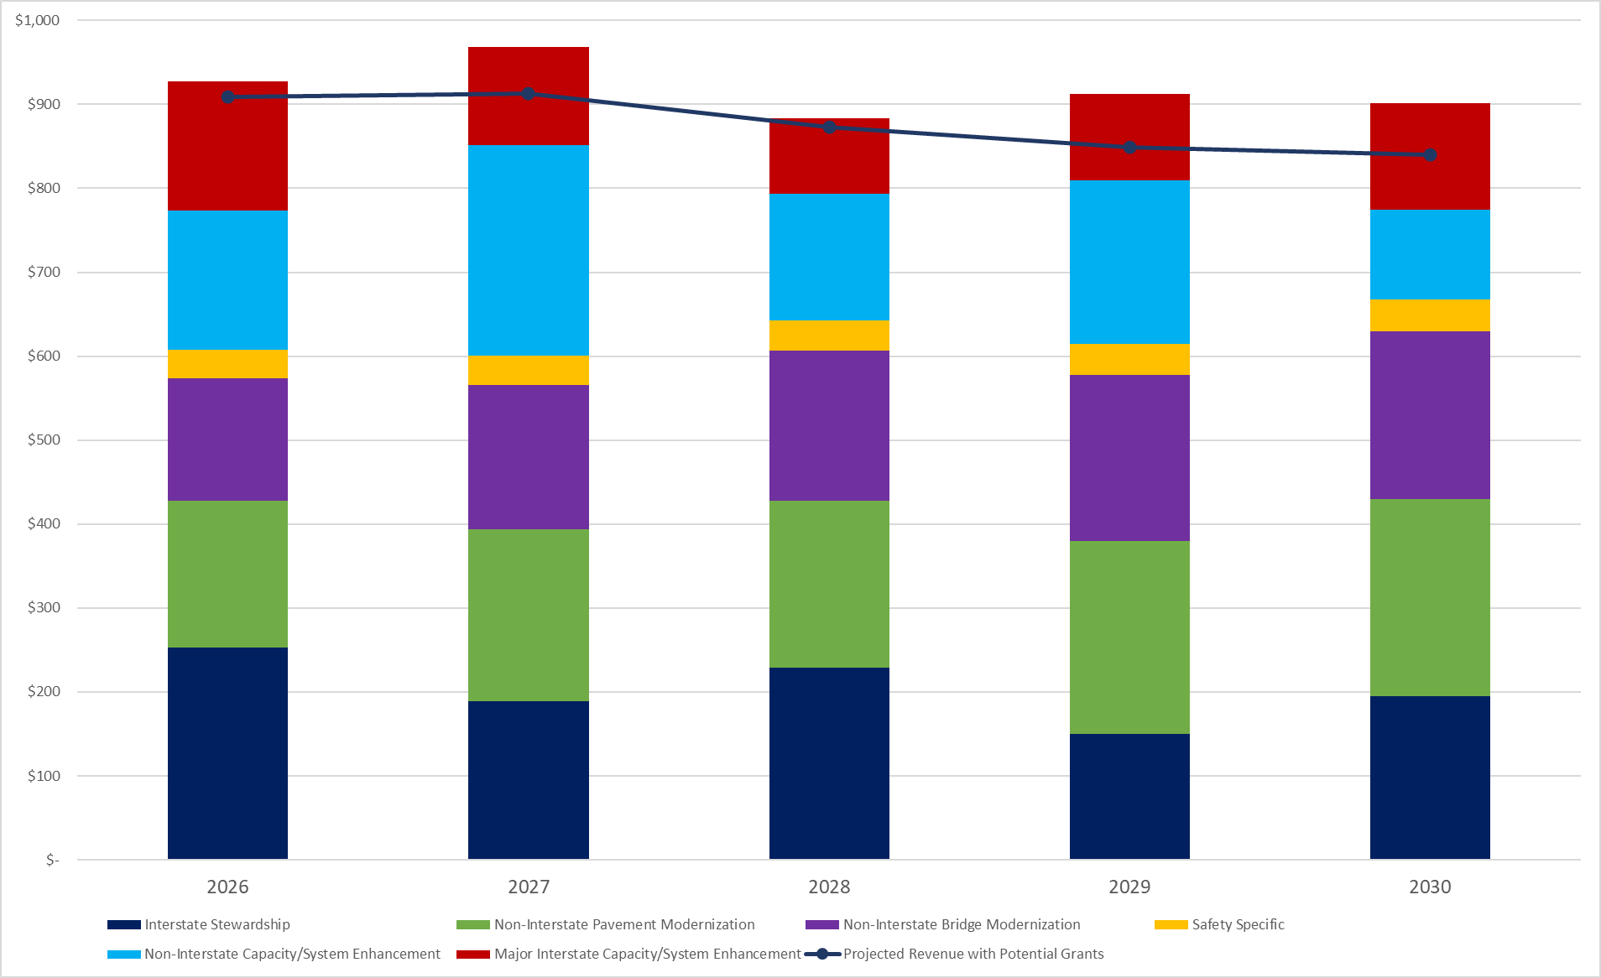
March 11, 2025
2026-2030 Highway Program Analysis
($ in millions)
(With Updated Revenue, FY 25 Projects Rescheduled, Project Cost and Schedule Updates)
(Updated Revenue includes Assumed Grant Awards)
(For Highway Planning Purposes Only)

Slide 28
March 11, 2025
2026-2035 Highway Program Analysis
($ in millions)
(For Highway Planning Purposes Only)
Proposed Highway Program Extended Highway Program
2026 2027 2028 2029 2030 2031 2032 2033 2034 2035
Highway Program Components
Interstate Stewardship 252.5 188.9 228.9 150.0 195.0 195.0 195.0 195.0 195.0 195.0
- Funds in years 2031 and beyond are placeholders (not programmed yet)
- Includes proposed adjustment to stewardship target in extended highway program.
- Projects in 2026-2030 are specifically identified in the highway program and include the following major schedule changes and additions:
Franklin I-35 paving added to 2026
Johnson I-80 bridge deck overlay 0.6 mi W of Co Rd W60 advanced from 2029 to 2028
Linn I-380 pavement rehab advanced from 2028 to 2026
Madison I-80 bridge at P48 interchange delayed from 2028 to 2030
Polk I-235 pavement rehab added to 2026
Pottawattamie I-29 pavement rehab delayed from 2028 to 2030
Pottawattamie I-29 pavement rehab advanced from 2028 to 2026
Pottawattamie I-80 pavement rehab added to 2028
Pottawattamie I-880 at L34 interchange delayed to 2030 and changed to bridge new
Pottawattamie I-880 at IA 191 interchange advanced from 2028 to 2026
Scott I-280 bridge deck overlay at IA 22 Interchange advanced from 2029 to 2028
Scott I-80 bridge rehabilitation at IMRL RR delayed from 2026 to 2027

Slide 29
March 11, 2025
2026-2035 Highway Program Analysis
($ in millions)
(For Highway Planning Purposes Only)
Proposed Highway Program Extended Highway Program
2026 2027 2028 2029 2030 2031 2032 2033 2034 2035
Highway Program Components
Non-Interstate Pavement Modernization 175.3 205.0 198.5 230.0 235.0 235.0 235.0 235.0 235.0 235.0
- Funds in Years 2027 and beyond are placeholders (no specific projects identified except for 3R reconstruction)
- Projects in 2026 and 3R reconstruction projects in 2026-2030 will be specifically identified in the highway program (to be handed
out in April)
- Includes proposed adjustment to stewardship target in extended highway program.
- Three projects advanced from 2028 to 2026 to, in part, take advantage of 2025 Program balance savings
Non-Interstate Bridge Modernization 146.3 171.9 179.2 197.2 200.0 200.0 200.0 200.0 200.0 200.0
- Funds in years 2031 and beyond are placeholders (not programmed yet)
- Projects in 2026-2030 will be specifically identified in the highway program (to be handed out in April)
-Includes proposed adjustment to stewardship target in extended highway program.
Safety Specific 34.0 35.0 36.0 37.0 38.0 38.0 38.0 38.0 38.0 38.0
- Funds in Years 2027 and beyond are placeholders (no specific projects identified)
- Projects in 2026 will be specifically identified in the highway program (to be handed out in April)
- Includes proposed adjustment to stewardship target in extended highway program

Slide 30
March 11, 2025
2026-2035 Highway Program Analysis
($ in millions)
(For Highway Planning Purposes Only)
Proposed Highway Program Extended Highway Program
2026 2027 2028 2029 2030 2031 2032 2033 2034 2035
Highway Program Components
Non-Interstate Capacity /
System Enhancement 165.2 250.6 151.1 195.3 106.7 12.3 37.6 2.3
- Funds in Years 2031 and beyond are project completion costs for projects already in Program
- Louisa US 61 project split and partially delayed two years
- Story US 30 610th Interchange delayed two years
- Woodbury Gordon Dr viaduct project letting advanced to 2028
Major Interstate Capacity /
System Enhancement 154.6 116.9 89.4 102.8 127.2 56.7 58.9
- Funds in years 2031 and beyond are project completion costs for projects already in Program

Slide 31
March 11, 2025
Highway Program Studies/Requests

Slide 32
March 11, 2025
Highway Program Studies/Requests

Slide 33
March 11, 2025
Highway Program Studies/Requests

Slide 34
March 11, 2025
Highway Program Studies/Requests

Slide 35
March 11, 2025
Highway Program Studies/Requests

Slide 36
March 11, 2025
2026-2034 Highway Program Candidates
($ in millions)
(For Highway Planning Purposes Only)

Slide 37
March 11, 2025
2026-2034 Highway Program Candidates
($ in millions)
(For Highway Planning Purposes Only)

Slide 38
March 11, 2025
2026-2034 Highway Program Candidates
($ in millions)
(For Highway Planning Purposes Only)

Slide 39
March 11, 2025
2026-2030 Iowa Highway Program
Decision Points
Should projects in the 2026-2029 Program continue to be programmed with cost/schedule updates?
What modifications to the Program should be considered?
  Adjust Stewardship Targets in the extended highway program?
  Add projects to the Program from the Program Candidates list?
How should Program be balanced?
  Program balances will need to be addressed, specifically 2027, 2029 and 2030.
  Options include project rescheduling and stewardship target adjustments.
  What additional information would be helpful?
  Come back with scenario(s) for March 20 Workshop

Slide 40
Topic 4
Program Development Considerations

Slide 41
March 11, 2025
Program Development Considerations
  Construction costs have declined this fiscal year.
  State road funding continues to come in higher than forecast.
  The last four years of federal funding in this Program are not part of an authorization.
  Continue to prioritize bridge and pavement stewardship investments on existing highway system.
  Pursue grant funding opportunities.
  Assess balance of pavement and bridge stewardship investments.
  Balance capacity improvements with stewardship needs.
  Address major river crossing needs.

Slide 42
Topic 5
Determine Highway Program Objectives

Slide 43
March 12, 2024
Potential 2026-2030 Highway Program Objectives
    Safety
      Maintain increasing funding levels for safety
      Complete statewide centerline rumble strip implementation
      Continue enhanced pavement markings to non-interstate highways
    Sustainability
      Maintain Interstate funding levels for pavement reconstruction, modernization, bridges, pavement patching/maintenance, rest areas, and other miscellaneous projects
      Maintain funding levels for non-interstate pavement modernization
      Maintain funding levels for non-interstate bridge modernization
      Invest in additional stewardship projects
      Transfer jurisdiction of portions of primary roadways to cities and counties
    Accessibility
      Invest in truck parking at Interstate Rest Areas
      Continue to invest in vault toilets at parking only sites
      Complete installation of adult changing stations at modernized rest areas
      Invest in corridor improvements
    Flow
      Invest in intelligent transportation systems infrastructure
      Invest in Super-2 improvements
      Invest in operational and Integrated Corridor Management improvements

Slide 44
Topic 6
Next Steps

Slide 45
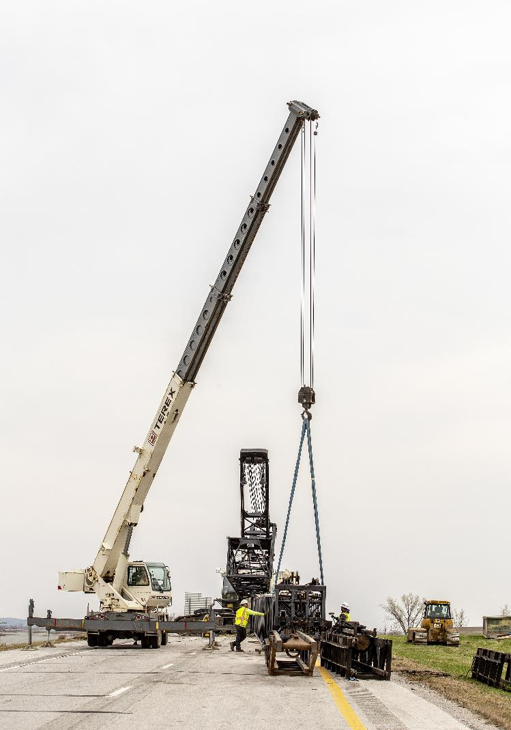
Next Steps
March Business Meeting - Action Item: Line-Item Targets for Programming
March 20 Workshop - Discuss 2026-2030 Highway Program Options
March 20 Workshop - Determine 2026-2030 Highway Program Objectives

Slide 46
Questions?

