Slide 1
ARTS Modernization

Slide 2
What is ARTS & What Does it Do?
Vehicle titling & registration
Driver’s license & ID cards
Persons w/ disabilities product issuance
License plate management
Car dealership licensing
Intrastate motor carrier authority
30 million | driver and vehicle records
1.5 million | transactions/week
15,800 | active users (internal/external)
$1.2B | annual state transportation revenue
$40M | annual fees collected by county treasurers for their general funds

Slide 3
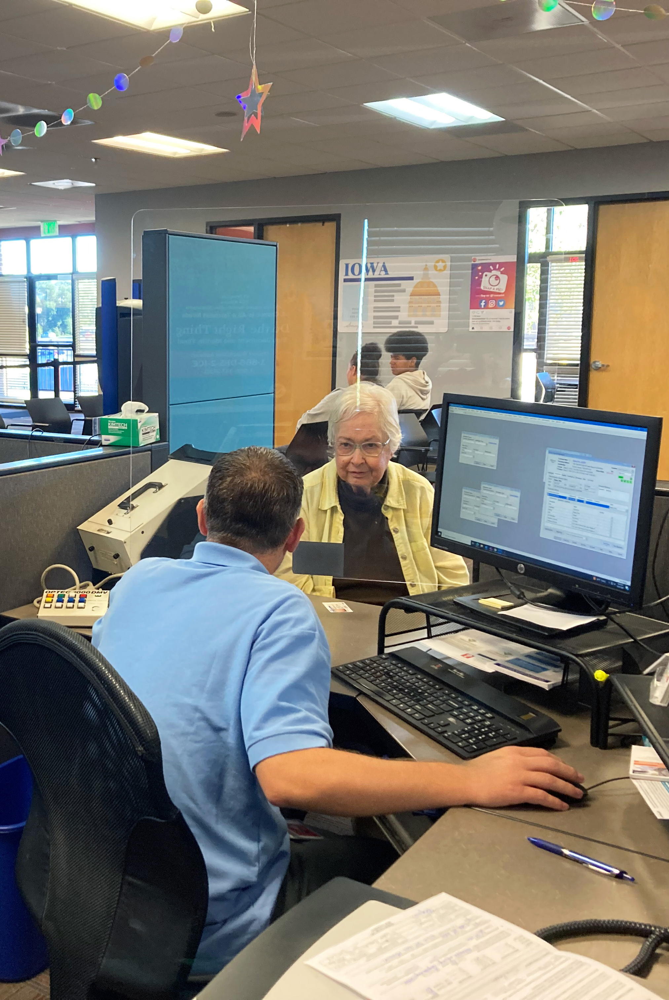
Why Modernize?
Combining multiple systems onto one platform
Outdated and complex
Inefficient
Challenging to innovate and improve service
Lack of revenue enforcement/financial tools
Difficult to meet stakeholder needs
Many functions not currently available

Slide 4
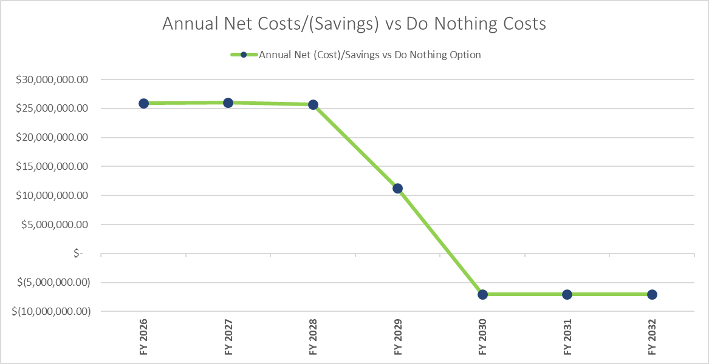
Return on Investment
Initial costs = | Approx. $20M/year (3 years)
Annual maintenance = | Approx. $5.5M/year
ANNUAL COST SAVINGS
Improved registration fee collection | $6M/year
Reduction of IT staff costs | $2M/year
Consolidation of software | $2M/year
Increased online services | $1.3M/year
CDL skills test fee and employer/insurance reporting | $235k/year
County treasurer software savings | $1M/year
Annual Net Cost Savings vs Do Nothing option reached FY29-FY30 upon go live of new system
= $12.5M annual savings

Slide 5
Funding & Timeline – 3 years
Funding Schedule
*Annual Operations and Maintenance costs/fees
Implementation Timeline

Slide 6
Questions?
scott.marler@iowadot.us
(515) 239-1111

