Slide 1

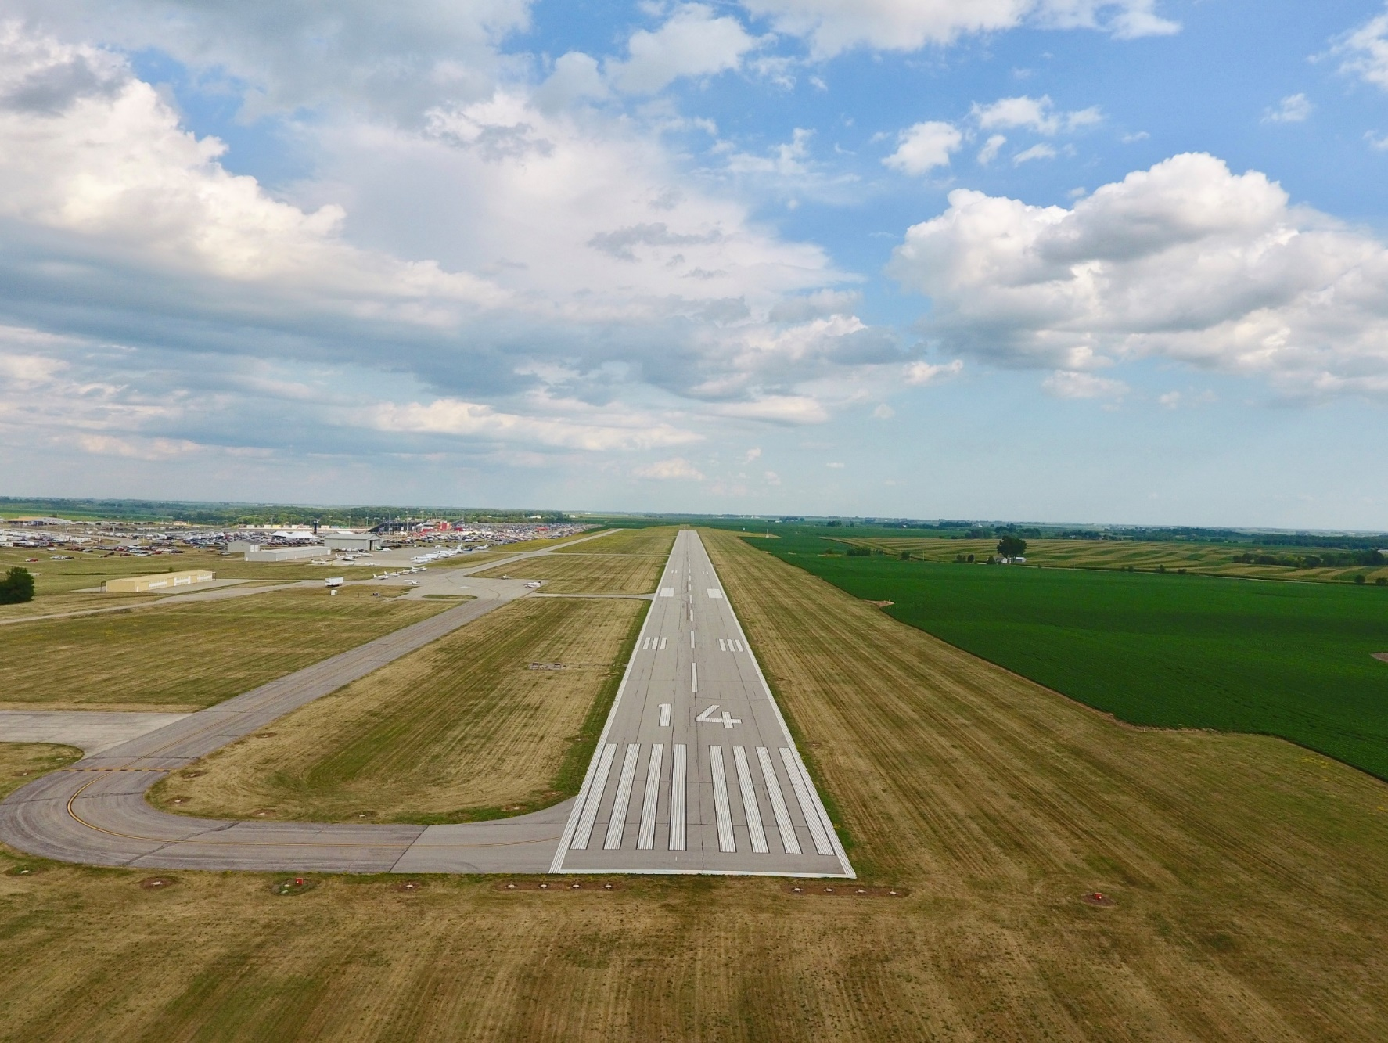
FFY 2026
Federal Aviation Administration
Funding Preapplications
Shane Wright
Modal Transportation Bureau - Aviation
February 11, 2025

Slide 2
Notes:
70 general aviation airports and 3 non-primary commercial service airports – Burlington, Fort Dodge and Mason City
DSM, CID, DBQ, SUX, ALO primary airports (more than 10,000 enplanements) go directly to FAA
30 general aviation airports not eligible for federal funds

Slide 3
Federal Aviation Administration Funding
Channeling Act of 1993 - Applies to all general aviation (GA) airports and commercial service airports that do not receive primary entitlement funds – Iowa Code Section 330.13
Must submit federal preapplication to the Iowa DOT prior to submittal to FAA
Transportation Commission approves submittal of applications to FAA
Final approval and programming of projects responsibility of the FAA

Slide 4
Federal Aviation Administration Funding
FAA Reauthorization Act of 2024
$4.0 billion for through FY2028
90% federal share (95% for FY25 and FY26 for non-hub and non-primary)
Total available dollars remain subject to annual appropriations
Federal Airport Improvement Program (AIP)
Nonprimary entitlement – Airports receive up to $150,000 each year, based on 5-year capital improvement plan included in the NPIAS (can accumulate 4 years)
State apportionment – Based on population and land area
Discretionary – Airport projects compete for funds based on FAA priority of project.
Entitlement funds are available to airports for any qualifying project. If a grant request exceeds the entitlement available, the FAA may apply apportionment or discretionary to fund the difference.
Notes:
Passed February 2012 after 24 continuing resolutions
FY 2013 funding approp thru March 27

Slide 5
Federal Aviation Administration Funding
Infrastructure Investment and Jobs Act of 2021
Known as Bipartisan Infrastructure Law (BIL)
$20 Billion for NPIAS airport infrastructure grants over 5 years
Two categories of airport funds
Airport Infrastructure Grants(AIG) - $15B – formula allocations to each airport
90% Federal share
Airport Terminal Program(ATP) - $5B – competitive grants dedicated to airport terminal infrastructure
95% Federal share for Iowa airports
Projects shown for this program have an ATP in the description.
Notes:
Passed February 2012 after 24 continuing resolutions
FY 2013 funding approp thru March 27

Slide 6
Summary of Federal Funding Nonprimary Airports in Iowa
 | 2021 | 2022 | 2023 | 2024 | 2025*
Entitlement | $7,338,428 | $16,231,042 | $19,956,793 | $12,751,903 | $10,109,486
Apportionment | $2,878,024 | $2,956,049 | $2,960,370 | $2,846,389 | $3,100,000
Discretionary | $13,985,261** | $11,761,702** | $2,472,386** | $6,331,955** | $15,671,025**
BIL |  | $405,000 | $6,469,229 | $7,430,975 | $14,941,512
 | $24,201,713 | $31,353,793 | $31,858,778 | $34,963,113 | $43,822,023
*Preliminary ** Includes Supplemental Discretionary
Notes:
2013 – Land purchases (Iowa City, Sioux County))
Washington rwy reconstructon
2014 – fewer projects requested that needed discretionary funding

Slide 7
FFY 2026 Federal Funding Project Categories
Safety and Planning
Projects that are safety or planning related
These projects are a high priority as they help to ensure the immediate safety and long-term viability of the Iowa air transportation system
Maintenance and Development Projects
Projects that are to replace, repair, or expand airport infrastructure.
Also include acquisition of snow removal equipment, fueling facilities, and buildings
Land acquisition
All conditions must be satisfied for FAA to program a project that must compete for discretionary funding
Justified, eligible project and shown on an airport layout plan
Environmental process complete
Must have purchased the land or have a formal negotiated agreement

Slide 8
FFY 2026 Federal Funding
Safety projects
Airport | Project description | Federal AIP | Federal BIL | Total Project Cost*
Humboldt Municipal | Obstruction Removal |  | $190,000 | $200,000
 | Total safety projects | $0 | $190,000 | $200,000
Planning projects
Airport | Project description | Federal AIP | Federal BIL | Total Project Cost*
Carroll - Arthur N Neu | Design and Bidding for Community Hangar | $104,500 |  | $110,000
Estherville Municipal | Design Partial Parallel Taxiway | $337,500 |  | $375,000
Fort Madison Municipal | Environmental Assessment | $76,000 |  | $80,000
Humboldt Municipal | Environmental Assessment |  |  | $142,500
Iowa DOT | Pavement Condition Study | $198,000 |  | $220,000
Marshalltown Municipal | Design Runway 13/31 Reconstruction | $450,000 | $525,000 | $1,026,500
Mason City Municipal | Rehabilitate Runway 18/36 Design | $380,000 |  | $400,000
Northeast Iowa Regional | Environment Assessment | $142,500 |  | $150,000
Ottumwa Regional | Taxiway Rehabilitation Design | $90,250 |  | $95,000
Sheldon Regional | Runway 33 Environmental and Alternatives |  | $144,970 | $152,600
Vinton Veterans Memorial | Design Runway 09/27 Reconstruction |  | $315,000 | $350,000
Webster City Municipal | Runway 05/23 Airport Layout Plan Update |  | $161,500 | $170,000
 | Total planning projects | $1,778,750 | $1,146,470 | $3,271,600
* Total Project Cost includes local, state, and other sources of funds not included on this summary
Notes:
The Iowa Aviation System Plan provides a detailed overview of the Iowa Aviation System. It evaluates existing conditions and makes recommendations for future development of the air transportation system.
Last Aviation System Plan was published in 2010.
Originally scheduled to receive FAA funding in FY2018, but FY2017 funds became available and offered to us to begin this effort early.
Estimated cost of $350,000 requiring a $35,000 state share.
Because this is a FAA FY2017 project, it does not appear on the list of projects, but we are requesting commission approval to move ahead with the project.

Slide 9
FFY 2026 Federal Funding
* Total Project Cost includes local, state, and other sources of funds not included on this summary

Slide 10
FFY 2026 Federal Funding
* Total Project Cost includes local, state, and other sources of funds not included on this summary

Slide 11
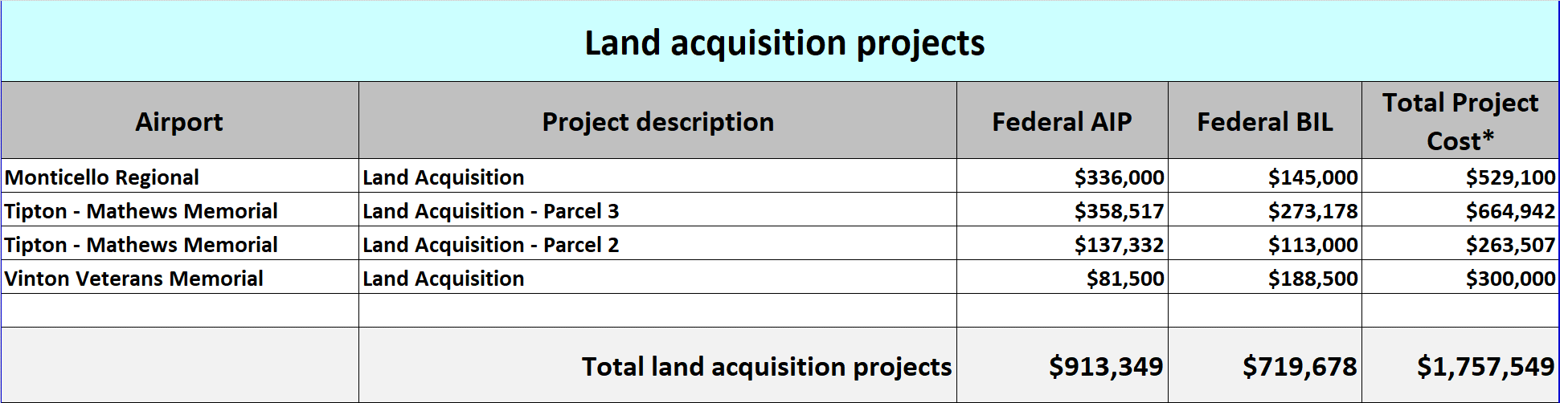
FFY 2026 Federal Funding

Slide 12
FFY 2026 Federal Funding Preapplications Summary
 | Projects | Airports | Federal Share | Total Applications
Safety and Planning | 13 | 13 | $3,115,220 | $3,471,600
Maintenance and Development | 53 | 43 | $59,548,340 | $65,263,802
Land Acquisition | 4 | 3 | $1,633,027 | $1,757,549
Total Preapplications | 70 | 59 | $64,296,587 | $70,492,951
Notes:
Total eligible airports: 73 plus 2 new/replacement
No projects: 21 airports

Slide 13
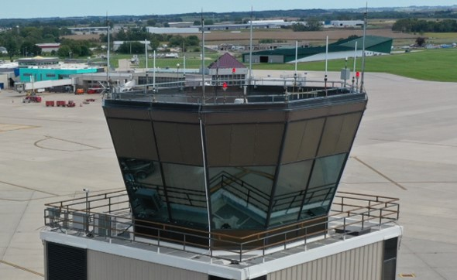
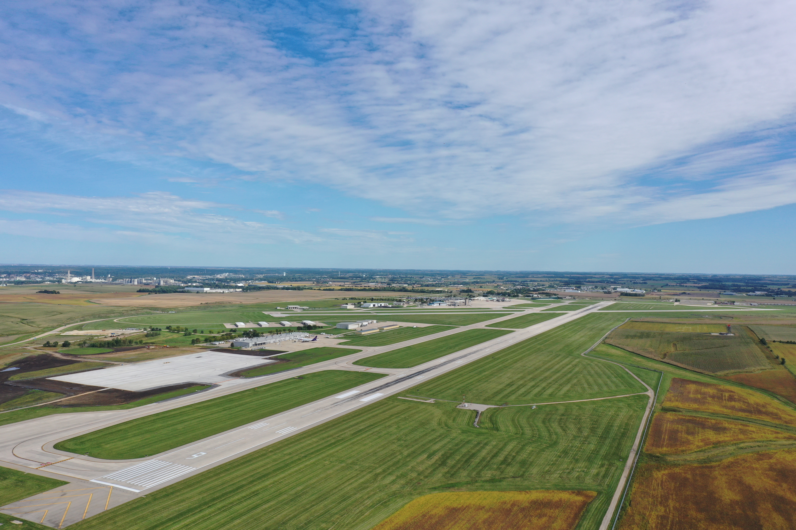
Summary
70 Projects totaling $70.4M
All projects fall within the Iowa Aviation System Plan
Modal Transportation Bureau offers no objections
Recommend approving submittal of applications, as presented, to the FAA

Slide 15
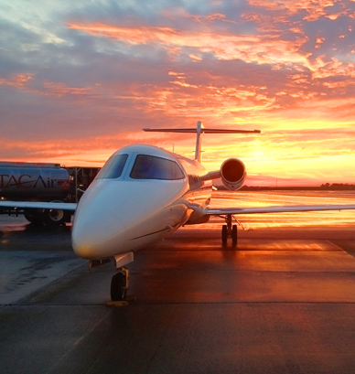
FFY 2026 Federal Aviation Administration Funding Preapplications
Questions??

