Slide 1
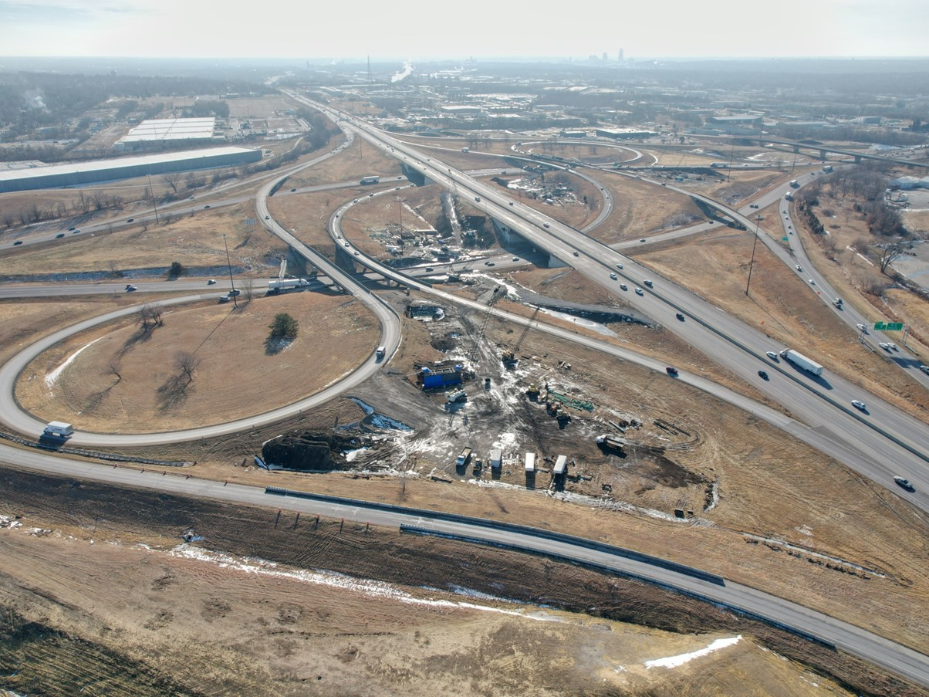


2026-2030 Highway Program Development
February 11, 2025
3/2/2023

Slide 2
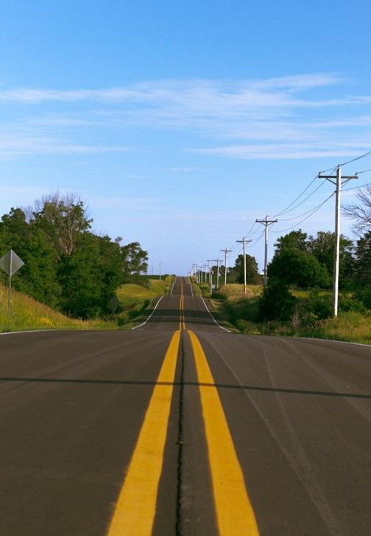

Agenda
TOPIC 1
2026-2030 Highway Program Development Schedule
TOPIC 2
Extended Highway Program Analysis
TOPIC 3
Statewide Line Items
  At what levels should the line item targets be programmed?
TOPIC 4
Federal Funding Status
Program Development Considerations
Next Steps

Slide 3
Topic 1
2026-2030 Highway Program Development Schedule

Slide 4
February 11, 2025
Highway Program Development Schedule (2026-2030)
February 2025
  Discuss Extended Highway Program Analysis
  Discuss Statewide Line Items
    At what levels should the line-item targets be programmed?
March 2025
  Discuss 2026-2030 available Highway Program funding
  Discuss 2026-2030 Highway Program options
  Determine 2026-2030 Highway Program Objectives
  Action Item: Line-Item Targets for Programming
April 2025
  Develop the Draft 2026-2030 Highway Program
  Action Item: 2026-2030 Highway Program Objectives
May 2025
  Present the Draft 2026-2030 Iowa Transportation Improvement Program to the public (including all previous program approvals and Draft 2026-2030 Highway Program)
June 2025
  Action Item: Approve the 2026-2030 Iowa Transportation improvement Program

Slide 5
Topic 2
Extended Highway Program Analysis

Slide 6
February 11, 2025 as presented on January 21, 2025
2025-2034 Highway Program Analysis
For Highway Planning Purposes Only (x $1,000,000)

Slide 7
February 11, 2025
2026-2035 Highway Program Analysis
For Highway Planning Purposes Only (x $1,000,000)

Slide 8
Topic 3
Statewide Line Items

Slide 9
February 11, 2025
Draft 2026-2030 Iowa Highway Program Line Items
  At what levels should the line item targets be programmed?
  March Action Item:
  Line Item Targets for Programming

Slide 10
February 11, 2025
Draft 2026-2030 Iowa Highway Program Line Items
Engineering Consultant Services
 |  | Project Estimated Costs X $1000
Location | Type Of Work | 2026 | 2027 | 2028 | 2029 | 2030
Statewide Consultant Services | Outside Services Engineering | 64,000 | 64,000 | 64,000 | 64,000 | 64,000
 |  | 8,000 | 10,000 | 12,000 | 14,000 | 16,000
Consultant costs have increased with inflation.
With an increasing program there are additional projects which need to be developed with consultant services.
This program includes several large and complex projects (e.g., Gordon Dr Viaduct and SW Mixmaster) that require consultant support.

Slide 11
February 11, 2025
Draft 2026-2030 Iowa Highway Program Line Items
Statewide Operations
 |  | Project Estimated Costs X $1000
Location | Type Of Work | 2026 | 2027 | 2028 | 2029 | 2030
Statewide Operations | Outside Services Engineering | 12,450 | 12,450 | 12,450 | 12,450 | 12,450
 |  | 3,550 | 3,550 | 3,550 | 3,550 | 3,550
Added Highway Helper services in Sioux City.
Increased Des Moines Highway Helper services to address clearance needs at Hickman Interchange, NE Mixmaster and SW Mixmaster projects.

Slide 12
February 11, 2025
Draft 2026-2030 Iowa Highway Program Line Items
Statewide Intelligent Transportation Systems (ITS)
 |  | Project Estimated Costs X $1000
Location | Type Of Work | 2026 | 2027 | 2028 | 2029 | 2030
Statewide ITS | Miscellaneous | 5,750 | 5,750 | 5,750 | 5,750 | 5,750
 |  | 2,250 | 2,250 | 2,250 | 2,250 | 2,250
Funding to support costs associated with maintenance of existing ITS infrastructure (modems, cameras, sensors etc.).
Cost increase to address inflation and increased volume of sensors to support and maintain ITS infrastructure.

Slide 13
February 11, 2025
Draft 2026-2030 Iowa Highway Program Line Items
Statewide Contract Maintenance
 |  | Project Estimated Costs X $1000
Location | Type Of Work | 2026 | 2027 | 2028 | 2029 | 2030
Statewide Contract Maintenance | Miscellaneous | 37,850 | 38,350 | 43,500 | 44,000 | 44,500
 |  | 5,000 | 5,000 | 5,000 | 5,000 | 5,000
Additional funding to support statewide roadside clean up and hazardous materials/cleaning at parking only rest areas.
Additional funding for pavement contract maintenance activities that support asset management strategies.

Slide 14
February 11, 2025
Draft 2026-2030 Iowa Highway Program Line Items
Statewide Traffic Control Devices/Signs
 |  | Project Estimated Costs X $1000
Location | Type Of Work | 2026 | 2027 | 2028 | 2029 | 2030
Statewide Traffic Control Devices/ | Miscellaneous | 5,000 | 5,000 | 5,000 | 5,000 | 5,000
Signs/Lighting
Modify description to include lighting to more accurately reflect use of funds.

Slide 15
Topic 4
Federal Funding Status
Program Development Considerations
Next Steps

Slide 16
February 11, 2025
Federal Funding Status
  FFY 2025 Appropriation: Second continuing resolution expires March 14.
  Infrastructure Bill authorizes federal funding through September 30, 2026, leaving some funding uncertainty for the last four years of this Program.
  Infrastructure Bill funding allocations based on Commission action in June 2022.
  The next Highway Trust Fund cliff is in 2028.
  Legislation to address a portion of the large August Redistribution amounts has been passed.
  Impacts associated with Executive Orders

Slide 17
February 11, 2025
Program Development Considerations
  Construction costs have declined this fiscal year.
  State road funding continues to come in higher than forecast.
  The last four years of federal funding in this Program are not part of an authorization.
  Continue to prioritize bridge and pavement stewardship investments on existing highway system.
  Pursue grant funding opportunities.
  Assess balance of pavement and bridge stewardship investments.
  Balance capacity improvements with stewardship needs.
  Address major river crossing needs.

Slide 18
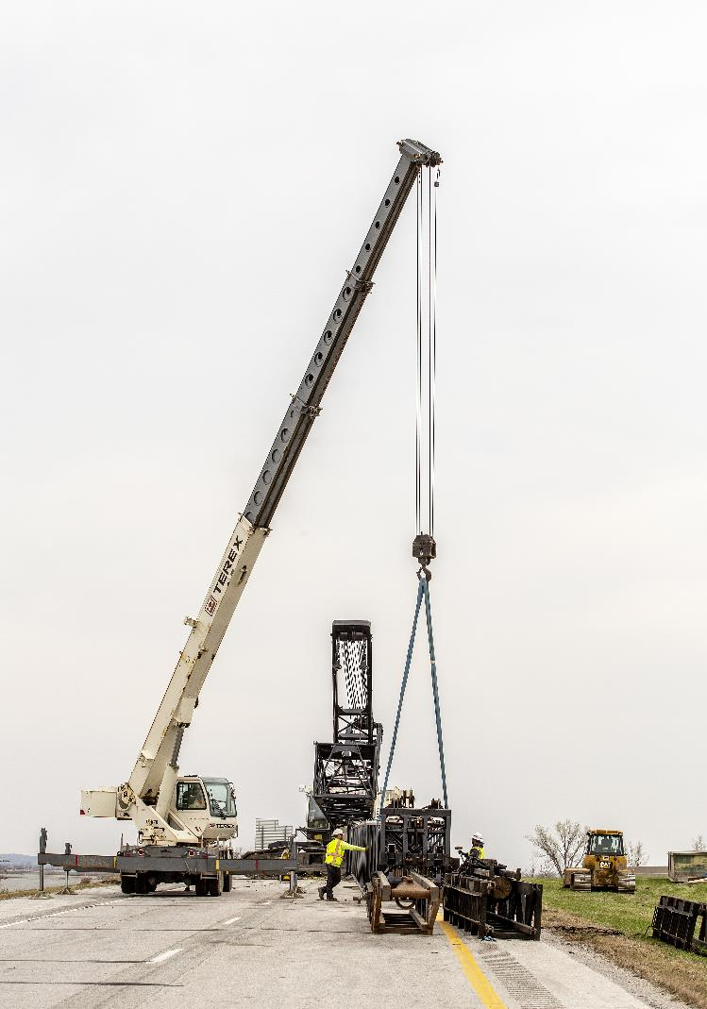
Next Steps
Discuss 2026-2030 available Highway Program funding
Discuss 2026-2030 Highway Program Options
Determine 2026-2030 Highway Program Objectives
Action Item: Line-Item Targets for Programming

Slide 19
Questions?

