Slide 1



Transportation Trends Update
April 7, 2025
3/2/2023

Slide 2
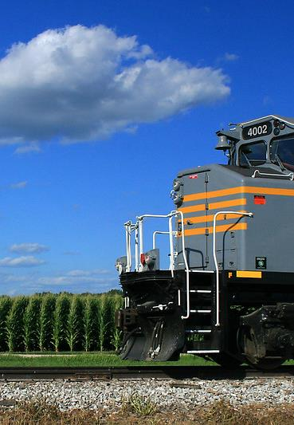

Agenda
US total rail carloads
Commercial air service passenger counts
Vehicular traffic

Slide 4
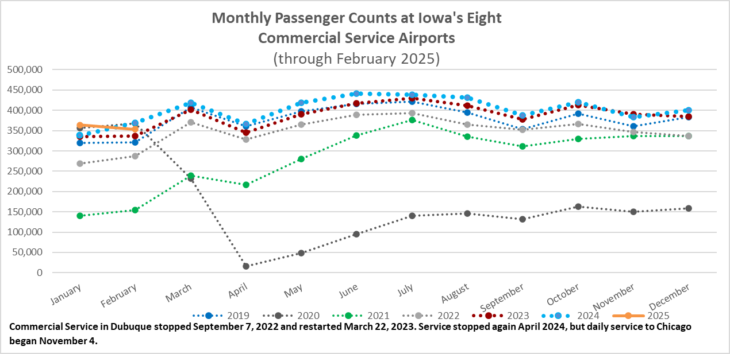

Slide 5
Monthly State Vehicle Miles of Travel
(through February 2025)

Slide 6
Questions?

