Slide 1
2024 Flooding – Cherokee County

Slide 2
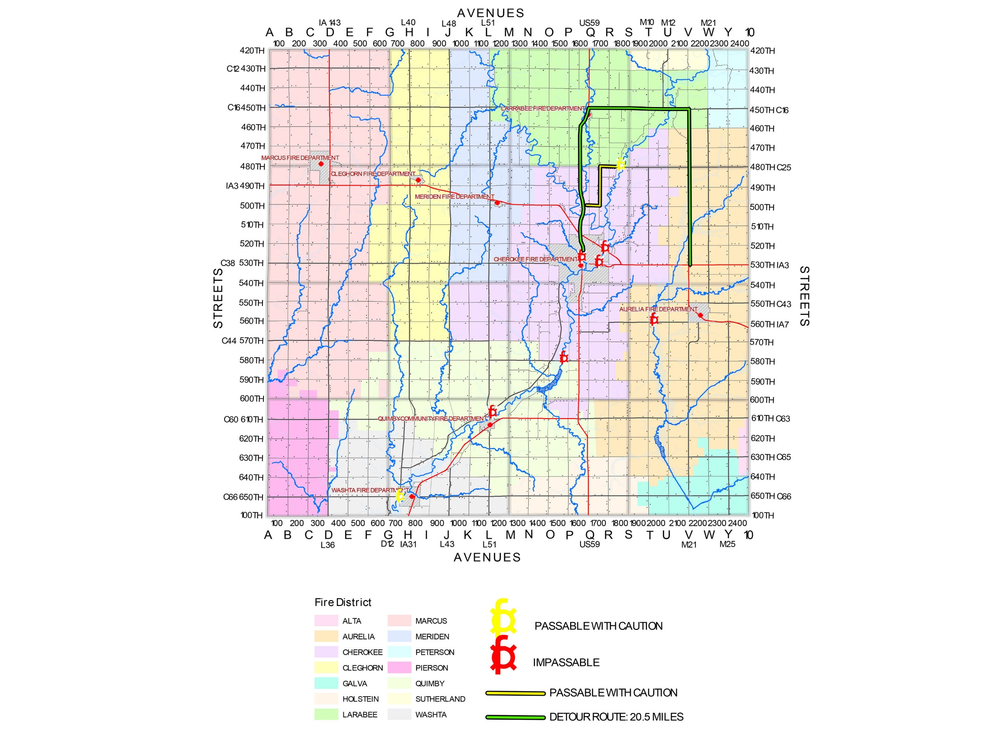

Slide 3
Little Sioux River Flood 2024 Cherokee County
Flood Stage: Previous record river level was 28’4”. The 2024 River level reached 34-35’. It should be noted that the sensors failed and depth was determined by local residents.
Housing:
120 homes were impacted to some degree
Of those homes impacted, 39 homes had major damage (basement was filled and water was in the main floor).
Of those 39 homes, 19 had catastrophic damage.
It is important to note that the flood of 1993 resulted in the loss of approximately 200 houses and numerous businesses in an area that became green space. The loss of those homes continues to be felt today with a continued housing shortage and population decline. In addition to devasting the lives of current residents, the Flood of 2024 will likely exacerbate those problems.
Businesses:
15-16 businesses had their property, equipment, and inventory damaged.
Of those, 1 did not reopen. Others continue to explore relocation options.
Impacted a broad spectrum of businesses: As an example, one was purchased June 1, 2024 and another is a 3rd generation business. Both businesses suffered major damage.
Many businesses had their ability to transact business impacted due to road closures.
Municipal:
Cherokee’s wastewater treatment plant needs to be relocated with an estimated cost of $45-50M
Spring Lake Park: access road and shelter house sustained major damage as did other infrastructure
Each town along the Little Sioux River experienced impacts.

Slide 4
ASSISTANCE
July 5, 2024 Under the Presidential Major Disaster Declaration, FEMA approved Cherokee County for Individual Assistance which enabled a Disaster Recovery Center to be opened in Cherokee County on July 20, 2024 bringing under one roof FEMA, SBA and SBDC to centralize assistance.
July 24, 2024 Under the Presidential Major Disaster Declaration, FEMA approved Cherokee County for Public Assistance which will enable access to Disaster Recovery Temporary Housing Program, funding assistance for wastewater treatment plant as well as other infrastructure damaged
Disaster Recovery Fund (DRF): Created in 2020 by the Cherokee County Legacy Foundation and with the generous support of Cherokee State Bank, the DRF was created. Members of the committee include Bill Anderson, Curt Johnson, Tammy Johnson, Justin Pritts and Paul Wilkens. To date, $30,000 has been raised to support relief efforts for immediate needs (temporary housing, clothing, food) and to provide “stop-gap” funding when/if public assistance is exhausted and need continues. This fund is also being enhanced by the Ministerial Association.
July 10, 2024 CAEDC announced a Disaster Loan Program for businesses impact by the flooding. With funding provided through CML Telephone Cooperative and the USDA through a revolving loan fund, a special loan fund of $200,000 has been established. Terms: A signature loan of up to $20,000 for 5 years with 0% interest. To date, $110,000 has been disbursed to 6 businesses saving 14 jobs and enabling businesses to get cleaned up, make repairs, order inventory and make payroll. Several other businesses continue to evaluate their need and additional applications are expected.

Slide 6
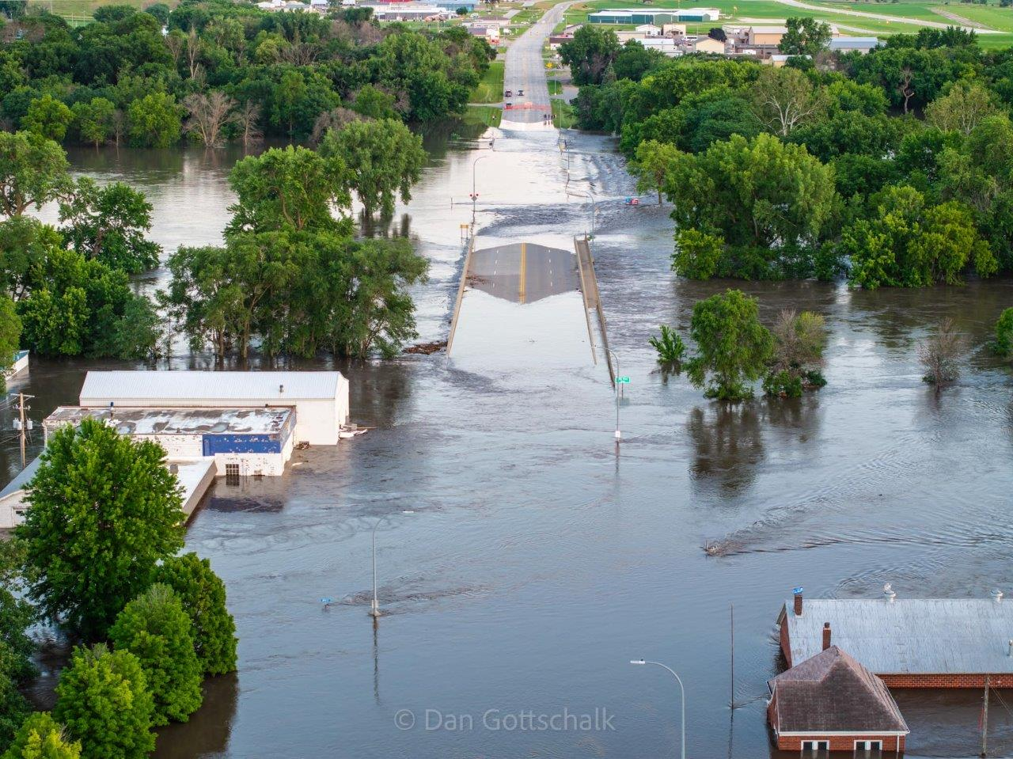

Slide 7
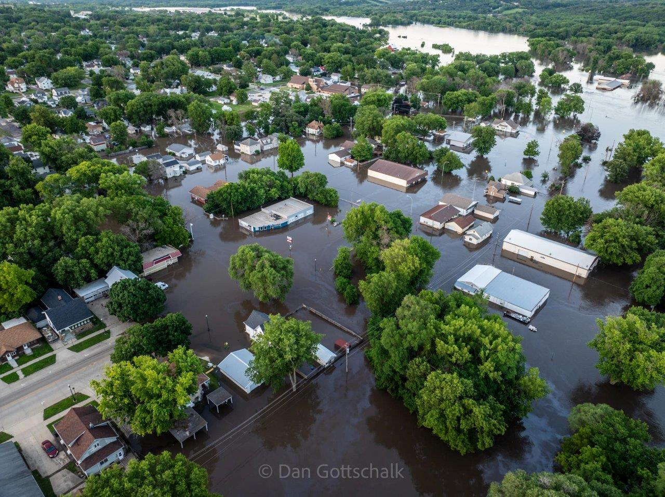

Slide 8
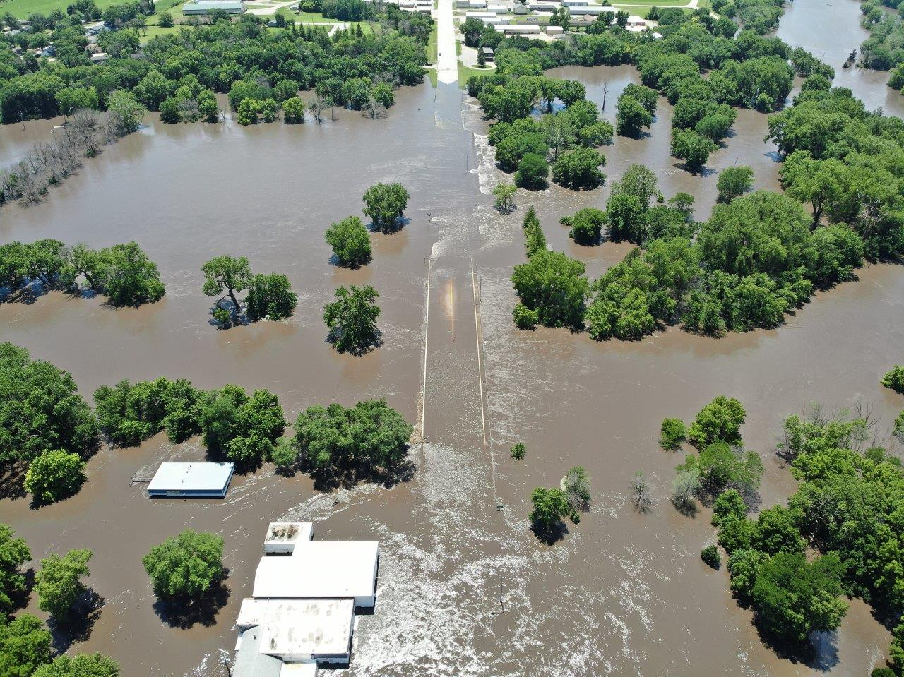

Slide 9
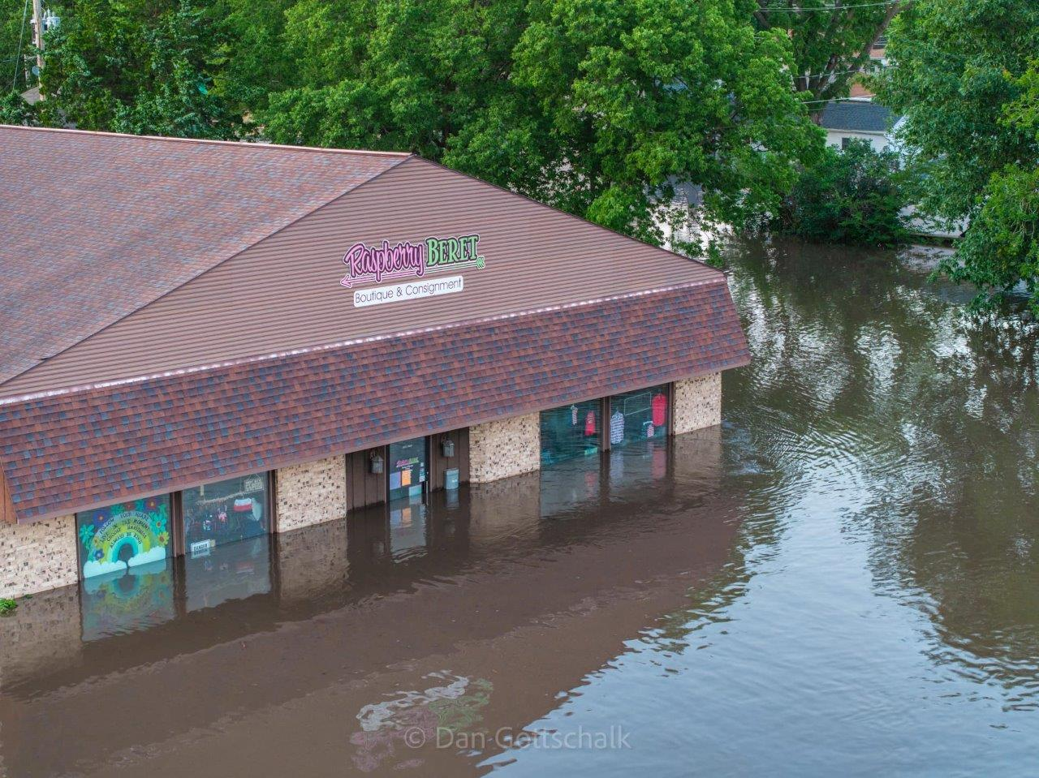

Slide 10
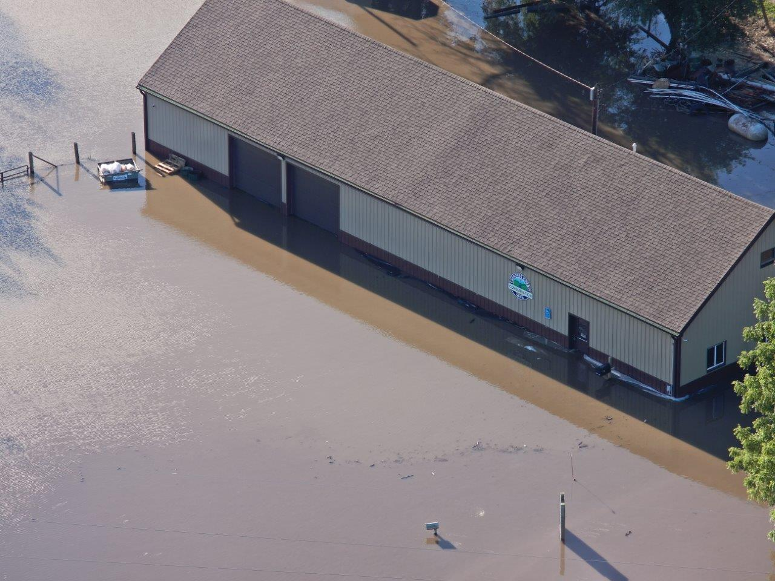

Slide 11
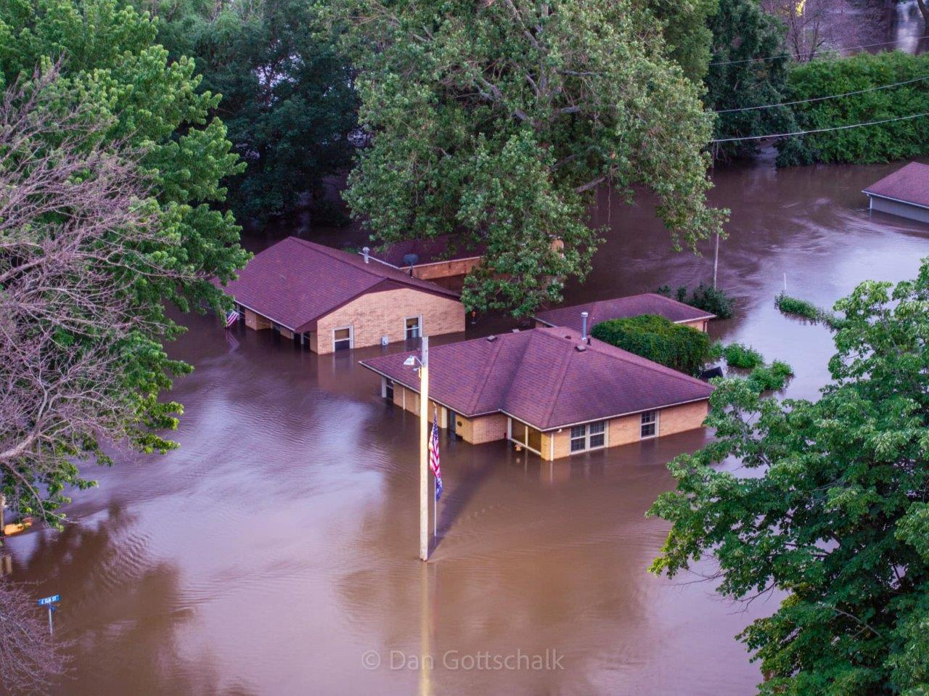

Slide 12
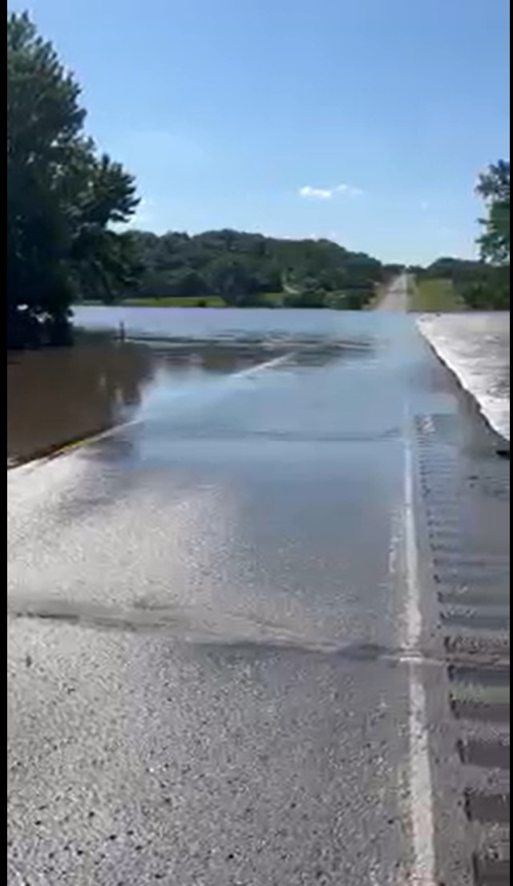

Slide 13
