Slide 1
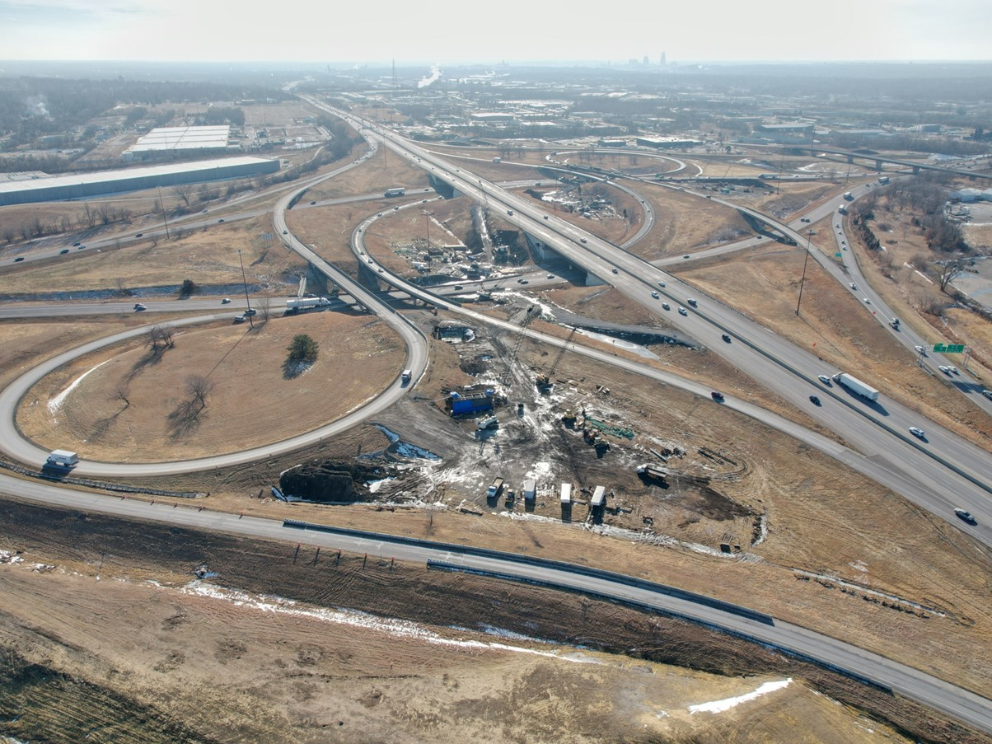


2026-2030 Highway Program Development
April 7, 2025
3/2/2023

Slide 2
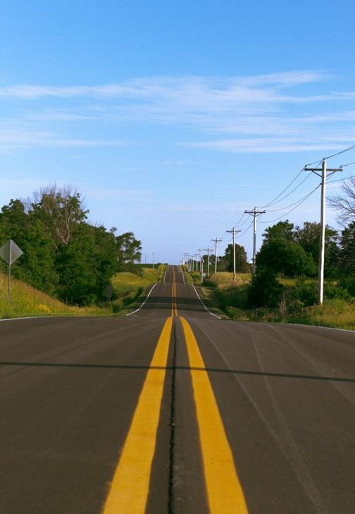

Agenda
TOPIC 1
Highway Program Analysis
TOPIC 2
Determine Highway Program Objectives
TOPIC 3
Explanation of Highway Program Changes
TOPIC 4
Next Steps

Slide 3
April 7, 2025
Highway Program Development Schedule (2026-2030)
April 2025
Develop the Draft 2026-2030 Highway Program
Action Item: 2026-2030 Highway Program objectives
May 2025
Present the Draft 2026-2030 Iowa Transportation Improvement Program to the public (including all previous Program approvals and Draft 2026-2030 Highway Program)
June 2025
Action Item: Approve the 2026-2030 Iowa Transportation improvement Program

Slide 4
April 7, 2025 as presented on March 20, 2025
2026-2030 Iowa Highway Program
Decision Points
Should projects in the 2026-2029 Program continue to be programmed with cost/schedule updates?
Proceed with programmed projects
What modifications to the Program should be considered?
Adjust Stewardship Targets in the extended highway program?
Proceed with adjustments to Stewardship Targets
Add projects to the Program from the Program Candidates list?
Add priority projects from Program Candidate list

Slide 5
April 7, 2025 as presented on March 20, 2025
2026-2030 Iowa Highway Program
Decision Points (continued)
3. How should Program be balanced?
Program balances will need to be addressed, specifically 2027, 2029 and 2030.
Options include project rescheduling and Stewardship Target adjustments.
Reschedule some non-stewardship projects in the program
Modify Stewardship Targets in 2028-2030
Come back with scenario(s) at March 20th Workshop
Provide balanced program scenario

Slide 6
Topic 1
Highway Program Analysis

Slide 7
April 7, 2025 as presented on March 20, 2025
2026-2030 Project Addition Scenario
($ in millions)
(For Highway Planning Purposes Only)

Slide 8
April 7, 2025 as presented on March 20, 2025
2026-2030 Project Rescheduling Scenario
($ in millions)
(For Highway Planning Purposes Only)

Slide 9
April 7, 2025 as presented on March 20, 2025
2026-2030 Stewardship Target Modification Scenario
($ in millions)
(For Highway Planning Purposes Only)

Slide 10
April 7, 2025 as presented on March 20, 2025
2026-2035 Highway Program Analysis
($ in millions)
(For Highway Planning Purposes Only)

Slide 11
Topic 2
Determine Highway Program Objectives

Slide 12
April 7, 2025 as presented on March 20, 2025
Potential 2026-2030 Highway Program Objectives
Safety
Maintain increasing funding levels for safety
Complete statewide centerline rumble strip implementation
Continue enhanced pavement markings to non-interstate highways
Sustainability
Maintain Interstate funding levels for pavement reconstruction, modernization, bridges, pavement patching/maintenance, rest areas, and other miscellaneous projects
Maintain funding levels for non-interstate pavement modernization
Maintain funding levels for non-interstate bridge modernization
Invest in additional stewardship projects
Transfer jurisdiction of portions of primary roadways to cities and counties
Accessibility
Invest in truck parking at Interstate Rest Areas
Continue to invest in vault toilets at parking only sites
Complete installation of adult changing stations at modernized rest areas
Invest in corridor improvements
Flow
Invest in intelligent transportation systems infrastructure
Invest in Super-2 improvements
Invest in operational and Integrated Corridor Management improvements

Slide 13
Topic 3
Explanation of Highway Program Changes

Slide 14
April 7, 2025
Explanation of Highway Program Changes

Slide 15
Topic 4
Next Steps

Slide 16
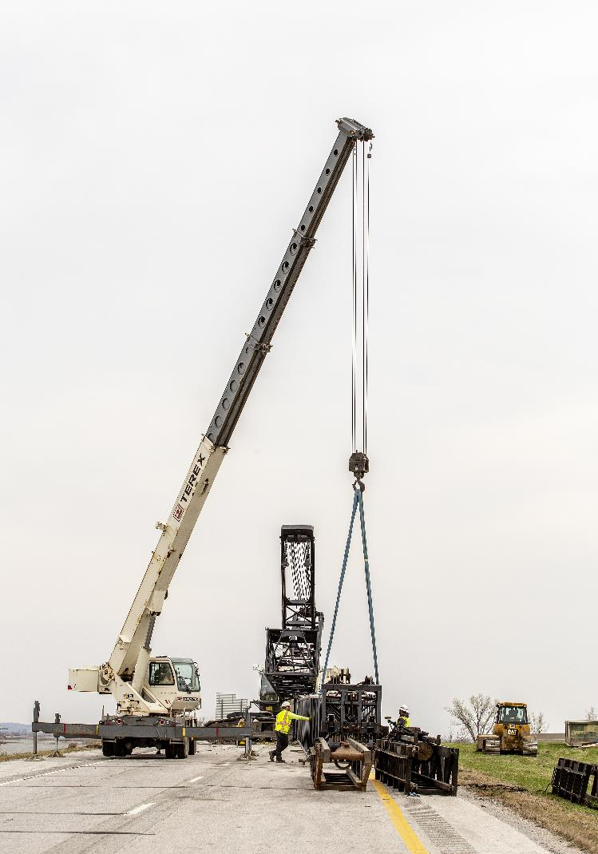
Next Steps
Present the Draft 2026-2030 Iowa Transportation Improvement Program to the public (including all previous Program approvals and Draft 2026-2030 Highway Program)

Slide 17
Questions?

