Slide 1
Spencer, Iowa
Kevin Robinson, City Manager

Slide 2
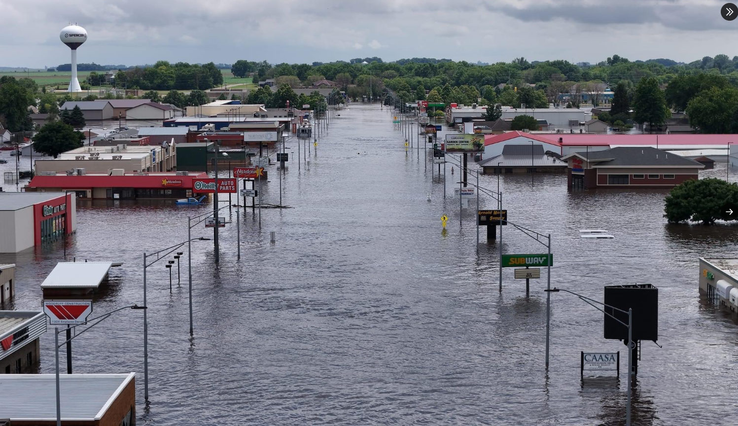
June 22, 2024

Slide 3
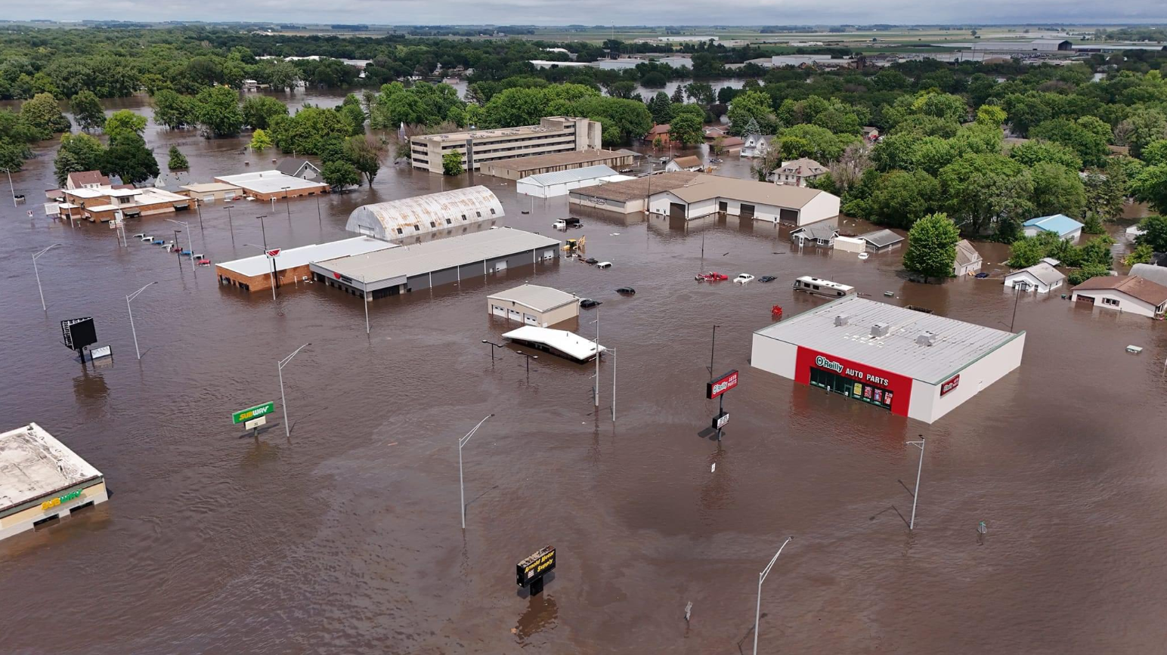
8’ rise in 90 minutes to historic 23’ crest (17’ prediction)

Slide 4
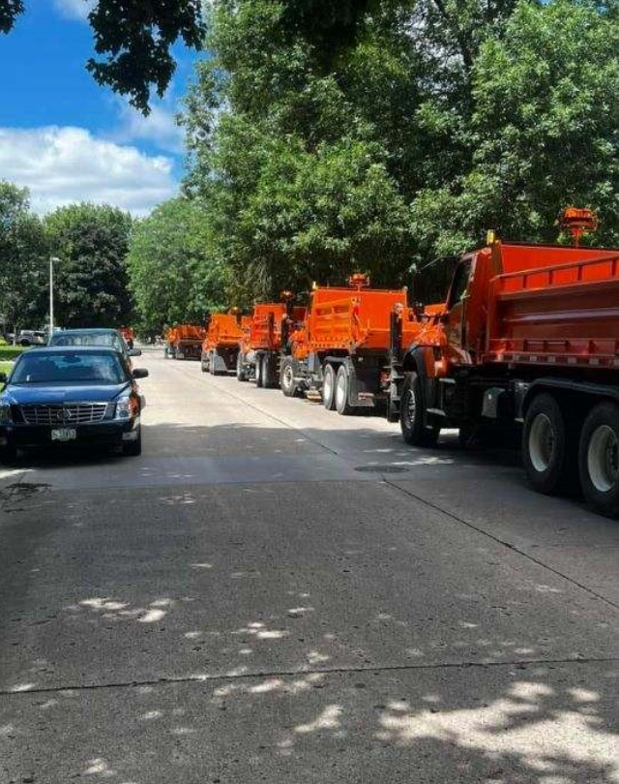
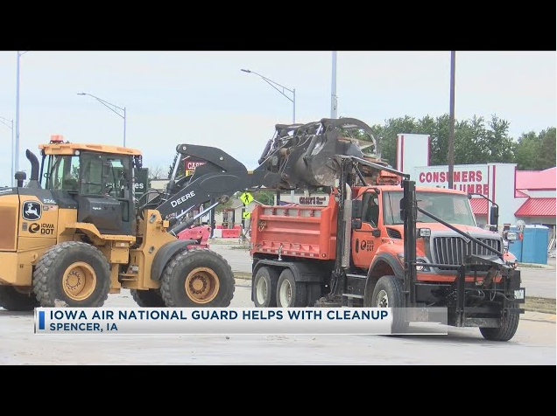
First sign of hope - The Iowa DOT Debris Removal Team

Slide 5
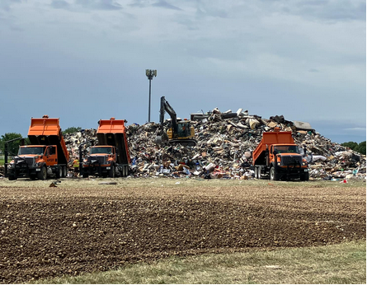
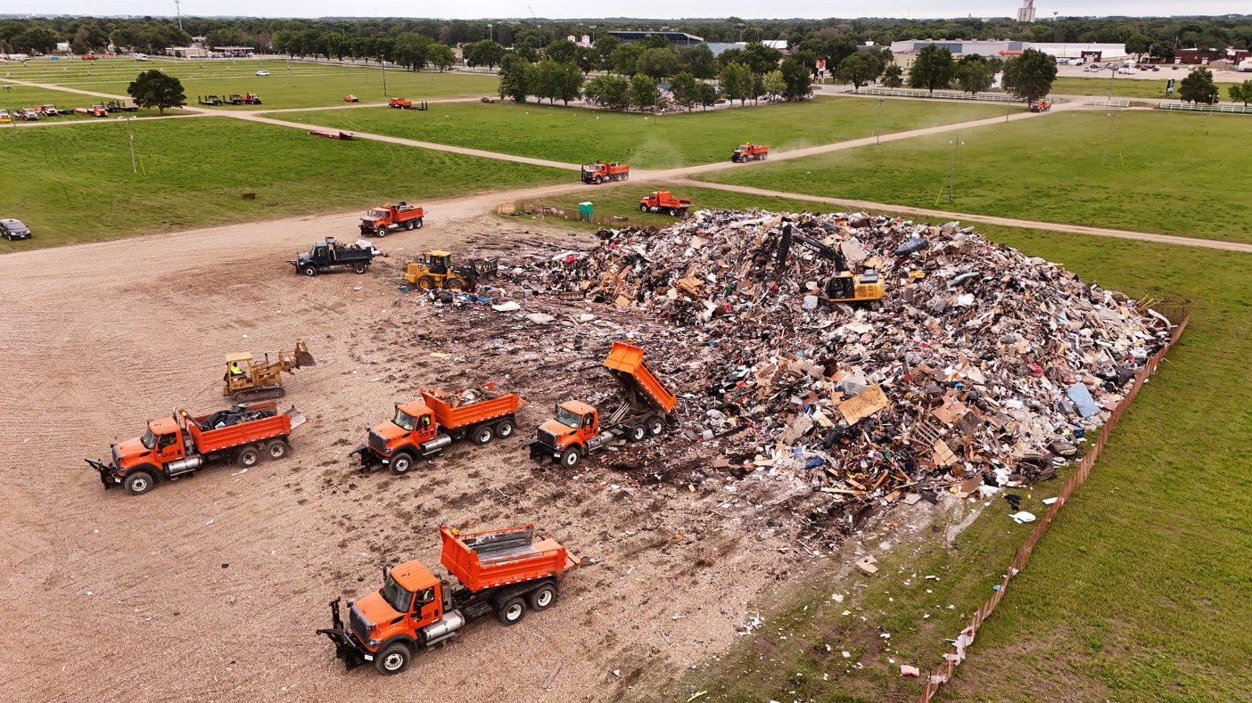

Slide 6
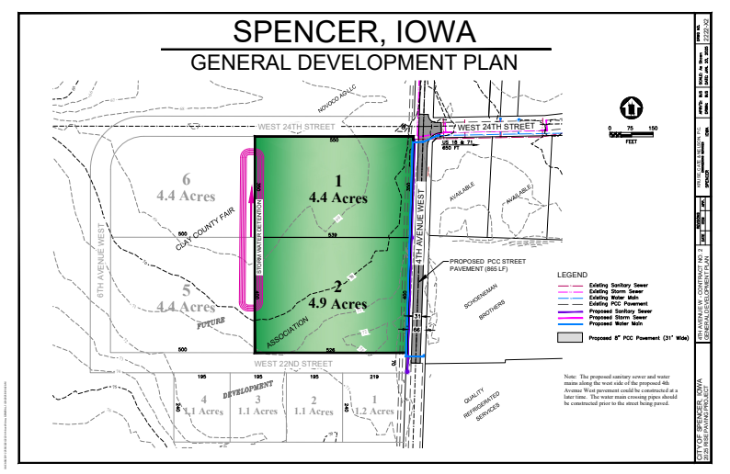
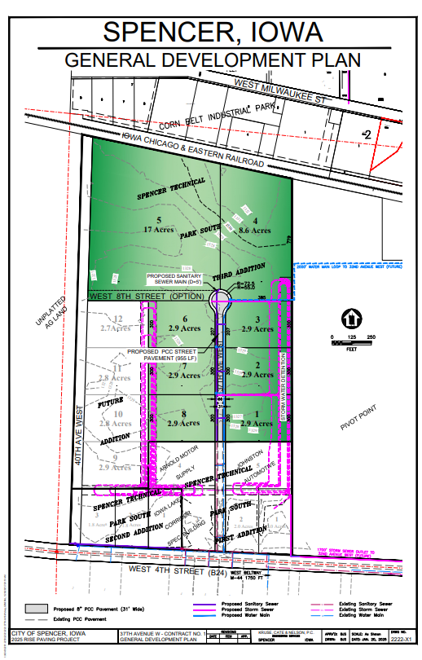
DOT Disaster RISE Grant Application

Slide 7
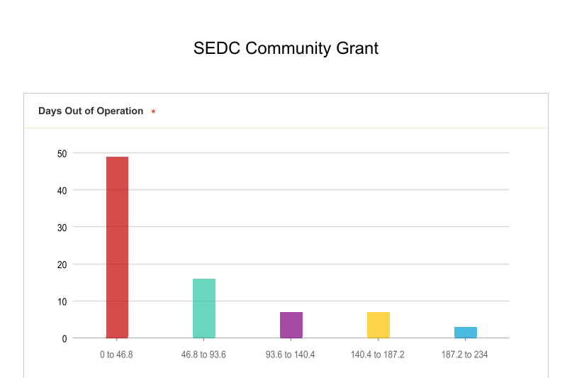
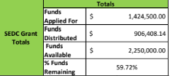
ARPA Re-obligation for Category 6 Revenue Loss
1.3MM turned into 2.6MM

Slide 8
North Y Roundabout - New Commercial Lots

Slide 9
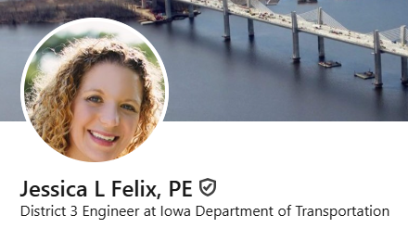
Your DOT Professionals ARE THE DIFFERENCE!
Jessica’s leadership before, during and after the disaster has been incredible. Jessica participated in our community post flood debrief and has worked tirelessly to support the community of Spencer. We are grateful for her!

Slide 10
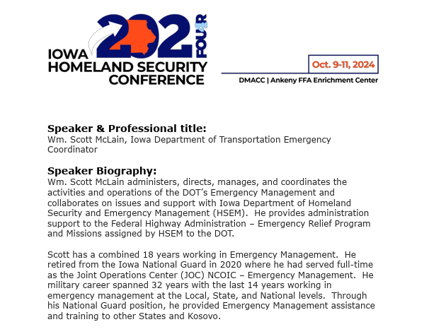
Your DOT Professionals ARE THE DIFFERENCE!
Scott’s leadership was the first sign of hope for the people of Spencer. For myself Scott was the mentor, advisor and guidance I needed leading the local recovery efforts. Scott’s professionalism, direct communication style and 24/7 availability empowered me to lead with confidence. I am forever grateful to Scott McLain.

Slide 11
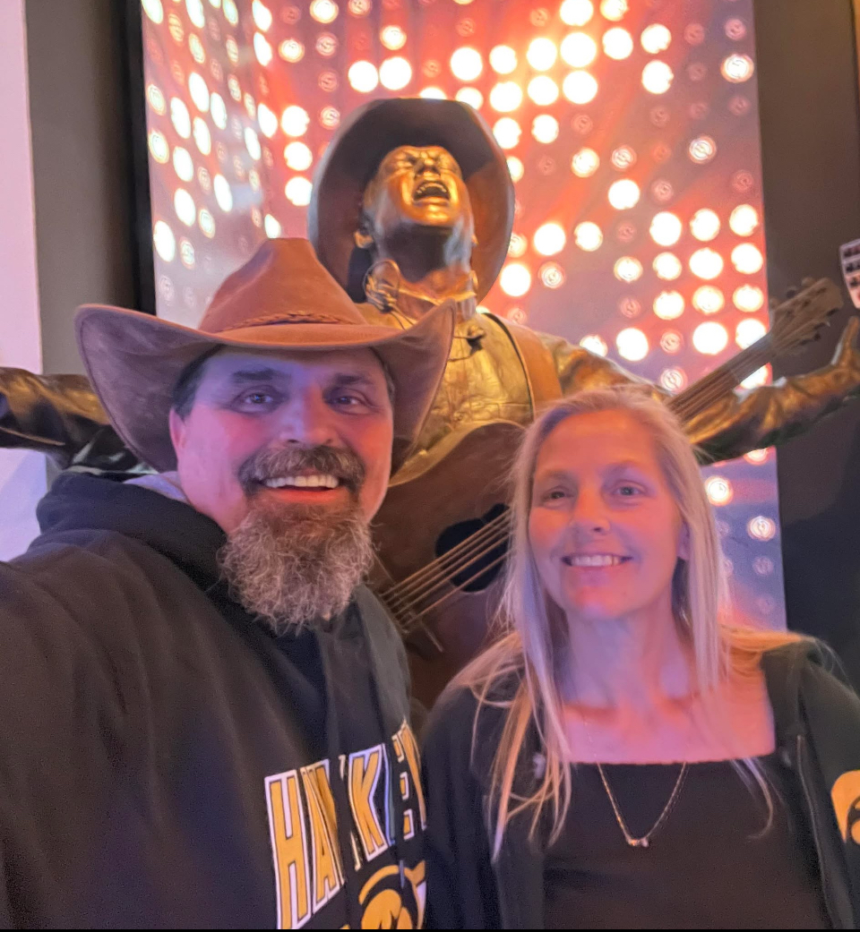
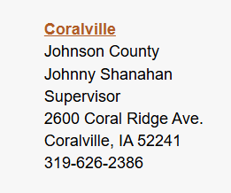
Your DOT Professionals ARE THE DIFFERENCE!
Johnny’s leadership organizing and executing the debris removal mission was amazing! “Who are the orange trucks and who is leading it? We’ve never seen anything so efficient and that well run before anywhere” - FEMA

Slide 12
Thank you for all you do providing leadership and insight to the Iowa Department of Transportation. As a City we are very grateful for your efforts and for the support of the DOT professionals who work tirelessly leading and executing the mission of the DOT on a daily basis.

