Slide 1
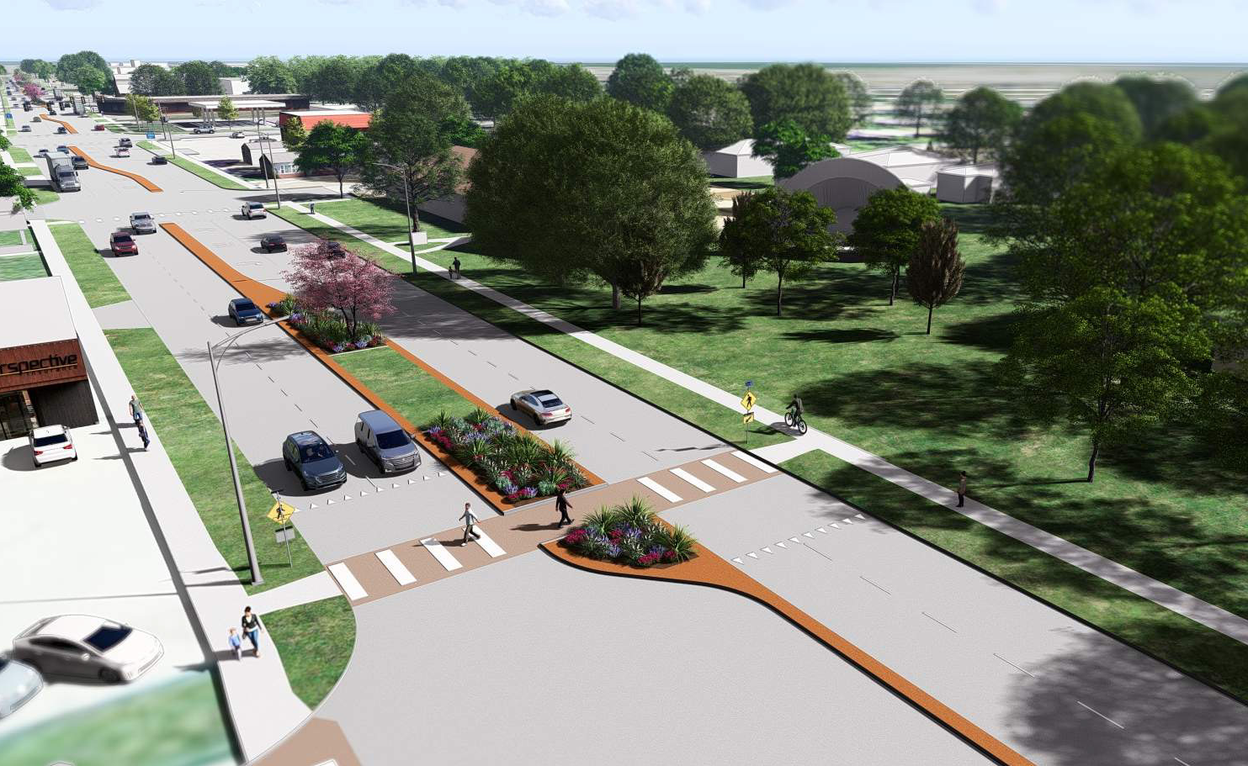
Highway 75
Iowa DOT Commission | April 8, 2025

Slide 2
Guiding priorities for this project
Centered on SAFETY
Improving the FUNCTION
Showcasing our CHARACTER

Slide 3
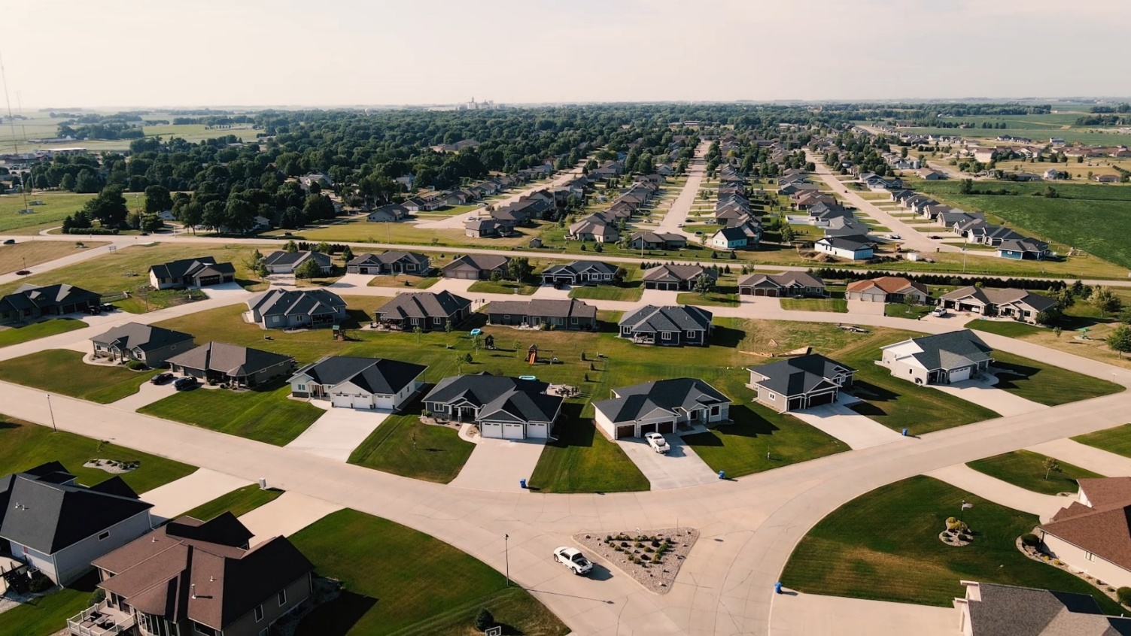
Local growth

Slide 4
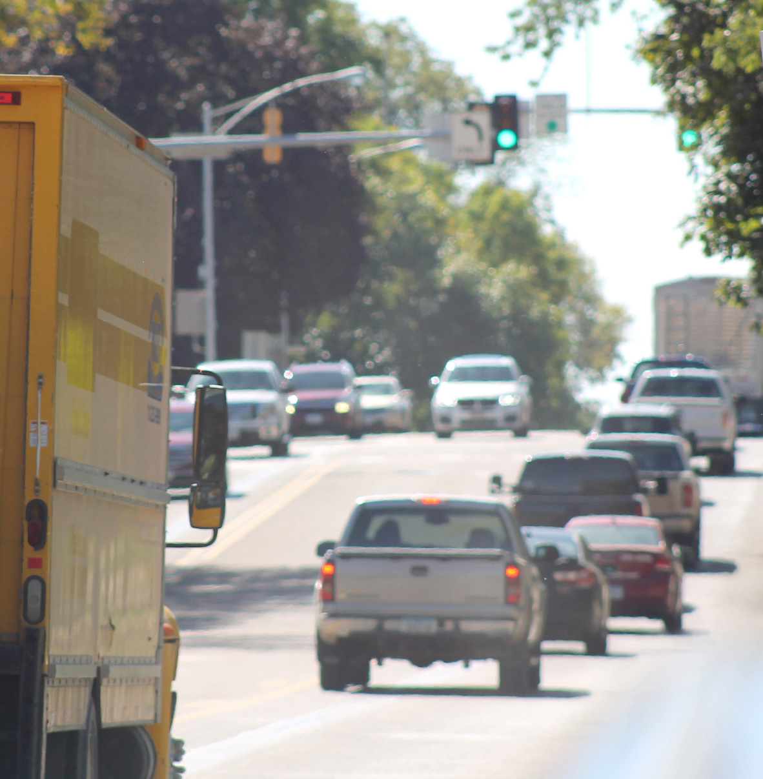
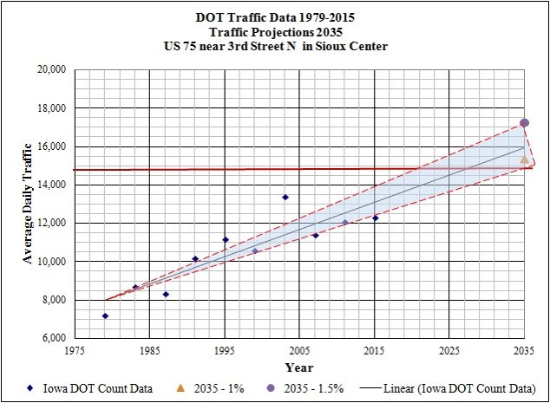
Traffic Growth of Highway 75

Slide 5
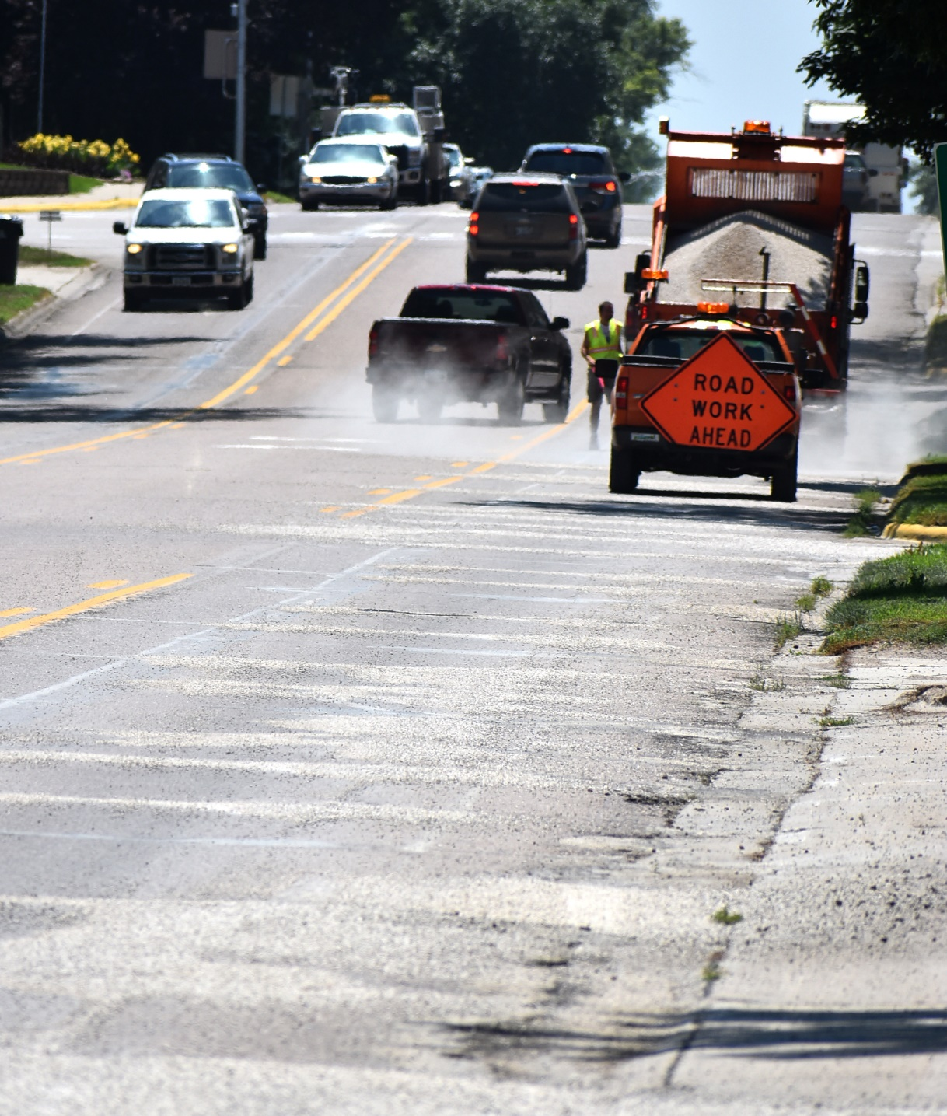
Pavement Condition
1938
1938
1927
1934
1934

Slide 6
DOT Partnership
Financial partnership
Significant state/federal investment in Sioux Center
Local partnership $18 M
ROW and easement acquisition
119 properties impacted
District 3 Office
Communication
Collaboration in design goals

Slide 7
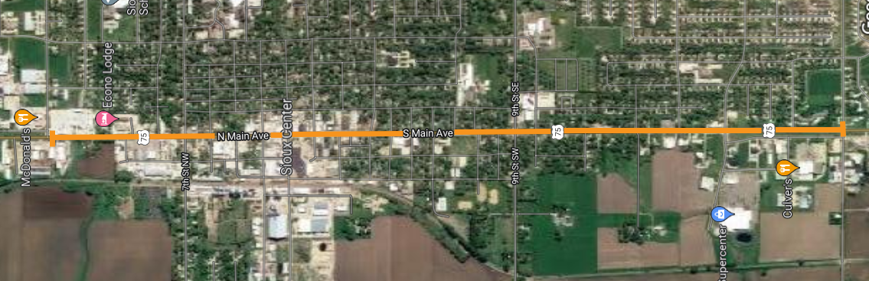
Highway 75
scope of project
Project includes:
Remove and replace roadway
20th St. South (Pizza Hut intersection)
to 12th St. North (just before McDonalds intersection)
2 ½ Miles
Two-lane travel each direction with medians/turn lane
Utilities, streetlights, traffic signals
Sidewalks along project + streetscape
Construction: 2023-2026 – DOT project in 2027-28

Slide 8
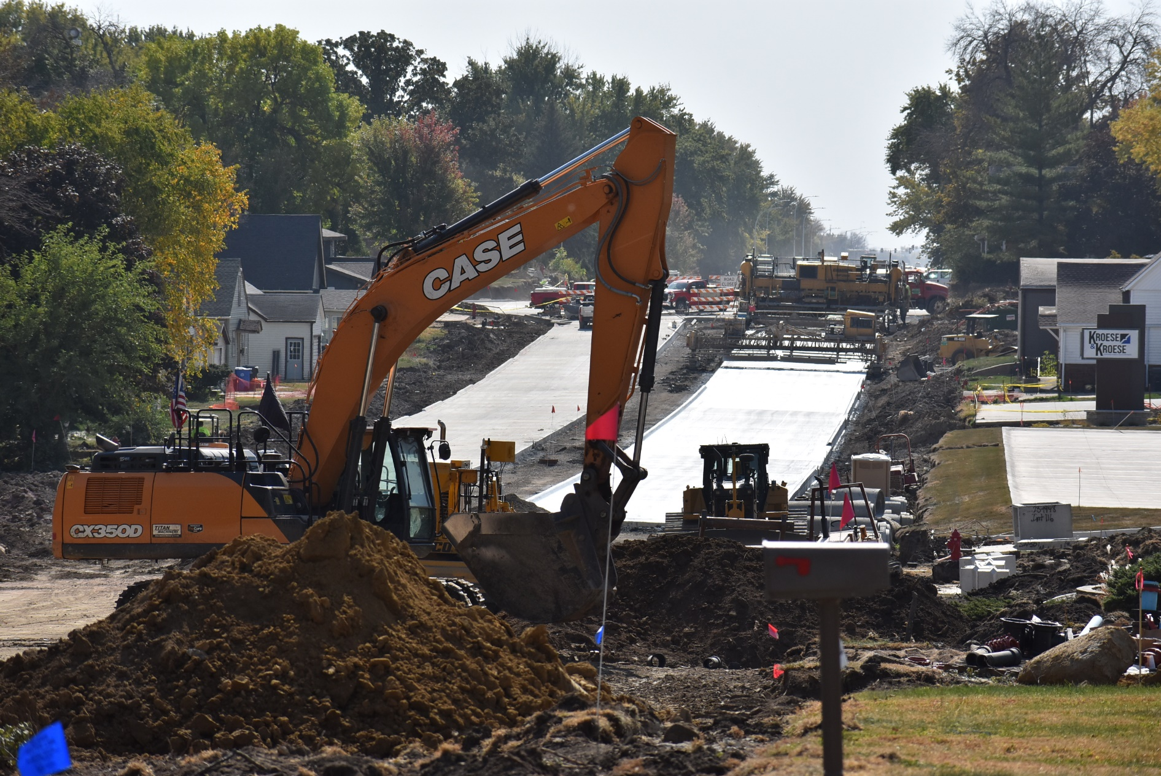
2023-24
Construction
20th-5th St. S – new pavement
Traffic signal at 20th St. S
16th St. S improvements
Utility improvements
Sidewalks, pedestrian safe havens – complete streets
Landscaped medians – minimal maintenance for safety

Slide 9
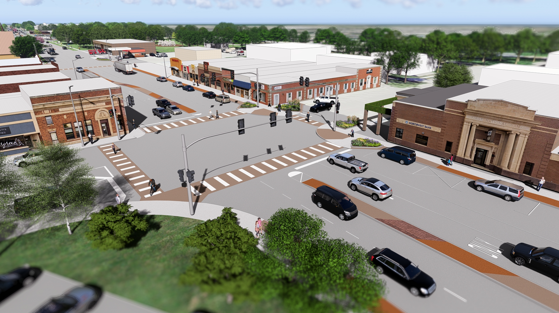
2025 Construction
5th St. S to 4th St. N
Downtown Sioux Center
Utility updates
Parallel water mains

Slide 10
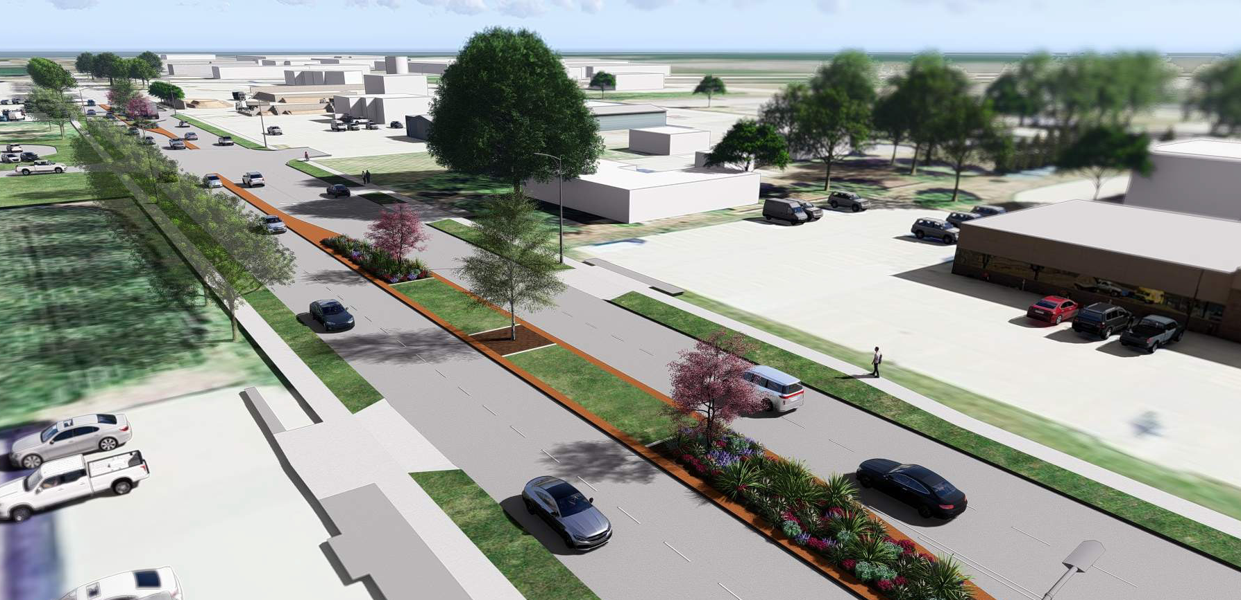
2026 Construction
4th St. N to 12th St. N
Completion of city-led project

Slide 11
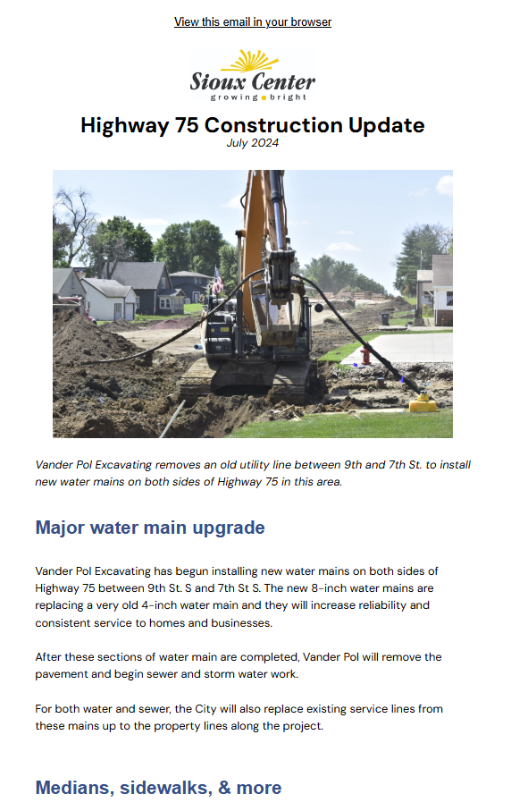
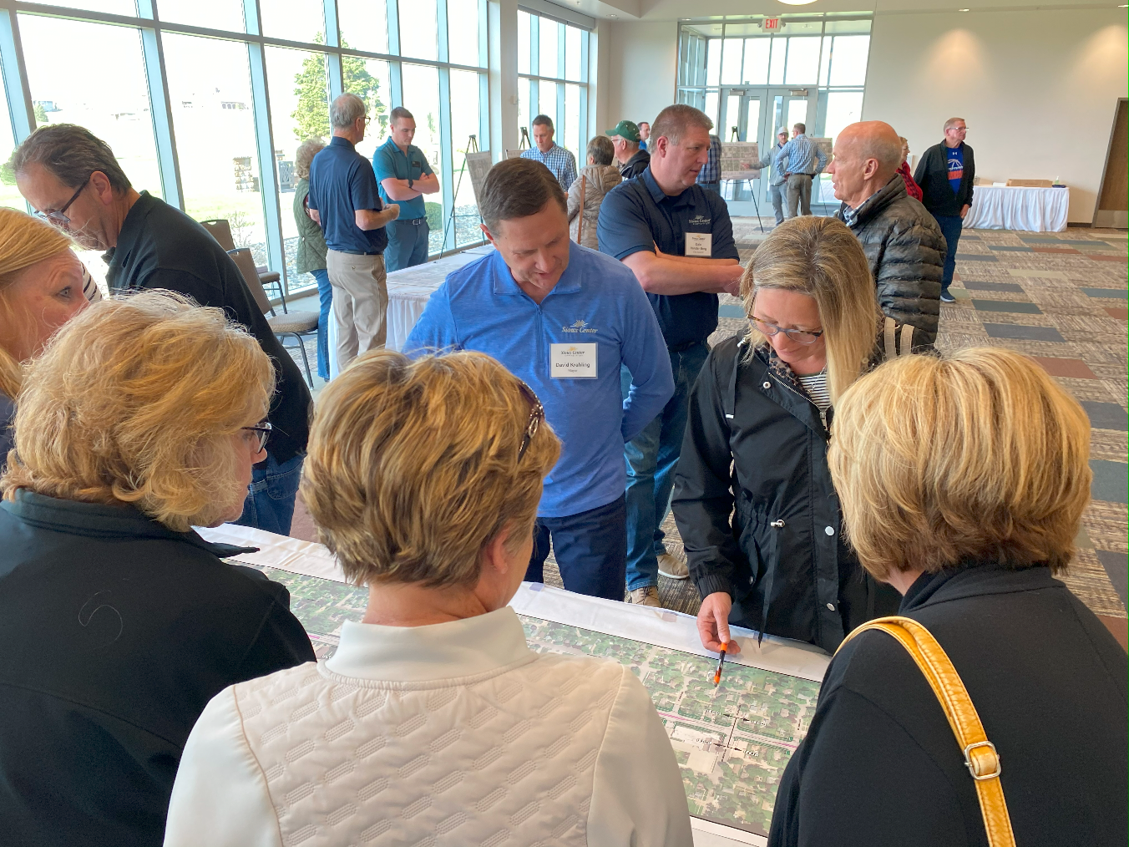
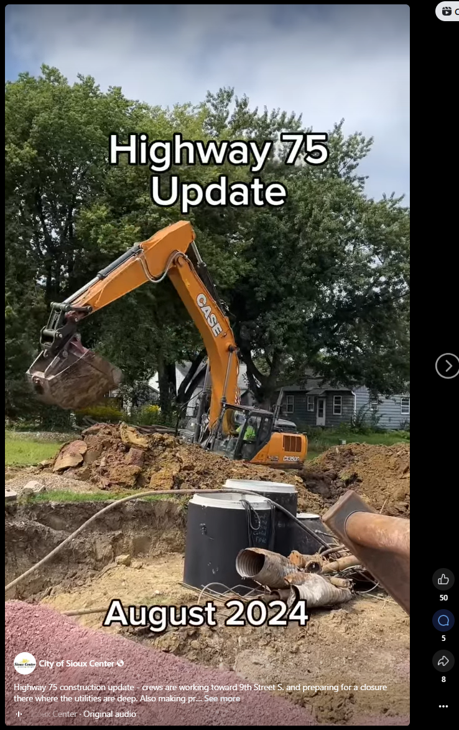
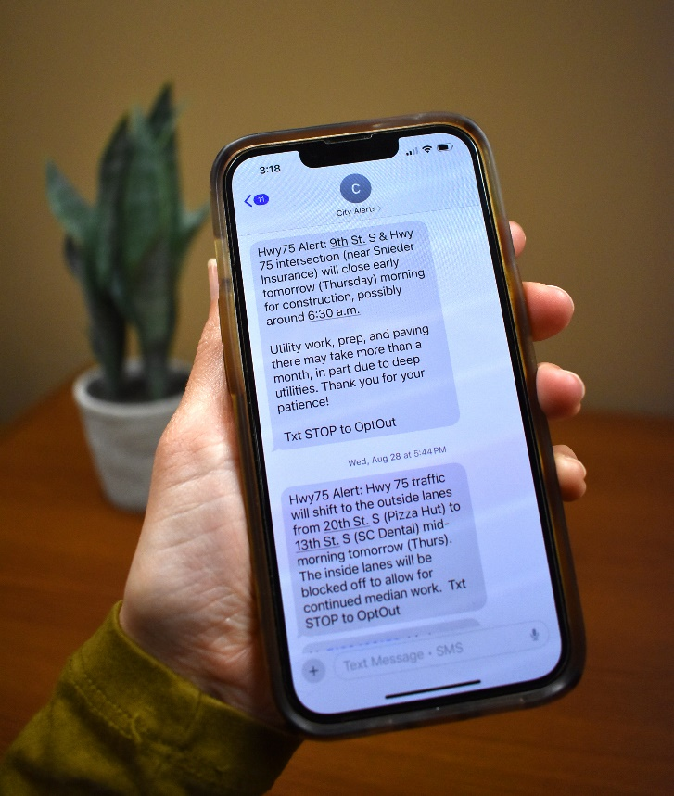
Project communication

Slide 12
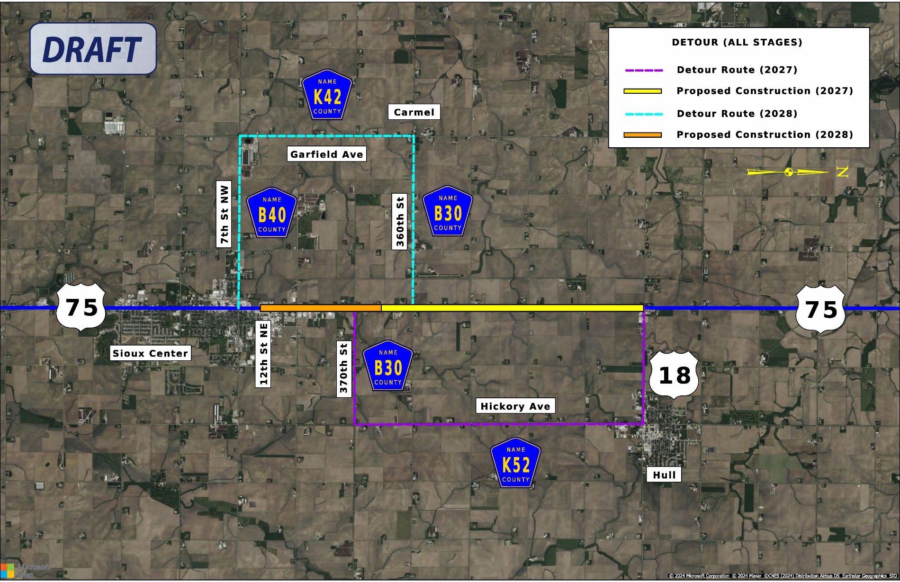
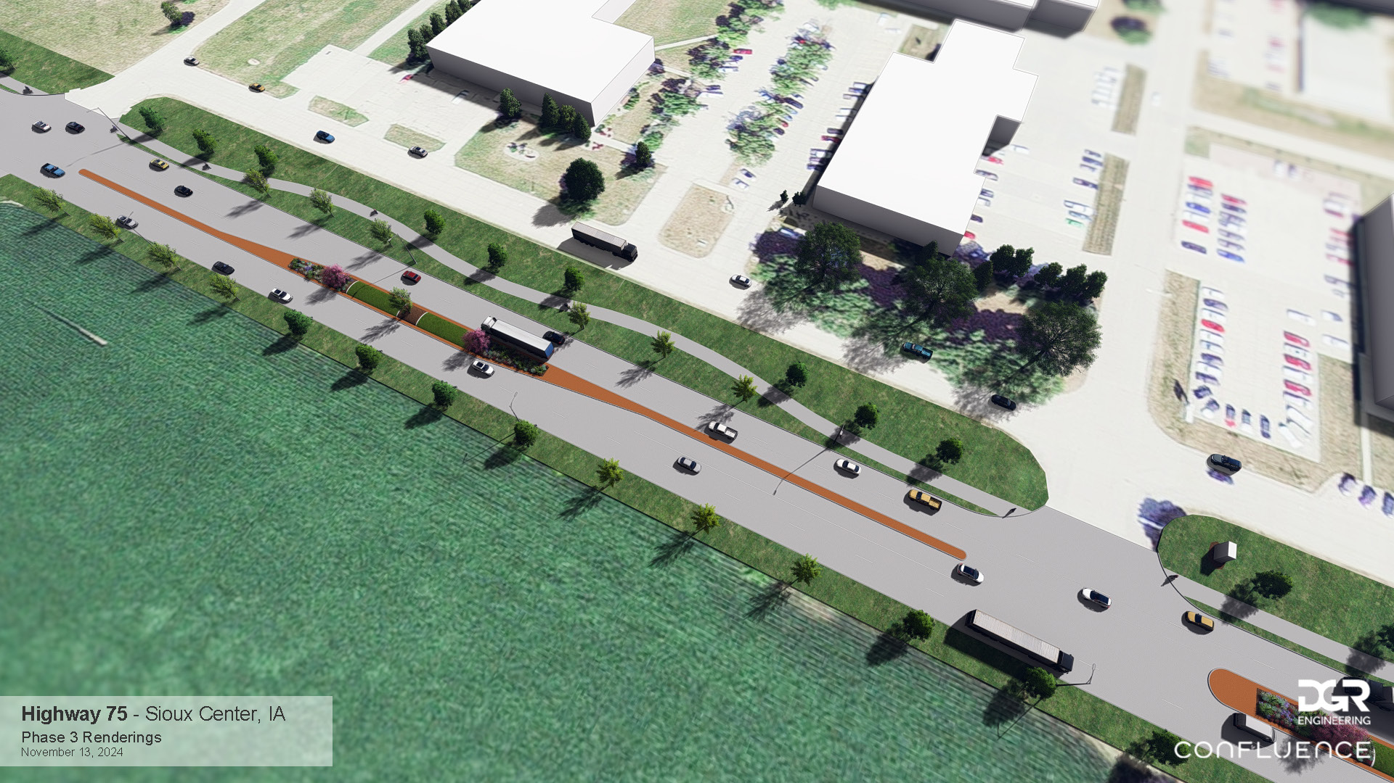
2027-28
DOT Project
Highway 75 from Highway 18 to 12th St. N
District staff communication
City partnership
12th to 20th St. N
Medians
Pedestrian trail
Traffic signal at 20th St. N

Slide 13
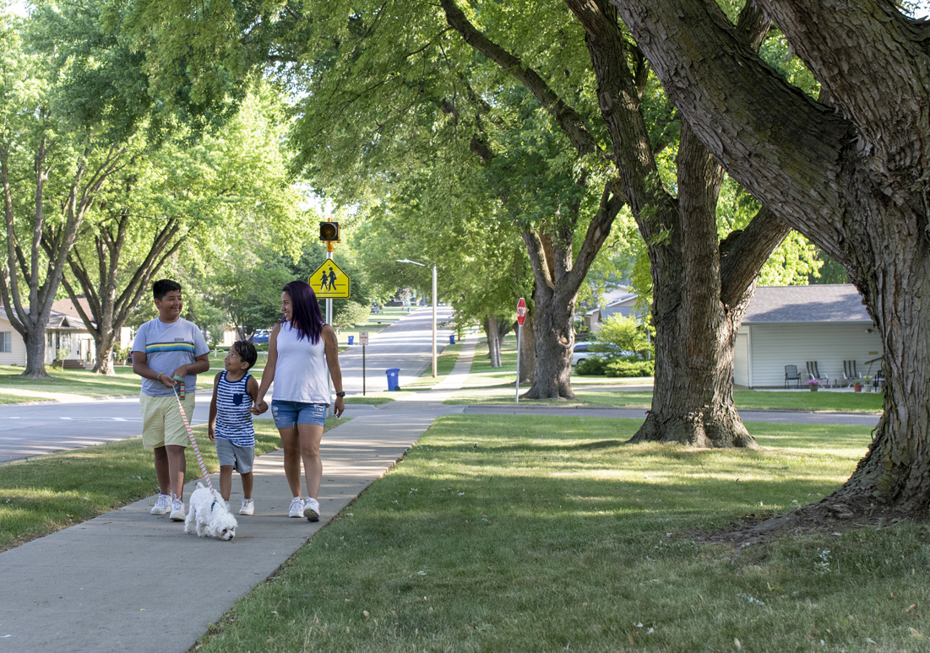
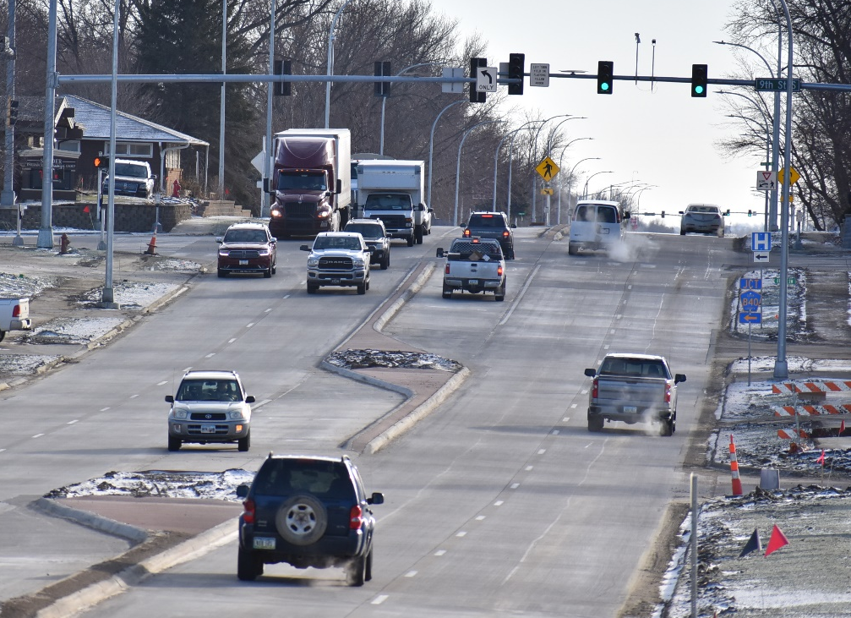
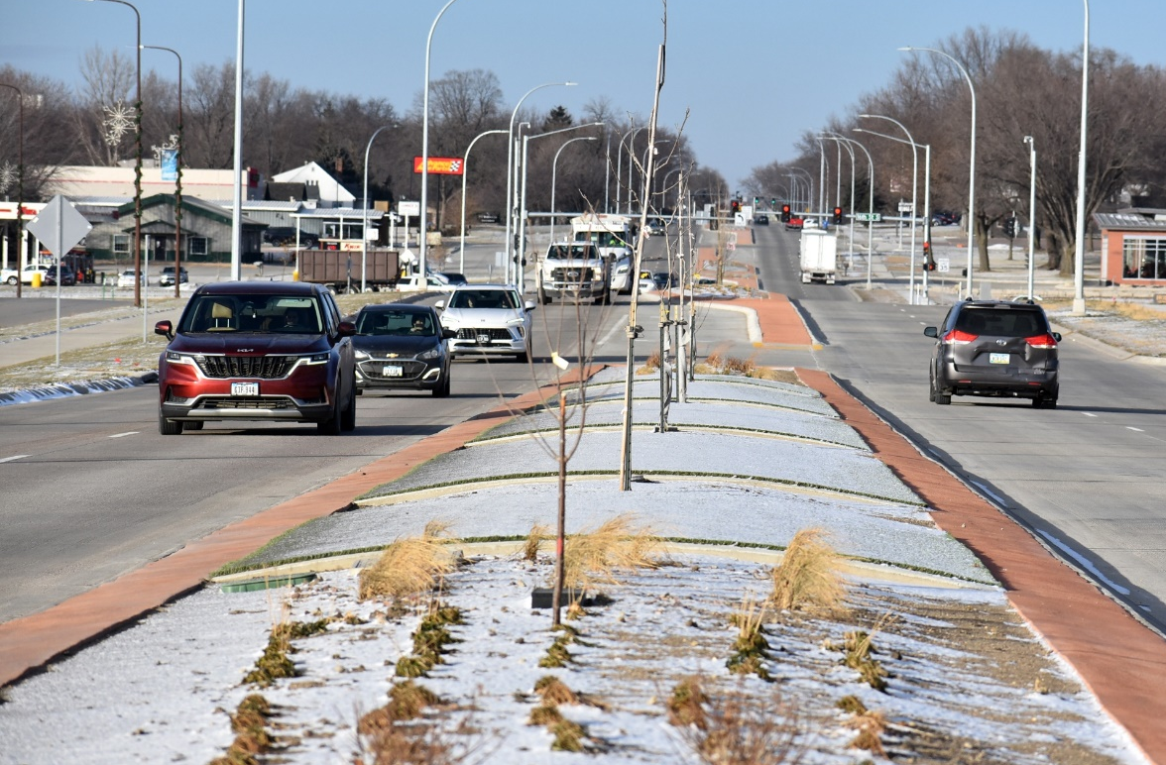
Highway 75: Impact
Safety
20th St S Traffic Signal
Sidewalks and pedestrian improvements
Traffic calming medians
Function
Improved traffic flow
Economic impact and anticipated growth
Character
Elements of nature and color welcome travelers to northwest Iowa
Lower maintenance streetscape for safety

