Slide 1
Welcome
DOT COMMISSION
SIOUX COUNTY
REGIONAL AIRPORT

Slide 2
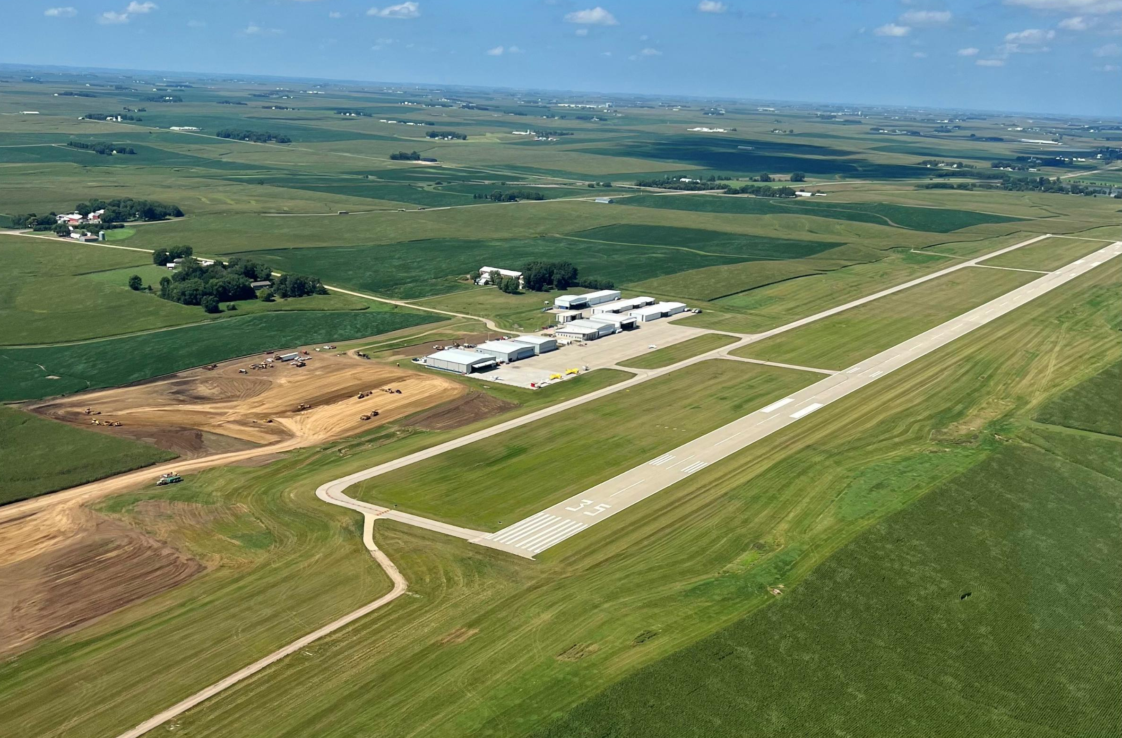
HWY 10
Airport Layout
460th St. access – DOT support
Future crosswind runway
HWY 75

Slide 3
MALSR System
Approach lighting system – combination of steady-burning and flashing lights that penetrates fog to provide pilots a clear visual path to assist in landing.

Slide 4
½ Mile Light System
Pilot Activated
Purchased with private fundraising
MALSR System

Slide 5
MALSR System

Slide 6
Planes & Operations

Slide 7
Planes & Operations
Opened November 2018
Today 5 businesses call SXK home
2 expansion projects
3rd expansion in process, starting Fall of 2024
2022 DOT Direct Annual Economic Activity for SXK - Nearly $7M

Slide 8
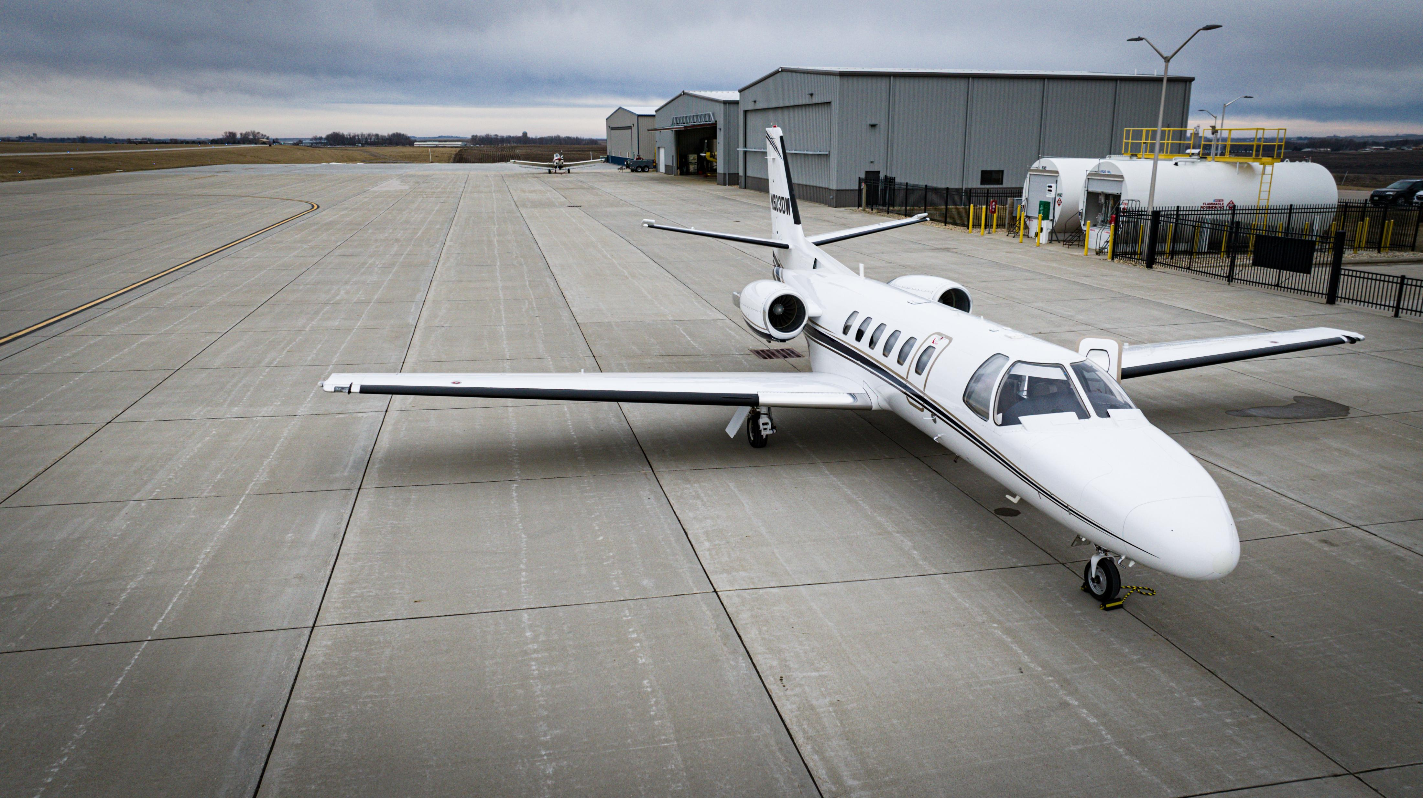
Planes & Operations
2 aerial application operators supporting NW Iowa
Part 135 Air Carrier & multiple corporate aircraft
3 Jets (2 mid-size and 1 light)
Over a dozen turbine aircraft-both multi and single engine
Full-service fueling system

Slide 9
Grand Opening

Slide 10
5,500-by-100 ft runway with full length taxiway
7 private box hangars (3 additional commitments)
24 T-hangar stalls (full with waiting list)
Runway & Landside

Slide 11
Runway & Landside

Slide 12
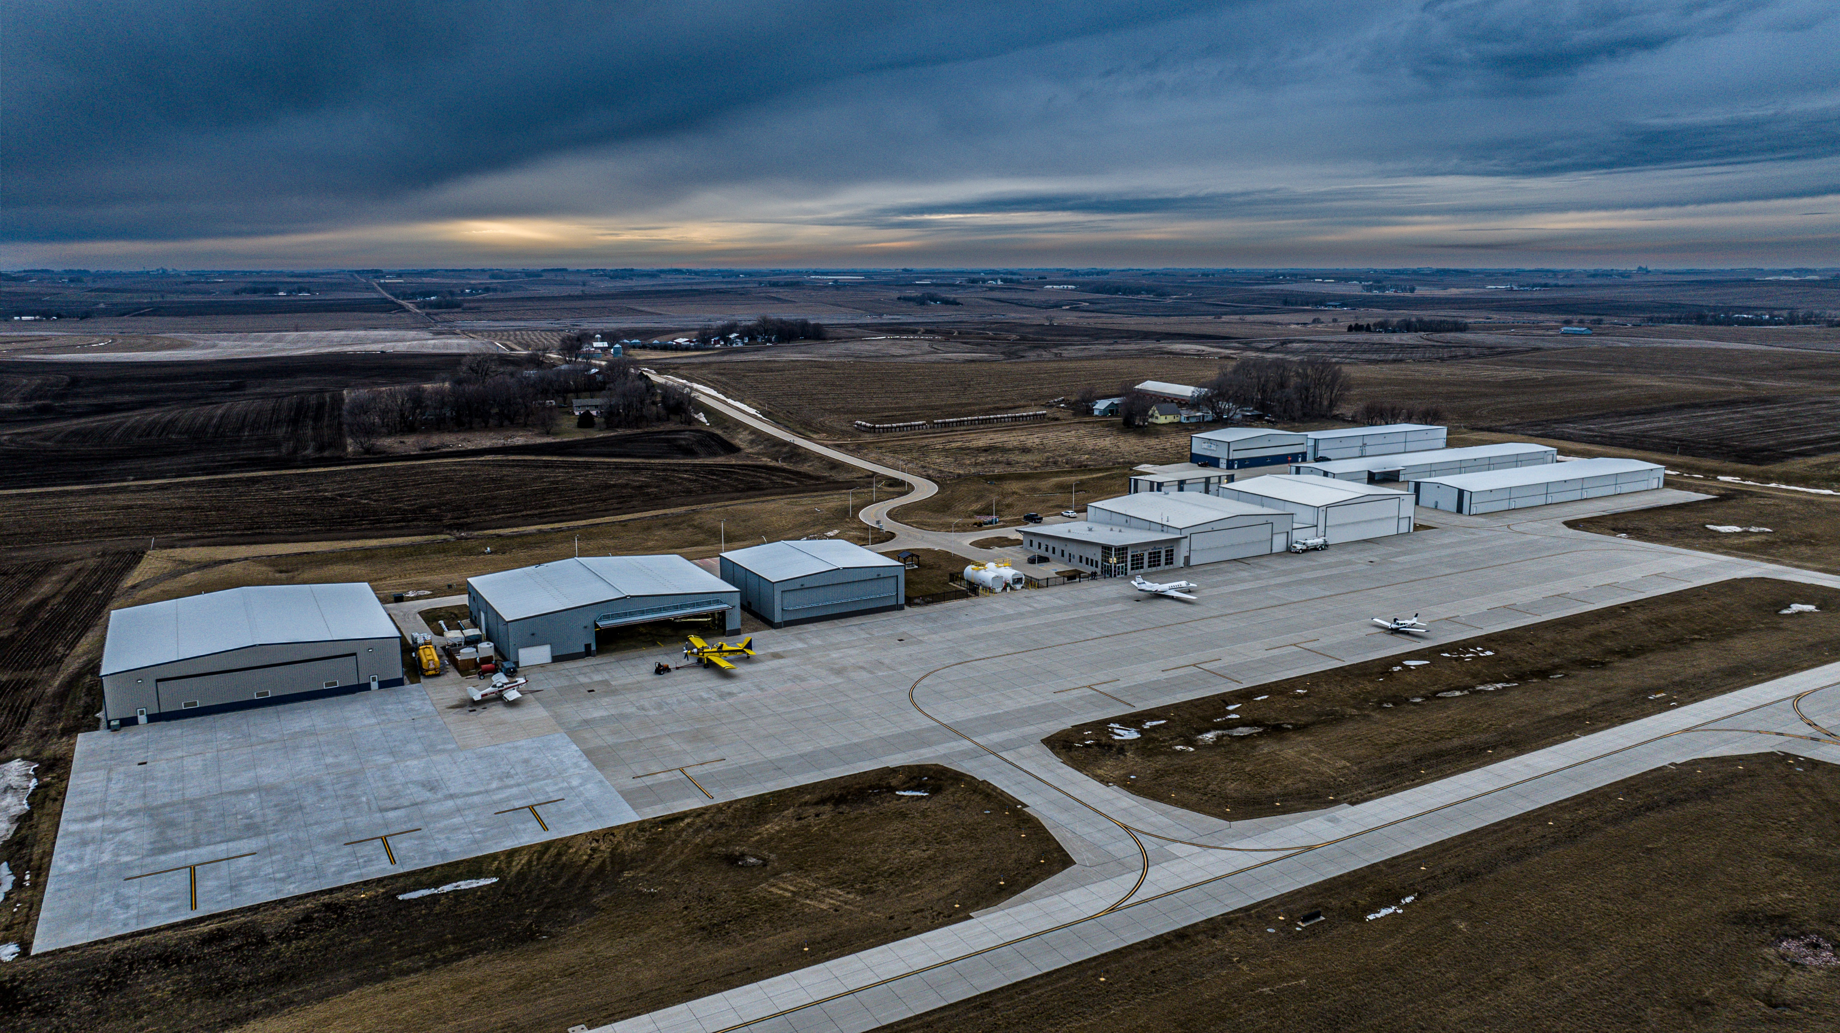
Landside
300-foot apron for airplane parking

Slide 13
Landside

Slide 14
24 acres recently purchased
Future private box hangars and T-hangars
Expansion site

Slide 15
Expansion site

Slide 16
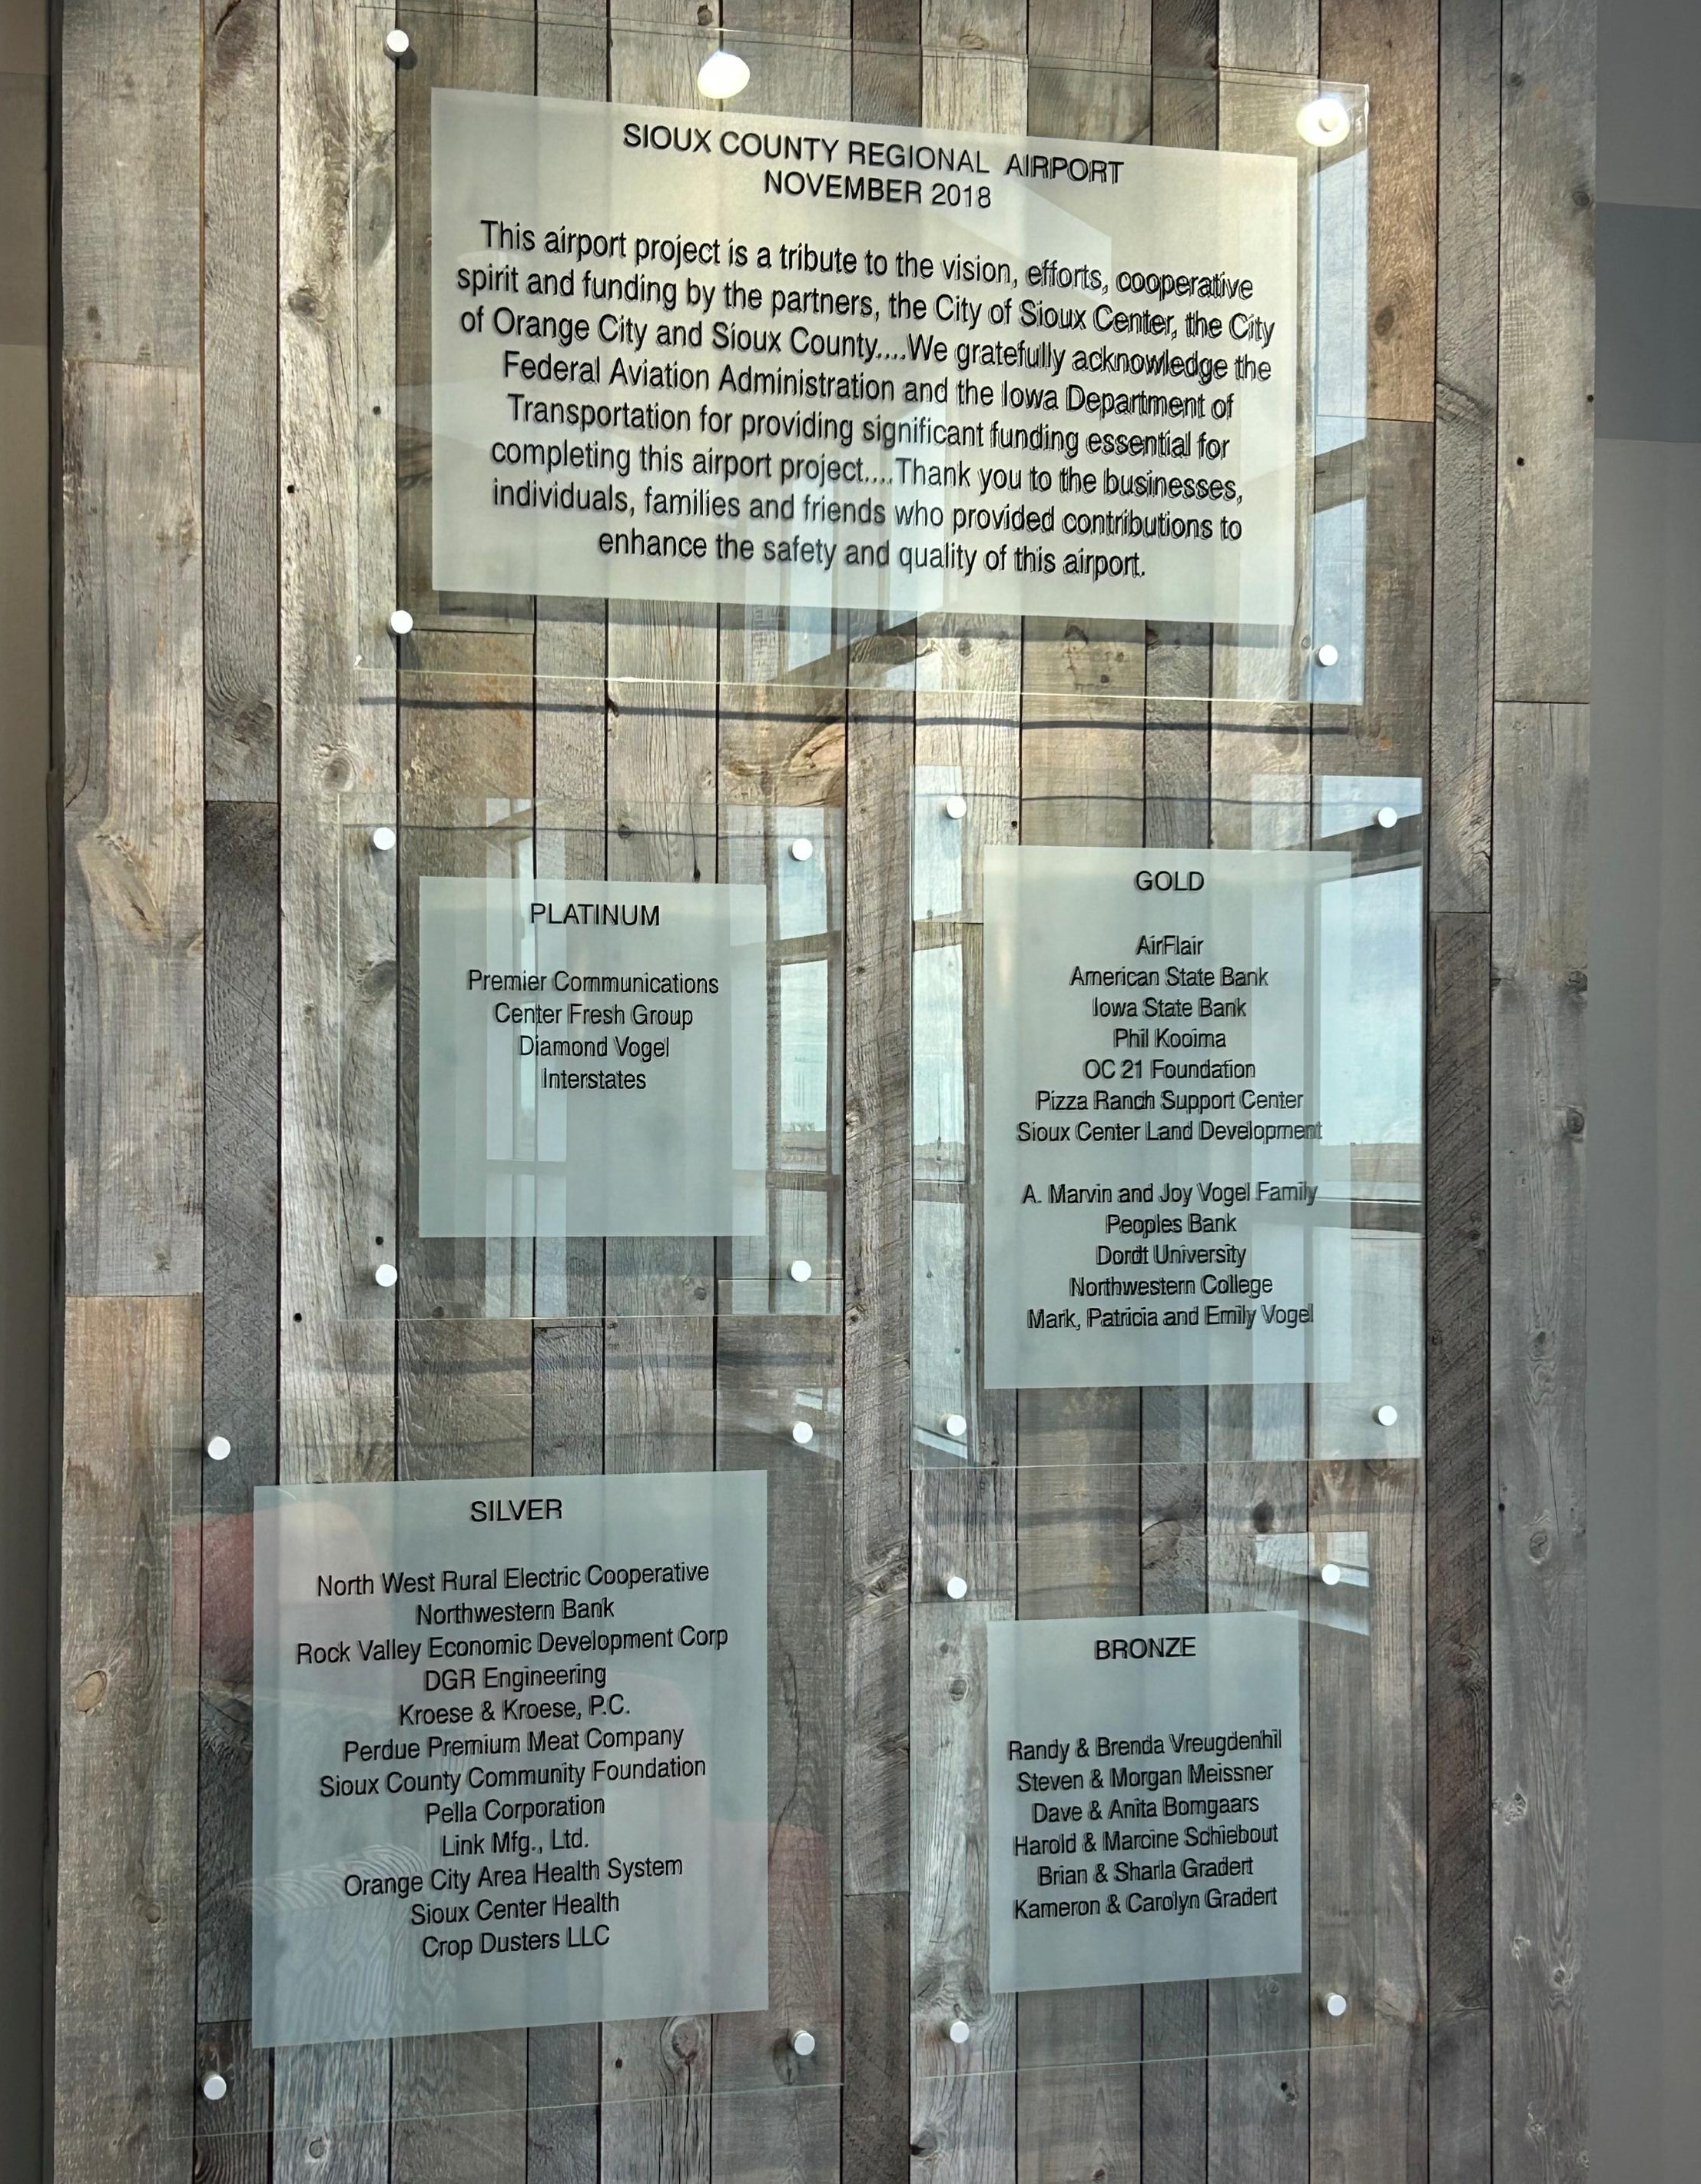
Sioux County Regional Airport
This airport project is a tribute to the vision, efforts, cooperative spirit and funding by the partners, the City of Sioux Center, the City of Orange City, and Sioux County.
We gratefully acknowledge the Federal Aviation Administration and the Iowa Department of Transportation for providing significant funding essential for completing this airport project.
Thank you to the businesses, individuals, families and friends who provided contributions to enhance the safety and quality of this airport.

Slide 17
Questions?
Thank you!
SIOUX COUNTY
REGIONAL AIRPORT

