Slide 1
Highway 7 & 110 Intersection Upgrade Project
Storm Lake, Iowa

Slide 2
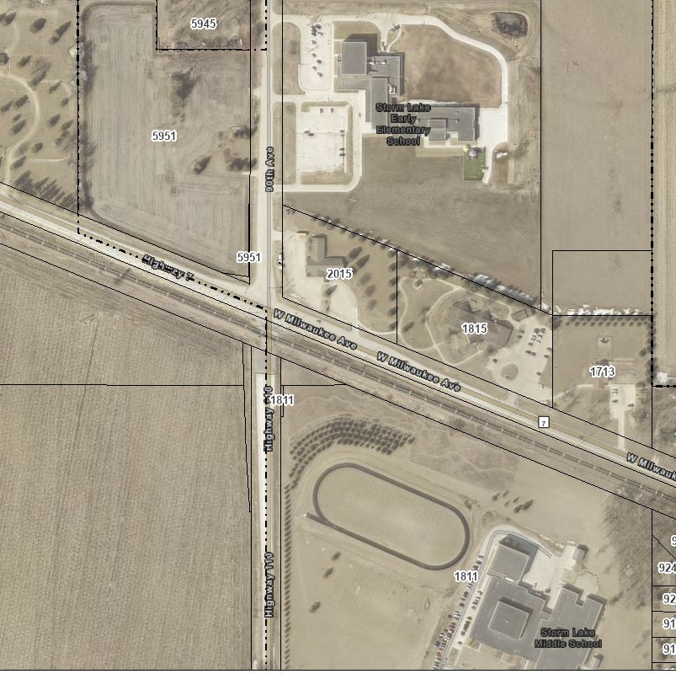
Thank you Iowa Department of Transportation Commission for making this project come to fruition.

Slide 3
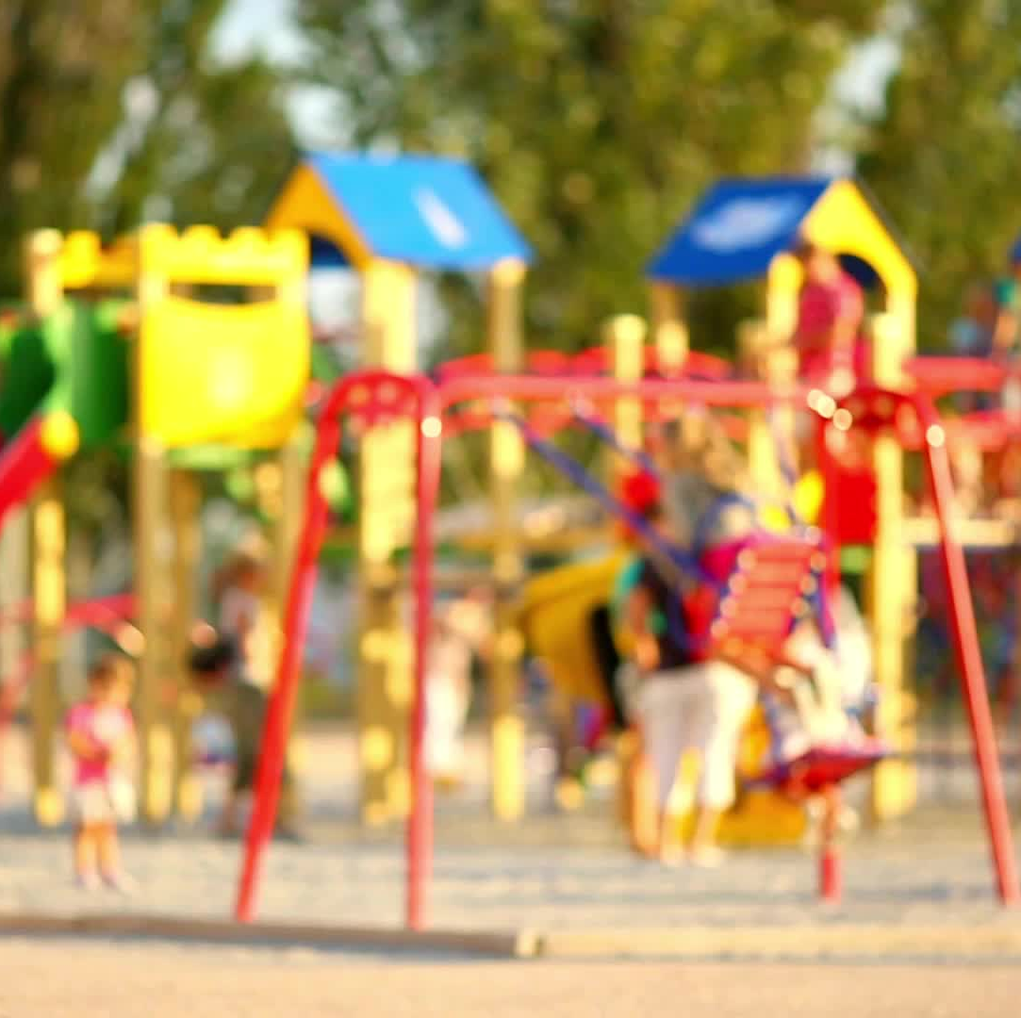
Storm Lake Growth
Elementary School was over capacity
September 2017 Storm Lake Community School District narrowed locations to final three site locations
May 2018 final location was disclosed to the public

Slide 4
Public Safety Concerns
Letters to City and School District stating the unsafe intersection
46 Accidents and 1 Fatality between 2008-2021
Angle of intersection restricted visibility
Railroad Crossing

Slide 5
Project Management Team
Project kick-off meeting April 16, 2020
The Project Management Team included 22 Members
Representatives from the Iowa Department of Transportation/ CN Railroad/Storm Lake Community School District/ City of Storm Lake/ Buena Vista County Engineer/Simmering-Cory
The Project Team met 14 times From April 2020 through October 2021

Slide 6
Project Partners
Iowa Department of Transportation $1,457,805
Storm Lake Community School District $1,911,669
City of Storm Lake
$1,810,483
CN Railroad

Slide 7
Project Challenges
New School Superintendent hired in 2018
Post Covid Supply Chain Constraints
Original Project Team Members differed from design to construction
Retirements
Employee transitions

Slide 8
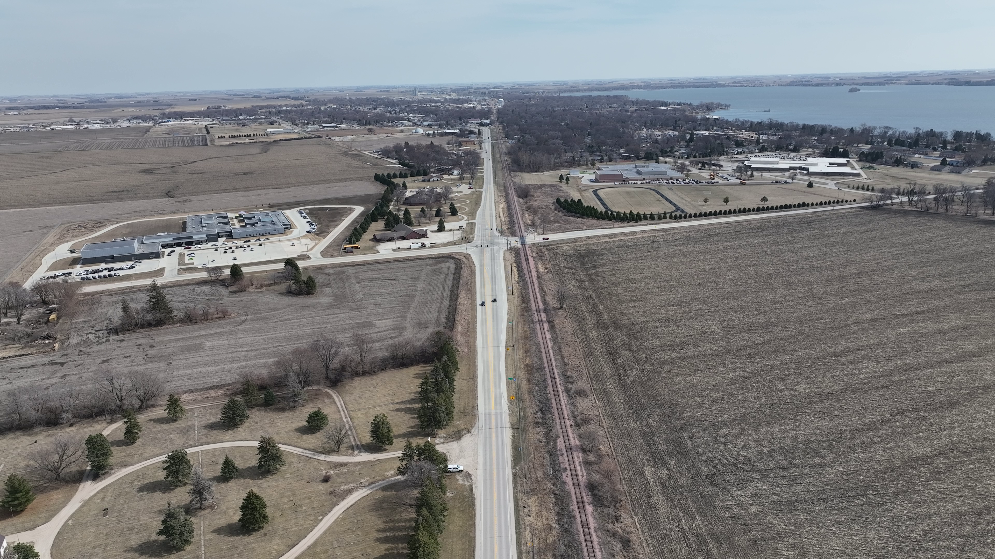
Project Photos

Slide 9
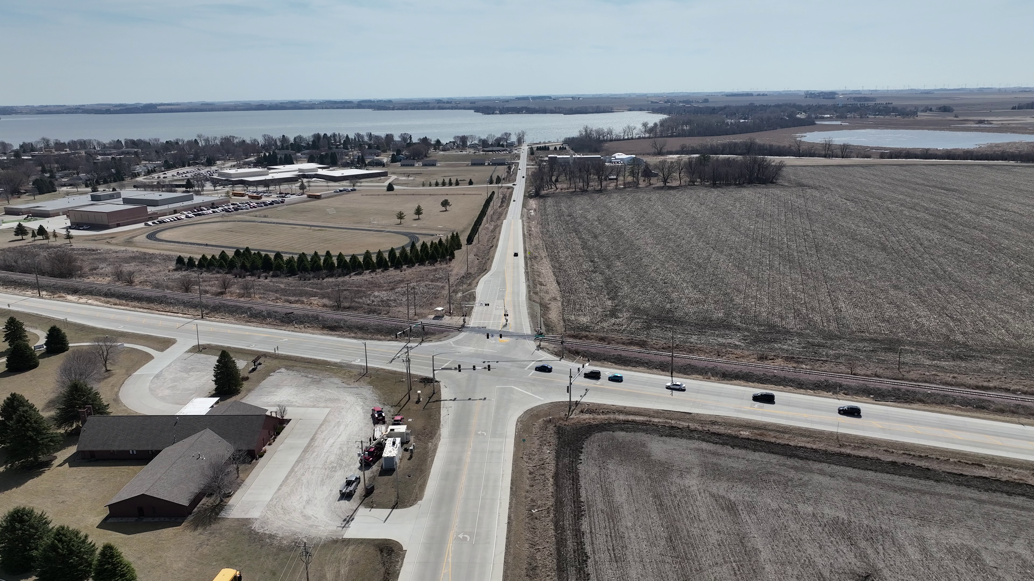
Project Photos

Slide 10
Project Photos

Slide 11
Project Takeaways
Power of the Public
Project Partners

Slide 12
Thank You
Thank you for the support to move this project forward

Slide 13
Keri Navratil
City Manager Storm Lake
Navratil@stormlake.org
712-732-8000

