Slide 1
Local systems bureau update mpo/rpa quarterly Meeting April 30, 2025
Sarah Okerlund, P.E.
Deputy Director / Acting Director
Local Systems Bureau
Iowa Department of Transportation

Slide 2
LOCAL SYSTEMS BUREAU UPDATE
Team Contacts
Federal-aid Funding
Typical Project Sequence
How Programming Fits In
Programming Reminders
Funding Request

Slide 3
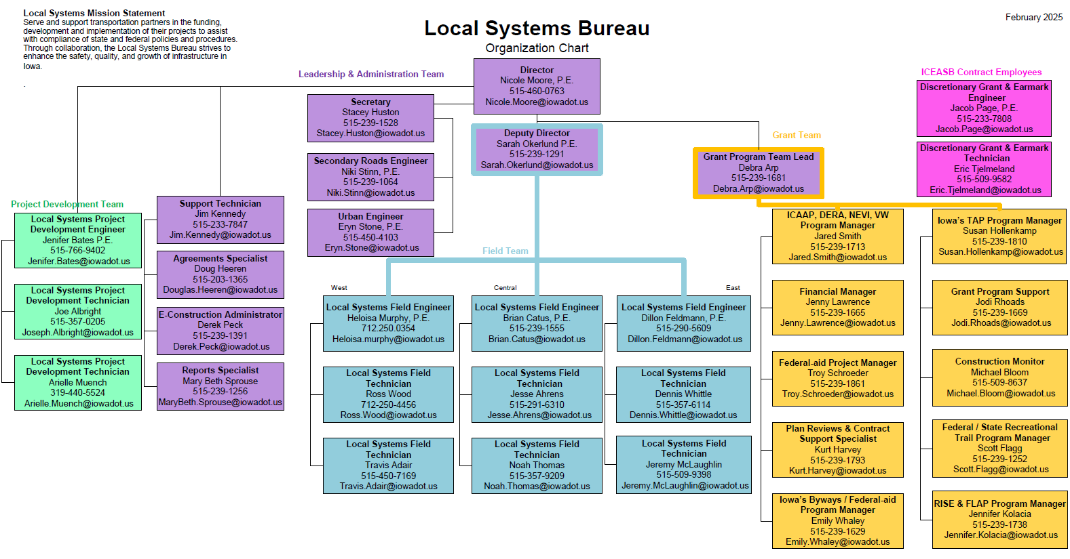
Notes:
Can everyone who is with Local Systems please stand up?

Slide 4
Local Systems PDT/FT & Grant Team
Local Systems – PDT / FT
Local Systems – Grant Team
Surface Transportation Block Grant Program (STBG)
Highway Bridge Programs for Cities and Counties
Highway Safety Improvement Program (HSIP)
Emergency Relief Program (ER)
Federal-aid Swap *
Various State-aid programs *
Farm-to-Market Program (FM) *
Mainly focus on Roadway and Bridge Projects
Transportation Alternatives Program (TAP)
Federal Recreational Trails Program
Iowa’s Clean Air Attainment Program (ICAAP)
Mainly focus on “Small Grants” projects, that are non-highway
*Not Federal-aid

Slide 5
Competitive Grant & Earmark Team (CGE) Fed-aid Formula Funds vs Competitive Grants
Federal-aid Formula Funds:
STBG (STBG-Swap when awarded to a City within an RPA)
HBP (County & City)
TAP
ICAAP
Federal Rec Trails
Most Earmarks
Federal-aid Competitive Grants (CGE*):
TIGER/BUILD/RAISE/BUILD
BIP
SS4A (Not administered by Iowa DOT)
INFRA/MEGA/RURAL
PROTECT
CHBP
*Also Administers most Earmarks.
5
Notes:
Tom – I added this same slide to my “Basics” with the box around Formula Funds. I thought it might be a way to tie the presentations together. - SRO
Before I dive into grant tips, it is important to understand the differences between formula funds and grants.
*Stewardship & Oversight Agreement – “pass through”
Grants = local agency (applicant) is a direct recipient.
Strings attached – often unique to each grant.
Reporting requirements
Funding agreement between FHWA and Recipient
For most of these you can follow our approved Iowa DOT processes.

Slide 6
Typical Project Sequence
Programming
Concept and
Agreement
Environmental
Review
Final
Design
Other Permits
Consultant Selection
Right-of-Way
Acquisition
Preliminary
Design
Utility & Railroad
Coordination
Contract Letting
and Award
Potential MPO / RPA Involvement
Project
Close-out
Construction

Slide 7
Planning and Programming
All Federal-aid transportation projects must be included in the Regional Planning Affiliation (RPA) or Metropolitan Planning Organization (MPO) Transportation Improvement Program (TIP)
All TIP projects must be submitted to Iowa DOT for inclusion in the Statewide Transportation Improvement Program (STIP) via the Transportation Program Management System (TPMS)
Projects cannot receive FHWA Authorization unless funds are programmed in the current TIP / STIP
Cost estimates must be in Year of Expenditure dollars
Estimates must be adjusted if moved from one fiscal year to another
Funding must be in the approved STIP prior to letting the project. Funding cannot be added post-letting.
Agency Project
RPA or MPO TIP
STIP

Slide 8
FEDERAL-AID PROGRAM REMINDERS
Mapping accuracy and location descriptions are critical
Set realistic letting dates!!
Workload management for Local Systems
Funding/cash flow management for Iowa DOT
STBG
to Counties & Cities through an MPO/TMA = Federal-aid
to Cities through an RPA = Federal-aid Swap
Construction Only
STIP Amendments
Needed if the Engineer’s Estimate of an HBP project has increased > 15% above programmed amount
For Cities: must be initiated BY THE RPA/MPO
For Counties: must be initiated BY THE COUNTY IN THEIR CFYP
Plan ahead to avoid last-minute time crunches

Slide 9
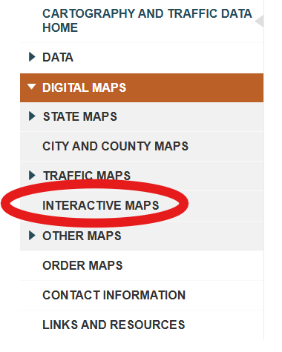
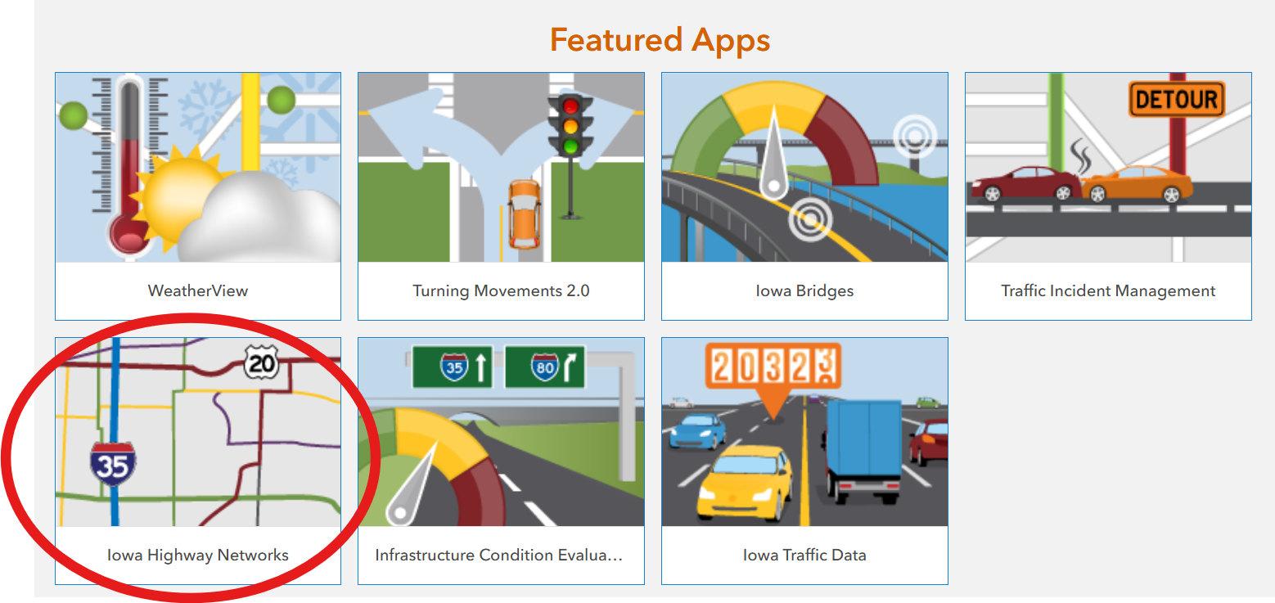
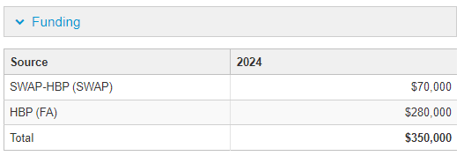
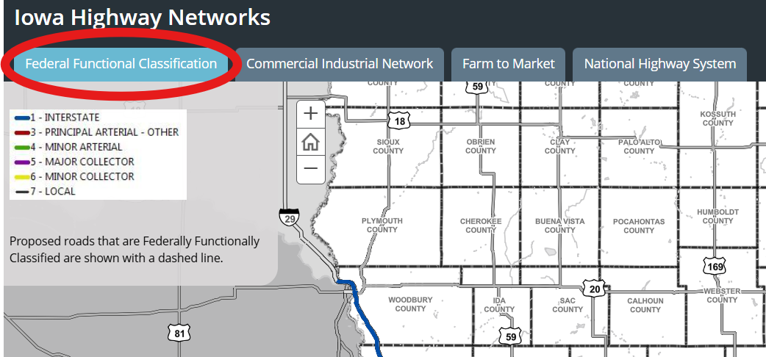
FEDERAL-AID PROGRAM REMINDERS
Federal Functional Classification System
On-System = Major Collectors and higher
Off-System = Minor Collectors and Local Routes
Highway Bridge Program (HBP) projects
On-System Bridges – 80% Federal-aid HBP + 20% Swap HBP
Off-System Bridges – 100% Federal-aid HBP

Slide 10
PROJECT FUNDING – KEEP IT SIMPLE, PLEASE
The more funding sources there are in a project, the more complicated it is to develop and administer the project.
This creates inefficiencies, increases the likelihood of errors, and creates situations that are not well handled by software used to make payments to contractors.
Each funding source has it own strings and has to be accounted for separately on the plans, in the quantities & estimates, and during construction.
More Strings = More Knots!

Slide 11
QUESTIONS?

