Slide 1
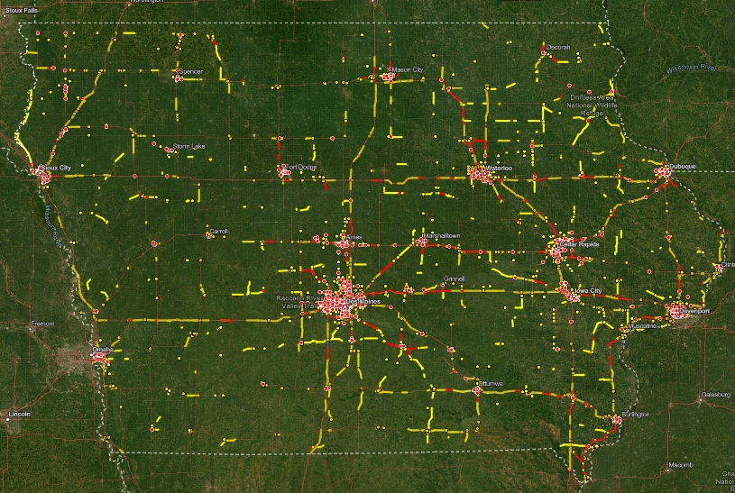


Traffic and Safety Bureau
MPO/RPA Quarterly Meeting
Hossein Naraghi
TAS Bureau Director
April 30, 2025
3/2/2023

Slide 2
Vision & Mission
Vision
  A safer Iowa where every road user arrives home safely.
Mission
  To enhance transportation safety and efficiency through
      data-driven solutions
      strategic planning
      innovative engineering

Slide 3
Overview of Services
Traffic Engineering:
Sign requests, speed studies, pavement markings, …..
Safety Engineering and Planning:
Safety analysis resources and safety programs.
Access Management:
Entrance placement and permitting requirements.
Advertising Management:
Billboards, logos, and tourist-oriented directional signs (TODS).
Sign Shop:
Manufacturing and providing highway and facility signs.

Slide 4
Key Programs
Traffic Safety Improvement Program (TSIP):
Funding for safety improvements on public roads.
Iowa Traffic Engineering Assistance Program (TEAP):
Technical assistance for local agencies.
Highway Safety Improvement Program – Local (HSIP-Local):
Federal funding for safety projects.
Strategic Highway Safety Plan (SHSP):
Statewide plan to reduce fatalities and serious injuries

Slide 5
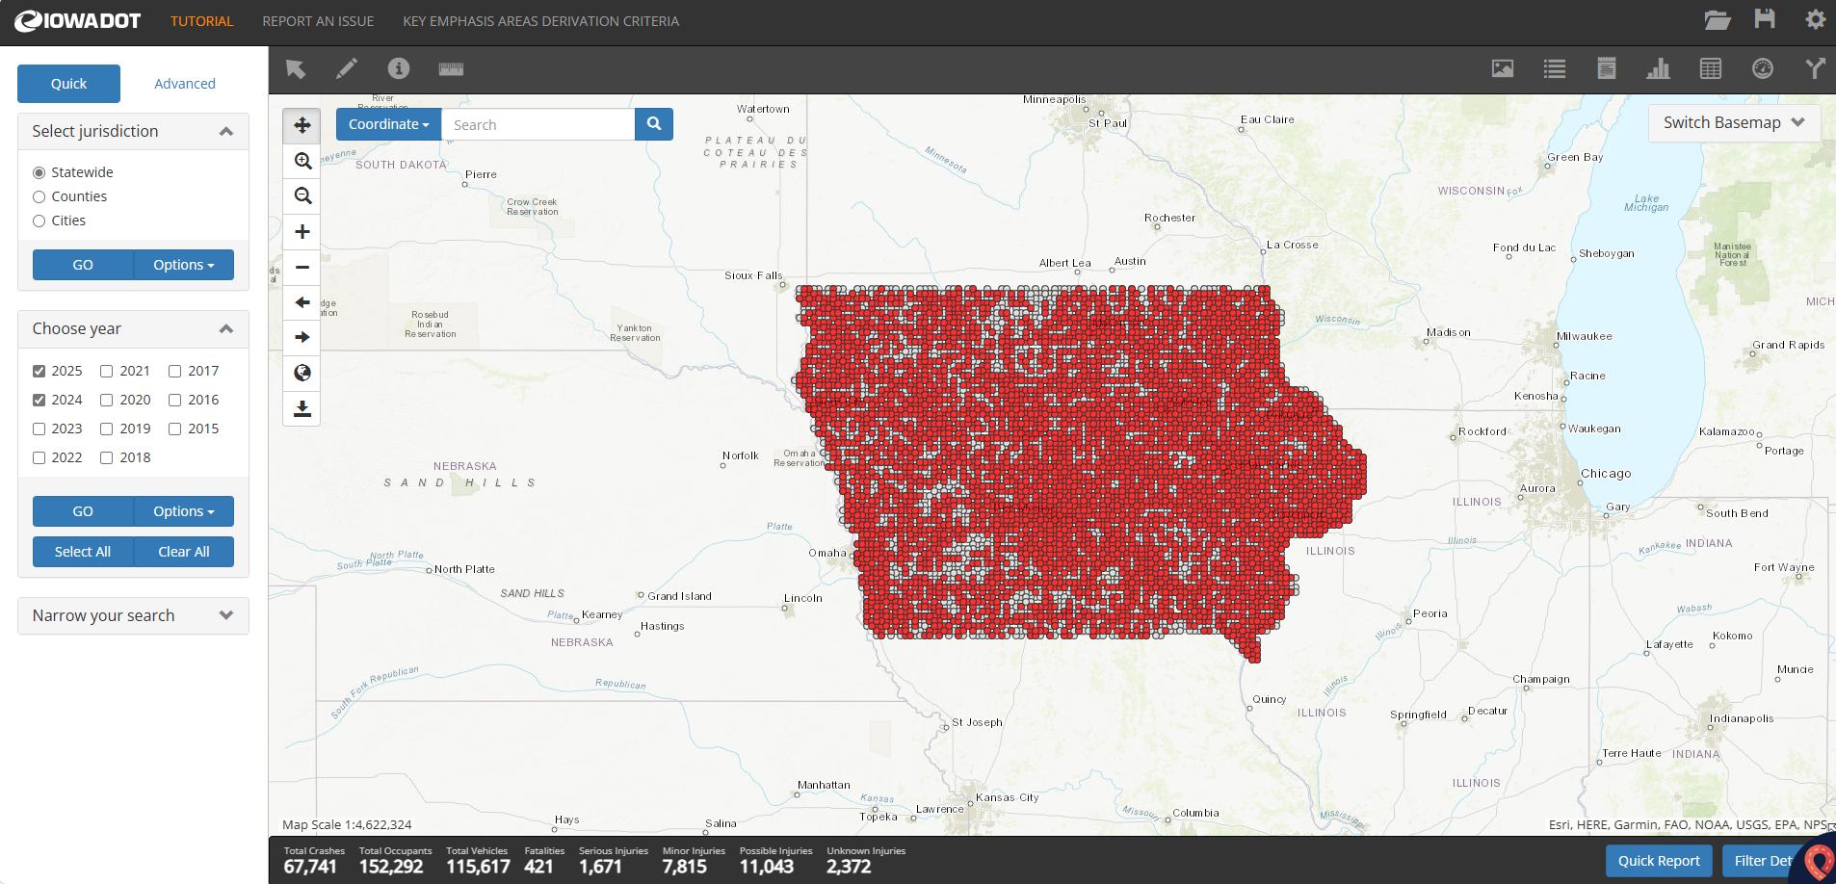
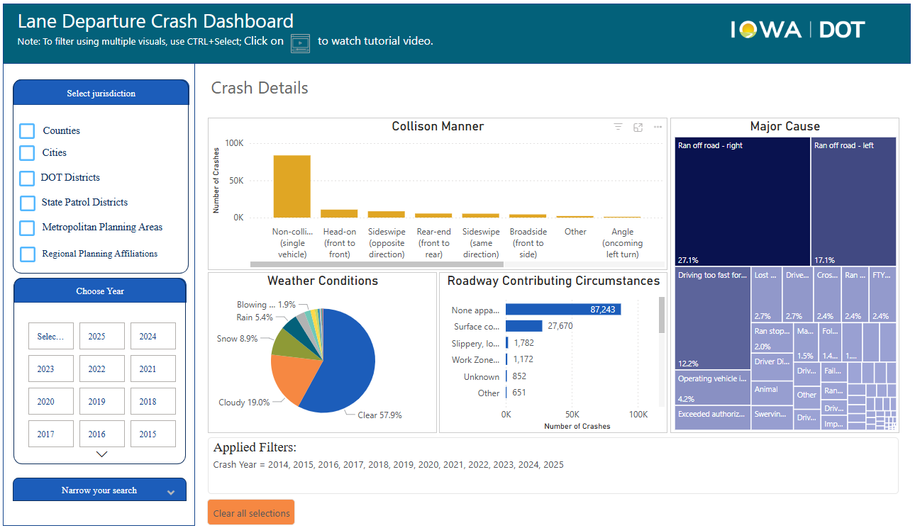
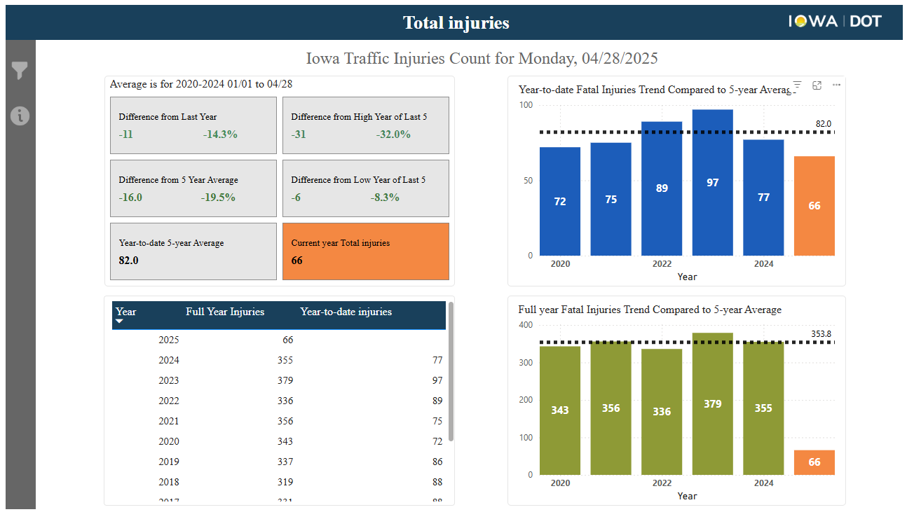
Crash Data Visualization Tools
Iowa Crash Analysis Tool (ICAT)
Key Emphasis Area (KEA) Dashboards
Injury Trend Dashboard

Slide 6
Injury Trends

Slide 7
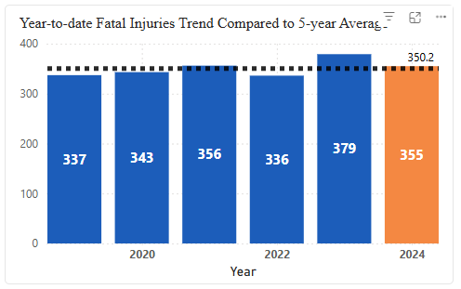
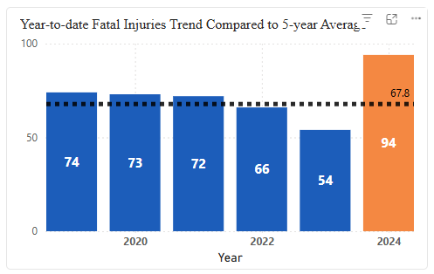


2024 Fatalities Trend Compared to 5-year Average
Statewide
Municipal Roads

Slide 8
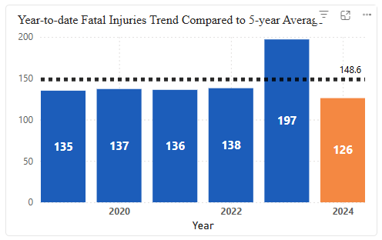

2024 Fatalities Trend Compared to 5-year Average
Primary Roads
Municipal Roads

Slide 9
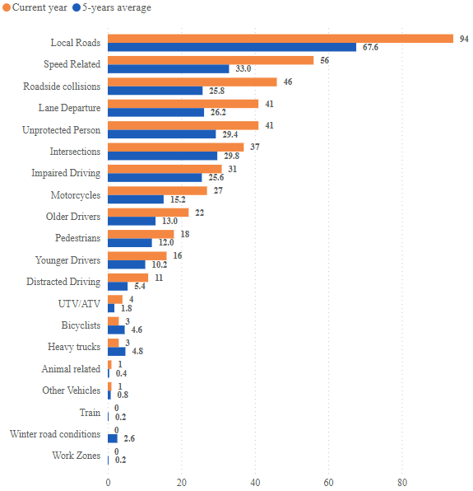
2024 Fatalities Key Emphasis Areas compared to 5-year Average

Slide 10
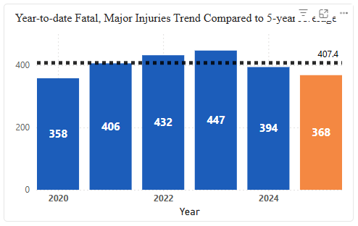
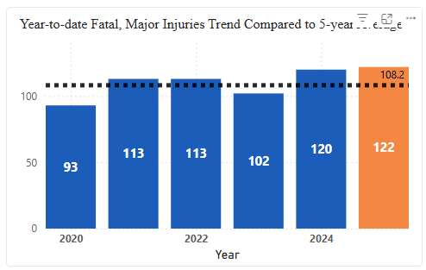


2025 year-to date Fatalities & Serious Injury Trends Compared to 5-year Average
Statewide
Municipal Roads

Slide 11
Risk Identifications and Solutions
Screen the network to identify areas with high potential for safety improvement
Diagnose the nature of safety problem
Apply the appropriate safety solution
  Short-term
  Long-term
Evaluate the effectiveness of the solution

Slide 12
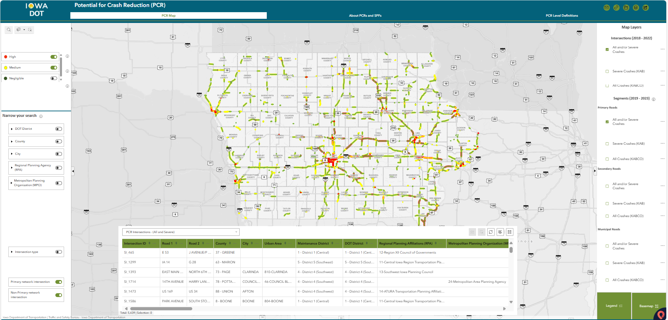
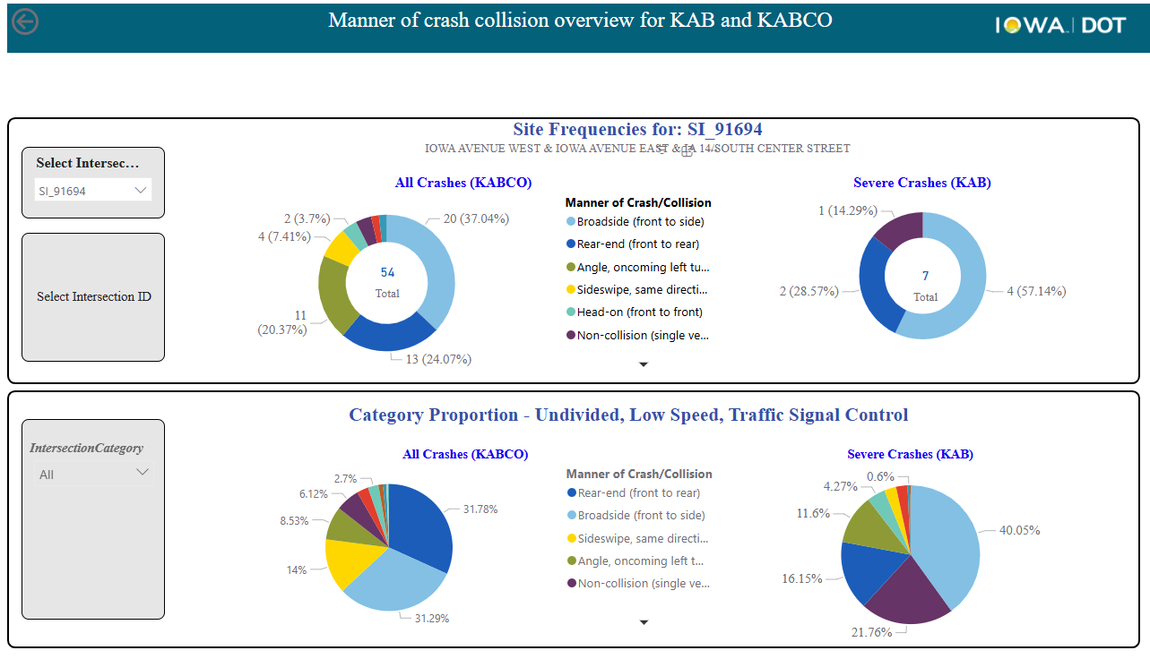
Risk Assessment Tools
Network Screening
  Potential for Crash Reduction (PCR)
Diagnose the nature of safety problem
  Crash Distribution Dashboard
Evaluate the effectiveness of the solution
  Safety Impact Dashboard
Traffic and Safety Bureau | Iowa DOT

Slide 13
Questions?
Hossein Naraghi
515-239-1129
Hossein.naraghi@iowadot.us​
iowadot.gov

