Slide 1
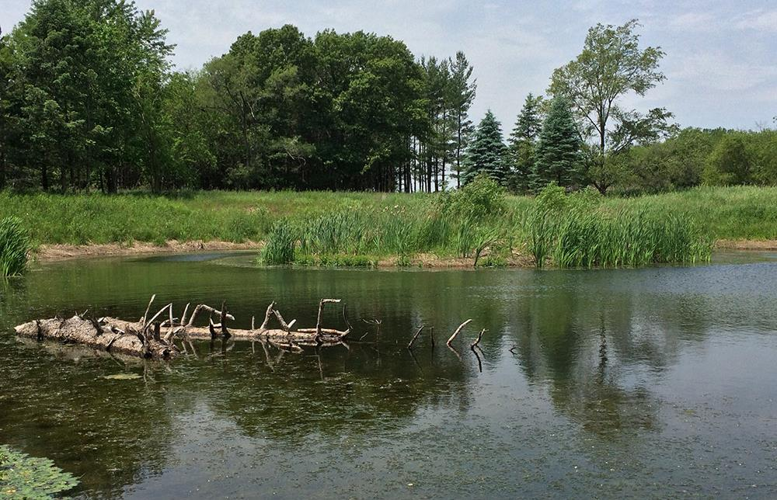
Location and Environment Bureau
What are we up to?
Angie Poole, Bureau Director
April 30, 2025
3/2/2023
Notes:
Good morning, everyone. I want to thank you for inviting me to talk at your RCE Conference.
For those of you who don’t know me, my name is Angie Poole and I am the Director of the Location and Environment Bureau. I am here to give you a behind the scenes look inside our bureau to answer the burning questions of who we are and what we do.

Slide 2
Overview of the Location and Environment Bureau
Helping to BRIDGE the gap between project delivery and environmental compliance.
Notes:
The Location and Environment Bureau works to merge engineering design and environmental study efforts. We are your partners in project delivery. We make sure the appropriate environmental rules and regulations are being followed from concept to construction.

Slide 3
LEB ORGANIZATION CHART
Notes:
Currently, the bureau has 30 full time employees, five interns and four embedded partners.
We have 11 sections within our bureau that help us achieve our mission.
Technology Support and Automation
Location (which manages the engineering/planning functions of planning studies)
Field Services Coordination
Public Involvement
Traffic/Noise/Air Quality/Vibration
Regulatory Compliance
Mitigation Design and Compliance
Protected Species and Natural Areas
Cultural Resources
Water Resources
NEPA Compliance Section
I will take a deeper dive into a very high-level overview of what these sections do.

Slide 4
Who Make up the Sections of the Bureau?
Taking a Deeper Dive
Notes:
I will now take you through an organizational chart journey through the sections of LEB and give you a glimpse of how they work with you.

Slide 5
LEB ORGANIZATION CHART
Notes:
We will start on the left with the section in charge of keeping us innovating.

Slide 6
Sam Sturtz, Team Lead
Technology Support and Automation
Microsoft, GIS, and CADD
And other duties as assigned
Jim Galliart
Shawn Goertz
Notes:
Let me introduce you to our Technology Support and Automation Group – better known as our Support Team. Sam, Jim and Shawn.
Their job is to help our teams use technology to create efficiencies and to improve communication between our bureau and our customers.
They do everything from data creation, storage, and analysis to providing one-on-one software training.

Slide 7
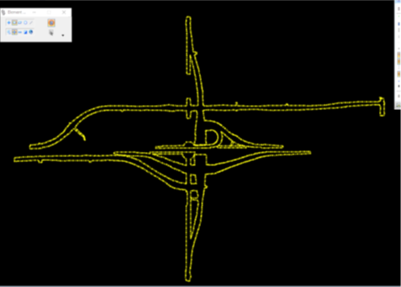
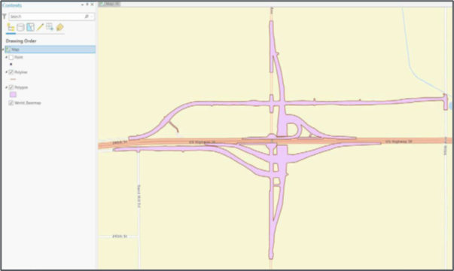
Interoperability
Improving communication between MicroStation and ESRI for better data sharing.
Notes:
One of the support team’s initiatives is to advance the possibilities of GIS-CADD interoperability. They have been working hard to develop ways we can ensure our bureau’s data are available for both our internal and external customers, as well as receive data in a way our teams can utilize it. Our goal is to have this integration happen earlier in the process to help eliminate the need for rework and project delays.

Slide 8
LEB ORGANIZATION CHART
Notes:
Next – let me tell you about our Location Section.

Slide 9
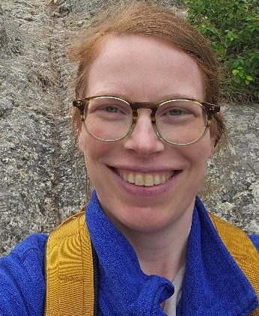
Donna Breitbach, Deputy Director
Location Section
Location Design/Planning Studies
Adrianne Knight
Gary Harris
Notes:
LEB’s Location section focuses on defining the problem (purpose and need for the project) and looking for potential solutions (developing a range of alternatives).
They are responsible for ensuring the Department analyzes both the existing conditions and the proposed improvements to balance environmental requirements, engineering feasibility, and public needs.
The Location engineers work closely with L E B staff, consultants, and internal DOT partners to ensure alternatives being developed and project timelines are in compliance with environmental regulations.

Slide 10
LEB ORGANIZATION CHART
Notes:
Let’s move on to a newly created position within our bureau – the Field Services Coordinator. This position was a repurpose of our Secretary 2 position.

Slide 11
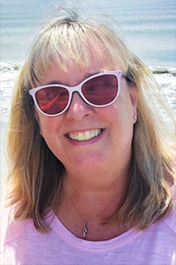
Field Services Coordinator
Susie McCullough
Public Permissions and Maintenance Compliance
Notes:
Our Field Services Coordinator is Susie McCullough.
Her duties include contacting property owners to educate them about the field surveys we will be conducting and asking them for their permission to be on their property to conduct the reviews.
The other aspect of her job is to educate field maintenance staff about environmental laws and regulations that must be followed when conducting maintenance activities, such as mowing, structure repairs, and culvert clearing.

Slide 12
LEB ORGANIZATION CHART
Notes:
Moving along, we will talk about our Public Involvement Section.

Slide 13
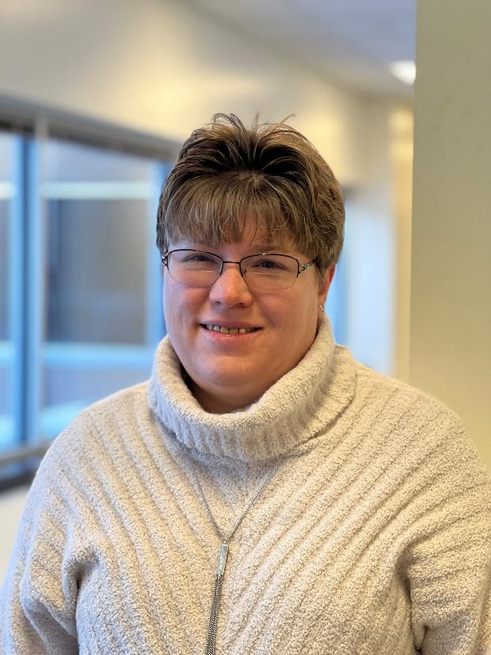
Trish Miller
Public Involvement Section
Information Sharing and Getting Input
Valerie Brewer
Notes:
LEB’s Public Involvement Section is made up of Trish Miller and Valerie Brewer. They both work closely with the Outreach and Development Bureau, as well as the Districts, to help ensure the department follows federal and state regulations that require public involvement activities during transportation project development.
Each public involvement opportunity allows the public a chance to provide ideas and comments regarding the development of a transportation project. And, because transportation projects can greatly affect a community, public input is extremely important.

Slide 14
LEB ORGANIZATION CHART
Notes:
Now we are going to highlight a few individuals and their roles, since they represent a mighty team of one.

Slide 15
Environmental Supervisor and NRCS Liaison
Ken Brink
Establishing workflows
Notes:
First, we have Ken Brink, he is the environmental supervisor over several units within our bureau (as you may have noticed from the org chart).
Ken has recently taken on the role of establishing a workflow for coordination with NRCS during and after project development.
This is a work in progress and will be evolving as we obtain more experience with working through NRCS’s environmental review process and mitigation needs.

Slide 16
LEB ORGANIZATION CHART
Notes:
Next, we move on to Charles.

Slide 17
Air, Noise, and Vibration
Charles Bernhard
Ensuring Compliance
Notes:
Charles Bernard helps to ensure the department stays in compliance with regulations and policies as they pertain to air, noise, and vibration.

Slide 18
LEB ORGANIZATION CHART
Notes:
Now it is time to talk about Regulated Materials and introduce Don Johnson

Slide 19
Regulated Materials
Contaminated Properties Review
Notes:
Don Johnson is new to our bureau and makes up our Regulated Materials Section. His role in LEB is to review potential project locations to identify any hazardous materials or waste.

Slide 20
LEB ORGANIZATION CHART
Notes:
Next up, is our Mitigation Design and Compliance team.

Slide 21
Alan Beddow
Mitigation Design
Site Design and Credit Purchases
Chin-Ta Tsai
Notes:
Here are the two engineers that make up our Mitigation Design Team. Chin-Ta is the designer and Alan oversees construction and bank credit purchasing.

Slide 22
LEB ORGANIZATION CHART
Notes:
T&E is the last section to review under Ken’s supervision.

Slide 23
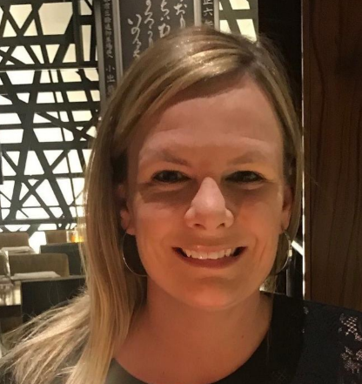
Jill Garton
Protected Species and Natural Areas
Also known as T&E
Brock Struecker
Notes:
Here is our Protected Species and Natural Areas team – commonly referred to as T&E
Jill and Brock review both state and local projects to determine whether the action may affect state and/or federally listed and proposed endangered species; or proposed or designated critical habitat.
We have two consultant partners that are heling us review local projects – Beth Kramer and Chelsea Duncan.

Slide 24
LEB ORGANIZATION CHART
Notes:
I am going to jump over to Cultural Resources and come back to NEPA later.

Slide 25
Brennan Dolan, Team Lead
Iowa DOT Tribal Liaison
Cultural Resource Section
Jacob Woodcock
Archeology and Historic Structures
Janee Becker
Jeff Bacon
Notes:
This is our Cultural Resource Management Section. **introduce the team**
They help to ensure the Department and local public agencies follow the Big 5! These are five laws that are applicable to cultural resources within Iowa.
The Big 5 is made up of the National Historic Preservation Act (Section 106) and Section 4(f) of the Department of Transportation Act, as well as three sections of Iowa Code.

Slide 26
LEB ORGANIZATION CHART
Notes:
Moving on to Water Resources.

Slide 27
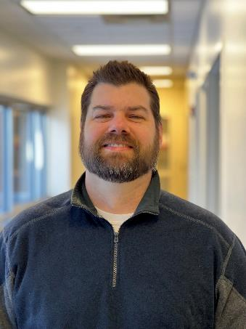
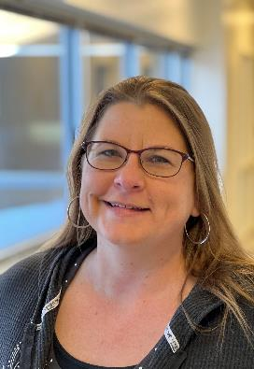
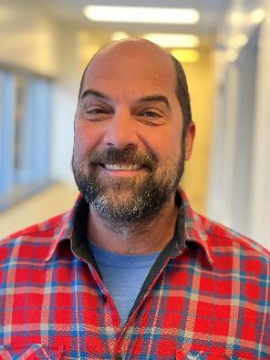
Marc Solberg, Team Lead
Water Resources Section
Claire Asberry
404 Clean Water Act Compliance
Brandy Beavers
Mark Sloppy
Brandon Walls
Notes:
The Water Resources Section is responsible for ensuring the Department complies with applicable state and federal environmental laws that regulate **pause** – as may have already guessed – the water resources within our state.
Their main job duties can be summarized into six bullet points:
Ensure compliance with the Clean Water Act​ and applicable state and federal laws
Meet deadlines during Project Development​
Conduct Wetland and Stream Delineations/Determinations​
Obtain Section 401/404 Permits​
Locate and Develop Compensatory Wetland and/or Stream Mitigation​
Monitor Wetland and Stream Mitigation Sites​

Slide 28
LEB ORGANIZATION CHART
Notes:
And, finally let’s talk about NEPA.

Slide 29
DeeAnn Newell, Team Lead
Mackenzie Rosenboom
NEPA
Telling the Story
Pedro Leanos
Chris Schwake
Chris Schwienebart
Notes:
Here is our NEPA team:
NEPA establishes a national policy and provides a framework for environmental planning and decision making by Federal agencies. NEPA directs Federal agencies, when planning projects or issuing permits, to conduct environmental reviews to consider the potential impacts on the environment by their proposed actions.​
The LEB works closely with FHWA and Local Systems to ensure NEPA compliance.

Slide 30
- LEB Mission Statement
LEB balances transportation project delivery, regulatory compliance, and environmental stewardship for Iowa’s transportation interests.
Notes:
Although you may not work directly with everyone from LEB, you can take comfort in knowing that our team is here to work with both our internal and external partners to help ensure that Iowa’s transportation projects are following the applicable environmental regulations during project delivery.

Slide 31
Questions?
Angie Poole
515-239-1798
Angela.poole@iowadot.gov​
iowadot.gov

