Slide 1
District Transportation Planners
Joint Meeting for ICOG and the MPO/RPA Quarterly Meeting
April 30, 2025
3/2/2023

Slide 2
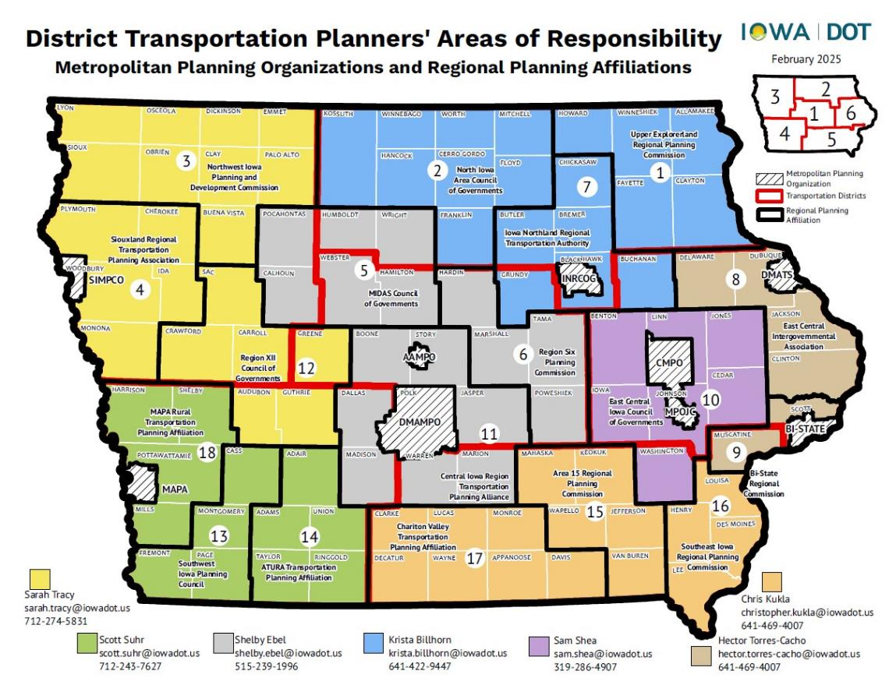

Slide 3
MPO/RPA
Attend Tech Committee, Exec Committee, Policy Board meetings
Attend Quarterly MPO/RPA meetings hosted by Systems Planning Bureau
Attend monthly District Transportation Planner meetings
Participate in MPO/RPA planning reviews
Review and approve Monthly or Quarterly reimbursement requests
Review planning documents as needed and support local corridor studies
Provide presentations to MPO/RPA committees as requested
Develop a list of district projects to include in LRTP updates and send status of current year projects for TPWP and TIP
Work with agencies on all requests/questions/issues that they send in. The DTP should be the first point of contact for everything.

Slide 4
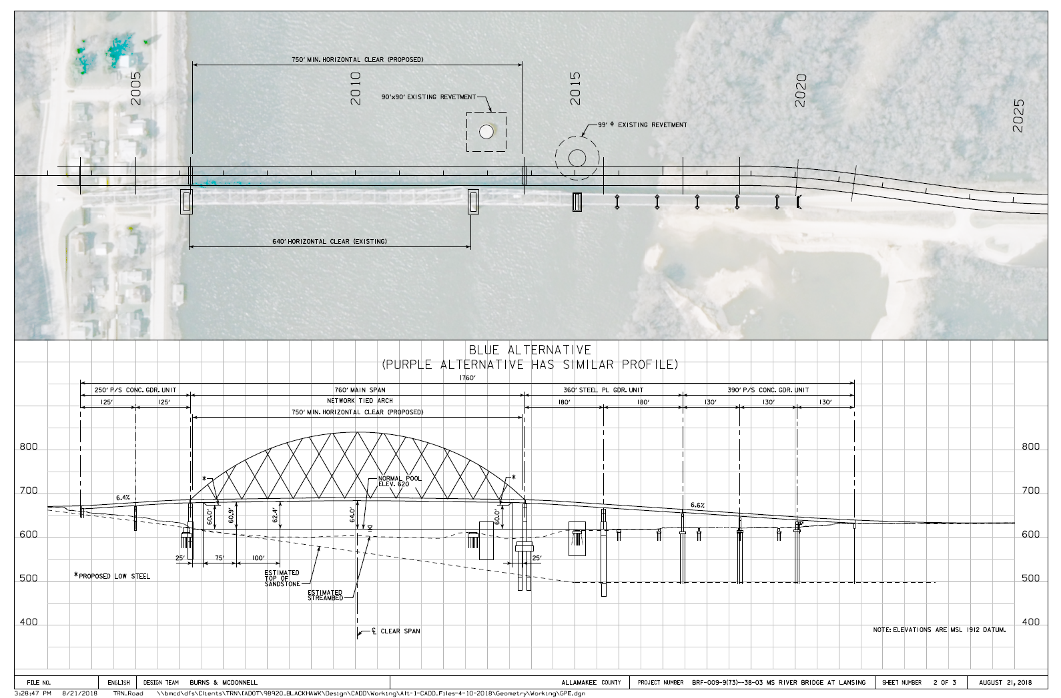
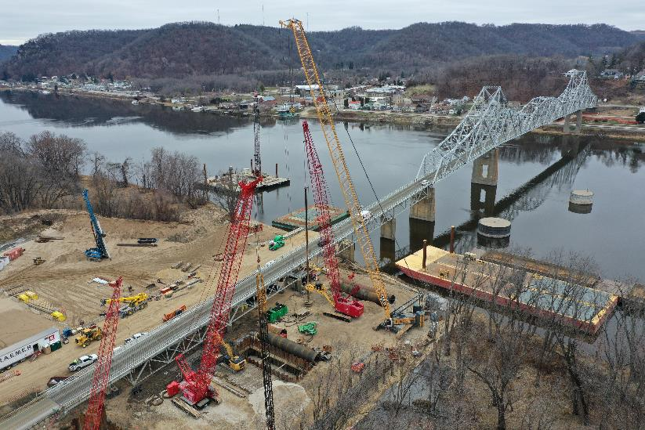
DOT Project Support
Public Involvement
IJR/IOR writing and review
Attend project management team meetings
Act as a reference to provide comments and information for all types of district projects

Slide 5
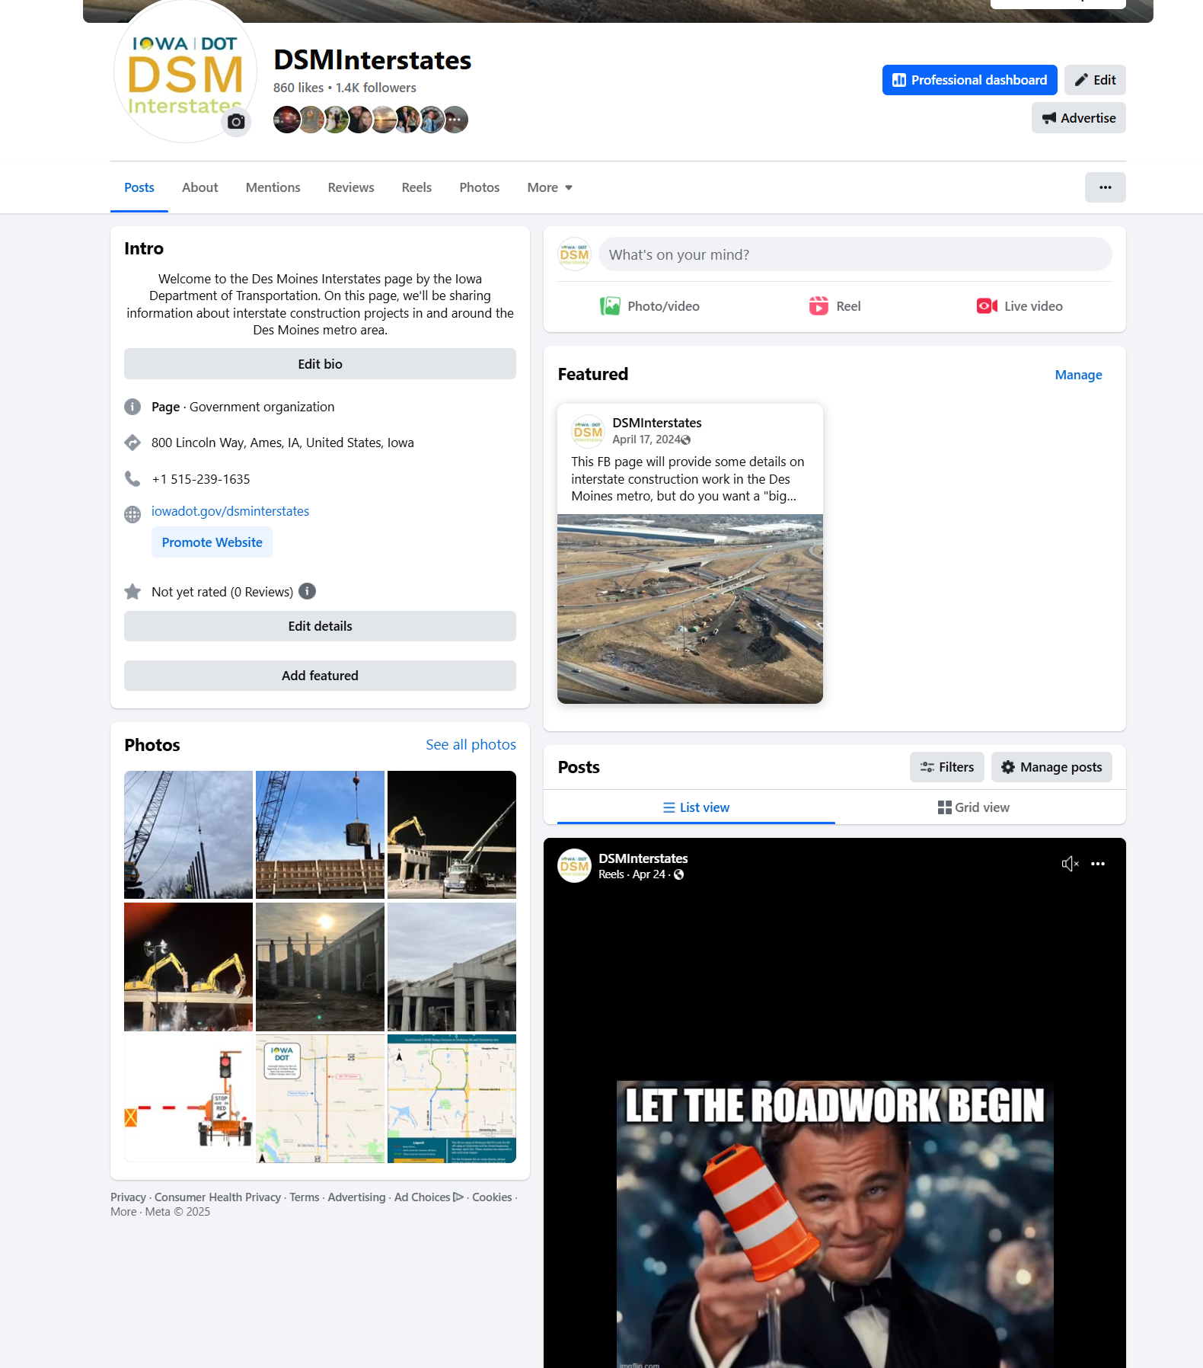
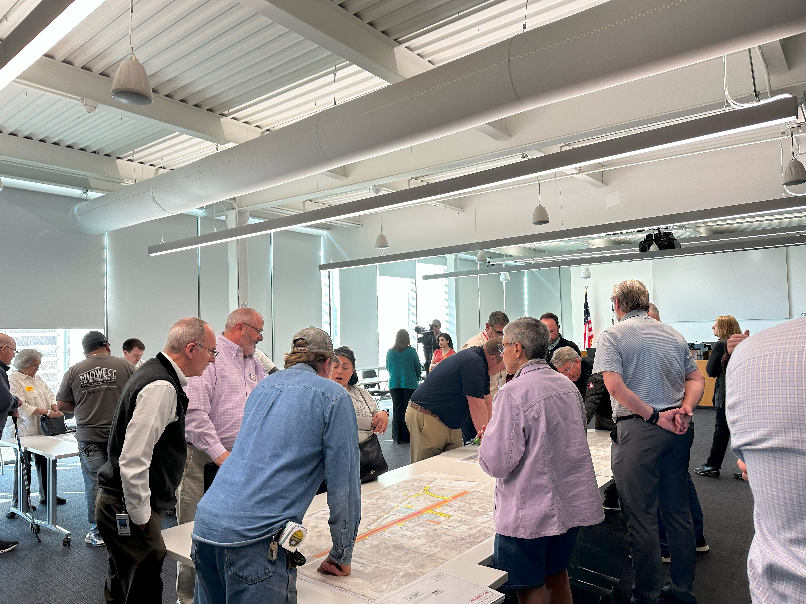
Public Engagement
Coordinate with DOT staff to host project-related public meetings. May be in person or virtual.
Review meeting invite lists, review the meeting invites and related media releases
Work with DOT web-team to load project displays, handouts, and detour displays onto the project related webpage about one week prior to the meeting.
Complete pre-recorded presentation for use in the online virtual meeting and submit to LEB/PI section one week prior to the meeting and use template provide by LEB/PI section.
Monitor PIMA for comments and respond as appropriate
District Planner and Public Involvement Section quarterly meeting
Work with media- both outreach and responding to requests
Manage websites and social media
Respond to citizen inquiries

Slide 6
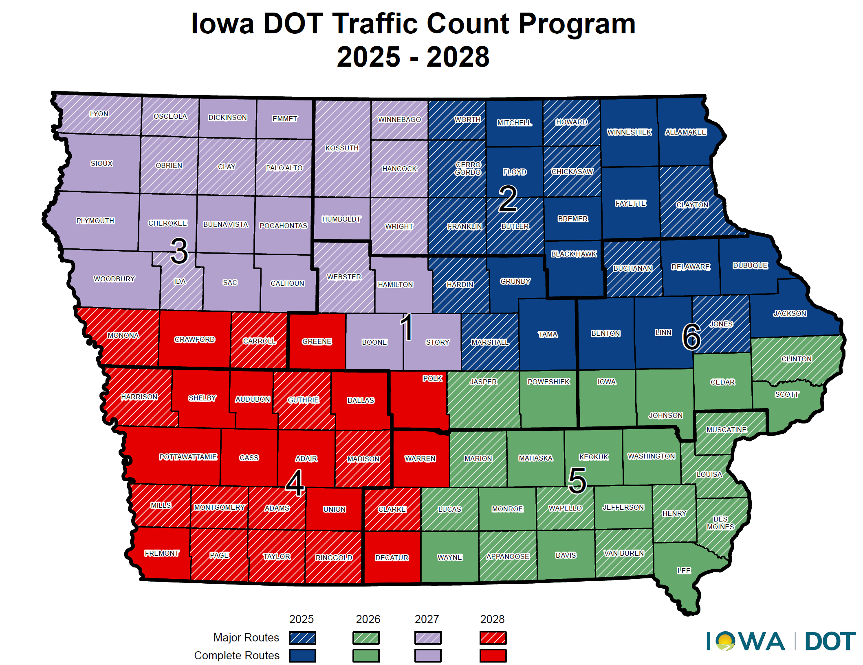
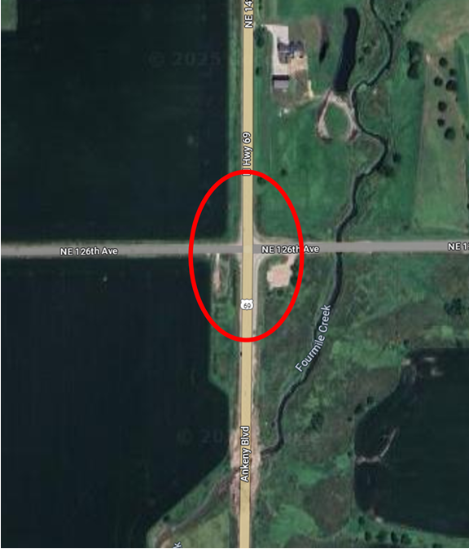
Modeling and Mapping Support
State of Iowa Map review- alternates between bike map and state map
Work with Systems Planning on forecast requests
Create maps for projects
Traffic count requests- can be initiated by DOT staff or local officials
Urban Area Boundary update

Slide 7
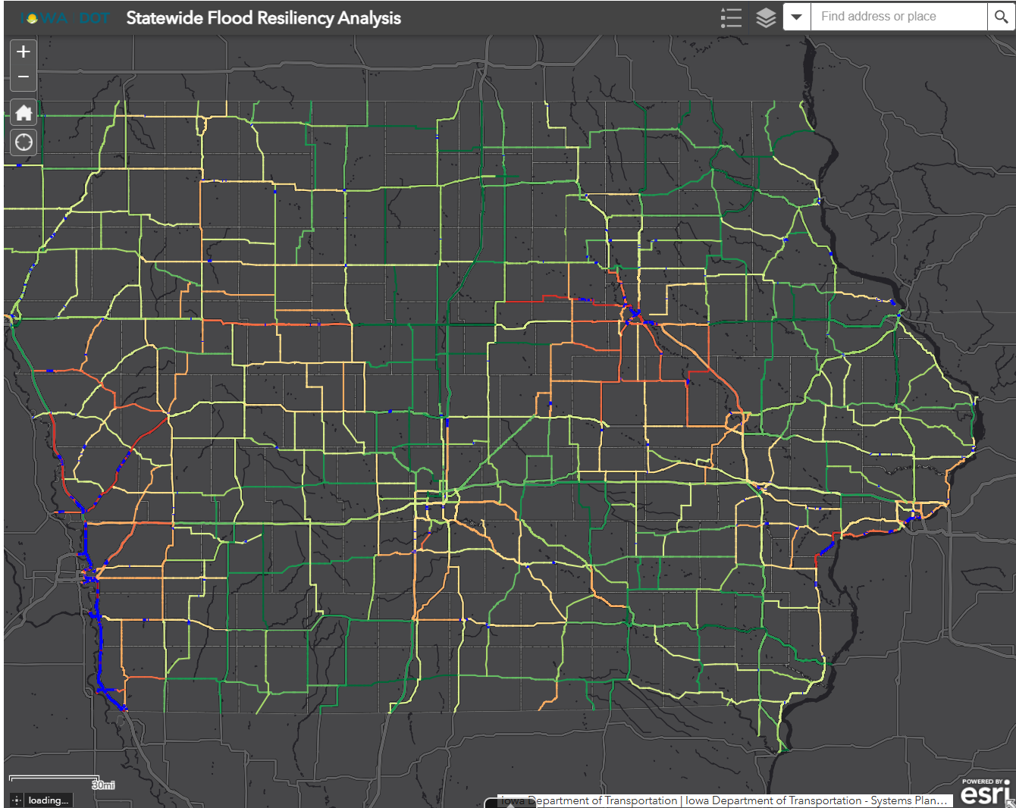
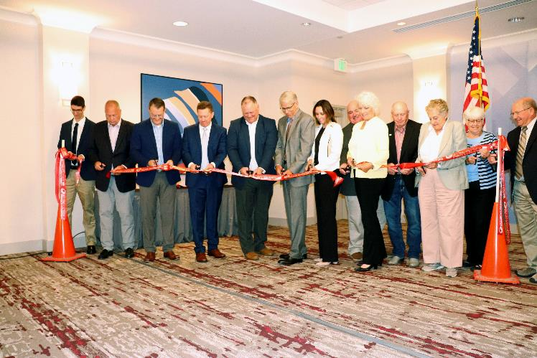
Committees
Various committees related to the MPOs and RPAs
Iowa DOT Transportation Commission
Monitor monthly meetings and host tours/input meetings as needed
MDST
Civil Rights Team
Resiliency and Sustainability Committee
Highway Advocacy Groups and Coalitions
Community Visioning

Slide 8
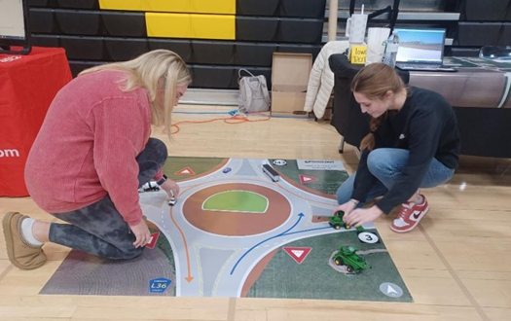
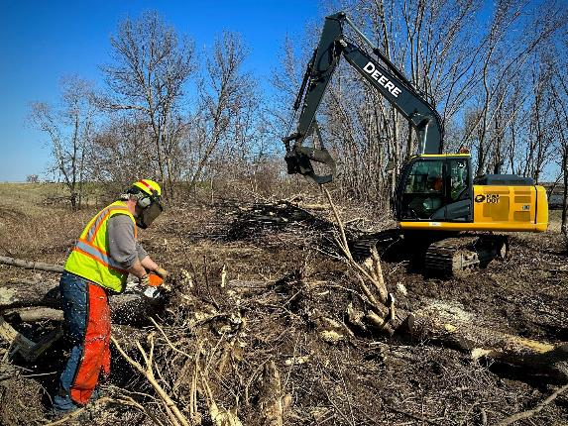
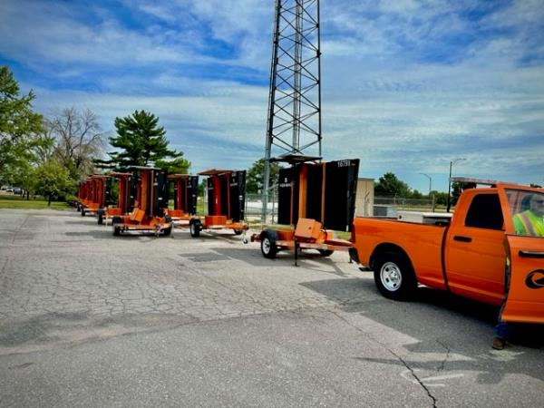
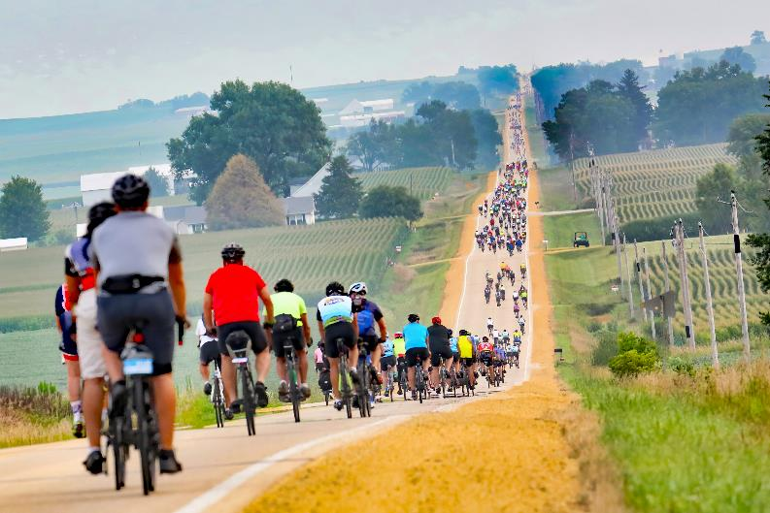
Other Duties as Assigned
Presentations to public groups
Grant assistance, including letters of support
Review annexations and local development projects/planning initiatives
Update website
Special event traffic planning like RAGBRAI
Various right-of-way concerns from public

Slide 9
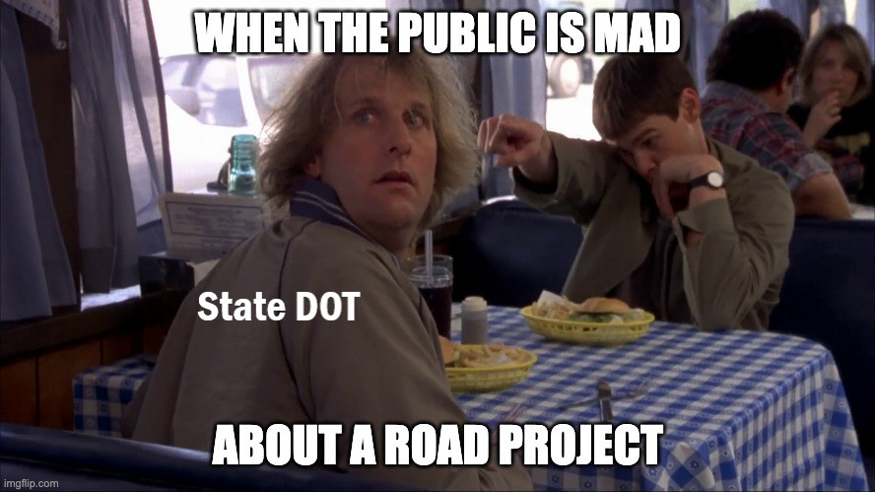
Questions?
SHELBY EBEL, AICP
515-239-1996
Shelby.Ebel@iowadot.us​
iowadot.gov
Locals

