Slide 1
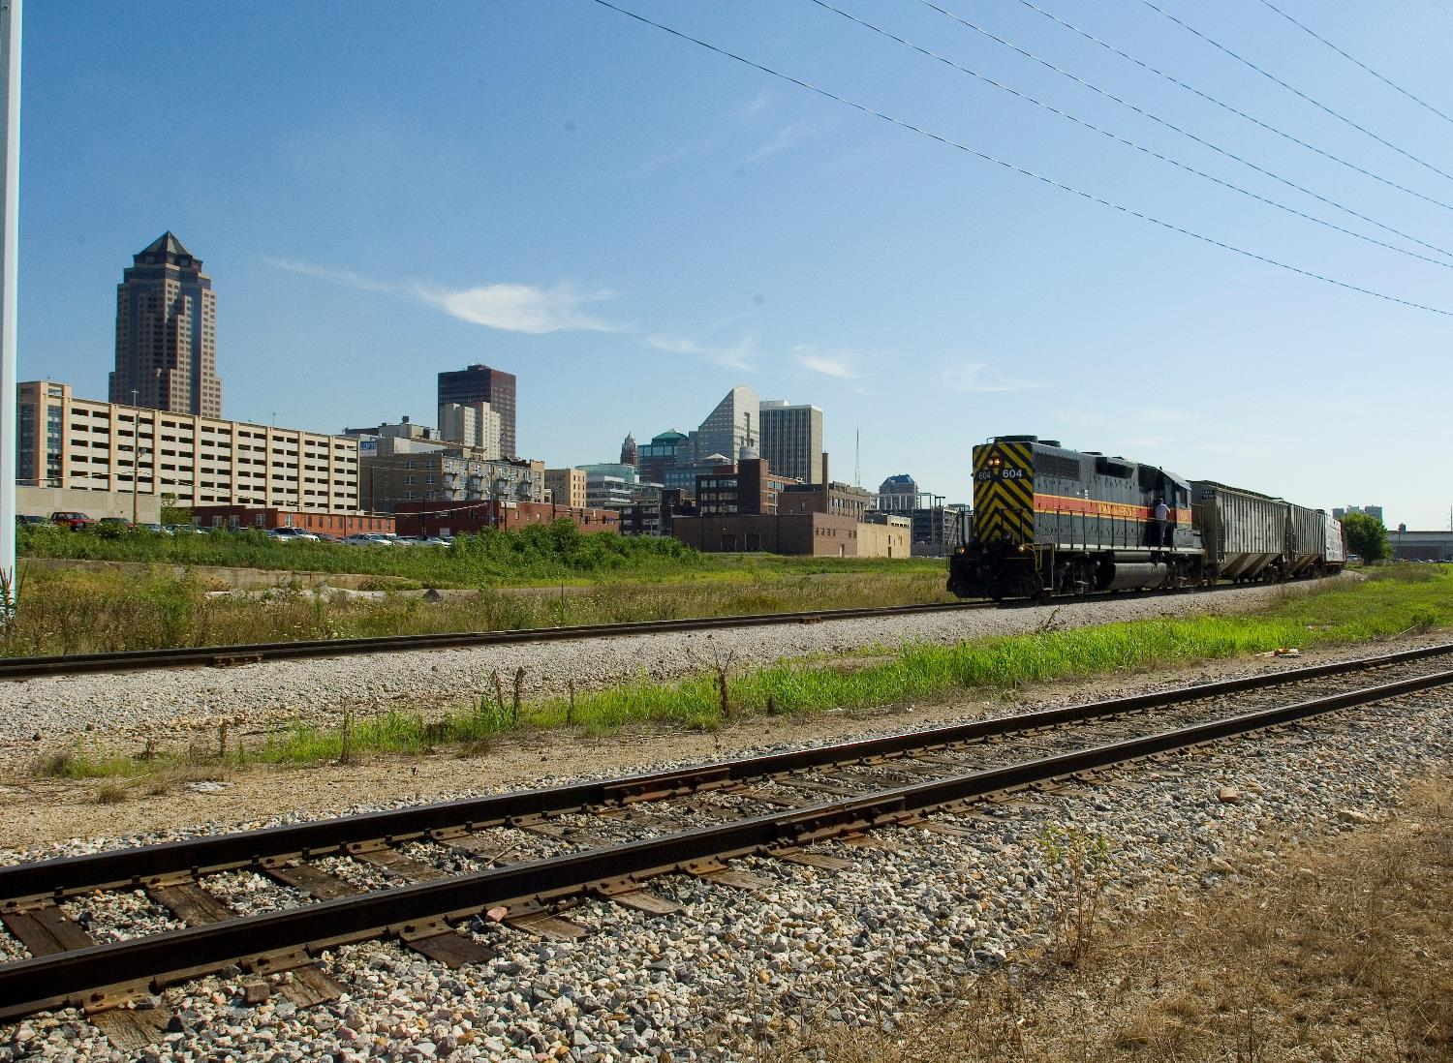
MPO/RPA Quarterly
ICOG 2025
3/2/2023
Caleb Whitehouse
2026 State Freight Plan
April 30th, 2025

Slide 2
Freight Updates
New Freight Planner
Ethan Aamodt
Rail Plan
Freight Plan
Freight Advisory Council

Slide 3
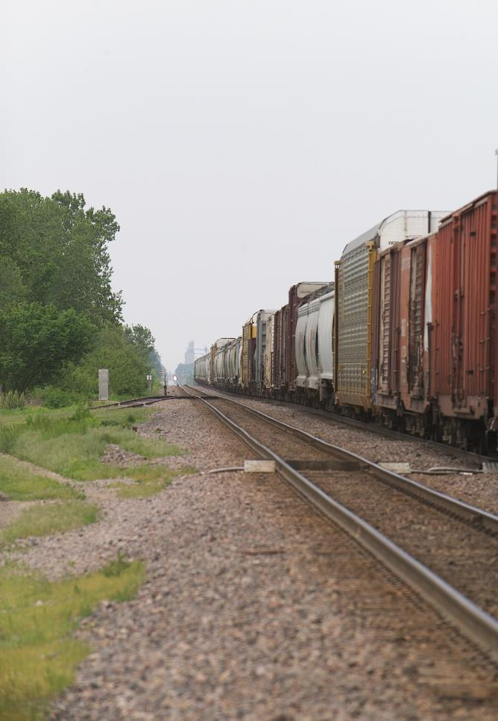
Timeline
2025 – Input Gathering and Development
Freight Advisory Council, Rail Advisory Council, MPO/RPA Quarterly Meetings
Q1 2026
Public Comment Period
August 18th, 2026
Due date

Slide 4
Critical Urban Freight Corridors (CUFCs)
23 U.S.C. 167(f) identifies the requirements for designating CUFCs. In an urbanized area with a population of 500,000 or more individuals, the MPO, in consultation with the State, may designate a CUFC. In an urbanized area with a population of less than 500,000 individuals, the State, in consultation with the MPO, may designate a CUFC.
A public road designated as a CUFC must be in an urbanized area, regardless of whether the population is above or below 500,000 individuals, and meet one or more of the following four elements:
(A) connects an intermodal facility to:
1. the PHFS;
2. the Interstate System; or
3. an intermodal freight facility;
(B) is located within a corridor of a route on the PHFS and provides an alternative highway option important to goods movement;
(C) serves a major freight generator, logistic center, or manufacturing and warehouse industrial land; or
(D) is important to the movement of freight within the region, as determined by the MPO or the State.
FHWA encourages States, when making CUFC designations, to consider first or last mile connector routes from high-volume freight corridors to freight-intensive land and key urban freight facilities, including ports, rail terminals, and other industrial-zoned land.

Slide 5
From 2024 SFP

Slide 6
What were asking:
Send additional candidate corridors with
1-2 sentence justification
AADT counts for those segments
Send to caleb.whitehouse@iowadot.us by Monday, June 2nd
150 miles to designate
DOT will prioritize candidate corridors
You may send corridors designated previously

Slide 7
Questions?
Caleb Whitehouse
Caleb.whitehouse@iowadot.us​
iowadot.gov

