Slide 1
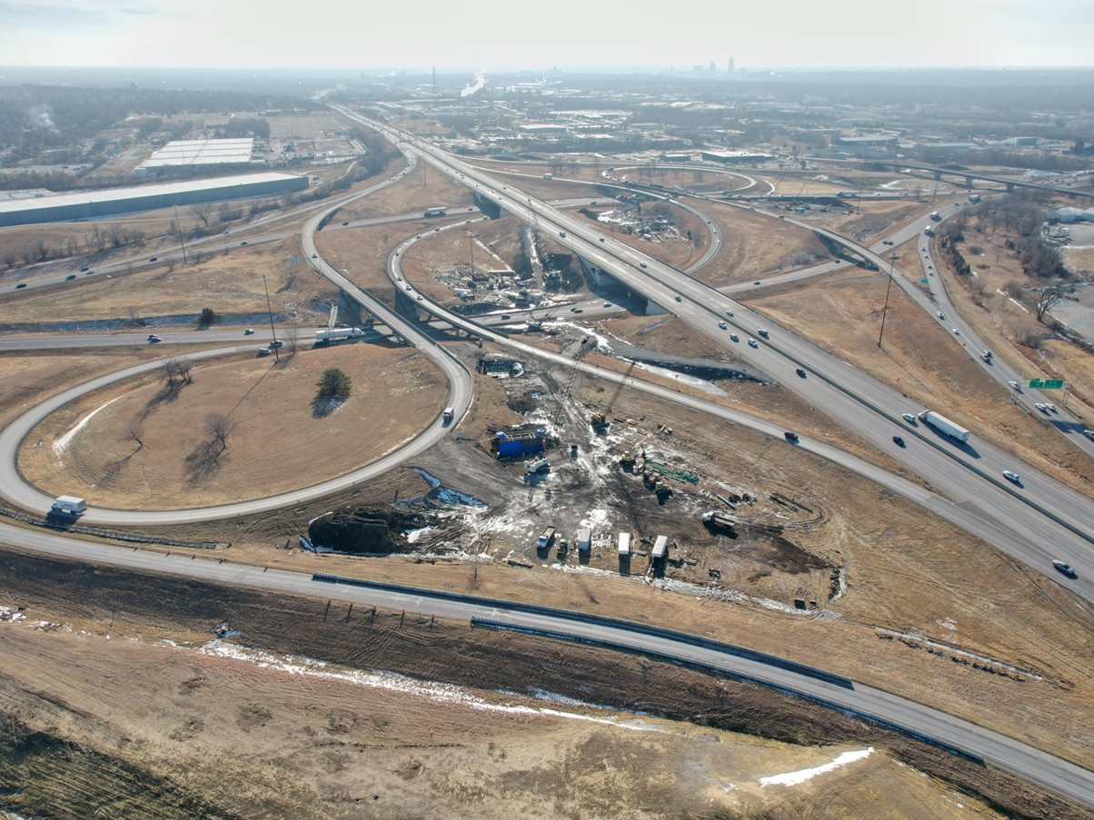
MPO/RPA Quarterly Meeting
Bureau Introduction and Updates
Program Management
April 30, 2025
3/2/2023

Slide 2
Agenda
TOPIC 1
Overview of Bureau Responsibilities
TOPIC 2
MPO/RPA Partnership
TOPIC 3
Key Dates and Tasks

Slide 3
Topic 1
Overview of Bureau Responsibilities

Slide 4
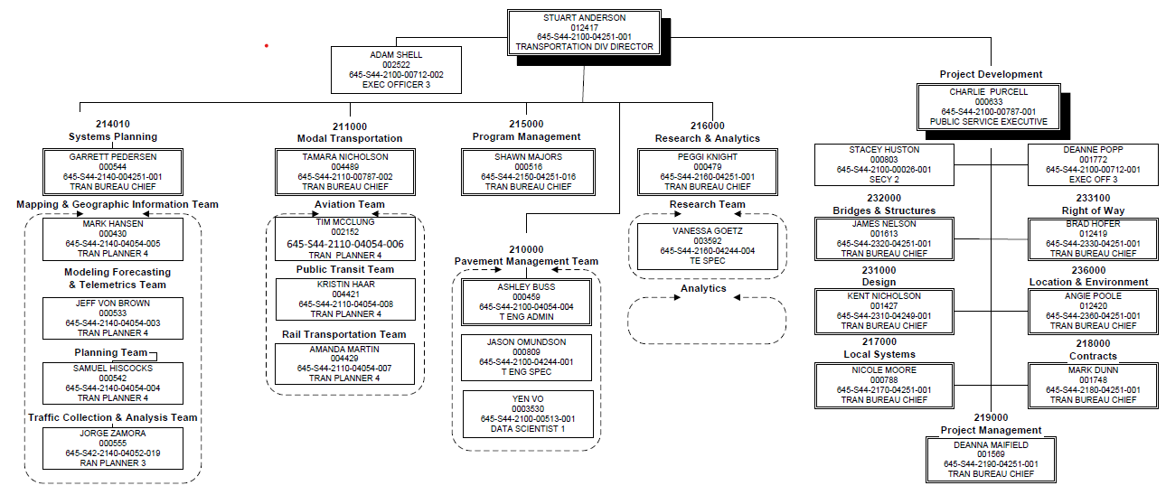
Transportation Development Division

Slide 5
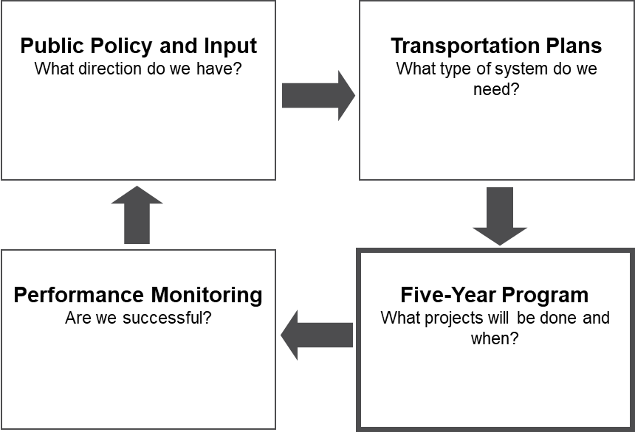
Highway Program Development Process

Slide 6
Program Management Overview
Iowa Transportation Improvement Program (Five Year Program)
Statewide Transportation Improvement Program (STIP)
Park and Institutional Roads Program
State and Federal Revenue Forecasting
Federal Funds Management
Primary Road Fund Cash Flow
Iowa Transportation Commission Public Input Meetings and Tours
FHWA Reporting (fuel consumption, vehicle registrations, motor fuel taxes etc.)

Slide 7
Topic 2
MPO/RPA Partnership

Slide 8
MPO/RPA Partnering Efforts
Transportation Improvement Program Development and Management
FHWA to FTA Transfers
Funding Targets
Quarterly Reports
Federal Aid Guidance
Facilitate Transportation Commission Input

Slide 9
Topic 3
Key Dates and Tasks

Slide 10
Key Dates For TIP Development Information
January/February
Surface Transportation Block Grant (STBG), Transportation Alternatives Program (TAP) and Carbon Reduction Program (CRP) funding targets provided to MPOs and RPAs.
April
Operations and Maintenance (O & M) data and city and county revenue information provided to MPOs and RPAs.
May
Draft Iowa DOT Five Year Program projects submitted to MPOs and RPAs for inclusion in TIPs.
June
Provide comments to MPOs and RPAs on Draft TIP.
July
Final TIPs submitted to Program Management for inclusion in Final STIP.
August
Final STIP distributed for public review and comment.
September
Final STIP submitted to FHWA/FTA for approval prior to October 1st.
Quarterly
Program Management provides MPOs and RPAs Quarterly Reports on balances of STBG, TAP and CRP funds (MPOs).

Slide 11
Questions?
Shawn Majors, Director
Program Management Bureau
Iowa Department of Transportation
800 Lincoln Way
Ames, IA, 50010
515-239-1288 office
shawn.majors@iowadot.us
iowadot.gov

