Slide 1
Systems Planning Bureau
MPO/RPA Quarterly Meeting
April 30, 2025
3/2/2023

Slide 2
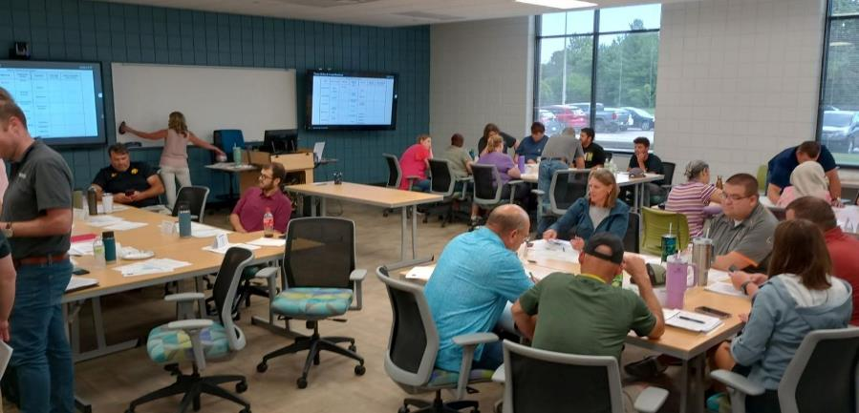
Bureau structure
Garrett Pedersen
Peggy Riecken
Traffic Collection & Analysis Team
Jorge Zamora
Mapping & Geographic Information Team
Mark Hansen
Modeling, Forecasting & Telemetrics Team
Jeff von Brown
Planning Team
Sam Hiscocks

Slide 3
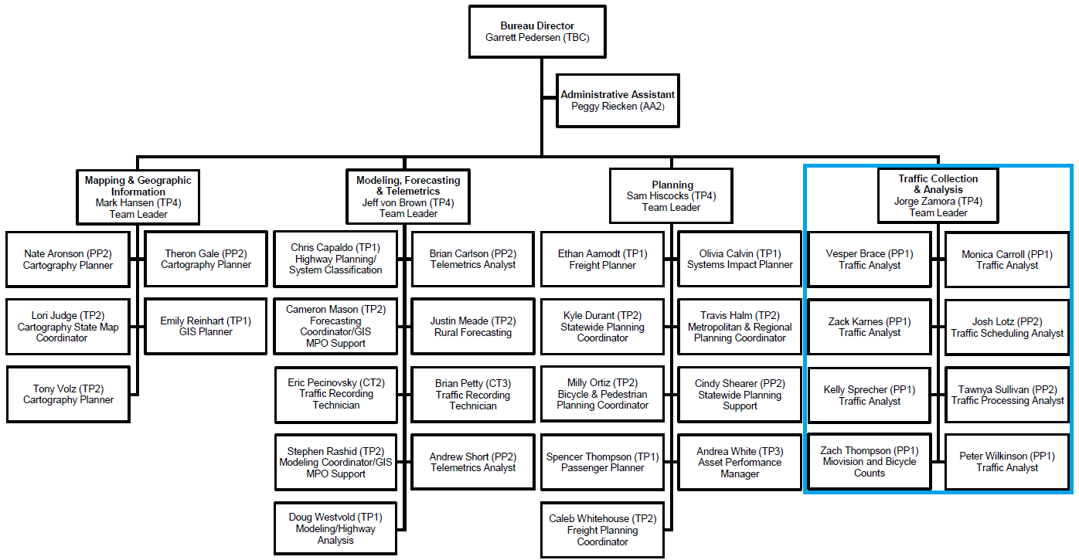
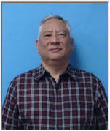
Traffic Collection & Analysis Team

Slide 4
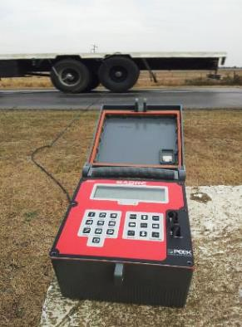
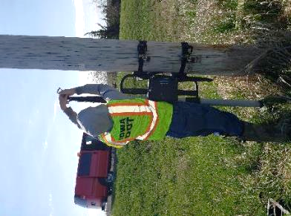
Traffic Collection & Analysis Team
What we do:
Collect, analyze, summarize, and distribute traffic volume data
Approx. 10,000 short-term counts are scheduled in a quad every summer
Portable Traffic Recorders (pneumatic tube)
Portable Miovision cameras (video)
Short-term counts get statistically annualized to determine Annual Average Daily Traffic (AADT)

Slide 5
Traffic Collection & Analysis Team
What we do:
AADT is attached to roadway segments within the Roadway Asset Management System (RAMS)
AADT is used in various Federal Highway Administration reporting, and supports distribution of funds, project development and prioritization, maintenance decisions, etc.
We also do bicycle counts on trail facilities

Slide 6
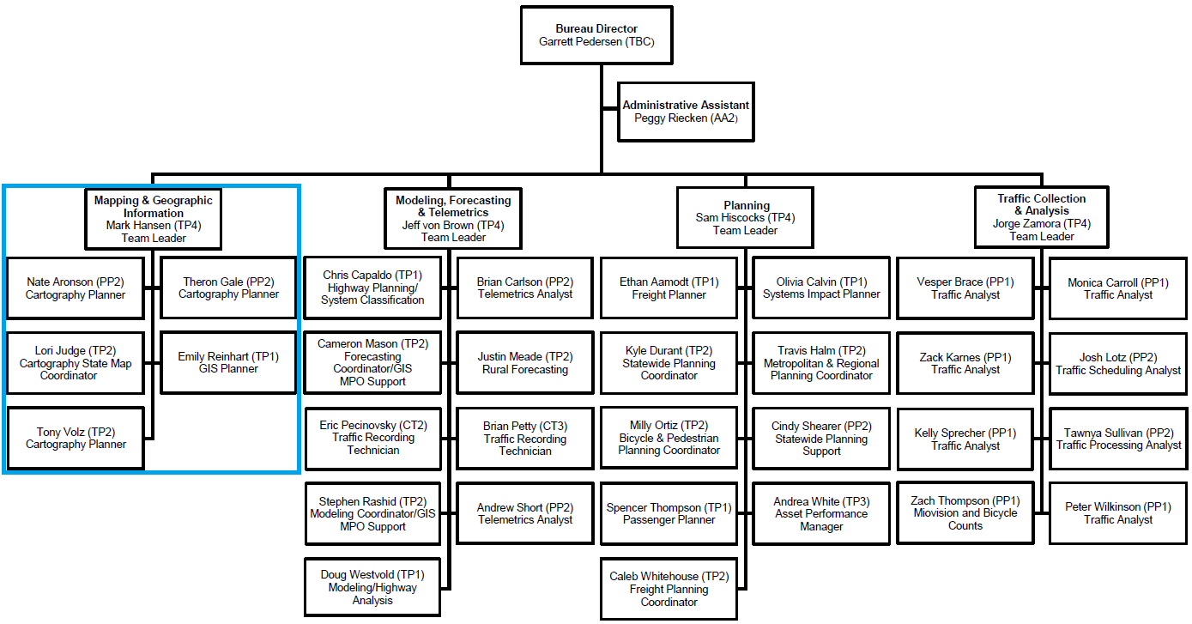
Mapping & Geographic Information Team

Slide 7
Mapping & Geographic Information Team
What we do:
Maintain city, county, state, and specialty maps
Develop static web-based and printed maps, online interactive maps
Support various geospatial analysis efforts
Use Bentley MicroStation and Esri ArcGIS Pro
iowadot.gov/maps

Slide 8
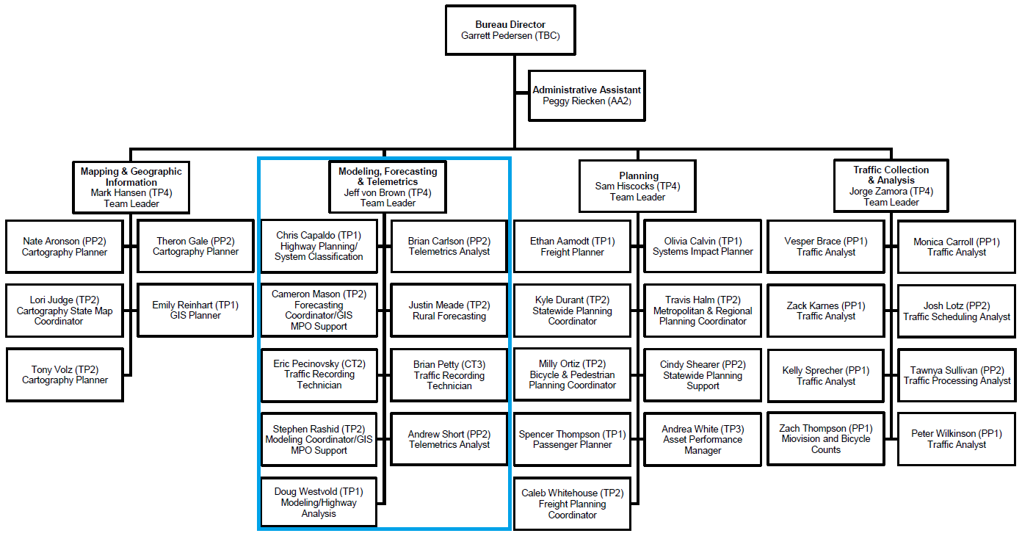
Modeling, Forecasting & Telemetrics Team

Slide 9
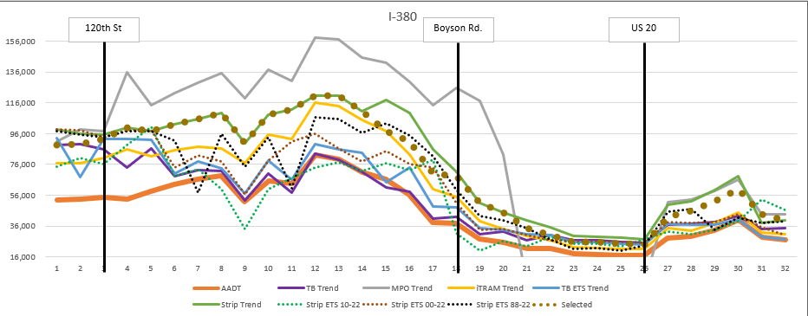
Modeling, Forecasting & Telemetrics Team
What we do:
Modeling using Travel Demand Models to understand traffic on the network
Utilizes GIS framework for road network, land use, and traveler behavior data
Support metropolitan planning organization (MPO) model development and use
Forecasting using historical data and predictive models to estimate vehicles that will use a transportation facility in the future
Complete 50-70 project forecasts each year
Recently completed 2055 interstate system forecast

Slide 10
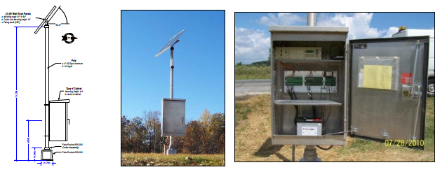
Modeling, Forecasting & Telemetrics Team
What we do:
Telemetrics using permanent traffic monitoring to record traffic volume, and/or vehicle classification/weight
Collected from 170 locations statewide
Used to develop factors to annualize
short-term counts
Highway classification and management of roadway system designations
Urban Area Boundary and Metropolitan Planning Area Boundary administration
Federal Functional Classification and Farm-to-Market System administration

Slide 11
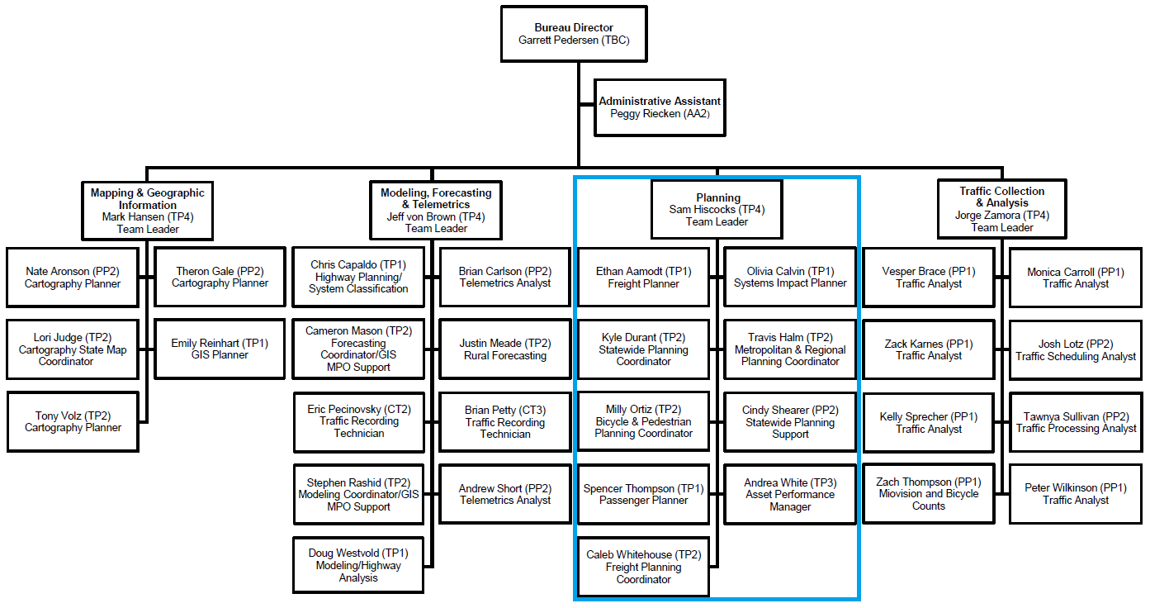
Planning Team

Slide 12
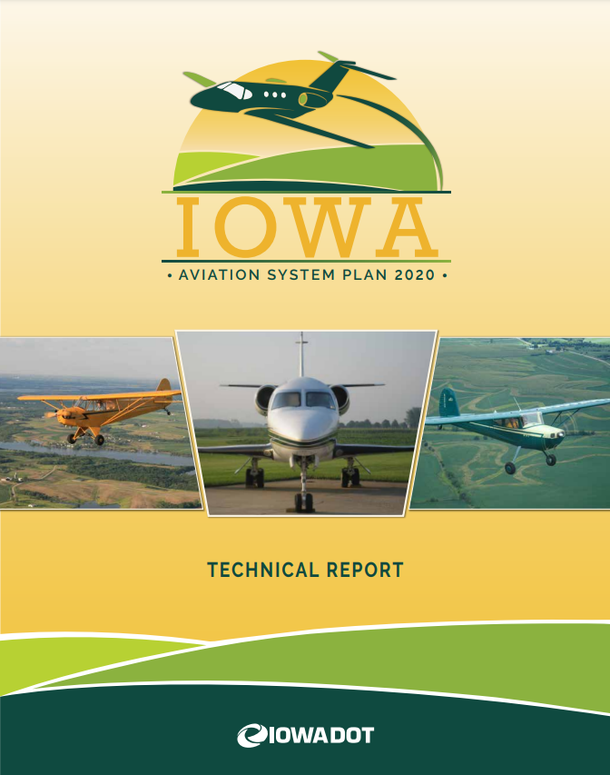
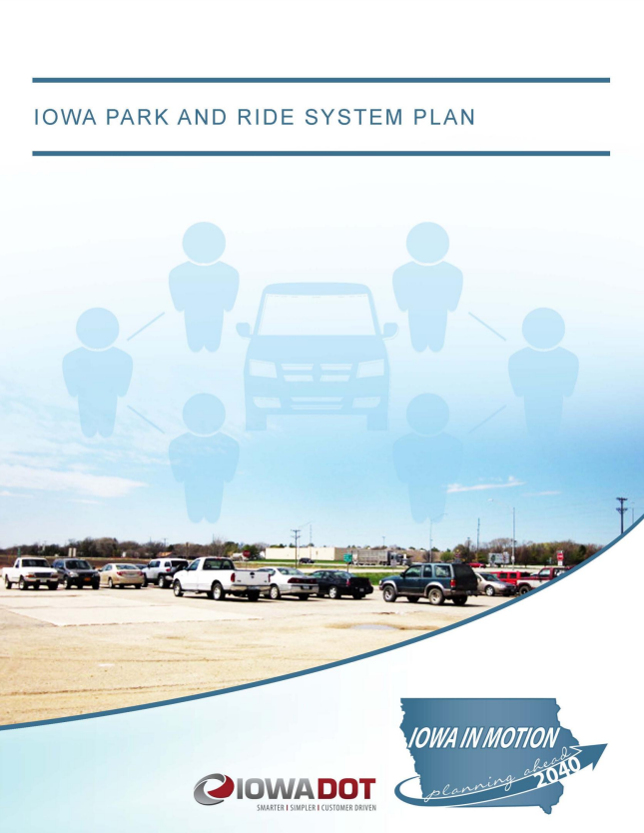
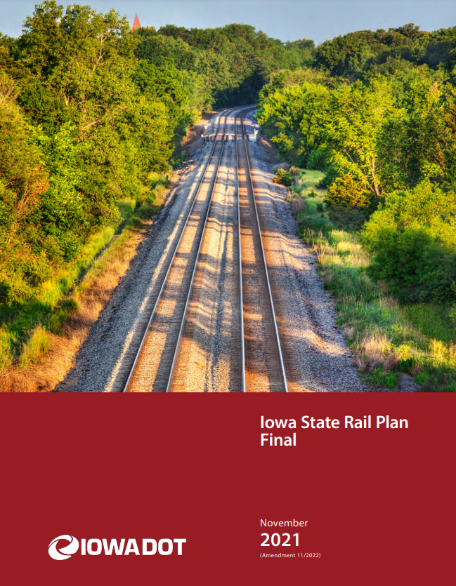
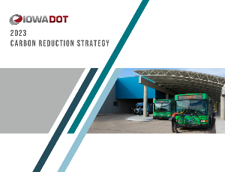
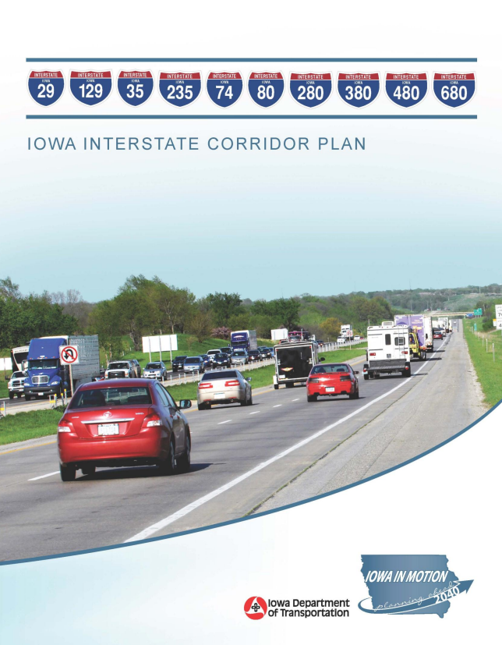
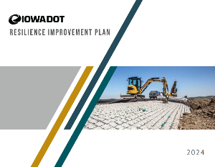
Planning Team
What we do:
Development of the Commission-adopted State Transportation Plan
Develop/support various modal, system, and specialized plans

Slide 13
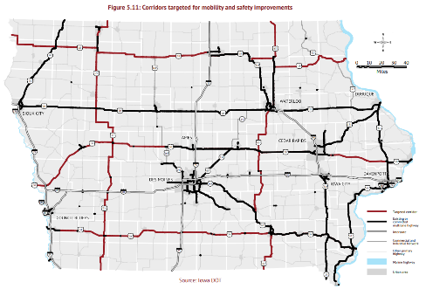
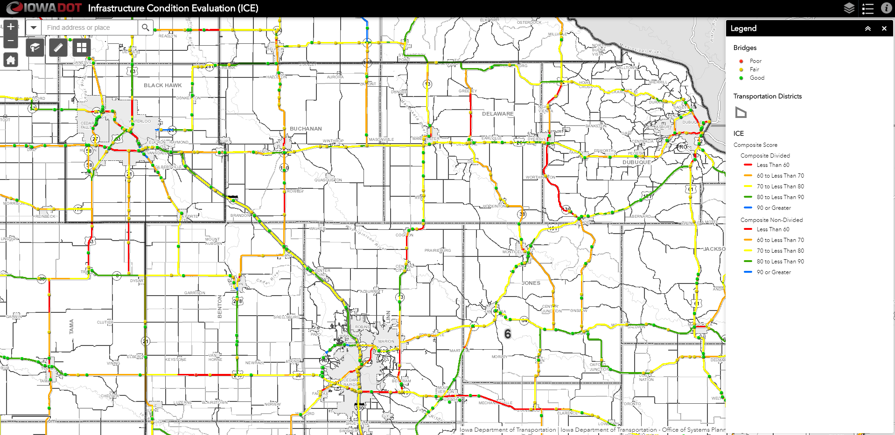
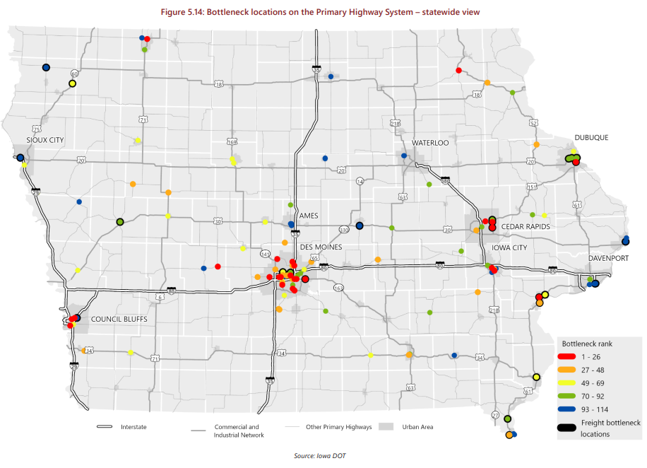
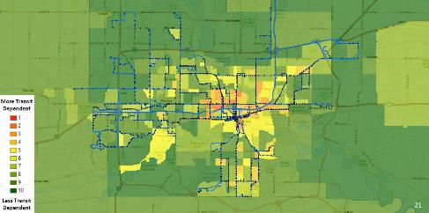
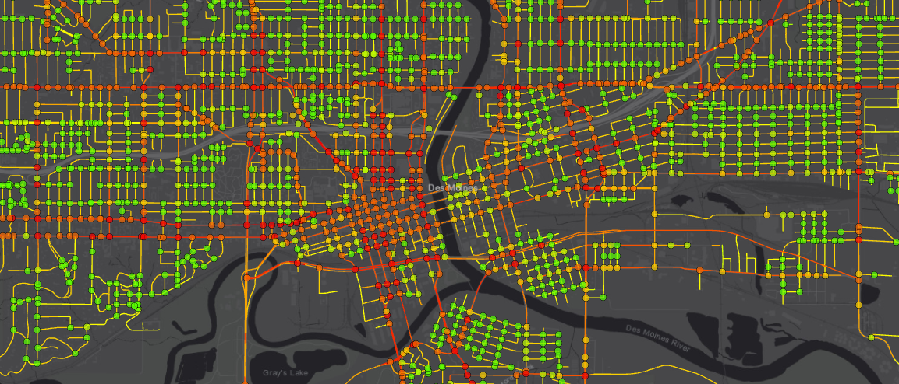
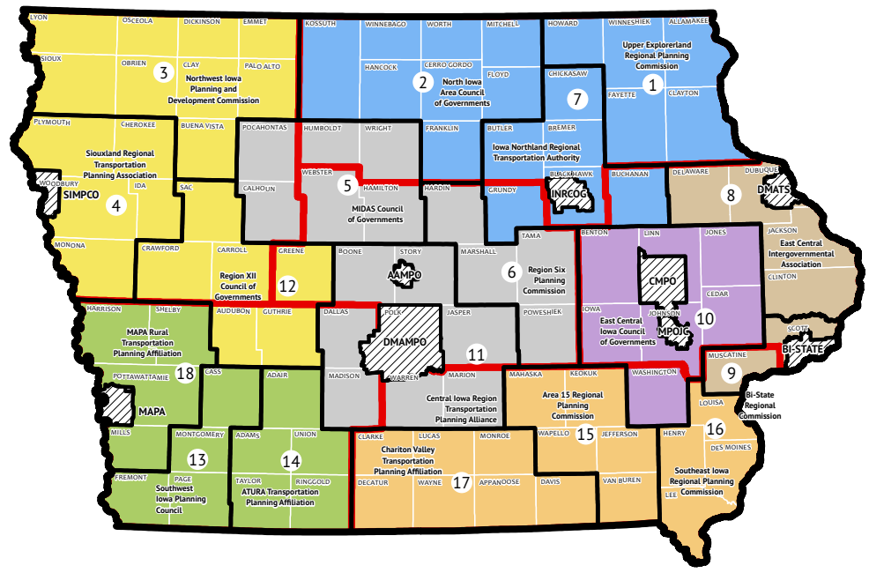
Planning Team
What we do:
Transportation systems analysis and performance reporting
Stewardship/oversight of Iowa’s 9 metropolitan planning organizations and 18 regional planning affiliations
System analysis
Infrastructure Condition
Evaluation (ICE)
Strategy analysis
Super-2 targeted corridors
System analysis
Bottleneck evaluation
Demand analysis
Transit dependency analysis
System analysis
Bicycle and pedestrian
Systemic safety analysis

