Slide 1
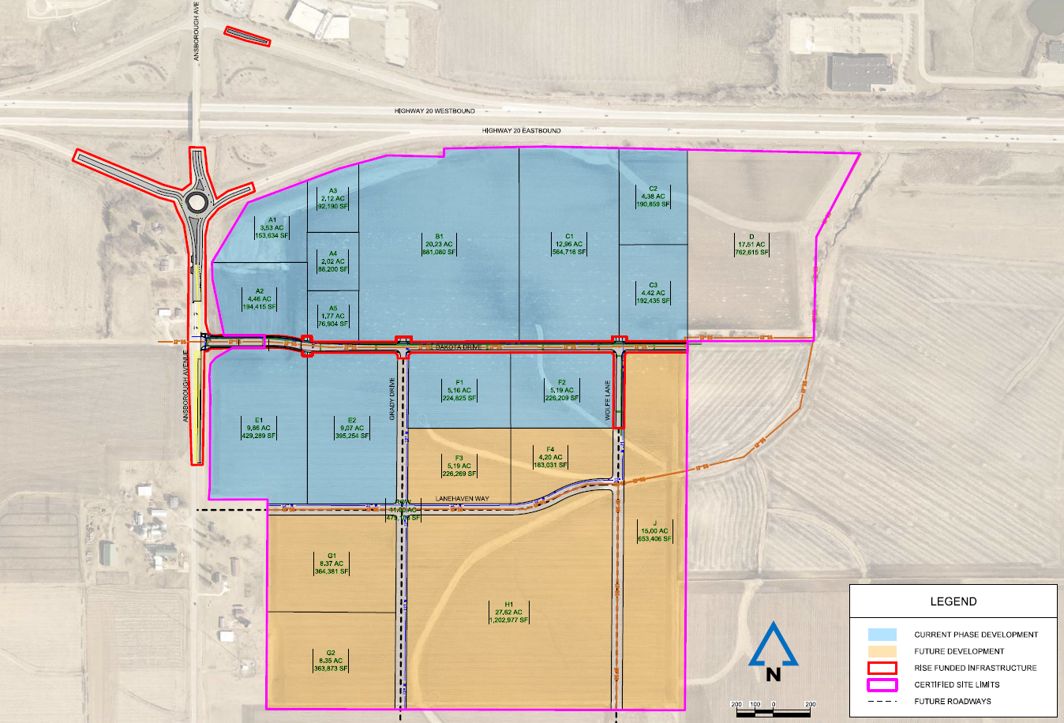
Local Development Recommendation
PROJECT NAME | SPONSOR | SCORE | TOTAL PROJECT COST | PERCENT PARTICIPATION | RECOMMENDED AMOUNT
Construct a roundabout at the intersection of Ansborough Avenue and the U.S. 20 eastbound ramps (Certified Site Amendment) | Waterloo | 58 | $2,541,438 | 60% | $1,524,863
1
1

