Slide 1
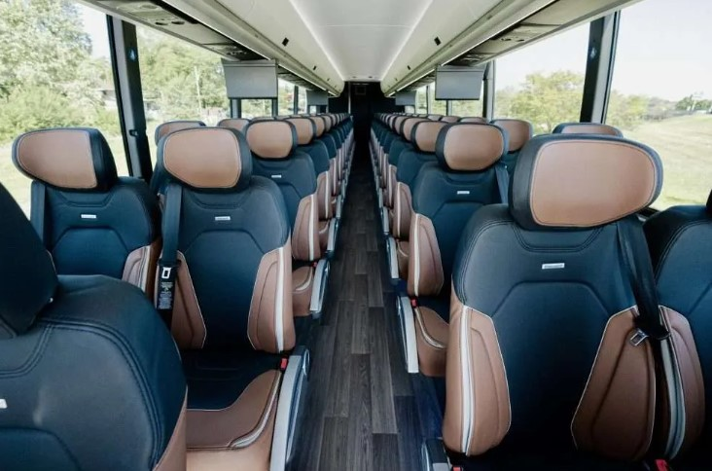


Intercity Bus Program
CY 2026 Proposed Funding Categories
Transportation Commission Workshop
May 13, 2025
3/2/2023
2025

Slide 2
Intercity Bus Program
Purpose: Support intercity bus services that include stops at non-urbanized locations and makes meaningful connections to nationwide network.
Available to private intercity bus companies, companies wishing to start bus service, public transit agencies either operating of proposing to operate bus service, and local communities wishing to support intercity connections to their community.
Each state must spend no less than 15-percent of its annual apportionment of FTA Formula Grants for Rural Areas money for the development and support of intercity bus transportation, unless it can certify, after consultation with intercity bus service providers, that the intercity bus needs of the state are being adequately met.
For the CY2026 ICB Program, it is anticipated that $3,500,000 to $4,000,000 will be available for funding.

Slide 3
Existing Funding Categories
Iowa’s current program has four components.
- In priority order:
Base level support of existing service.
    $0.20 per revenue mile.
Start-up support for new services.
    Three years at $0.50 per revenue mile.
Support for marketing of intercity bus services and interlined services.
    Maximum $7,500 for existing routes per agency and $12,000 per each new route with 20% match required.
Support for intercity bus capital improvements.
    Over the road motorcoaches, vertical infrastructure, vehicle renovations/ improvements, ADA improvements to vehicles and facilities. Vehicles require a 15% match while all other capital projects require 20% match.

Slide 4
The Need for ICB Program Changes
Current funding program was set in 2009.
    Priority 1 funding increased from $0.10 per revenue mile to $0.20 per revenue mile.
    Priority 2, 3, and 4 funding did not increase at this time.
These funding levels have not changed in 16 years, while inflation and COVID era costs have increased significantly.
ICB Carriers in Iowa operate at a deficit of approximately $1.00 per revenue mile.
Proposed changes would bring the ICB Program in line with how Iowa’s public transit agencies are funded through Federal Transit Programs and focus the funding on operating support.
These funding changes may encourage other Iowa public transit agencies to participate in the ICB Program and add intercity bus routes to their service offerings.

Slide 5
CY 2026 Proposed Funding Categories
Proposed changes to Iowa’s program has two components.
- In priority order:
Iowa based Operating Deficit (including marketing).
    50% Federal with a 50% match.
Support for intercity bus capital improvements.
    Over the road motorcoaches, vertical infrastructure, vehicle renovations/ improvements, ADA improvements to vehicles and facilities.
      ADA vehicles require a 15% match.
      All other capital projects require 20% match.

Slide 6
Next Steps:
Comments or Questions?
If supported, this will be implemented with the CY 2026 ICB Program round of funding.
  Notice of Funding Availability August 1, 2025
  Applications due October 1, 2025
  Commission Workshop November 12, 2025
  Commission Action December 9, 2025

Slide 7

Questions?
Jefferson Lines
For more information on Iowa’s public transit and intercity bus programs, visit
www.iowadot.gov/transit
Or contact the ICB Program Administrator
Matt Oetker
515-239-1765
matthew.oetker@iowadot.us

