Slide 1
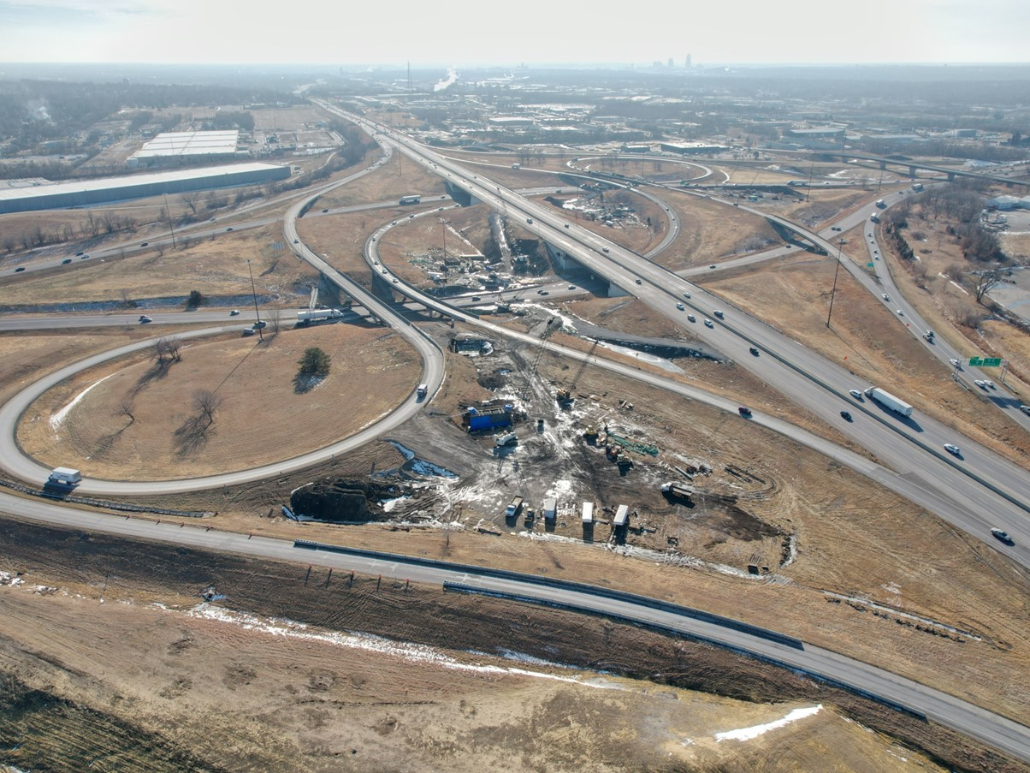


2026-2030 Highway Program Development
May 13, 2025
3/2/2023

Slide 2


Agenda
TOPIC 1
Highway Program Analysis
TOPIC 2
Next Steps

Slide 3
April 7, 2025
Highway Program Development Schedule (2026-2030)
May 2025
Present the Draft 2026-2030 Iowa Transportation Improvement Program to the public (including all previous Program approvals and Draft 2026-2030 Highway Program)
June 2025
Action Item: Approve the 2026-2030 Iowa Transportation improvement Program

Slide 4
Topic 1
Highway Program Analysis

Slide 5
May 13, 2025 as presented on April 7, 2025
2026-2035 Highway Program Analysis
($ in millions)
(For Highway Planning Purposes Only)

Slide 6
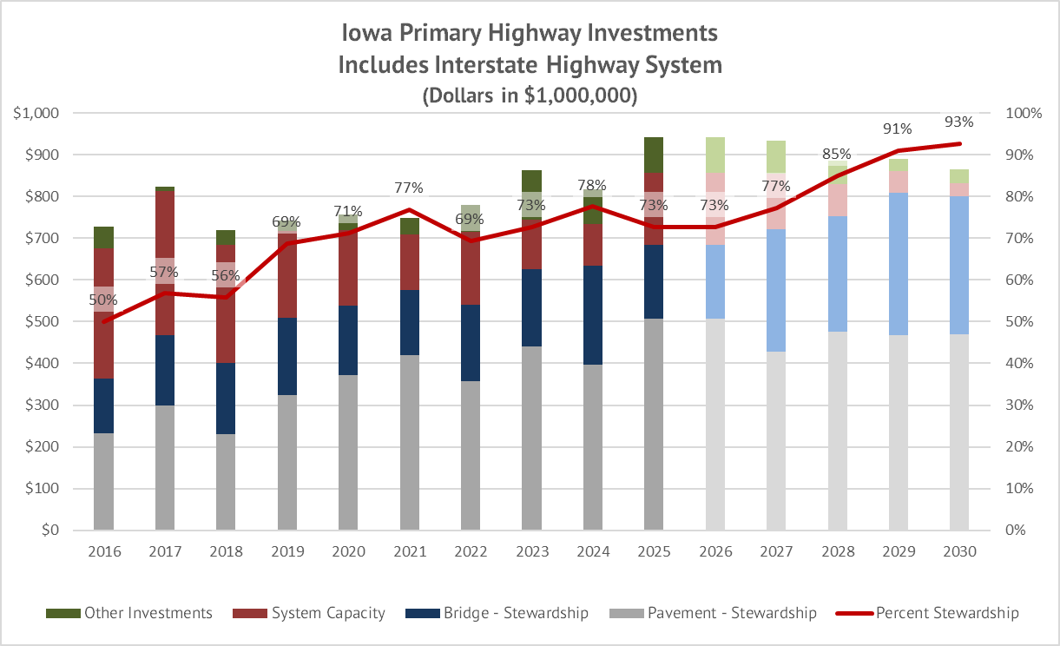

Slide 7
Topic 2
Next Steps

Slide 8
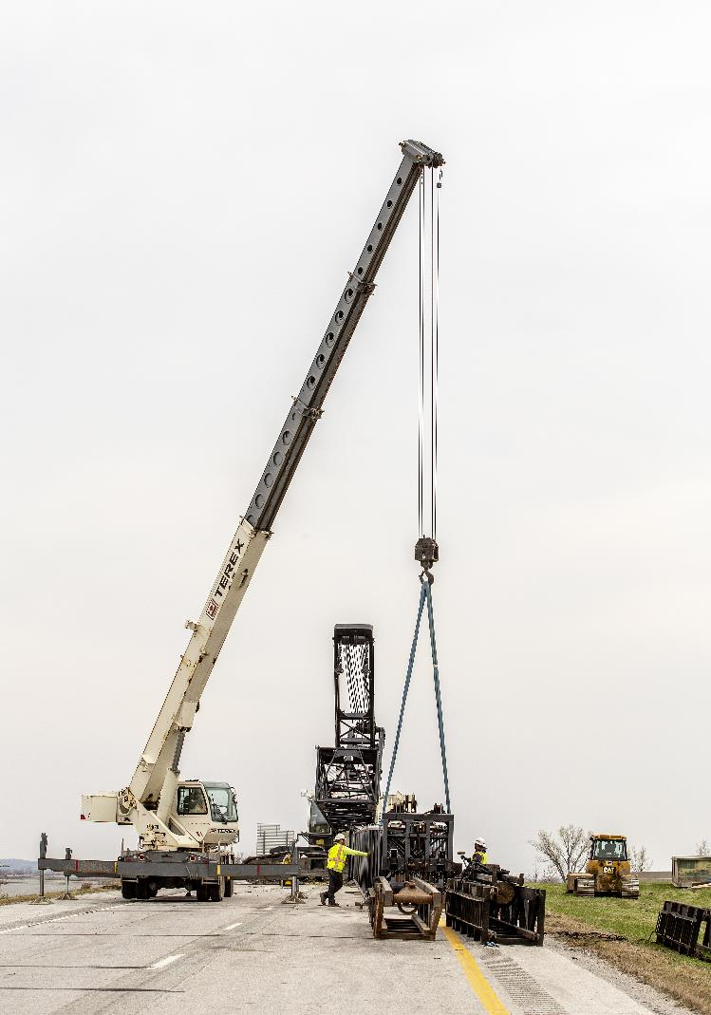
Next Steps
Action Item: Approve the 2026-2030 Iowa Transportation Improvement Program.

Slide 9
Questions?

