Slide 1
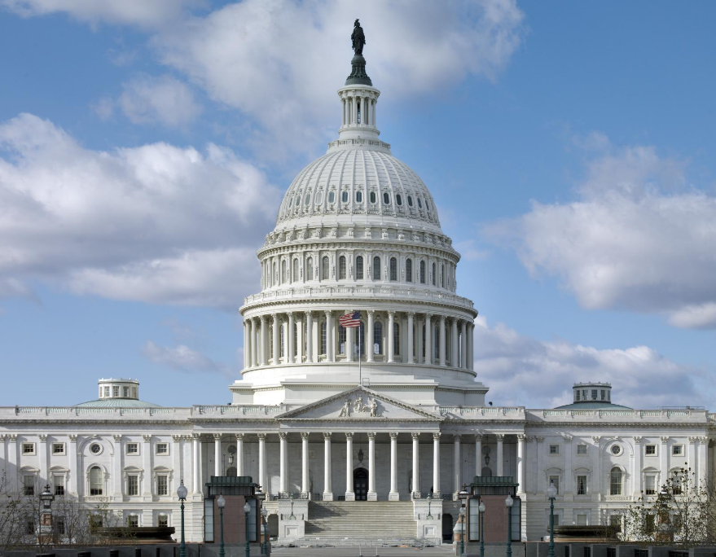
Washington, D.C. Trip
May 13, 2025
3/2/2023

Slide 2
Purpose
Meet with Iowa’s Congressional Delegation and US DOT administration officials
Discuss Iowa’s use of federal transportation funds
Provide Iowa perspectives of future transportation authorization priorities

Slide 3
Potential Dates
Considerations
Avoid regular Commission meeting
Congress in Session
Timing with authorization bill discussions
Options
Monday, September 15 through Wednesday, September 17
Tuesday, September 16 through Thursday, September 18

Slide 4
Sample Itinerary (based on 2023 trip)
Day 1 – Fly to D.C.
Day 2
Morning: House meetings
Afternoon: US DOT administration meetings
Day 3
Morning/Early Afternoon: Senate meetings
Late Afternoon/Evening: Fly back

Slide 5
Potential Focus Areas
Iowa’s efficient use of federal funds on core transportation needs
Iowa’s strong partnerships with stakeholders
Transportation Challenges
Inflationary impacts
Revenue
Discretionary programs and awards
Recommendations for Reauthorization

Slide 6
Questions/Comments

