Slide 1



Transportation Trends Update
May 13, 2025
3/2/2023

Slide 2
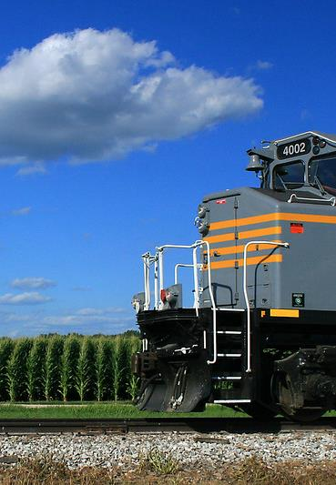

Agenda
US total rail carloads
Commercial air service passenger counts
Public transit ridership
Vehicular traffic

Slide 4
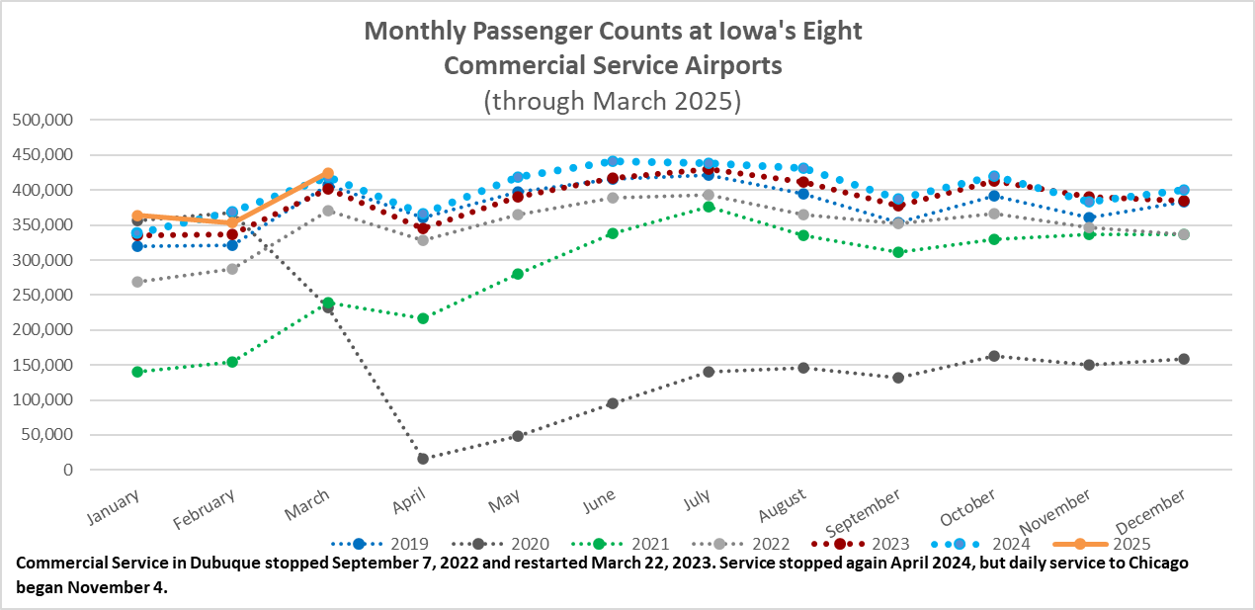

Slide 5
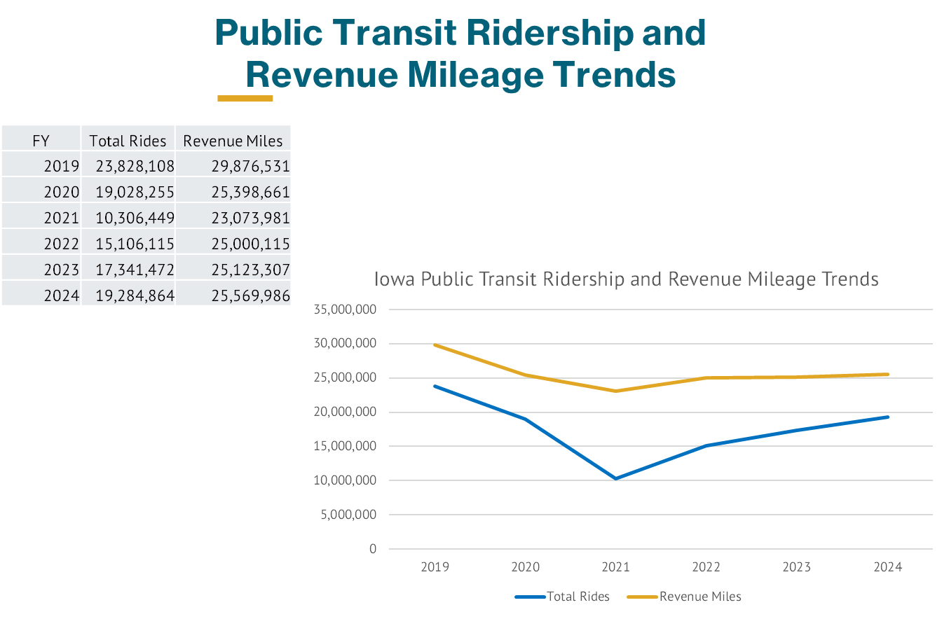

Slide 6
Monthly State Vehicle Miles of Travel
(through March 2025)
Vehicle Miles of Travel (in millions)

Slide 7
Questions?

