Slide 1


June Commission Tour Preview
May 13, 2025
3/2/2023

Slide 2
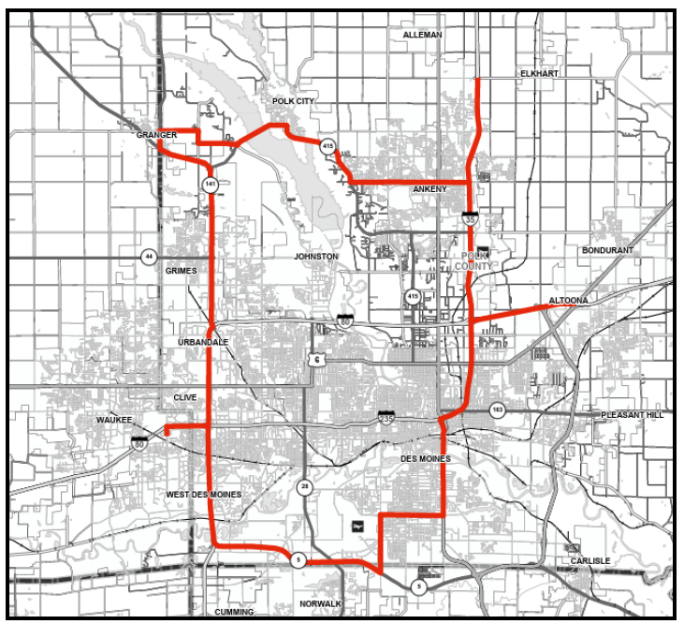
June Commission Tour Preview

Slide 3
June Commission Tour Preview
Begin tour at the West Des Moines Marriott
Des Moines International Airport
Iowa DOT Traffic Management Center
I-35/80 NE Mixmaster
I-35/80/235 SW Mixmaster
Hickman Road Interchange
End tour at West Des Moines Marriott

Slide 4
June Commission Tour Preview
Questions?
Shawn Majors
Shawn.majors@iowadot.gov​
iowadot.gov

