Slide 1
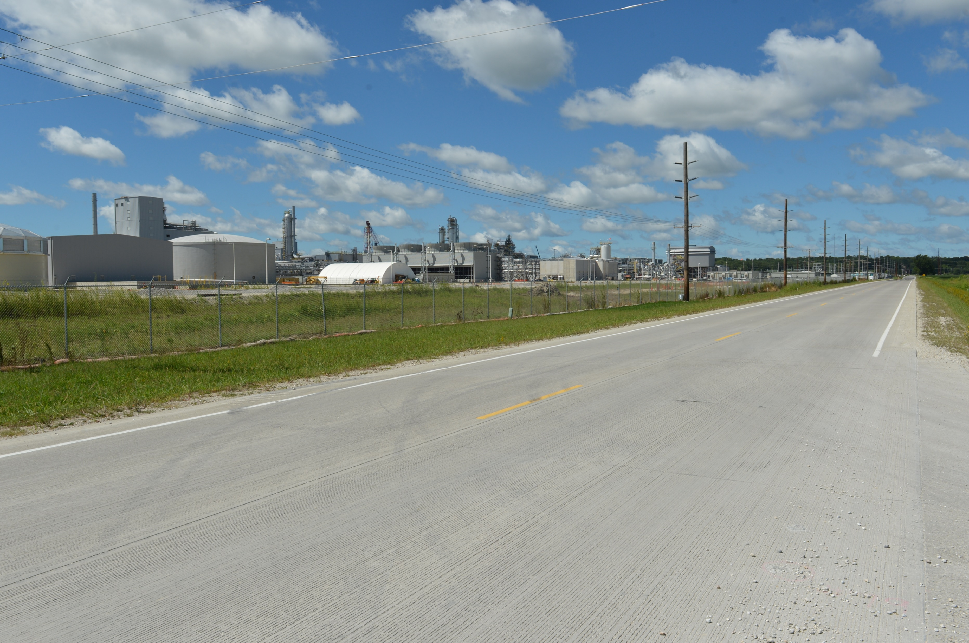
Revitalize Iowa’s Sound Economy Program
Funding Recommendation
Debra Arp
Local Systems Bureau, Grant Team Leader
5/13/2025

Slide 2
Revitalize Iowa’s Sound Economy Program
Created in 1985
Purpose: To promote economic development through roadway improvements
Eligible development shall have value-adding activities that feed new dollars into the economy
Available to cities and counties through an application program
2
2

Slide 3
Monthly Program Financial Report
Funded annually with dedicated state motor fuel and special fuel tax revenues
 | City RISE Fund | County RISE Fund
FY2025 Projected Total RISE Road Use Tax Fund (RUTF) Revenue ¹ | $11,611,933 | $5,805,967
Actual RISE Revenue Received as of 3/31/2025 ² (% of FY2025 Projected Revenue) | $9,756,204 (84.0%) | $5,168,076 (89.0%)
FY2025 RISE Funds Awarded as of 3/31/2025 (% of Projected Total RUTF committed) | $11,169,292 (96.2%) | $285,212 (4.9%)
Fund Balance as of 3/31/2025 | $56,228,381 | $22,167,750
Outstanding Commitments as of 3/31/2025 | ($42,191,060) | ($13,916,135)
Uncommitted Balance as of 3/31/2025 | $14,037,321 | $8,251,614
¹ Calculation based on FY2024 average monthly RISE RUTF revenue of $967,661 to the city RISE fund and $483,831 to the county RISE fund. As of 3/31/2025, FY2025 is 75.0% complete.
² Actual RISE revenue includes RUTF revenue, loan repayments, and project settlements. These revenue sources are variable and are not included in projections.
3
3

Slide 4
Local Development Project Evaluation Criteria
Criteria | Points
Development Potential | 35
Economic Impact and Cost Effectiveness | 20
Local Commitment and Initiative | 33
Transportation Need and Justification | 4
Local Economic Need | 6
4
4

Slide 5
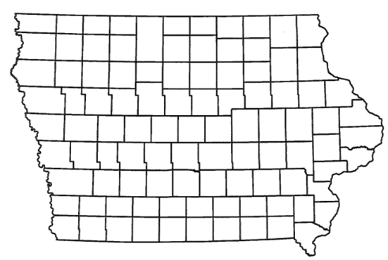
Local Development Recommendations
PROJECT NAME | SPONSOR | SCORE | TOTAL PROJECT COST | PERCENT PARTICIPATION | RECOMMENDED AMOUNT
Construct a roundabout at the intersection of Ansborough Avenue and the U.S. 20 eastbound ramps (Certified Site Amendment) | Waterloo | 58 | $2,541,438 | 60% | $1,524,863
5
5

Slide 6
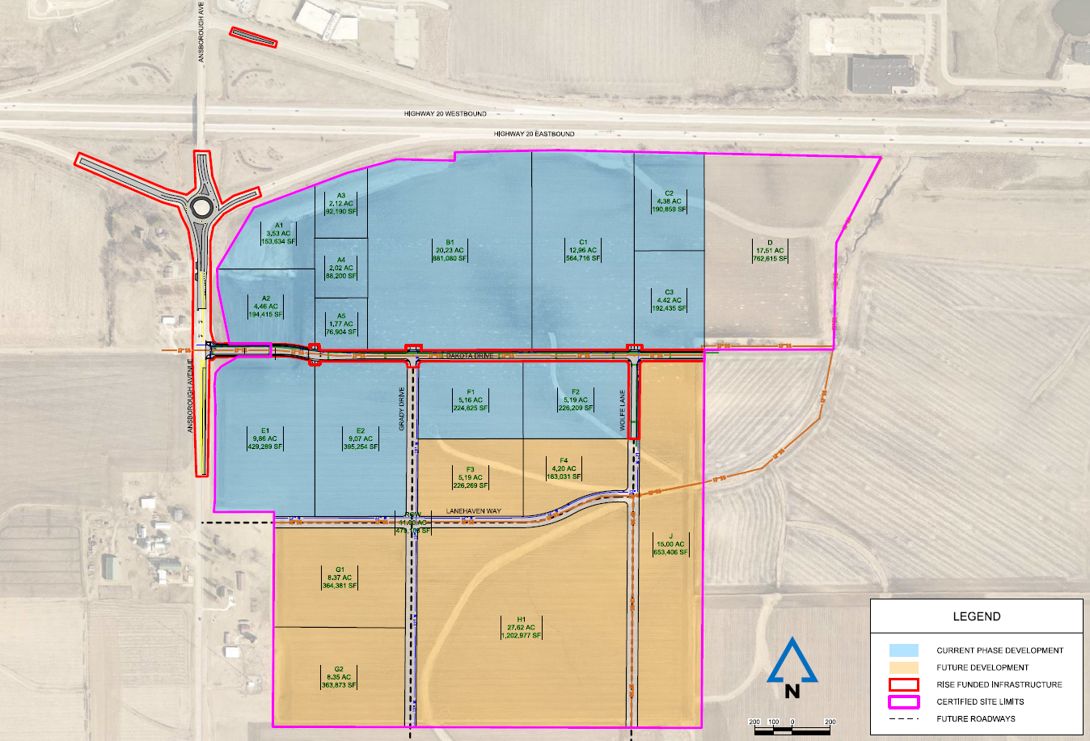
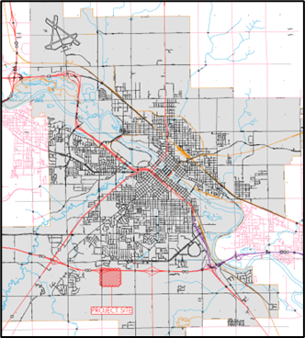
Waterloo
Certified Site Local Development
Amendment
An amendment to the scope and grant award was requested to construct a roundabout at the intersection of Ansborough Avenue and the U.S. 20 eastbound ramps.
December 2024 Award
Total Cost: $3,788,225
RISE Awarded: $2,272,935 (60%)
Add Total Cost: $2,541,438
Add RISE Request: $1,524,863 (60%)
New Total Cost: $6,329,663
New Total RISE: $3,797,798 (60%)
6

Slide 7
RISE Cost Per Job Analysis
Due to a 22.1% Highway Construction Cost increase from 2021 to 2022, the maximum RISE Cost Per Job was increased from $13,000 to $14,000 in April 2023 for projects with high capital investment and/or high-quality wage rates/benefits that exceed normal applications.
Highway Construction Cost Index from 2023-2024 has decreased by 11.9%.
No change recommended.
7
7

Slide 8
Questions?
jennifer.kolacia@iowadot.us
515-239-1738

