Slide 1
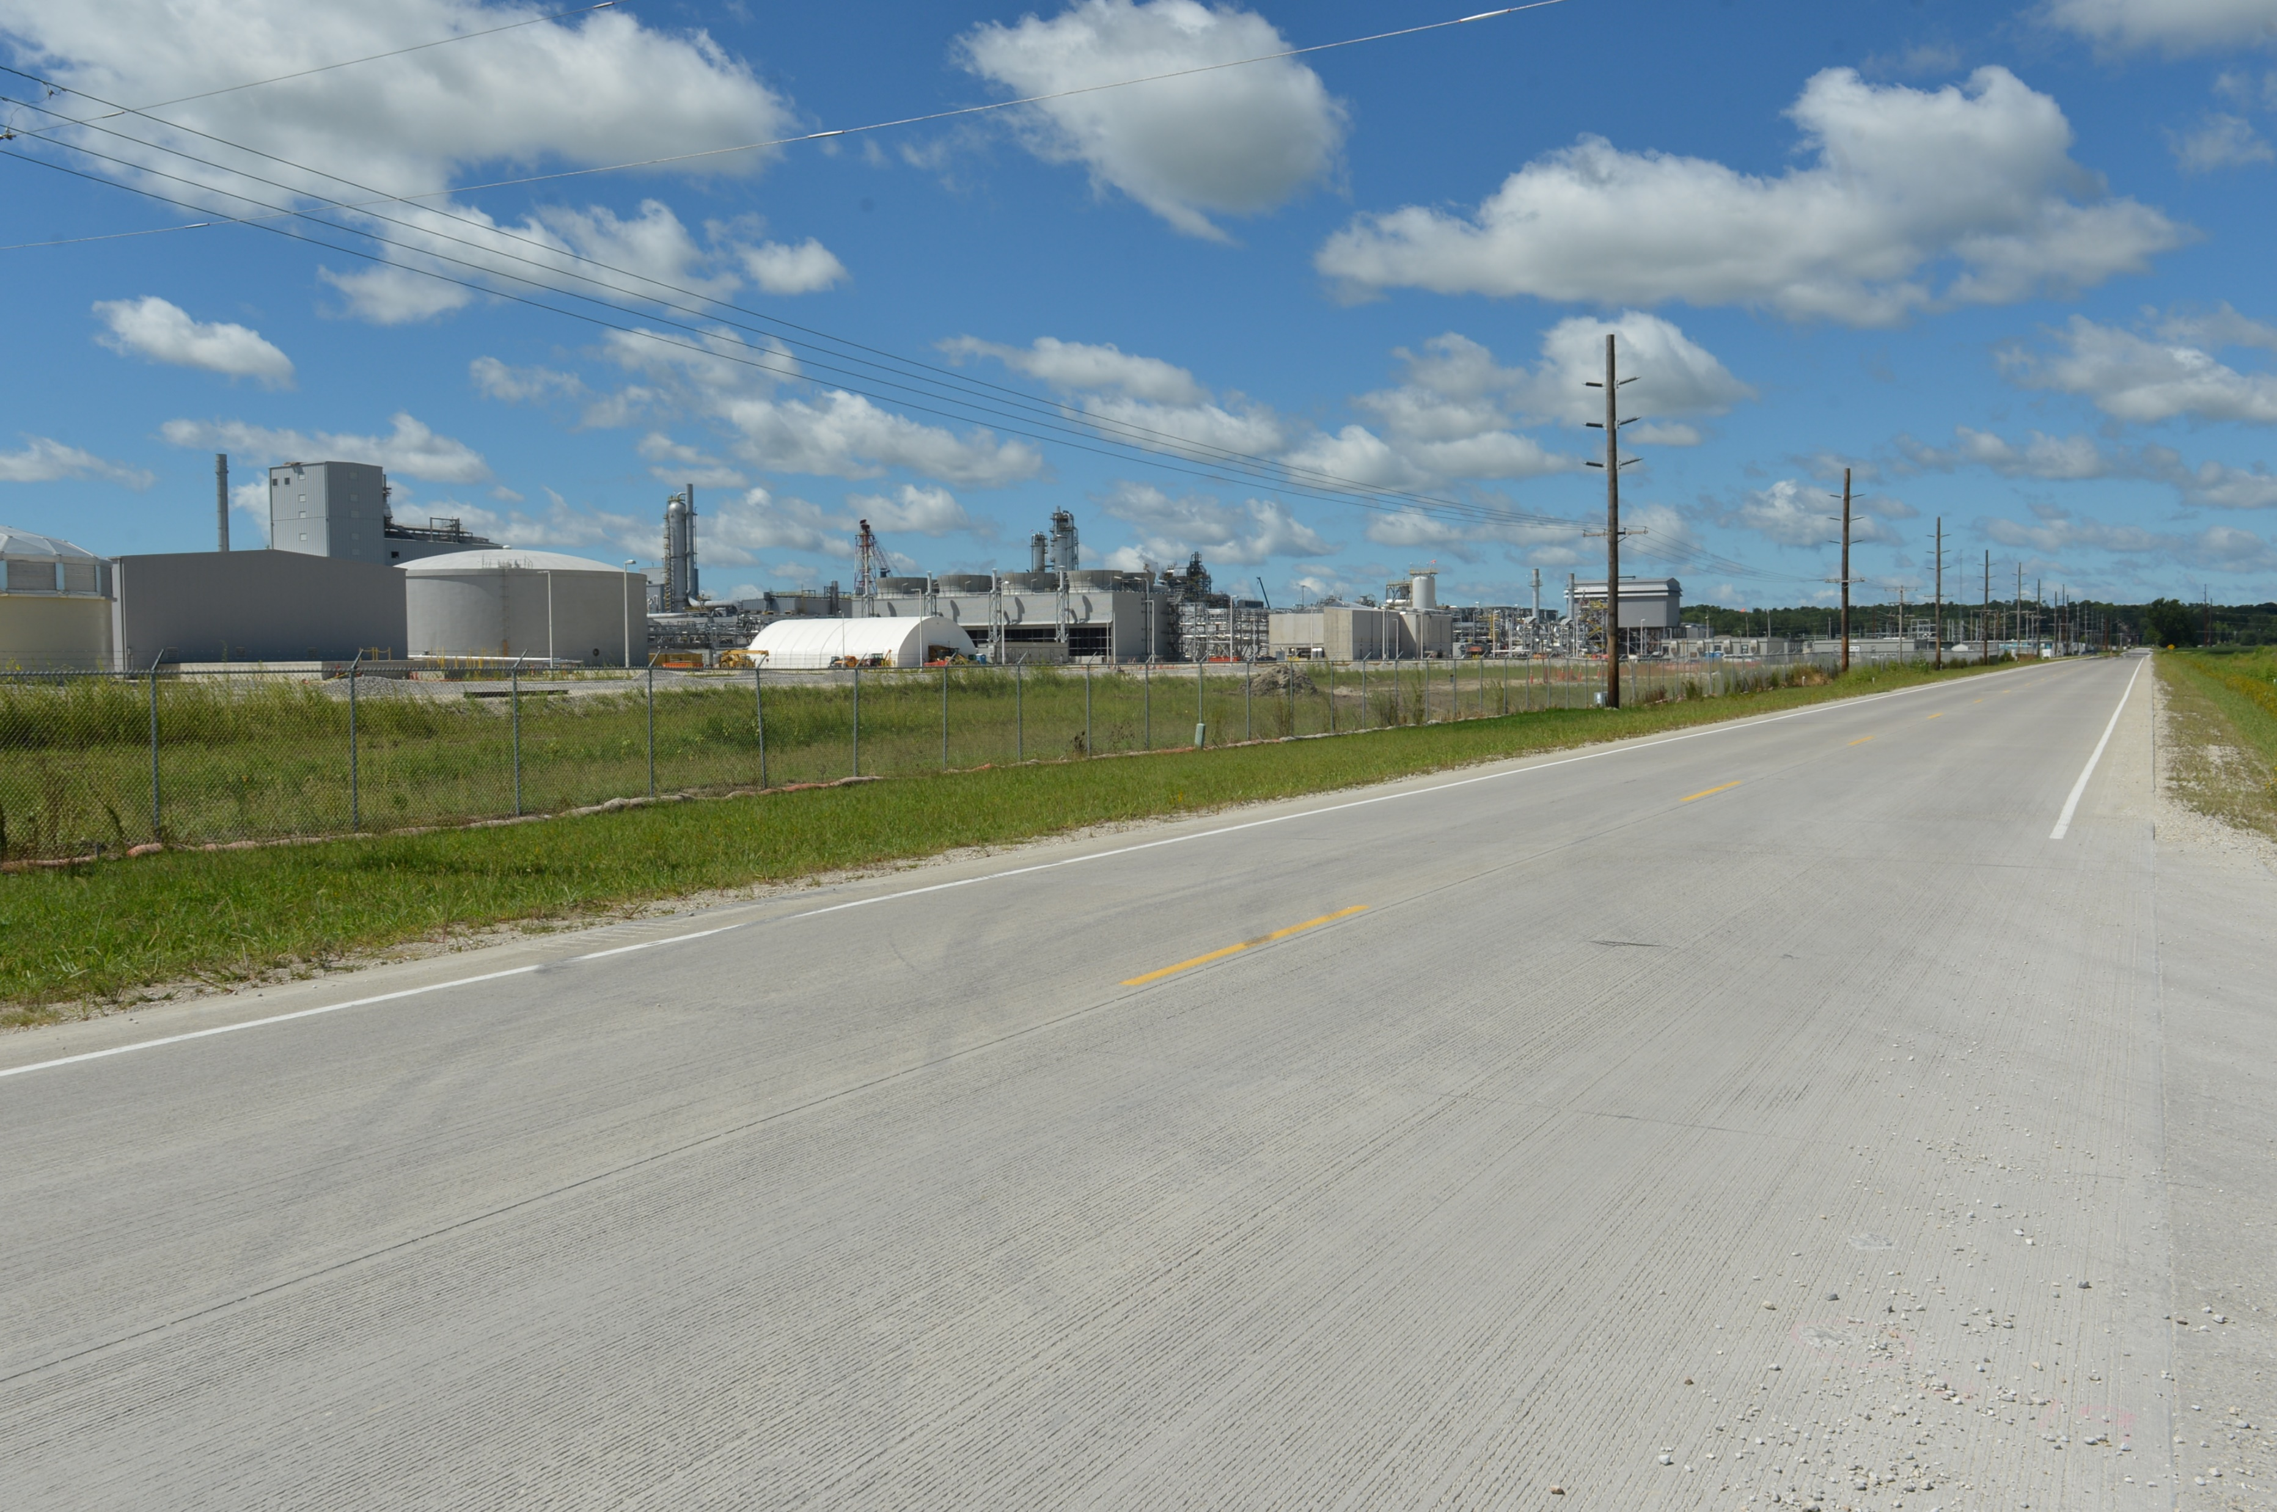

Revitalize Iowa’s Sound Economy Program
Funding Recommendation
Debra Arp
Local Systems Bureau, Grant Team Leader
6/9/2025

Slide 2
Revitalize Iowa’s Sound Economy Program
Created in 1985
Purpose: To promote economic development through roadway improvements
Eligible development shall have value-adding activities that feed new dollars into the economy
Available to cities and counties through an application program
2
2

Slide 3
Monthly Program Financial Report
Funded annually with dedicated state motor fuel and special fuel tax revenues
 | City RISE Fund | County RISE Fund
FY2025 Projected Total RISE Road Use Tax Fund (RUTF) Revenue ¹ | $11,611,933 | $5,805,967
Actual RISE Revenue Received as of 4/30/2025 ² (% of FY2025 Projected Revenue) | $10,782,323 (92.9%) | $5,681,136 (97.8%)
FY2025 RISE Funds Awarded as of 4/30/2025 (% of Projected Total RUTF committed) | $11,169,292 (96.2%) | $285,212 (4.9%)
Fund Balance as of 4/30/2025 | $56,961,887 | $22,409,759
Outstanding Commitments as of 4/30/2025³ | ($41,898,447) | ($13,645,085)
Uncommitted Balance as of 4/30/2025 | $15,063,440 | $8,764,674
¹ Calculation based on FY2024 average monthly RISE RUTF revenue of $967,661 to the city RISE fund and $483,831 to the county RISE fund. As of 4/30/2025, FY2025 is 83.3% complete.
² Actual RISE revenue includes RUTF revenue, loan repayments, and project settlements. These revenue sources are variable and are not included in projections.
³ Award of $1,524,863 to Waterloo in May 2025 is not reflected in the outstanding commitments of 4/30/25.
3
3

Slide 4
Local Development Project Evaluation Criteria
Criteria | Points
Development Potential | 35
Economic Impact and Cost Effectiveness | 20
Local Commitment and Initiative | 33
Transportation Need and Justification | 4
Local Economic Need | 6
4
4

Slide 5
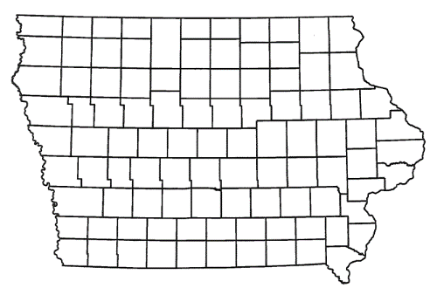
Local Development Recommendations
PROJECT NAME | SPONSOR | SCORE | TOTAL PROJECT COST | PERCENT PARTICIPATION | RECOMMENDED AMOUNT
Paving of approximately 2,610 feet of Binford Avenue and 3,610 feet of 245th Street and turn lanes on U.S. 30 at Binford Avenue located southwest of State Center | Marshall County | 73 | $2,032,965 | 50% | $1,016,483
5
5

Slide 6
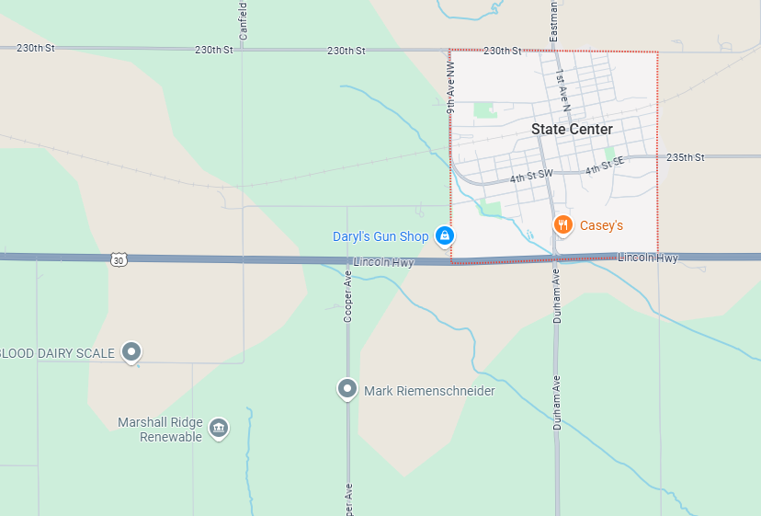
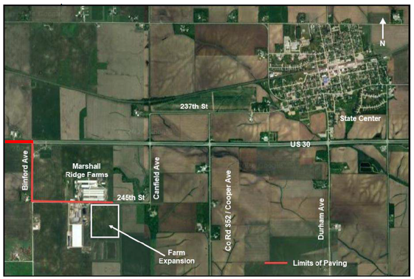
Marshall County Local Development
Paving of approximately 2,610 feet of Binford Avenue and 3,610 feet of 245th Street and turn lanes on U.S. 30 at Binford Avenue located southwest of State Center. This project is necessary to provide improved access to more than 30 acres for industrial purposes.
Total Cost: $2,032,965
Requested: $1,016,483 (50%)
6

Slide 7



Questions?
jennifer.kolacia@iowadot.us
515-239-1738

