Slide 1
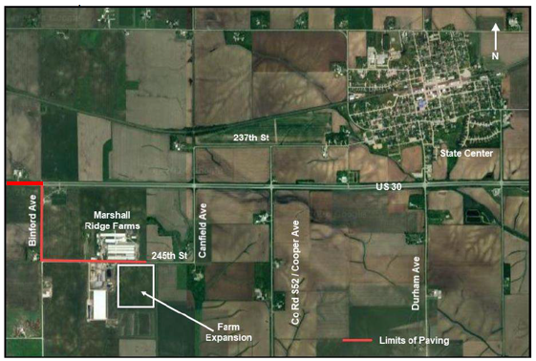
RISE Local Development Recommendation
PROJECT NAME | SPONSOR | SCORE | TOTAL PROJECT COST | PERCENT PARTICIPATION | RECOMMENDED AMOUNT
Paving of approximately 2,610 feet of Binford Avenue and 3,610 feet of 245th Street and turn lanes on U.S. 30 at Binford Avenue located southwest of State Center | Marshall County | 73 | $2,032,965 | 50% | $1,016,483
1
1

